Slide 1


The Joy of Ambiguity in Vision and Visual Art
Song-Chun Zhu
University of California, Los Angeles, USA
Lotus Hill Research Institute, China
References:
[1] J. Porway and S.C. Zhu, C4 : Computing Multiple Solutions in Graphical Models by Cluster Sampling, 2010.
[2] M.T. Zhao and S.C. Zhu, Sisley the Abstract Painter, NPAR, 2010.

Slide 2
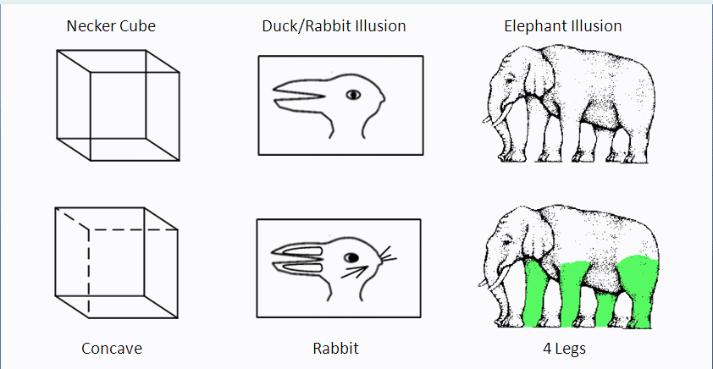
Part 1: Computing Multiple Solutions from Images
Criteria for designing “effective and robust algorithms”
1, Fast convergence to global optimal solutions: “not greedy”
2, Exploring diverse solutions (liquidate) : “not stubborn”

Slide 3
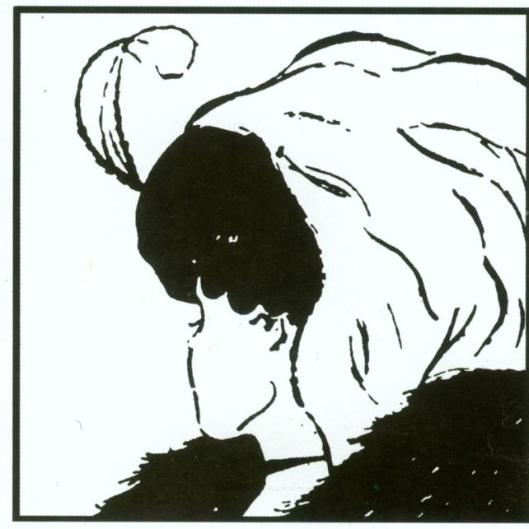

Sometime, it is more challenging …
Jumping between the two solutions requires
the swapping of two hierarchical parse trees!
In fact, we may design ambiguities and thus create art pictures (part 2).

Slide 4
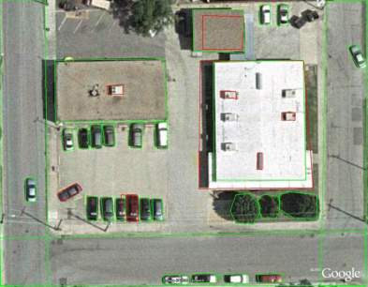
Ambiguities are ubiquitous in images
Example I. scene labeling: cars on parking lot vs. vent on roof
Local interpretations are often strongly coupled !
They form “clusters” and the search algorithms often get stuck.

Slide 5
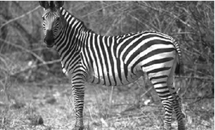
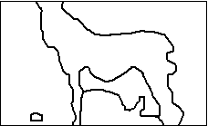
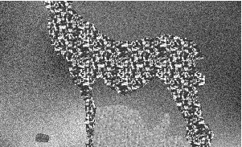
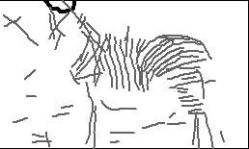
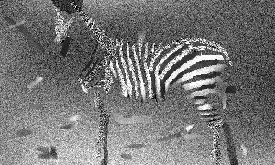
Ambiguities are ubiquitous in images
Example 2. A whole zebra vs. a number of stripes
(black on white vs. white on black ?)
a. Input image b. Segmented texture regions c. synthesis by texture models
d. curve processes + bkgd region e. synthesis by curve models

Slide 6
In a statistical language … it is fast “mixing rate”
Sampling Probabilities with Multiple Modes
The two criteria for MCMC design:
1, Short “burn-in” period --- The Markov Chain reaches the equilibrium fast
2, low “auto-correlation” --- The Markov chain states are less correlated in time
Posterior probability p
A
B
MC 1: AAAAAAAAAA …. AA … BBBBBBBBB…
MC 2: AABBBABAAABBABAABB … mixes faster

Slide 7
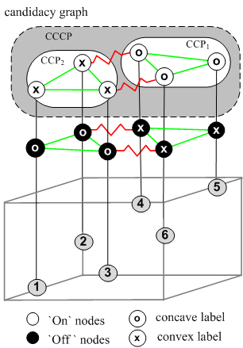
Example: Necker Cube as line-drawing interpretation
Some labels/edges omitted for clarity

Slide 8
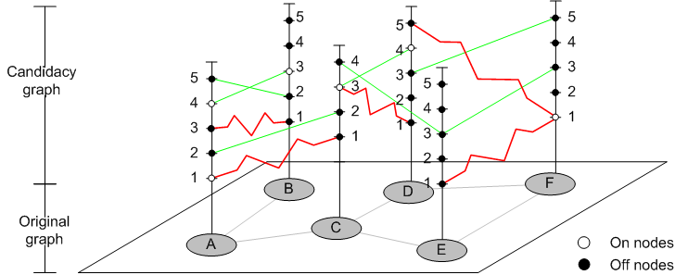
Candidacy graphs as a general representation of local hypotheses
We formulate a candidacy graph representation, as it can represents
1, MRF and CRF structures
2, Soft and hard constraints.
3, Positive (collaborative) and negative (competitive) edges.

Slide 9
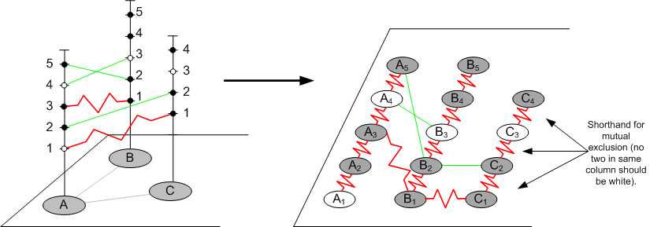
Flattening the candidacy graphs
This becomes a graph coloring/partition problem: each color is a solution.

Slide 10
Experiments on Negative Edge Ising Model
Split our edge set E into E⁺ and E- to represent positive and negative interactions:
Negative Edge Potts model:
Created “checkerboard” constraint problem.

Slide 11
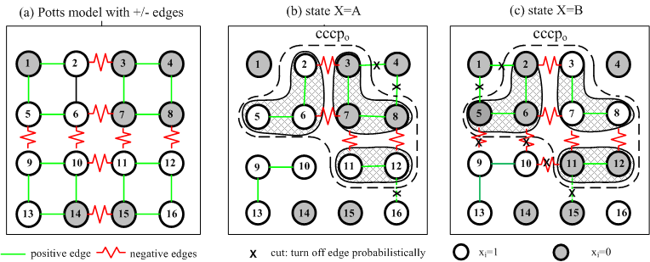
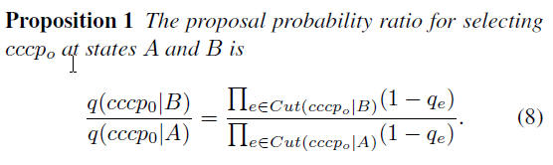
CCCP: Composite Connected Components

Slide 12
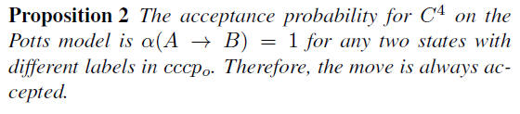
Edge probabilities for clustering cccp’s
For positive edge, the edge variable follows a Bernoulli probability
u_{e} ~ Bernoulli(q_{e}1(x_{s}=x_{t}))
For negative edge, it follows
u_{e} ~ Bernoulli(q_{e}1(x_{s} x_{t}))

Slide 13
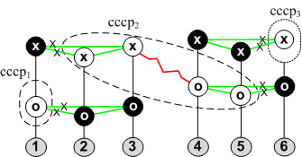
Example 1: the Necker Cube
solution states over time for Ising model (two states)
C⁴ has
- Low burn-in time (converges quickly).
- High mixing rate (samples remaing unbiased over short run).

Slide 14
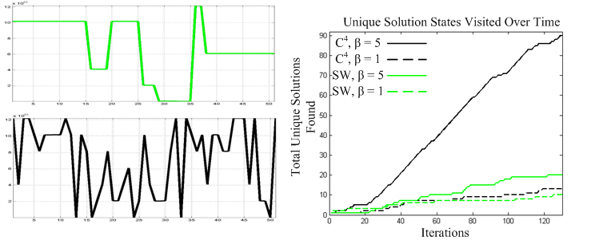
Example 2: Simulating the Potts model on the checkerboard pattern
Energy vs. time
SW

Slide 15
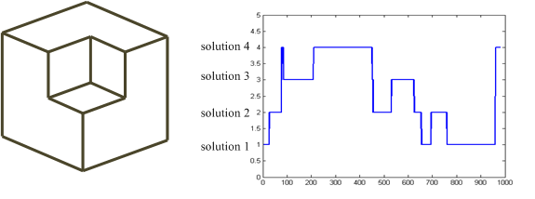

Example 3: Line drawing interpretation
+
+
+
+
+
+
-
-
-
+
-
+
+
+
+
+
+
-
-
+
-
+
+
-
+
+
+
+
-
-
+
-

Slide 16
Problem with “Flat”-- C⁴
B
The “love triangles”:
create inconsistent clusters
C
A
e.g. Love triangles in the
duck/rabbit illusion.

Slide 17
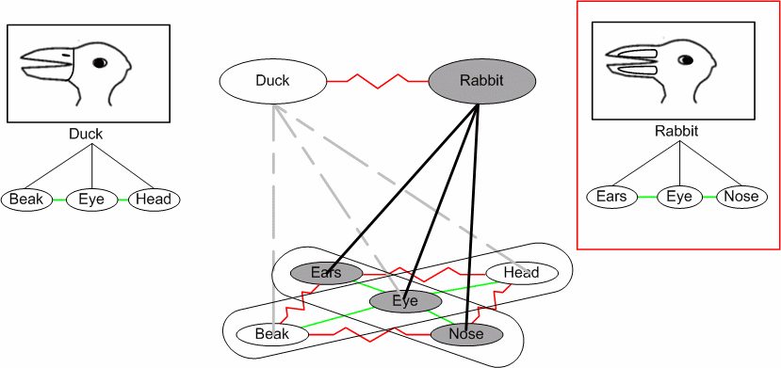
Hierarchical C⁴
The candidacy graph so far represent pair-wise edges, high-order relations are
represented by extended candidacy graphs
System will now flip between duck and rabbit without love triangle issue.

Slide 18
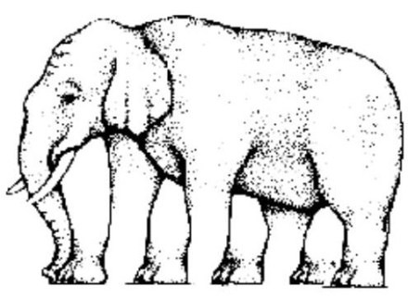
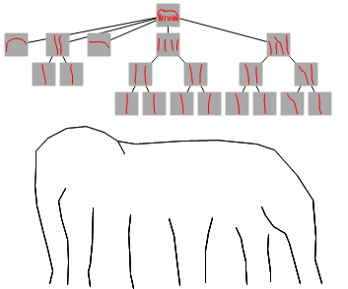
The Elephant Illusion
Hierarchical part model
Layered representation of hierarchy
Elephant
Leg Pair, Head, Back
Leg, Trunk
Line
Notes:
The object is represented as a hierarchical composition of parts. These parts are then arranged into a set of layers such that all subparts are always in a lower layer.

Slide 19
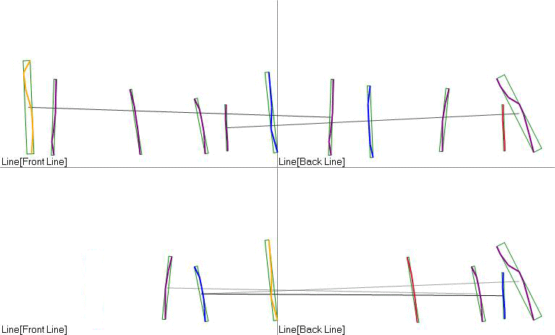
Composing the Bottom Layer
Trunk compatibilities
Leg compatibilities
Elephant
Leg Pair, Head, Back
Leg, Trunk
Line
Notes:
For each layer, a candidacy graph is constructed to represent both compatible and incompatible constraints between part representations. A probability model is defined on this graph, and sampled with the C4 sampler. Nodes that are turned on with low frequency are pruned.

Slide 20
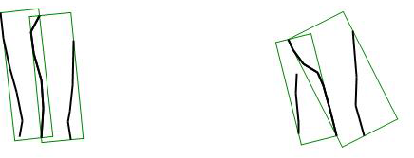
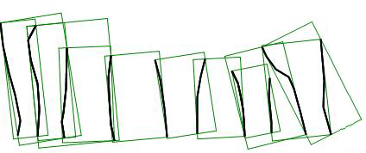
Part Binding for Next Layer
Trunk bindings
Leg bindings
Elephant
Leg Pair, Head, Back
Leg, Trunk
Line
Notes:
After pruning, the remaining nodes are composed using binding rules to form parts for the next layer.

Slide 21
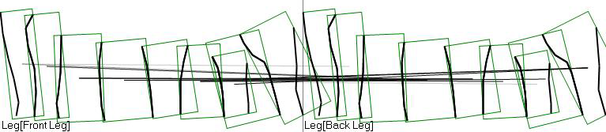
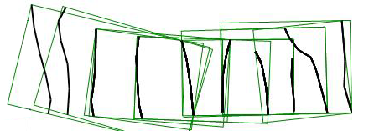
Continue Sampling/Binding for each layer
Leg pair compatibilities
Leg pair bindings
Elephant
Leg Pair, Head, Back
Leg, Trunk
Line
Notes:
This process of sampling / pruning / binding continues for each layer.

Slide 22
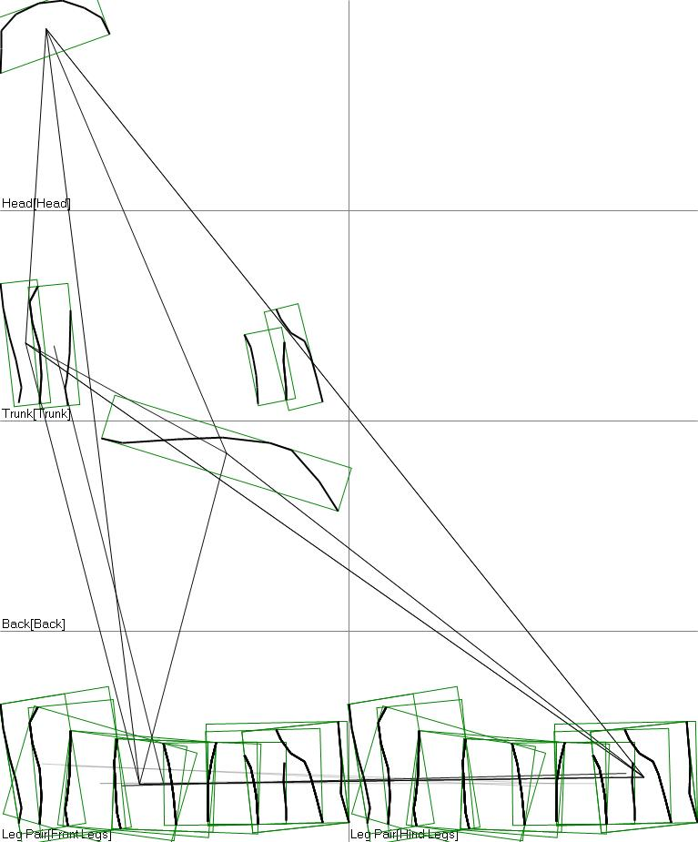
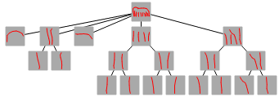
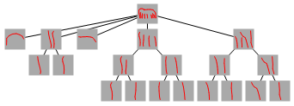
Top Level Bindings and sampling
Elephant
compatibilities
Elephant
Leg Pair, Head, Back
Leg, Trunk
Line
Notes:
At the top layer, the target object itself is bound together. Each proposal at each layer retains the hierarchy of parts that composed it.

Slide 23
Summary
1, A candidacy graph representation incorporates
MRF and CRF structures
Soft and hard constraints.
Positive (collaborative) and negative (competitive) edges.
hierarchical compositional structures for high-order relations.
2, An algorithm with large composite moves
Fast convergence to global solutions
Effective mixing between solutions

Slide 24
Literature: MCMC developments related to vision
Waltz 1972 (labeling)
Metropolis 1946
Rosenfeld, Hummel, Zucker 1976 (relaxation)
Hastings 1970
Heat bath
Kirkpatrick 1983
Miller, Grenander,1994
Geman brothers 1984, (Gibbs sampler)
Green 1995
Swendsen-Wang 1987 (clustering)
DDMCMC, Tu and Zhu 2001-2005
Swendsen-Wang Cut 2003
What about Loopy BP, ICM, Graphcut, … ?
C⁴ Porway and Zhu, 2009

Slide 25
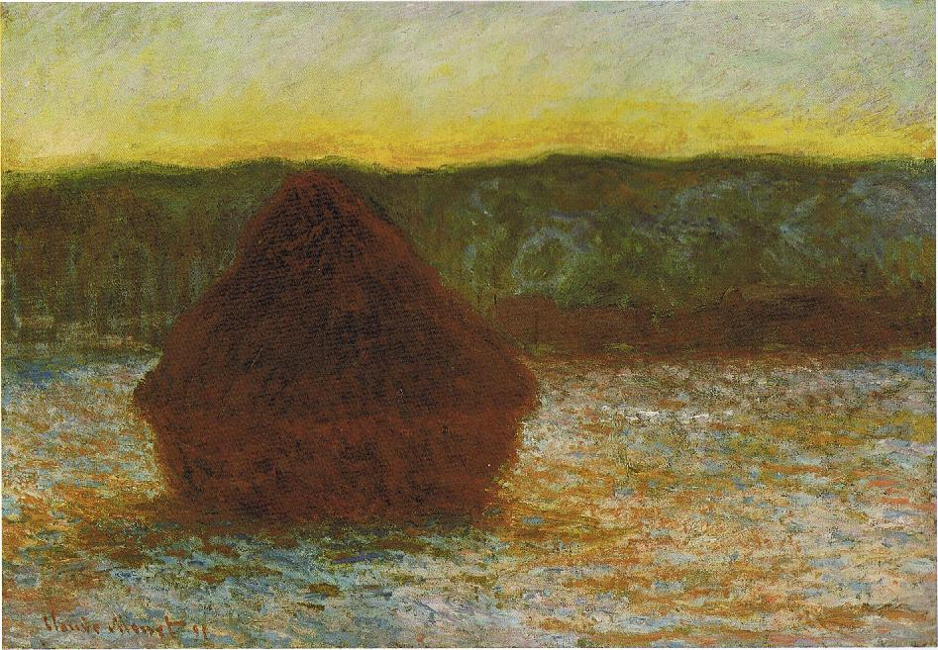
Part II: Sisley the Abstract Painter
Wheat stack (Thaw, Sunset)
Claude Monet
1890-91
“I considered that the painter had no right to paint indistinctly … and I noticed with surprise and confusion that the picture not only gripped me, but impressed itself ineradicably on my memory.”
-- Wassily Kandinsky

Slide 26
Perceptual Ambiguity
The Mechanism of Abstract Arts [Berlyne 1971]
  Perceptual Ambiguity
  =>Mental Efforts
  =>Arousal Changes
  =>Aesthetic Pleasures

Slide 27
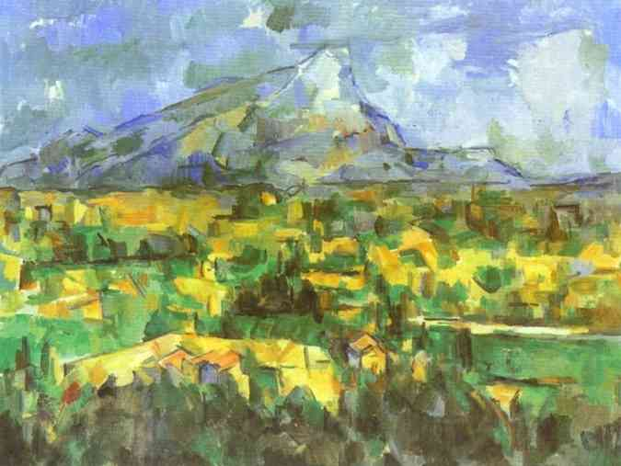
Cézanne, Mont Sainte-Victoire.
Any object recognition algorithm is bound to failure !
You cannot recognize the houses locally.

Slide 28
A generative model for top-down/bottom-up image parsing
Using a couple of key objects to prime the recognition of the scene
in a bottom-up process, then predict/figure the other objects in the
scene in a top-down process.
scene
object 1
object 2
object 3
object n

Slide 29
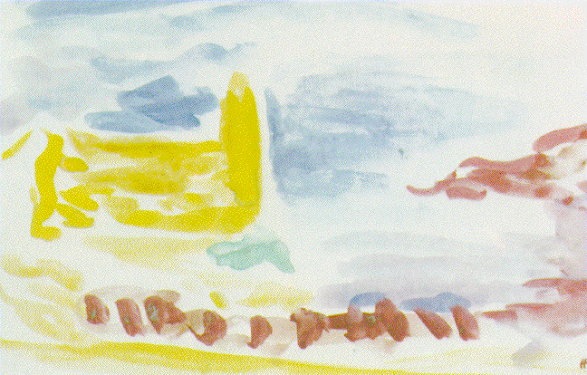
  Matisse: Le Clocher (bell-tower), Collioure, 1905.
Guess: what are the objects?

Slide 30
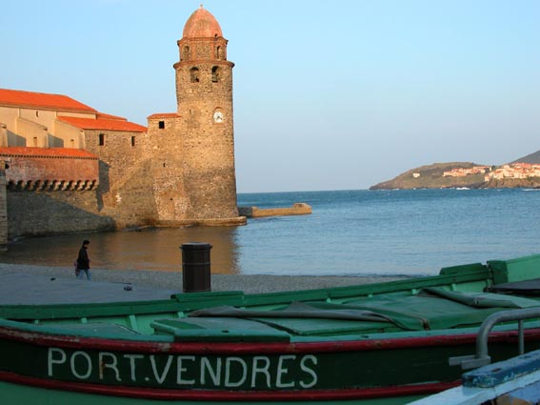
The real bell-tower
Only those who are familiar with this scene could appreciate
the previous painting.

Slide 31

Art paintings by a modern
French artist that I scanned
from a magazine, 2006.

Slide 32
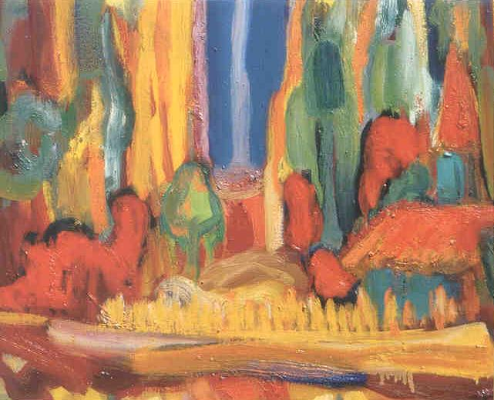
Art paintings by a modern
French artist that I scanned
from a magazine, 2006.

Slide 33

Art paintings by a modern
French artist that I scanned
from a magazine, 2006.

Slide 34
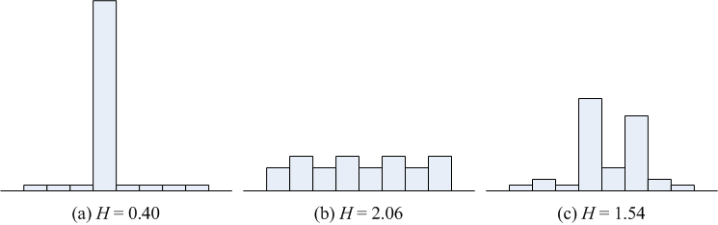
Ambiguity and imperceptibility
Visual inference is often posed as maximizing a posterior probability
L* = arg max p(L | I)
L= (L₁, L₂, …., L_{n}) is a vector of labels for scene, objects, and parts
in a parse tree.
But, MAP does not characterize the uncertainty in p(L|I).
We define imperceptibility to measure the level of perceptual ambiguity
H(L)|I= - Σ_{L} p(L|I) log p(L|I)
(this is not the conditional entropy H(L|I)).

Slide 35
Design Principles
For a photo image I and an abstract art rendering I’
Principle 1: Identity Preserving
L*=arg max_{L} p(L | I)=arg max_{L} p(L | I’)
Principle 2: Imperceptibility Increasing
H(L) | I < H(L) | I’.

Slide 36
Computation of Imperceptibility
Computation and storage of the joint probability p(L|I) is extremely expensive (e.g. for 10 nodes from 100 categories, |Ω_{L}|=100¹⁰) and perhaps unnecessary [Pearl 1986].
We do computation of its marginal probabilities through two steps:
(1) Computing p(l_{k}|I_{k}’) and H(l_{k})|I_{k}’ for each node R_{k} in the parse tree based on its image appearance I_{k}’.
(2) Computing p(l_{k}|I’) with the contextual information of the entire image, using the belief propagation algorithm [Pearl 1986] on the parse tree, initialized with results from the previous step, then estimate the total imperceptibility H(L)|I’.

Slide 37
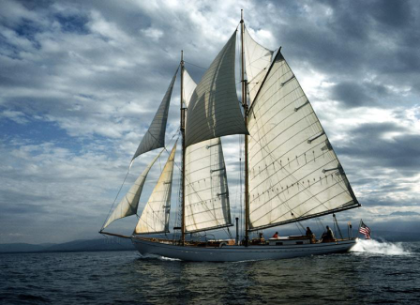
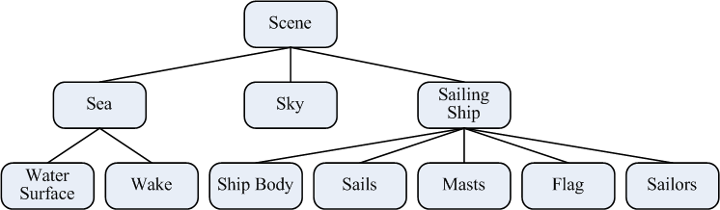
Image parsing
An image and its parse tree

Slide 38
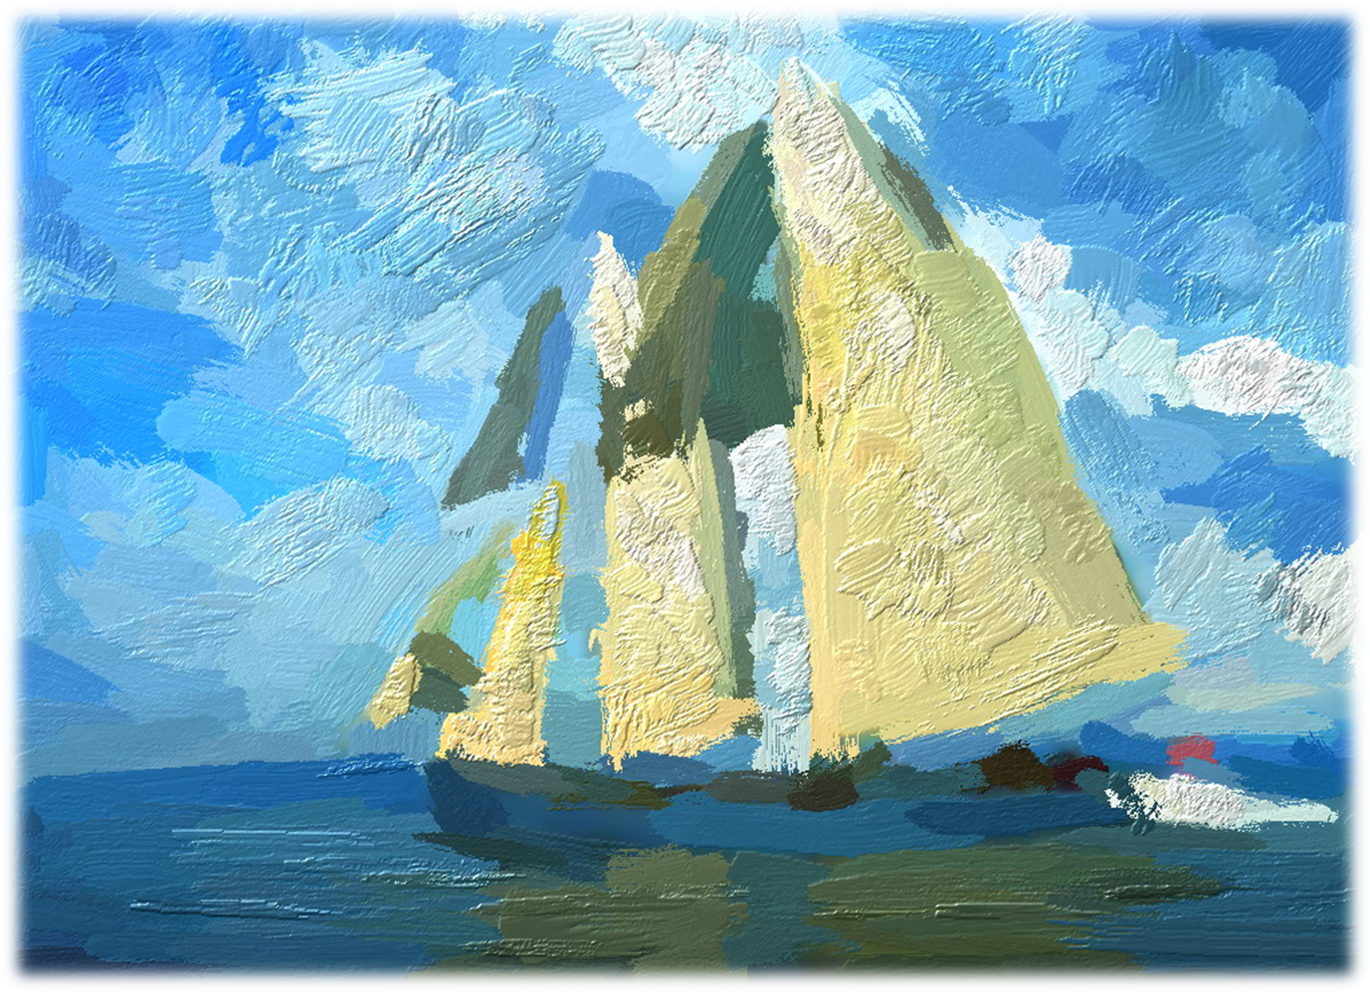

Slide 39
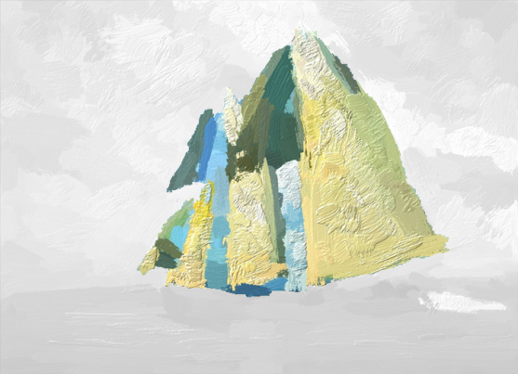
The Perception path
Most people first recognize the sails.
Scene
Back-
ground
Sailing
Ship
Sky
Sea
Ship
Body
Sails
Masts
Flag
Sailors
Wake

Slide 40
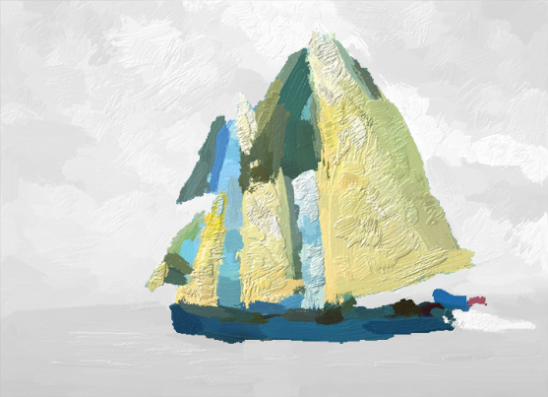
The Perception path
Then they recognize the entire sailing ship, and can locate the ship body and masts which are almost unrecognizable without the context.
Scene
Back-
ground
Sailing
Ship
Sky
Sea
Ship
Body
Sails
Masts
Flag
Sailors
Wake

Slide 41
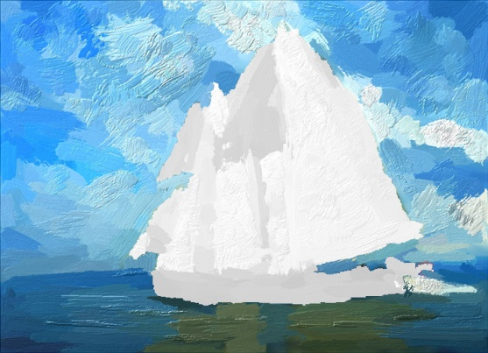
The Perception path
The sailing ship also hints the background sky and the sea.
Scene
Back-
ground
Sailing
Ship
Sky
Sea
Ship
Body
Sails
Masts
Flag
Sailors
Wake

Slide 42
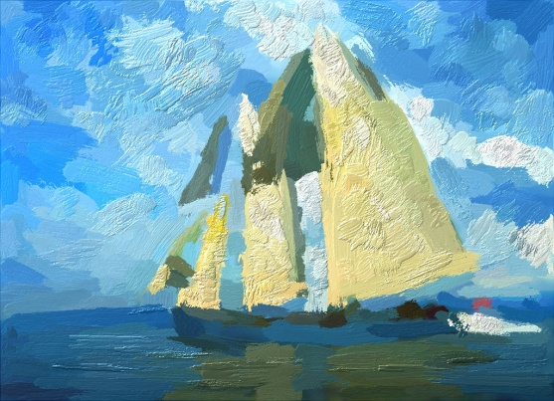
The Perception path
Finally some tiny parts are probably recognized by hallucination, for example, the wake after the ship, the flag and sailors on the ship, etc.
Scene
Back-
ground
Sailing
Ship
Sky
Sea
Ship
Body
Sails
Masts
Flag
Sailors
Wake

Slide 43

Effect (II)

Slide 44
Perceptual path II
3
Scene
Background
Sailing Ship
3
2
Sea
3
2
1
3
3
1
1
Sky
Ship Body
Sails
Masts
Flag
Sailors
Wake
1

Slide 45
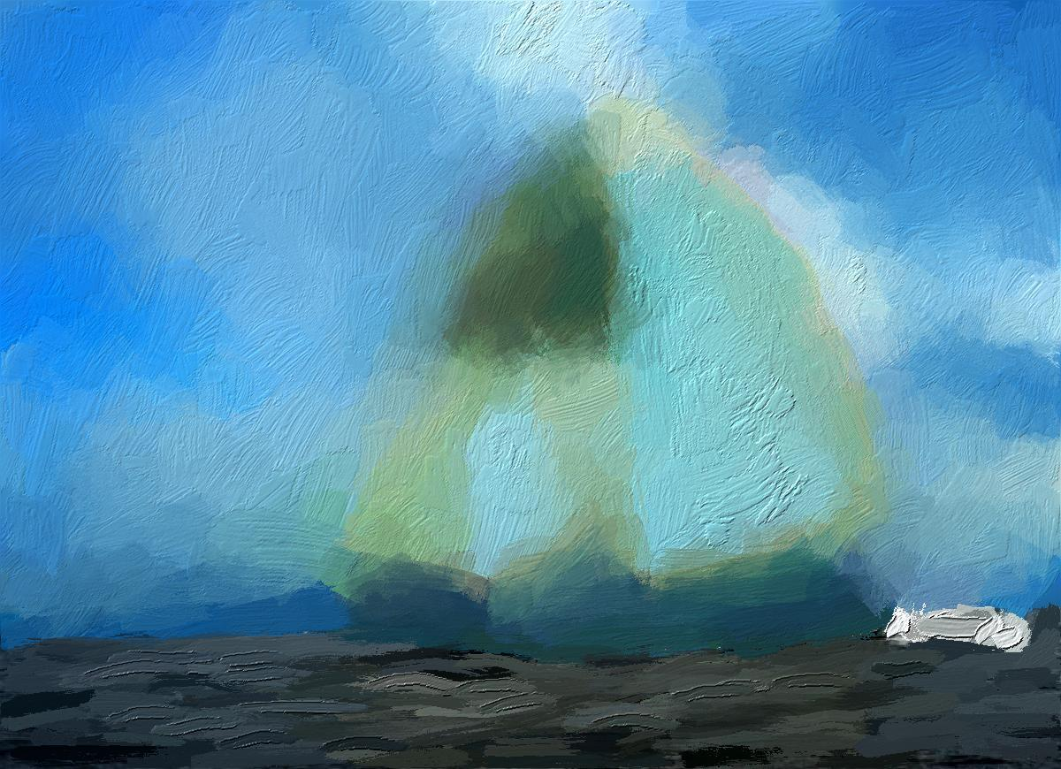
Effect (III)

Slide 46
Perceptual path III
2
Scene
Background
Sailing Ship
2
2
Sea
2
1
3
3
3
3
3
Sky
Ship Body
Sails
Masts
Flag
Sailors
Wake
2

Slide 47
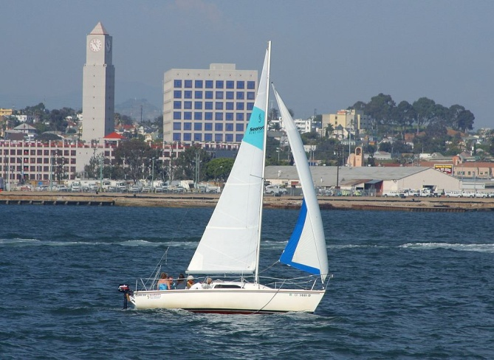
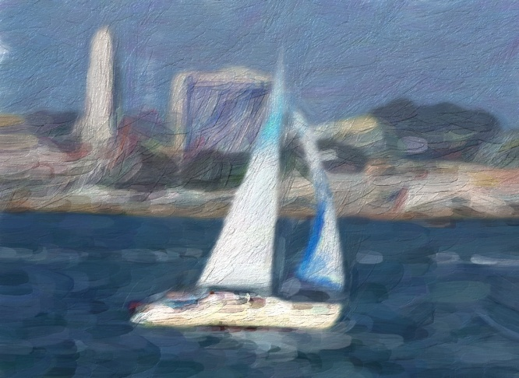
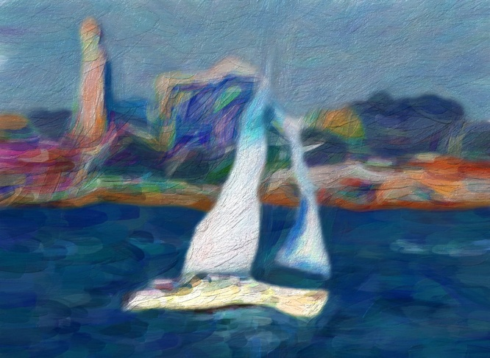
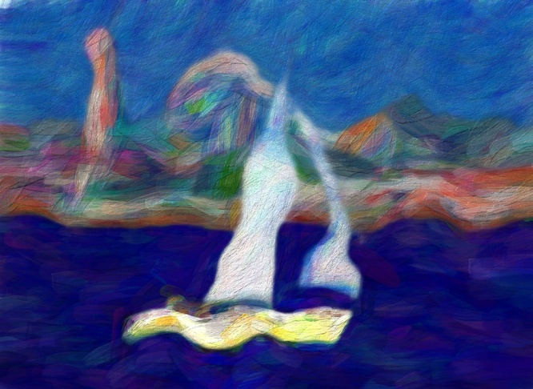
Degrees of Abstraction can be controlled by a sliding bar
H=0
H=0.25
H=0.50
H=0.75

Slide 48
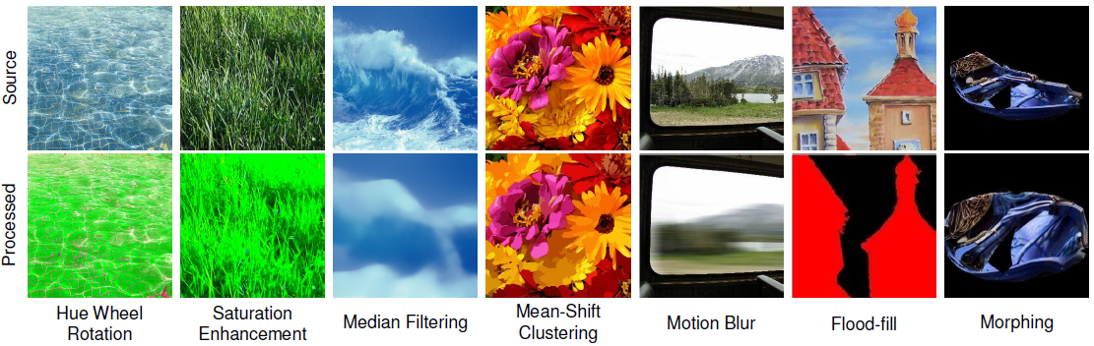
Stochastic image operators on regions
The operators affect the color, texture and shape features of images.
Color Scheme Transfer
Color Richness Reduction
Kernel Smoothing
Texture Modification
Morphing

Slide 49
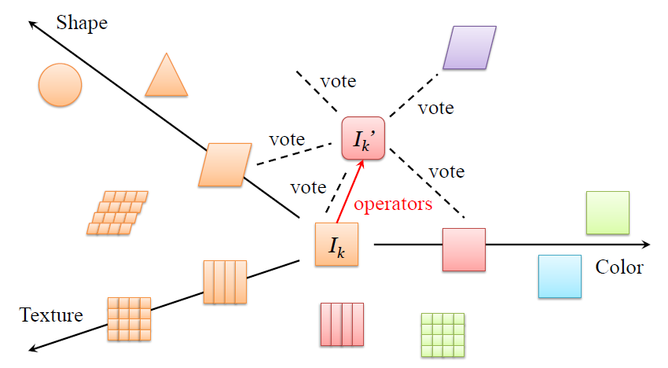
Computing the entropy by non-parametric model
Using appearance-category pairs { (J_{n},l_{n}),n=1,2,…,N } of 323,414 parse tree nodes from 14,360 natural scene images from the LHI image database.
Classification by probabilistic vote:

Slide 50
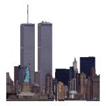
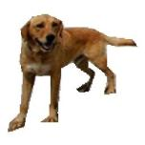





Computing the entropy by non-parametric model
We need to determine the weights of votes, based on the distances.
Close:
high-weight votes
Distant:
low-weight votes

Slide 51



Computing the entropy at leaf nodes
Probabilistic vote for leaf nodes in the parse tree:
λ is a rate parameter determined empirically (we don’t have ground truth p)
Logistic distance
h_{f}’s are image features in color, texture and shape aspects
α and β_{f} are learned by logistic regression with

Slide 52


Propagating the entropy in the parse tree
Uusing belief propagation [Pearl 1986], which iteratively updates the beliefs of each node according to current marginal probabilities of its neighbors. (very fast for a small parse tree) .

Slide 53








Painterly Rendering
Ref. Zeng, et al ACM ToG 2009
Our previous work on Stroke-Based Rendering (SBR)
(1) Brush Modeling Brush Dictionary and Color Transfer
(2) Stroke Placement Sketch and Orientation Field

Slide 54


More results

Slide 55


Slide 56


Different Paths of Perception

Slide 57


Slide 58


Slide 59


Slide 60

Human Experiment
We collect 123 pairs of abstract art images and their counterparts of photos from 14 scene categories and 70 object categories, and have them observed by 20 test subjects.
We measure their response time and recognition accuracy.

Slide 61

Human Experiment
Similar results are observed for more scene and object categories.

Slide 62

Human Experiment

Slide 63

What is this colorful thing?

Slide 64


Locomotive
Source Image
After Applying Operators

Slide 65

Looks like moving …

Slide 66


Neuschwanstein Castle
Source Image
After Applying Operators

Slide 67

Hot vs. Cold?

Slide 68


Oriental Pearl, Shanghai
Source Image
After Applying Operators

Slide 69

Again, what is this?

Slide 70


Flying Bird
Source Image
After Applying Operators

Slide 71

Red, pink and violet, a lot of them, they are …

Slide 72


Fishes
Source Image
After Applying Operators

