Slide 1
Information Scaling and Perceptual Transitions in Natural Images and Video
Song-Chun Zhu
University of California, Los Angeles
Joint work with Yingnian Wu, Kent Shi, Zhangzhang Si, ….

Slide 2
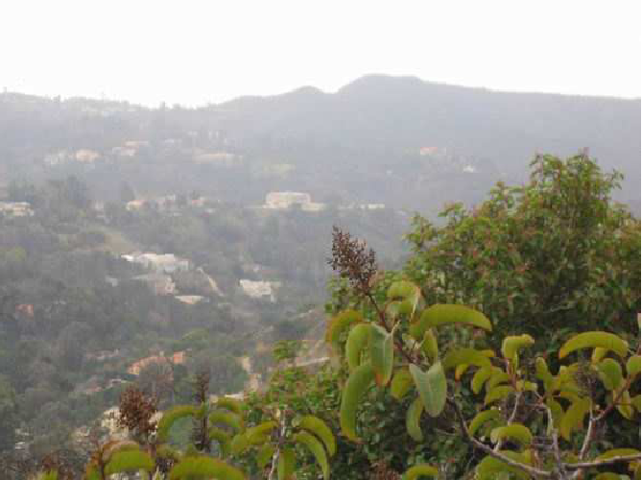
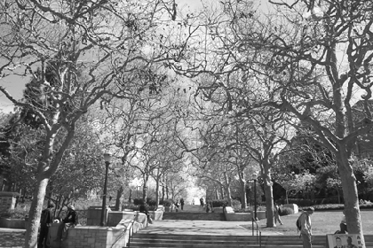
1, Information scaling and perceptual transitions
Watch the texture-texton transitions over scale / distance
D
B
C
A
A photo at Bei Air
A photo at UCLA campus

Slide 3




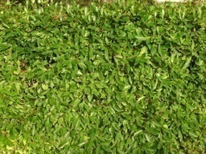
An example: the leaves
Scaling (zoom-out) increases the image entropy (dimensions)
Image representations: sketchable vs. non-sketchable

Slide 4
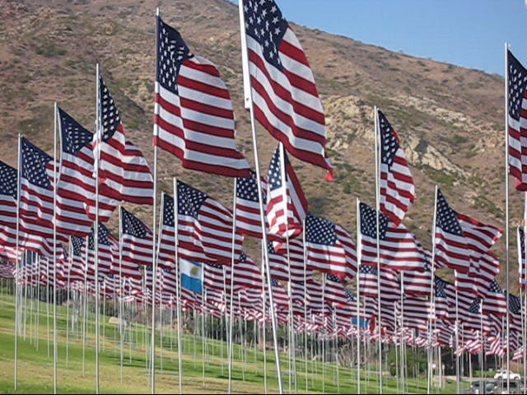
Information scaling and perceptual transition in video
Density (occlusion) and motion dynamics also contribute to perceptual transitions
Video representations: trackable vs. non-trackable
A video shoot at the Pepperdine University 9-11-memorial, Malibu, CA. 2009

Slide 5
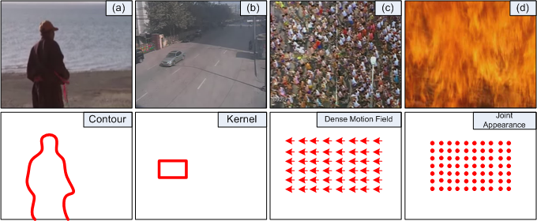
Different motion representations in computer vision
Video representation: trackable vs. non-trackable motion

Slide 6
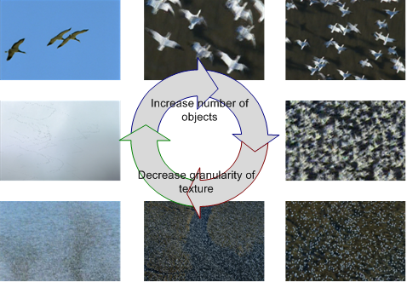
An example: the birds
Info. scaling can be triggered by scale (sizes), density (occlusion) and dynamics (speed) .

Slide 7
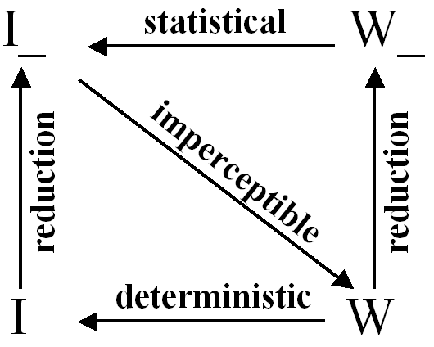
Imperceptibility and perceptual transitions
Definition: Imperceptibility is defined as the entropy of posterior probability (uncertainty of perception)
H(p(w | I)) = H(w) – H(I)
Theorem:
Imperceptibility increases with down-scaling.
For a single image/video, this is
perceptual transition.
For an ensemble of image/video,
this is model transition !

Slide 8

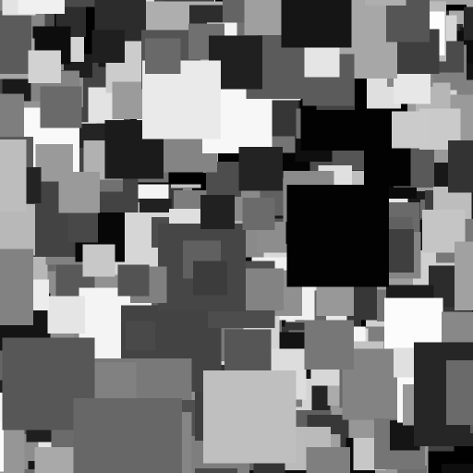
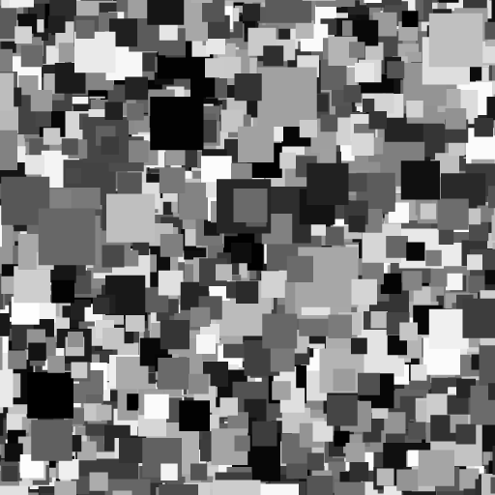
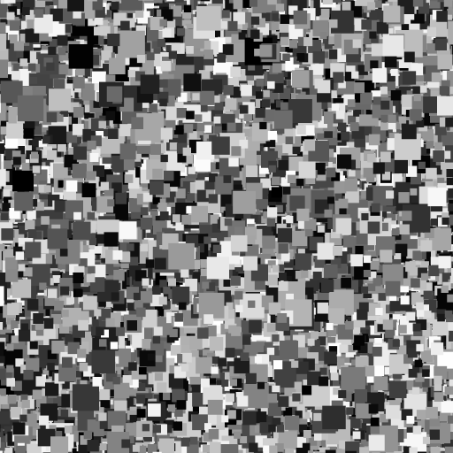
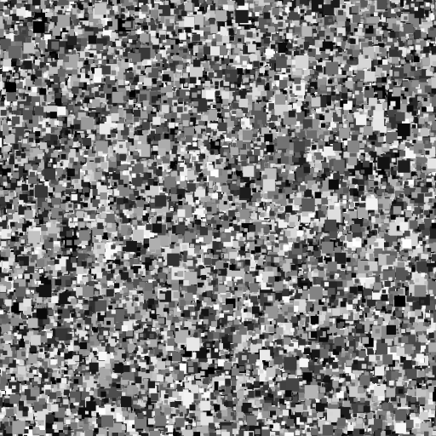
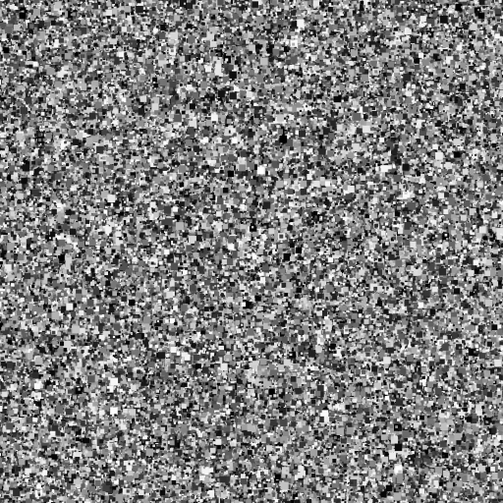
Information scaling and regimes of models !
scale 1
scale 2
scale 3
scale 4
scale 5
scale 6
scale 7
Issues: not only the perception changes, our models and coding mechanism changes as well.
Wu, Zhu, Guo, 04,07

Slide 9
Coding efficiency and number of clusters over scales
middle entropy crisis

Slide 10
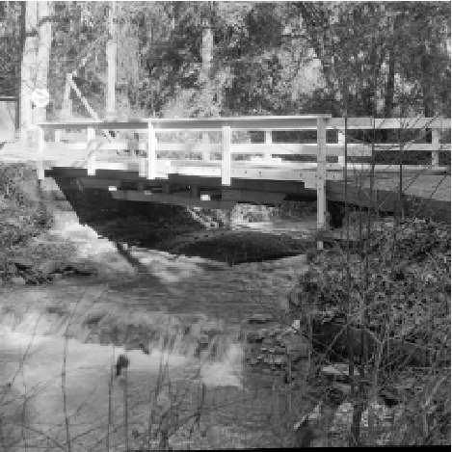
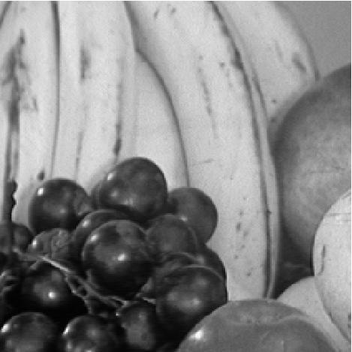
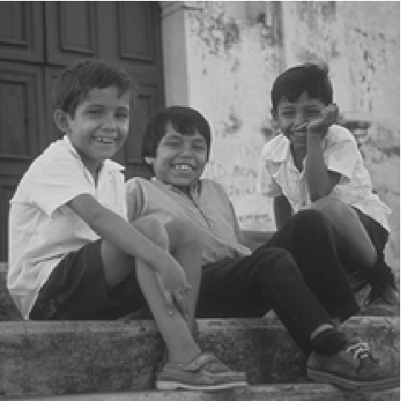
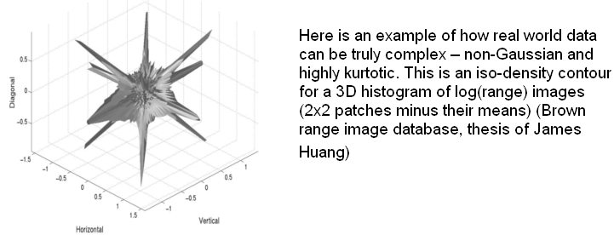
2, Looking at local, generic natural image statistics
….
Ruderman and Bialek 87, 94
Fields 87, 94
Zhu and Mumford 95-96
Chi and Geman 97-98
Huang, 2000
Simoncelli etc 98-03
…..
Most of these work studied marginal statistics !

Slide 11
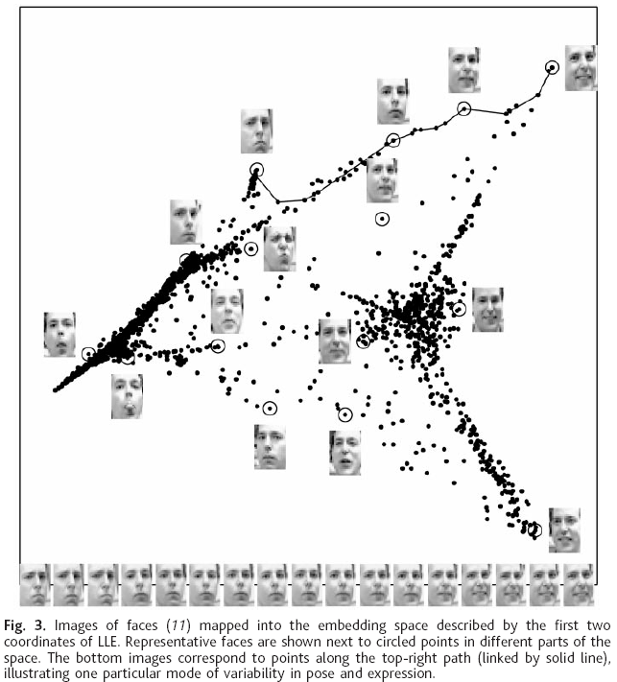
Studies on visual (appearance) manifolds
Image patches from a single object category
are often found to form low dimensional manifolds.
e.g. ISOMAP, LLE:
Saul and Roweis, 2000.
But, people found that image patches of generic
natural images do not follow this observation.

Slide 12
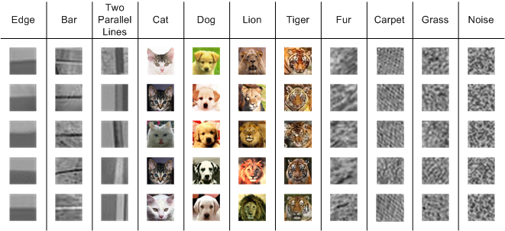
A wide spectrum of categories from low to high entropy
Entropy ~ Dimension ~ Log volume( manifold )

Slide 13



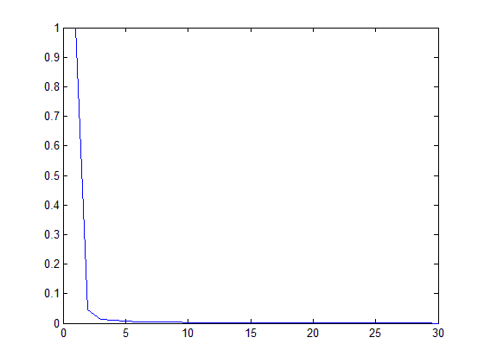
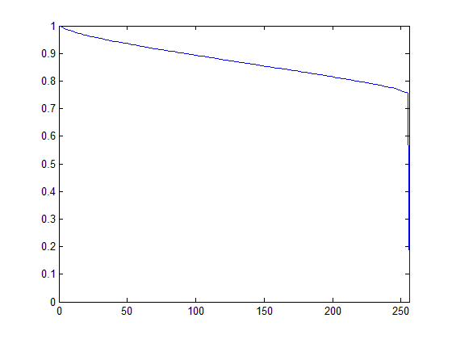


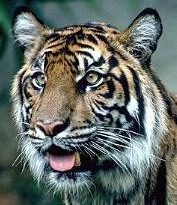
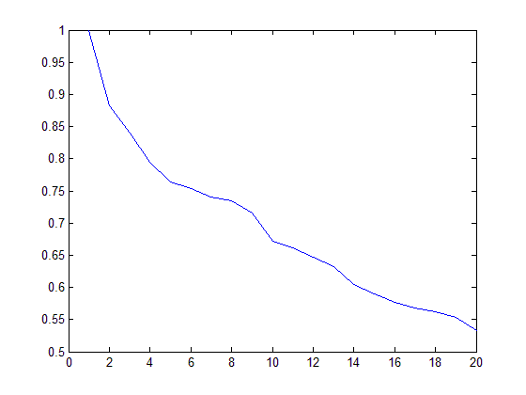
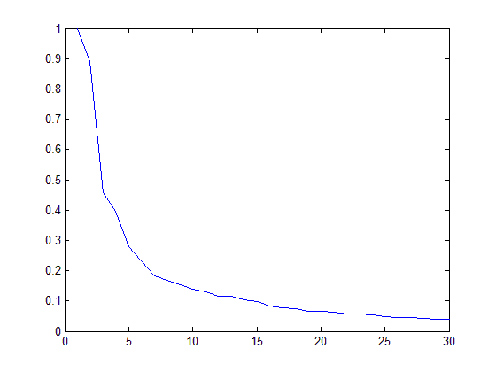
Visual manifolds have varying dimensions
Take 16x16 image patches (256-space), run PCA for each category, and plot the eigen-values in decreasing order.
primitives
unif. noise
tigers
texture

Slide 14
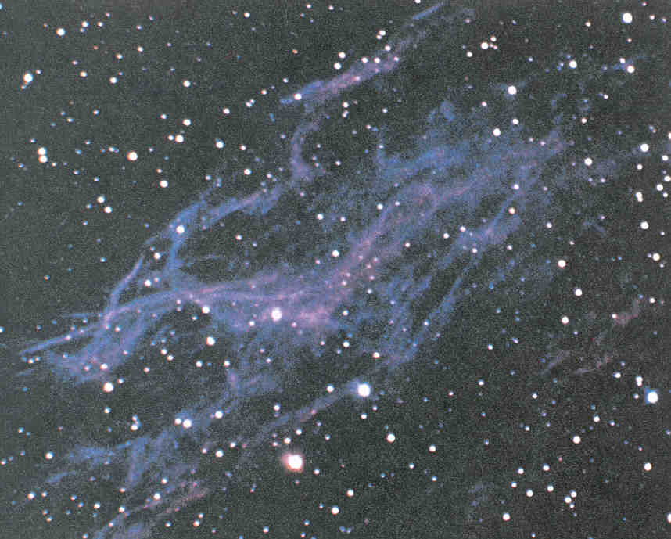
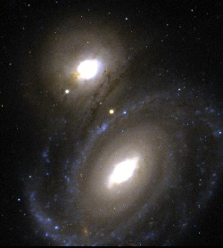
By analogy: pictures of our universe
entropy ( temperature ) regimes.
compositional structures.
How do we learn these manifolds?
Can we do it by K-mean clustering?
3 modeling theories in vision:
(1) Markov random fields, (2) Sparse coding, (3) Grammar and Composition

Slide 15

3, Manifold pursuit in the universe of image patches
f : target distribution; p: our model; q: initial model
image universe:
every point is an image.
1, q = unif()
2, q = δ()
model ~ image set ~ manifold ~ cluster

Slide 16
Intuitive idea: a professor grading an exam
The full score (like dimension in our case) is 100. You have two ways:
For top students (high dimensional manifolds), you start from 100 and deduct points :
100 – 2 – 0 – 0 – 3 – 0– 2 – 0 – 0 – 0 – 0 – 0 – 1 = 92
For bottom students (low dimensional manifolds), you start from 0 and add points
0 + 8 + 0 + 0 + 3 + 0 + 2 + 0 + 0 + 5 + 0 + 0 + 1 = 19
In reality, suppose the exam is very long (just like the large image has >1M pixels), a student may
have mixed performance, e.g. doing excellent in the 1st half and doing poorly in the 2nd half. Thus
a most effective way is to use the two methods for different sections of the exam.
(50 – 2 – 0 – 0 – 3 – 0) + (0 + 5 + 3 + 0 + 0 + 2) = 45 + 10 = 55
In fact, most of the object categories are middle entropy manifolds and have mixed structures.

Slide 17
Manifold pursuit in the image universe
In a simple case: f is a Gaussian distribution
eigen-value λ
e.g. texture
mixed: e.g. tiger face
e.g. face
1 2 3 N

Slide 18


Manifold pursuit by information projection
Given only positive examples from a class c
We pursue a series of models p to approach a underlying “true” probability f
At each step, we augment the current model p to a new model
Subject to a projection constraint:

Slide 19


Manifold pursuit by information projection
.
Solving the constrained optimization problem leads to the Euler-Lagrange equation
where
For q being a uniform distribution, we have

Slide 20





Information projection
DellaPietra, DellaPietra,Lafferty, 97
Zhu, Wu, Mumford, 97
So the KL-divergence decreases monotonically.

Slide 21


A Maximin Learning Principle
max-step: choosing a distinct feature and statistics
min-step: given the selected feature constraint, computing the parameter
Claim: this learning procedure unifies almost all we know in visual modeling
PCA, sparse coding,
MRF, Gibbs, FRAME,
Adaboost (when h() is binary),
Stochastic grammar

Slide 22
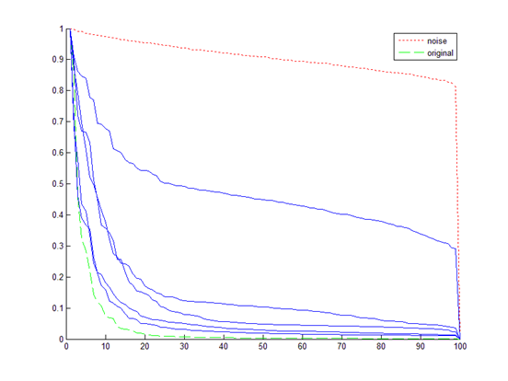
4, Case studies:
Case 1: Pursuing texture models by compression from white noise

Slide 23
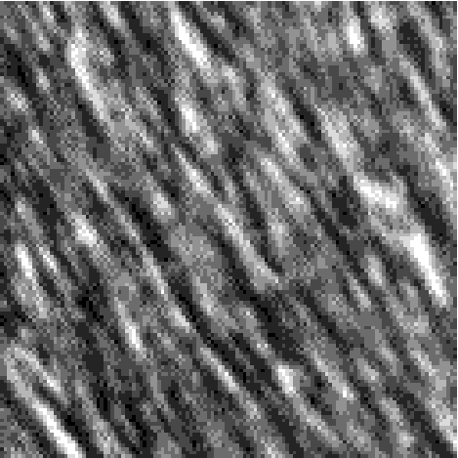
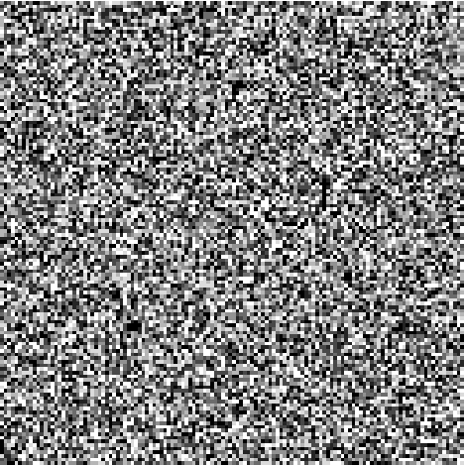
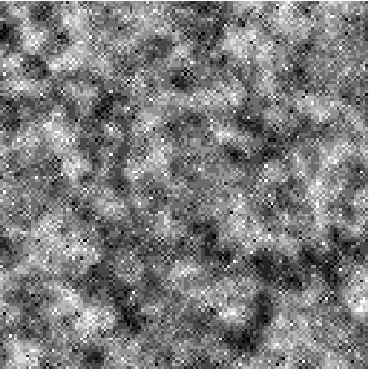
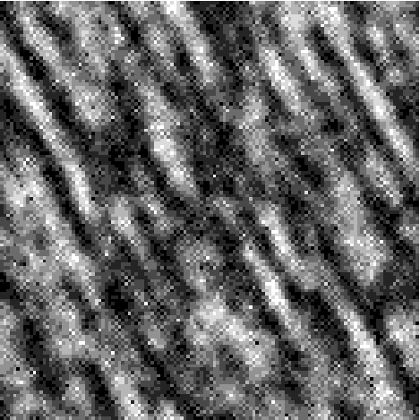
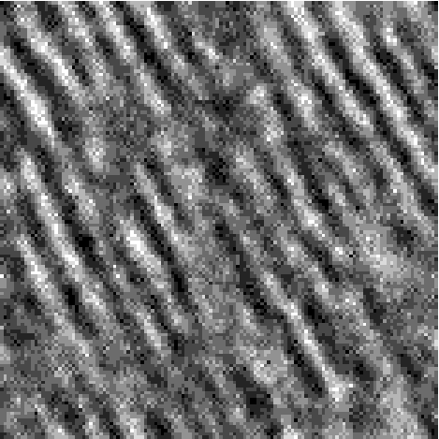
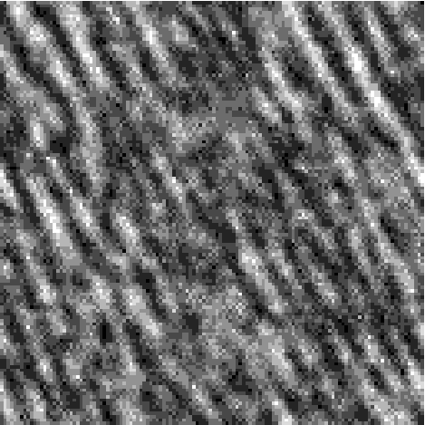
A texture pattern is an “implicit manifold”
H_{c} are histograms of Gabor filters, i.e. marginal distributions of f (I)
I^{obs}
I^{syn} ~ Ω(h) k=0
I^{syn} ~ Ω(h) k=1
I^{syn} ~ Ω(h) k=3
I^{syn} ~ Ω(h) k=4
I^{syn} ~ Ω(h) k=7
(Zhu,Wu, Mumford 97,99,00)

Slide 24
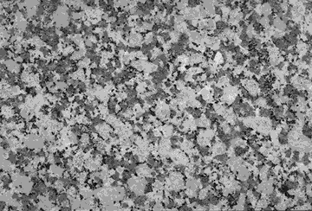
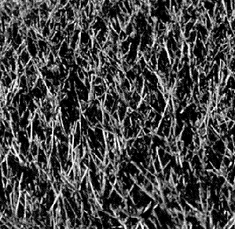
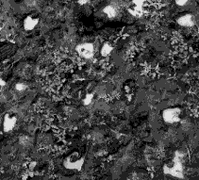
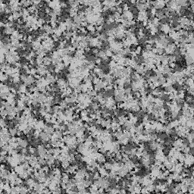
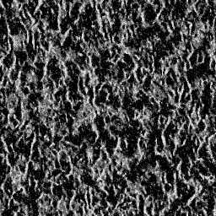
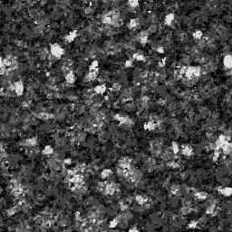
More examples of the texture manifold (implicit)
Observed
MCMC sample

Slide 25
This is originally from statistical physics !
Statistical physics studies macroscopic properties of systems
that consist of massive elements with microscopic interactions.
e.g.: a tank of insulated gas or ferro-magnetic material
N = 10²³
A state of the system is specified by the position of the N elements X^{N} and their momenta p^{N}
S = (x^{N}, p^{N})
But we only care about some global properties
Energy E, Volume V, Pressure, ….
Micro-canonical Ensemble
Micro-canonical Ensemble = Ω(N, E, V) = { s : h(S) = (N, E, V) }

Slide 26
Equivalence of Julesz ensemble and FRAME/MRF models
Zhu, Wu, Mumford, 1997
Wu and Zhu, 1999
Λ
Z²
Theorem 1
For a very large image from the Julesz ensemble any
local patch of the image given its neighborhood follows a conditional
distribution specified by a FRAME model
Theorem 2
As the image lattice goes to infinity, is the limit of the
FRAME model , in the absence of phase transition.

Slide 27






Case 2: A car pattern is an “explicit manifold”
Learning active basis as deformable template
A basis is an image space spanned by a number of vectors (e.g. Gabor/primitives)
A car template
(Gabor elements represented by bar)
An incoming car image:
With slight modification, this model can handle multi-views
Wu, Si. Gong, Zhu, 2008

Slide 28








Deformed to fit many car instances
A car template

Slide 29
B₁
B₂
…
B₁
B₃
template
instance 1
instance 2
instance n
q(r)
p(r₃)
p(r₂)
p(r₁)
0
projection r
1 2 3 4 5 6 7
no. of base functions selected
instance 3

Slide 30




Pursuing the active basis model (explicit manifold)
q(I): background distribution
(all natural images)
p(I): pursued model to approximate
the true distribution.
Example images
B1
B2
B3
# Gabor elements selected

Slide 31
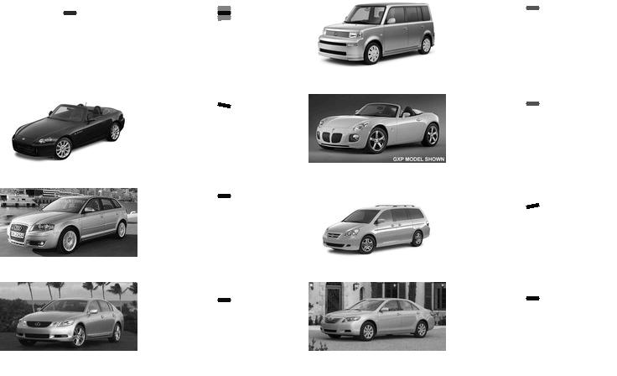
A running example
A car template consisting of 48 Gabor elements
Car instances

Slide 32
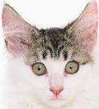
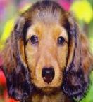
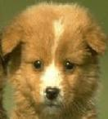


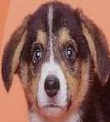
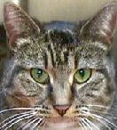
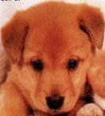
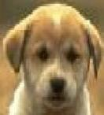
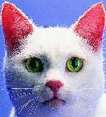
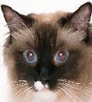
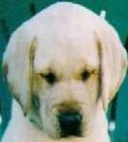
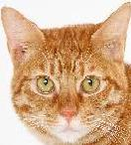














Experiment : learning and clustering
Learning active basis
EM clustering

Slide 33














































Experiment : learning and detection
Wu,Si,Fleming,Zhu,07
vs: Viola, Jones, 04

Slide 34







Template detection experiment
Wu,Si,Fleming,Zhu,07

Slide 35





Summary: two pure manifolds
implicit vs. explicit

Slide 36








Summary: a second look at the space of image patches
implicit manifolds
image space
+
+
+
explicit manifolds

Slide 37


5, Relations to the literature: psychophysics
(1) textures vs textons (Julesz, 60-70s)
textons
Response time T
Distractors # n

Slide 38

Textons vs. Textures
textures
Response time T
Distractors # n

Slide 39
6, Frequency plot of the ex/implicit manifolds in natural images
implicit texture clusters (blue),
explicit primitive clusters (pink).

Slide 40






7, Primal sketch: integrating the two regimes
org image
sketching pursuit process
sketches
=
+
syn image
synthesized textures
sketch image
(Guo,Zhu,Wu, 2003-05)

Slide 41
Manifolds of image primitives
Learned texton/primitive dictionary with some landmarks that transform and warp the patches

Slide 42


Primal Sketch is a two-level MRF model
Spatial MRF
Texture MRF

Slide 43




Primal sketch example
input
image
sketching pursuit
process
synthesized
image
sketches

Slide 44



Primal sketch example
original image
synthesized image
sketching pursuit process

Slide 45

8, deformable template: mixing the im/explicit manifolds
Zhangzhang Si et al 2009

Slide 46


Learning Hybrid Object Template
Hedgehog template learned only 10 examples

Slide 47





Examples of Learned object templates

Slide 48

The info. gain in pursuing the object templates

Slide 49



9, Clustering video primitives (trackable and intrackable)
Notes:
49

Slide 50




















Examples in video
explicit | implicit

Slide 51





10, Learning action templates
1. Initialize action template T₀ from an annotated example.
2. Find spatial-temporal alignment between T₀ and all other examples.
3. Adaptively select primitives to update T₀ by pooling over all aligned video frames.
4. Repeat 2,3.

Slide 52


Representation
V₀
V₁
V₂
V₃
V₄
V₅
Training videos
Deformable shape template
Deformable motion template
Colors are used to illustrate motion direction & speed.

Slide 53


Action detection in video with time warping
We use a dynamic space-time warping (DSTW) algorithm based on DTW. To match the template of length T₀ with a image sequence of length T_{target} equivalents to search the optimal path in the (T₀,T_{target}, x, y, scale) space.

Slide 54
Summary
2 pure atomic
image spaces
where
2.1D
Sketch
2.5D
Sketch
3D
Sketch
Scaling --Transition
Texture
Primal Sketch
Texton
Graphlets
Parts
Objects
Scenes
what
What do these mean to biologic vision?

