Slide 1
Scene Understanding by Inferring the "Dark Matters"
--- Functionality, Physics, Causality and Mind
Song-Chun Zhu
University of California, Los Angeles
Scene Understanding Workshop, at CVPR, Portland, Oregon, June 23, 2013

Slide 2
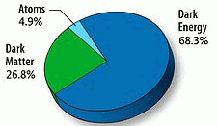
Outline: Methods for Scene Understanding
1, Appearance
2, Functionality
3, Physics
4, Causality and mind
“Dark Matter and Dark Energy”
5, Joint representation
--- spatial-temporal-causal and-or graph

Slide 3
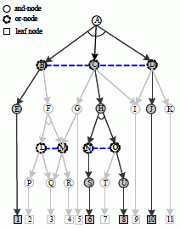
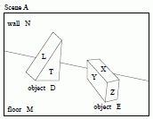


1. Appearance-based approaches --- a brief history
Two streams of research
Grammar
models
Tu, iccv03
1, Image parsing
1975-1984
1984-1994
1994-2003
2005-2010
Fu, Riseman,
Ohta/Kanade
DARPA IU
Rosenfeld et al
Dormant era
Zhu, Geman, Mumford
Todorovic, Felzenszwalb, et al
You are here
2, scene classification
Thorpe
1996
Oliva/Torralba
IJCV 2001
Hoiem
cvpr 06
context
attributes

Slide 4
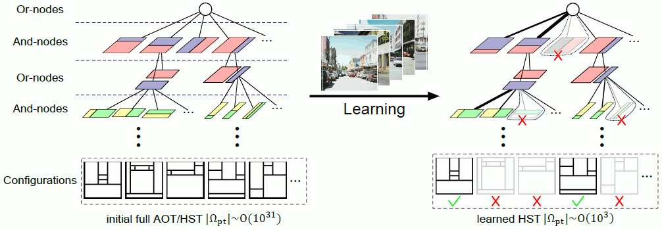

Representing scene configurations by and-or graph
Quantizing the enormous scene configurations by tiling (Tangram)
Shuo Wang
S. Wang et al “Weakly Supervised Learning for Attribute Localization in Outdoor Scenes,” CVPR 2013.

Slide 5
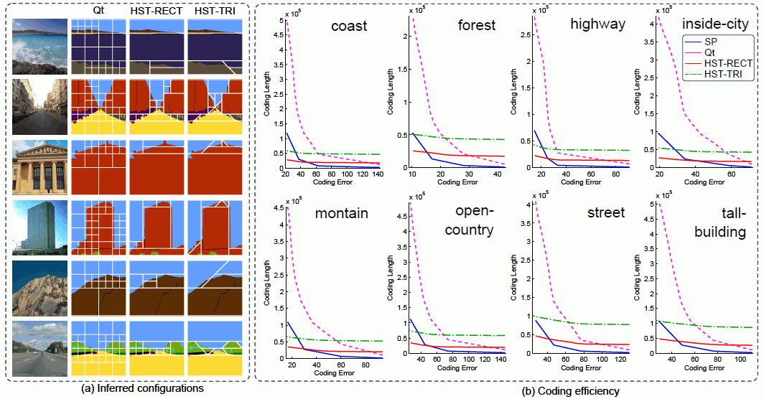
The AoG form a sparse representation effectively coding scene configurations
Rate-distortion curves for coding different categories
S. Wang et al, “Hierarchical Space Tiling for Scene Modeling,” ACCV, 2012.

Slide 6
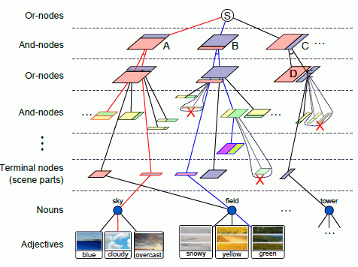
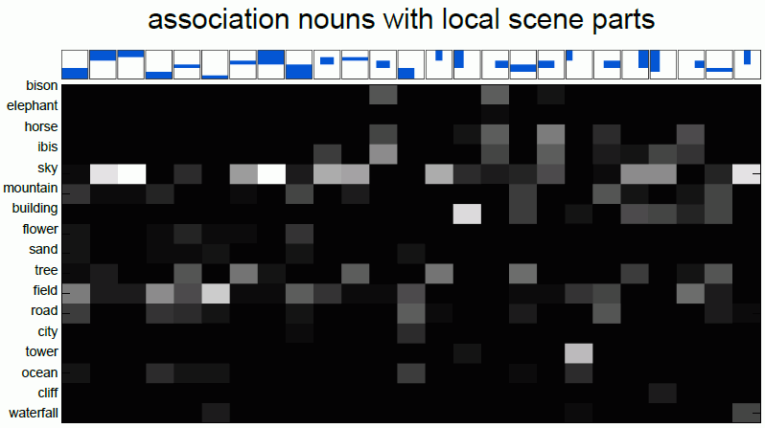
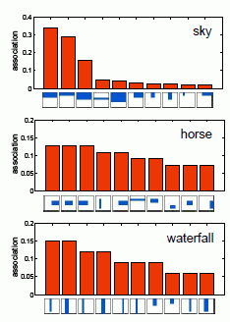

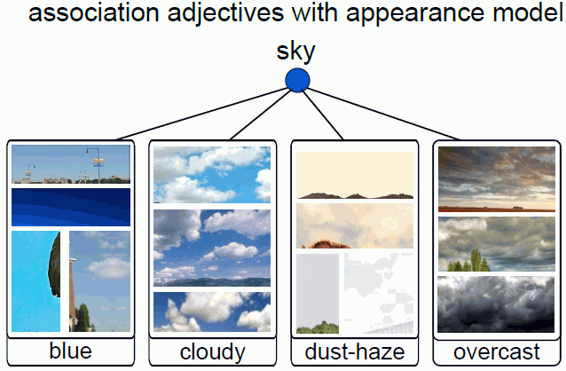
Learning the AoG with attribute
input image
+ text

Slide 7
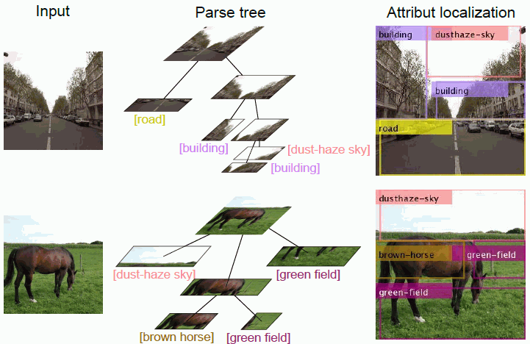
Scene parsing with attribute tagging
S. Wang et al “Weakly Supervised Learning for Attribute Localization in Outdoor Scenes,” CVPR 2013.

Slide 8
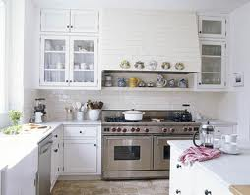
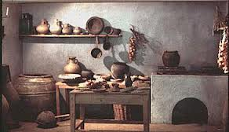
2. Reasoning scene functionality
Most scene categorizes are defined and designed by functions not appearance.
functions are more consistent (invariant) across geo-location and history.

Slide 9

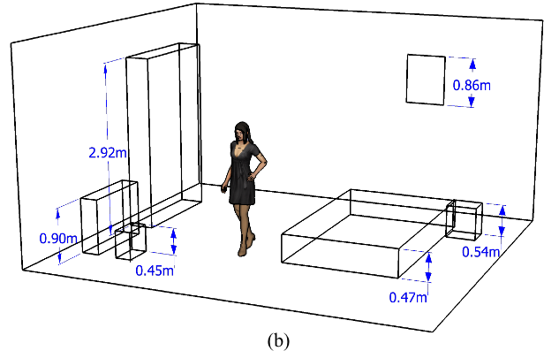

Reasoning scene functionality
Functionality = imagined human actions in the dark !
Y. Zhao and S.C. Zhu, “Scene Parsing by Integrating Function, Geometry and Appearance Models,” CVPR, 2013.

Slide 10
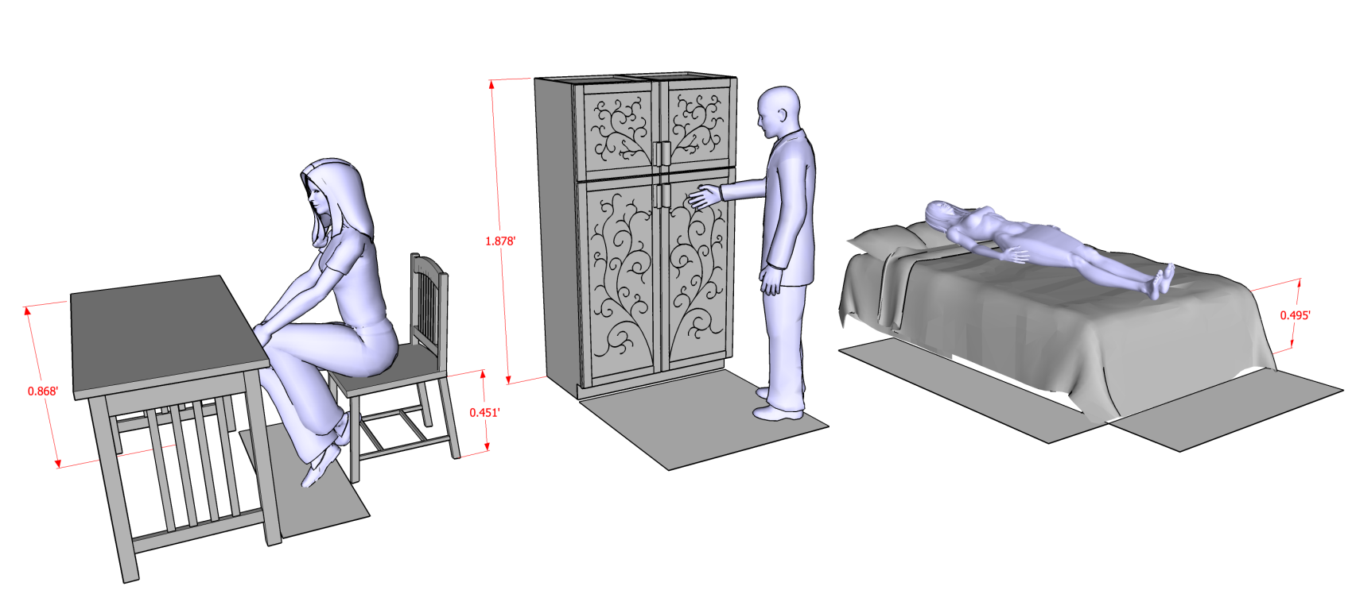
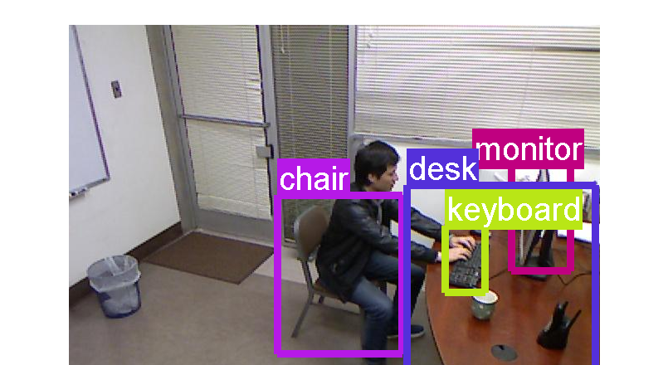
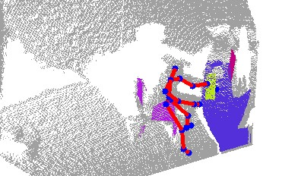
Functionality = imagined human actions in the dark
Storing
Sleeping
Sitting/working
One can learn these relations from Kinect RGBD data and use them for reasoning.

Slide 11
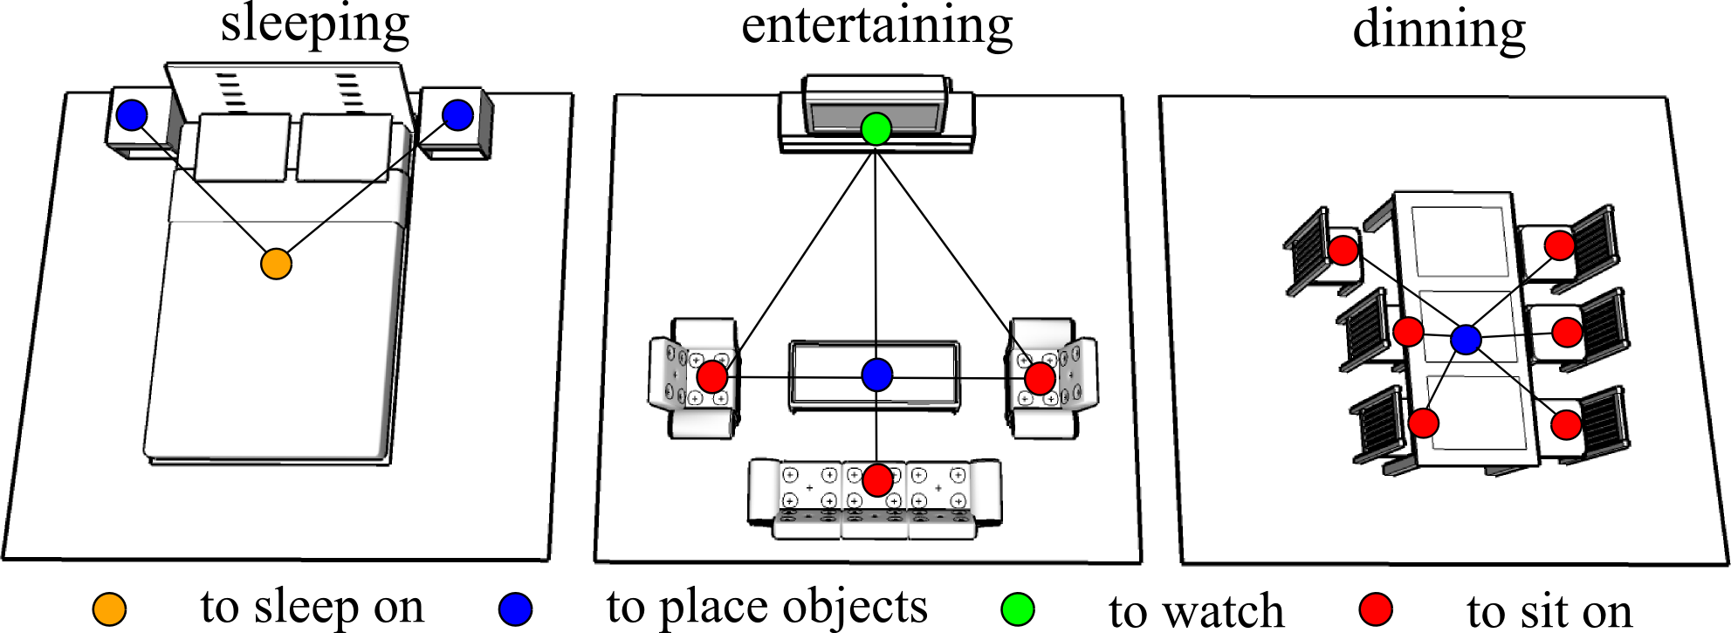
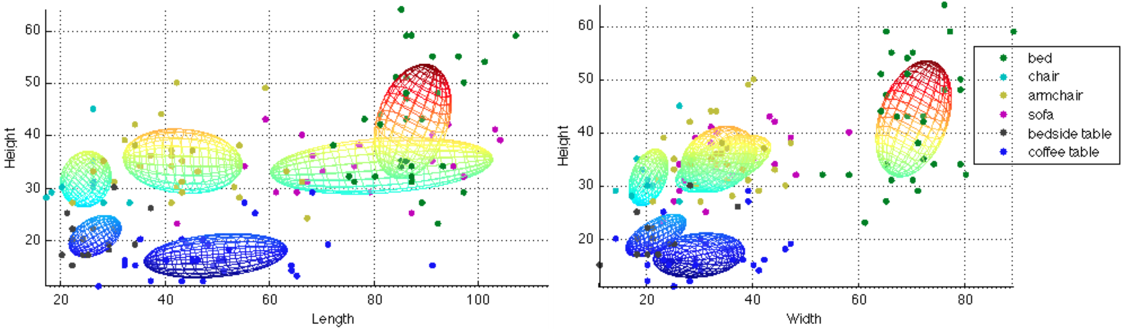
Representing human-object relations in those actions
These relations are the grouping “forces” for the layout of the scene. (C. Yu et al Siggraph 2012)

Slide 12
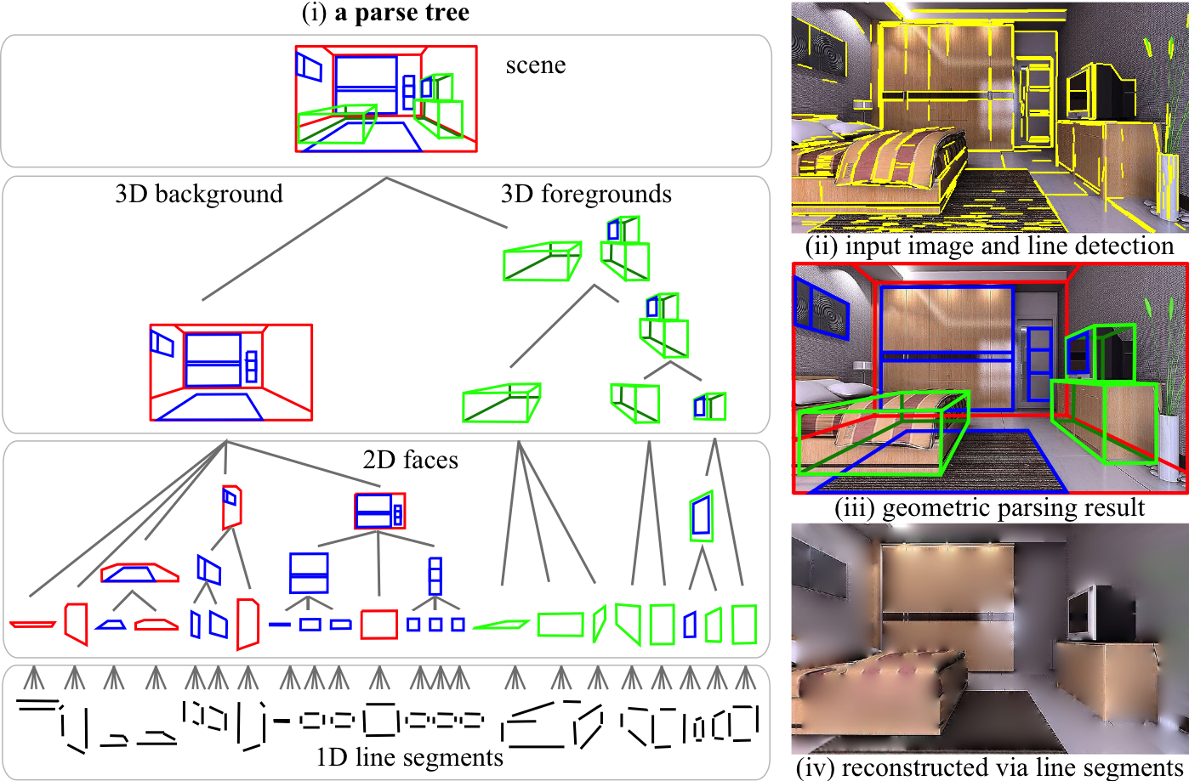
Scene parsing by stochastic grammar
Y. Zhao and S.C. Zhu, “Image Parsing via Stochastic Scene Grammar” NIPS, 2011.

Slide 13
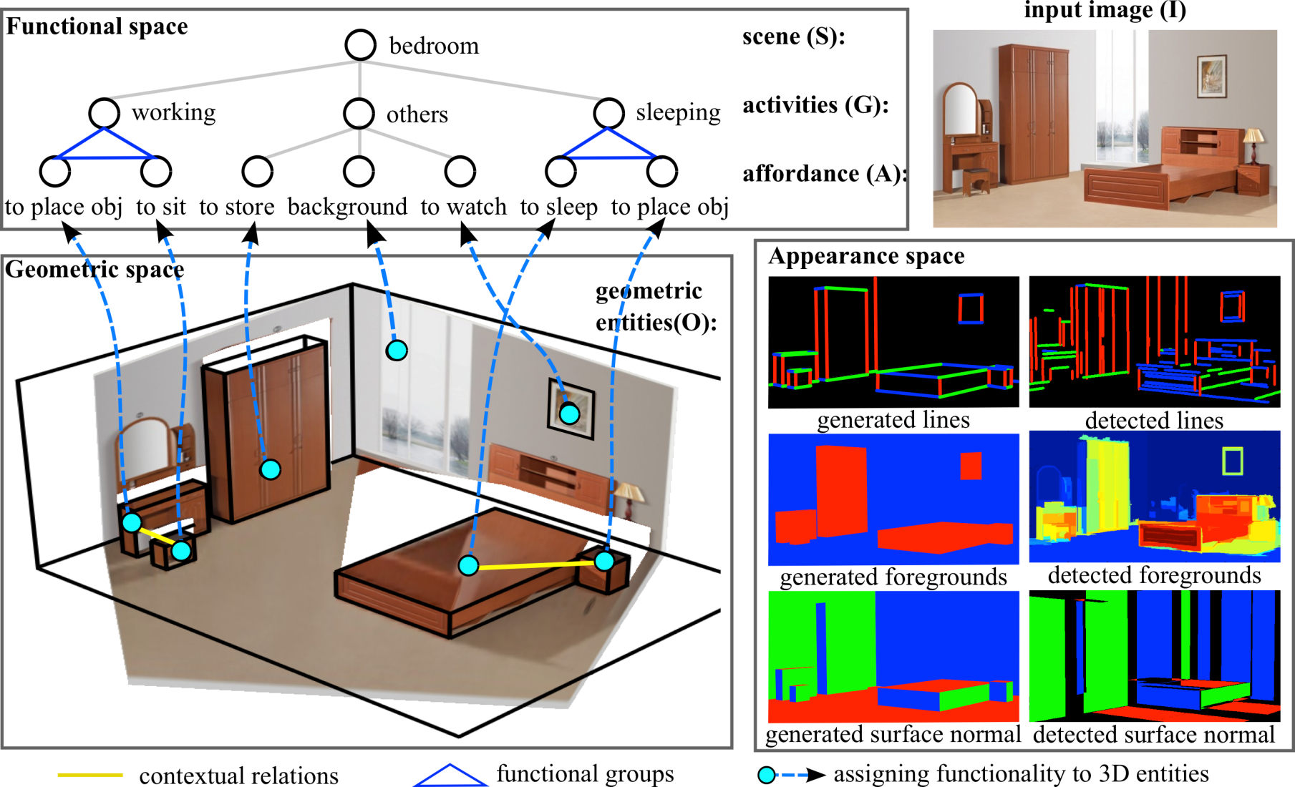
Augmenting the and-or grammar with functions

Slide 14
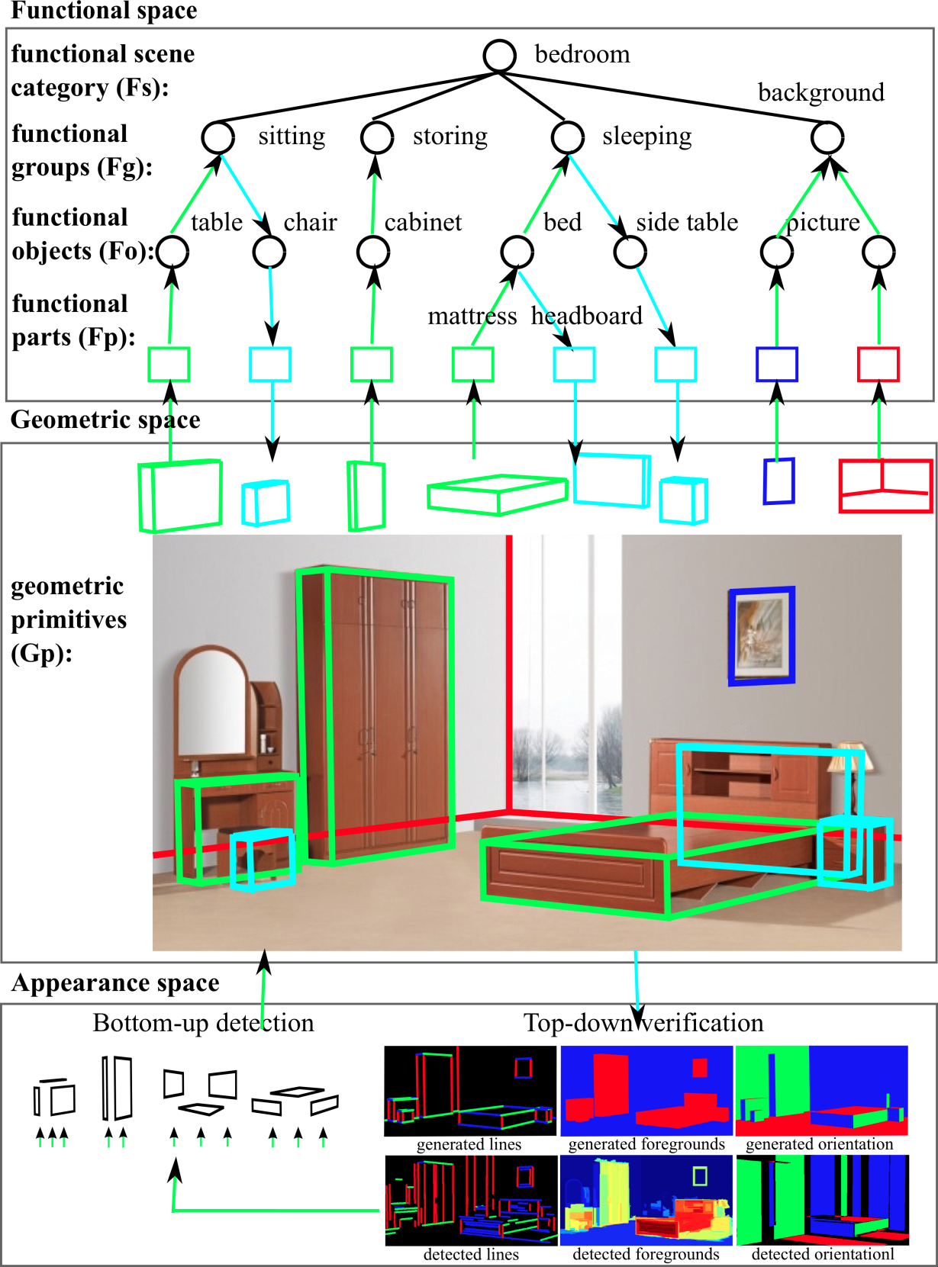
Bottom-up /
Top-down inference
by MCMC

Slide 15
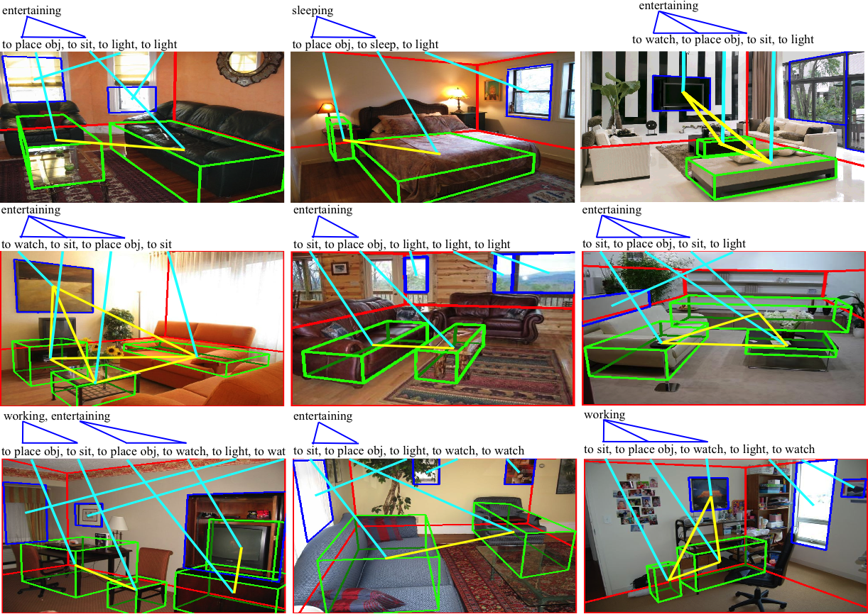
Results on public dataset of 2D indoor images

Slide 16
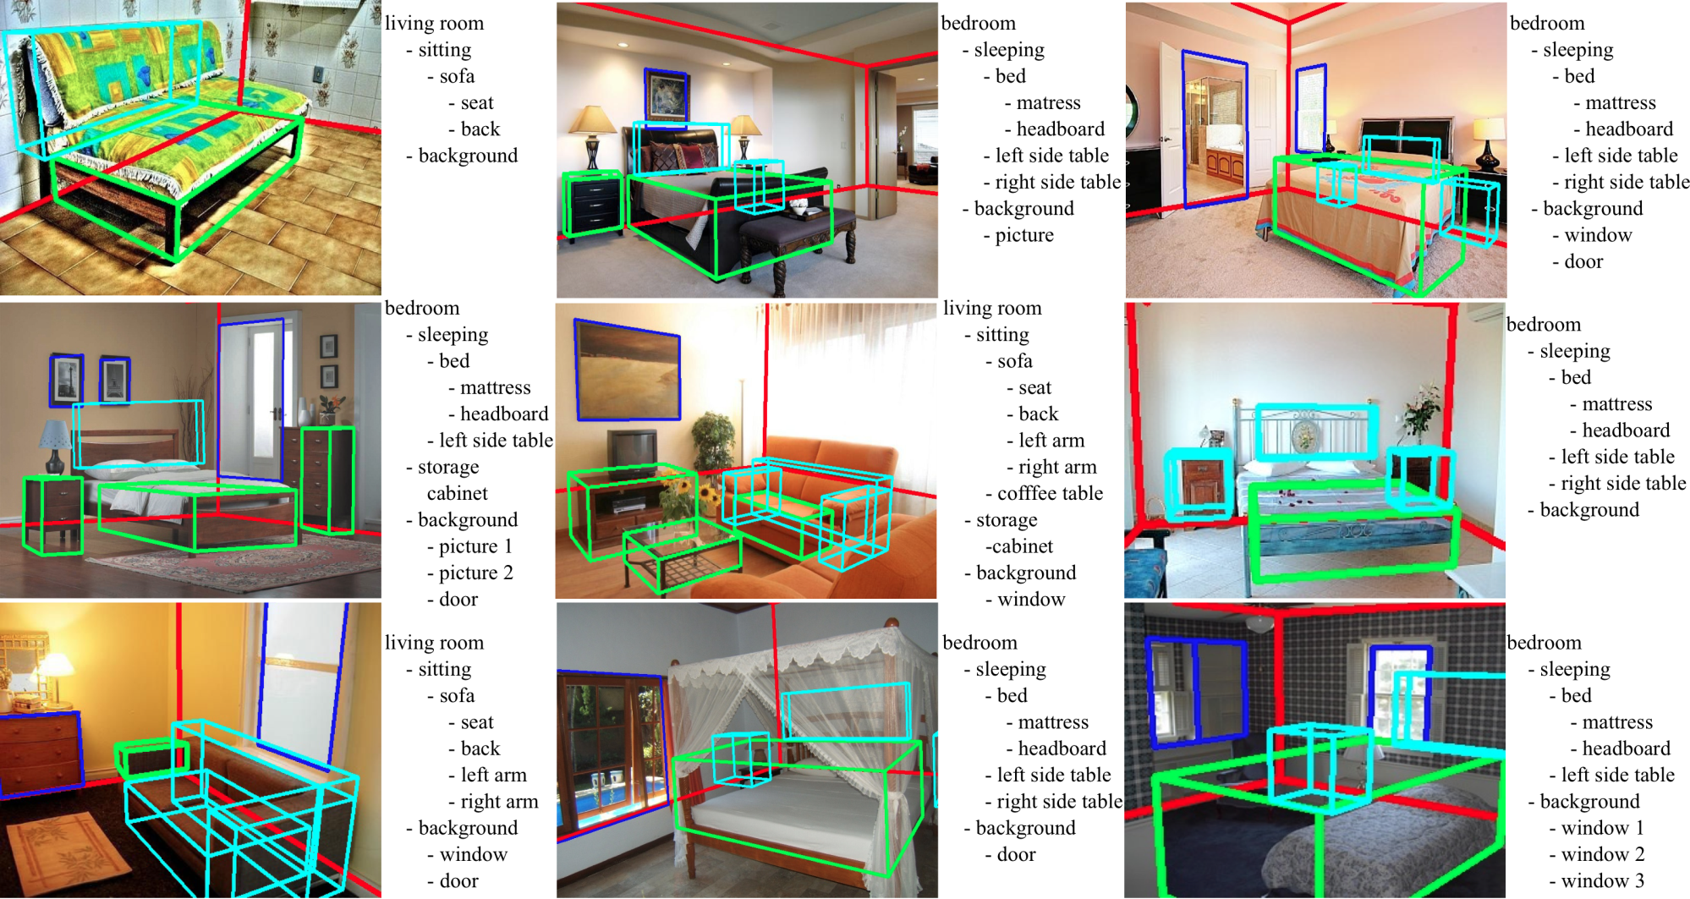
Results on public dataset of 2D indoor images
Y. Zhao and S.C. Zhu, “Scene Parsing by Integrating Function, Geometry and Appearance Models,” CVPR, 2013.

Slide 17
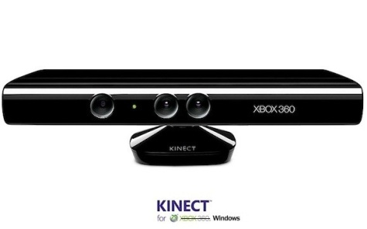
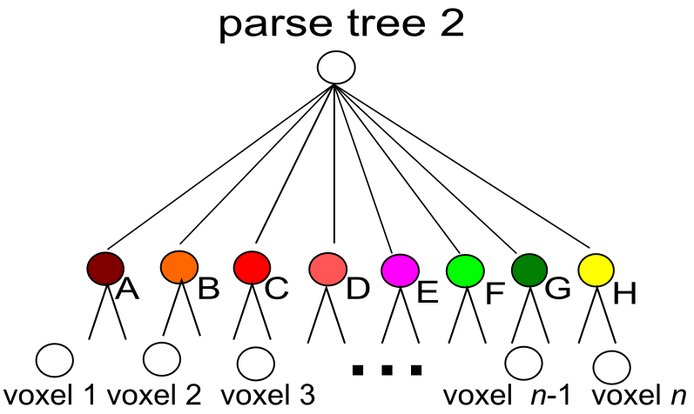
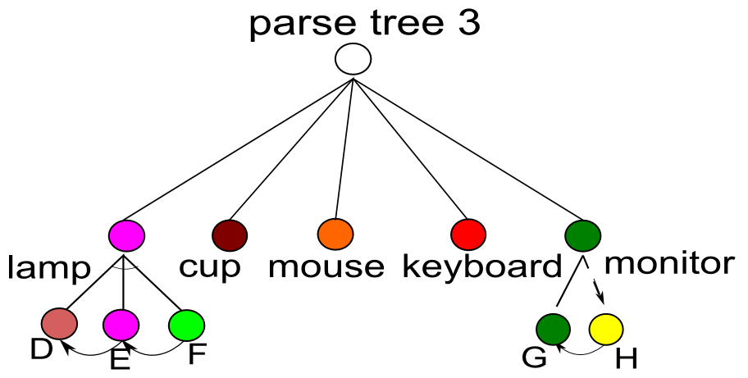
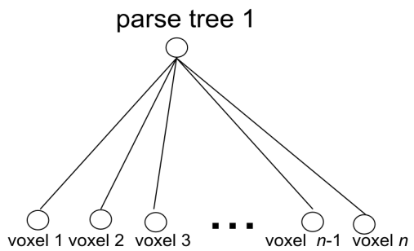
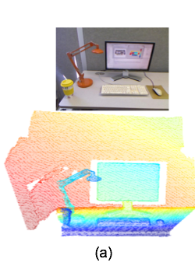
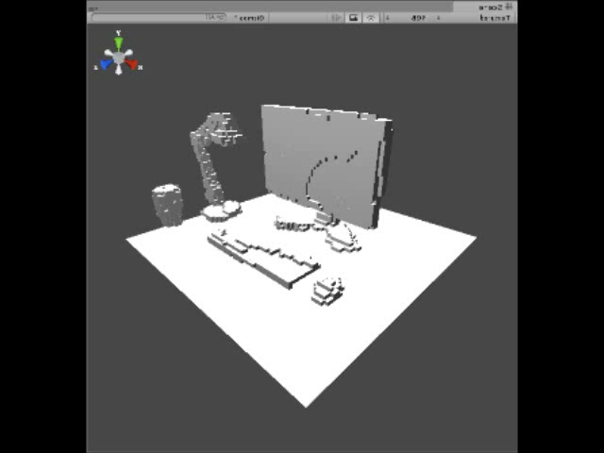
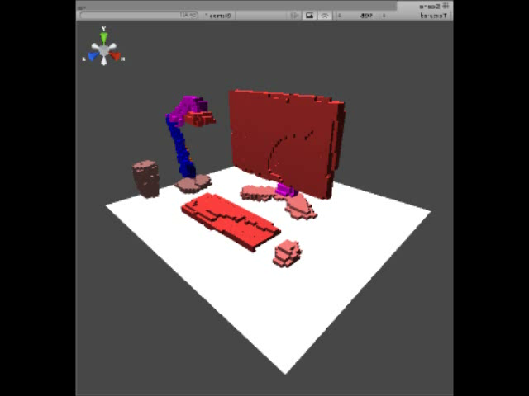
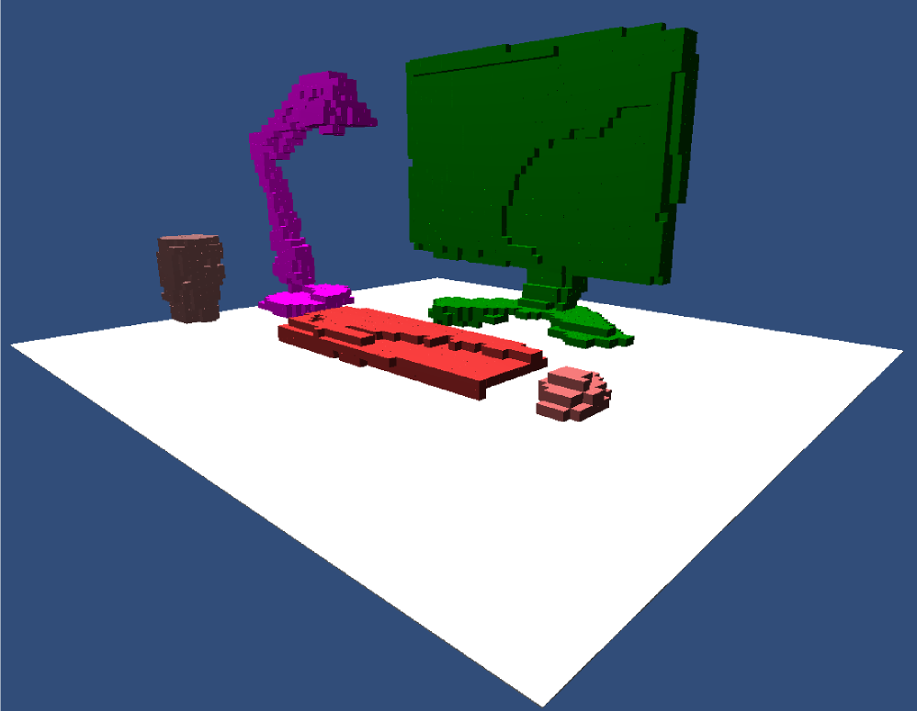
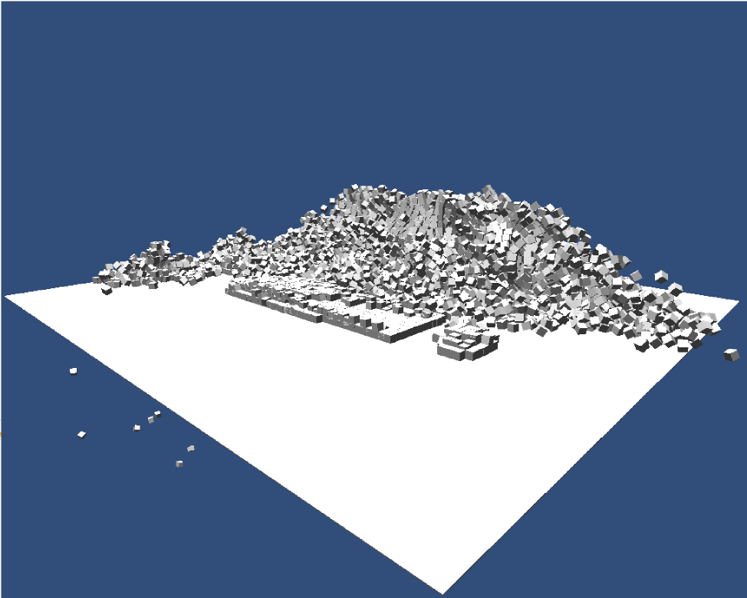
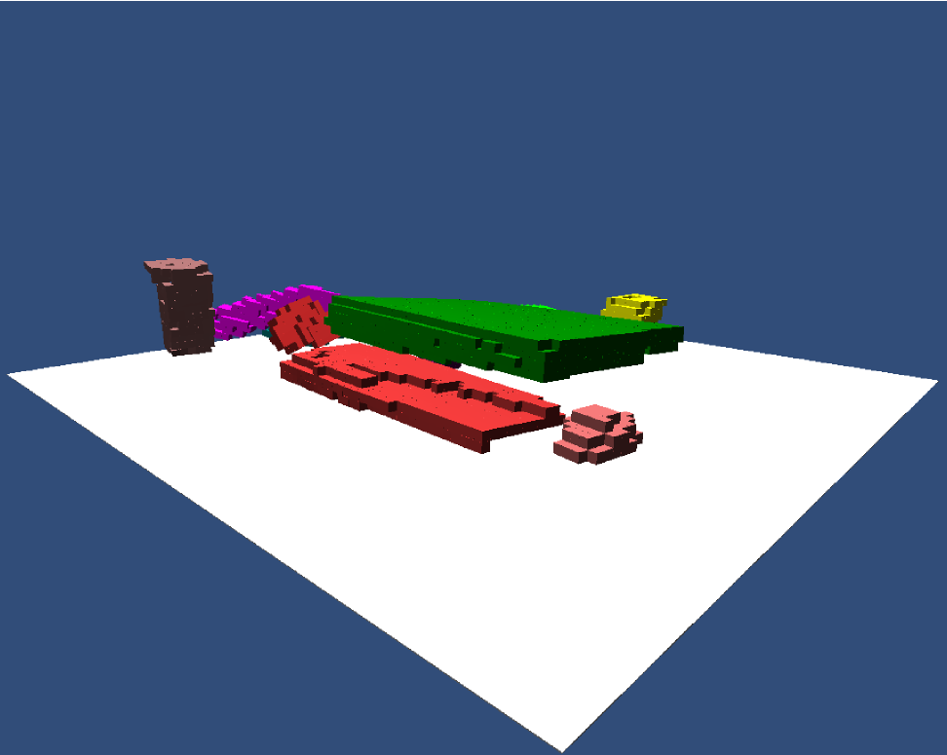
3. Reasoning Physics --- forces governing scenes in the dark
A valid scene interpretation must observe the physics and
be stable to disturbances.
color image
depth image
B. Zheng, Y. B. Zhao et al. “Beyond Point Clouds: Scene Understanding by Reasoning Geometry and Physics,” CVPR 2013.

Slide 18
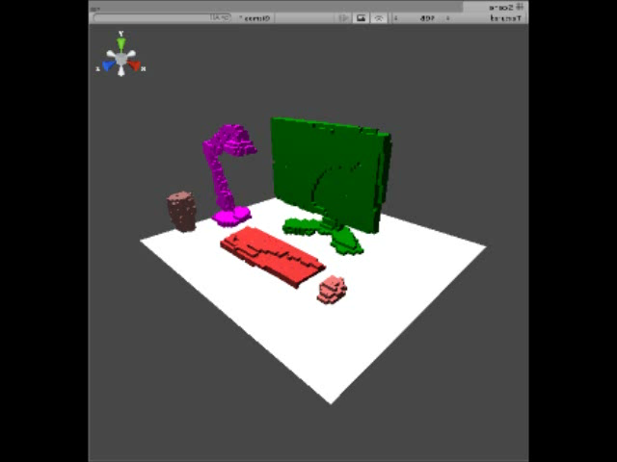
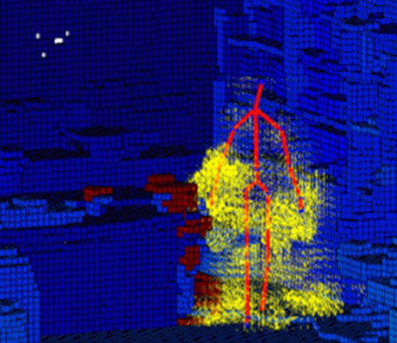

Other physical disturbances: earthquake, gust, human activities
B. Zheng, Y. B. Zhao et al. “Beyond Point Clouds: Scene Understanding by Reasoning Geometry and Physics,” CVPR 2013.

Slide 19
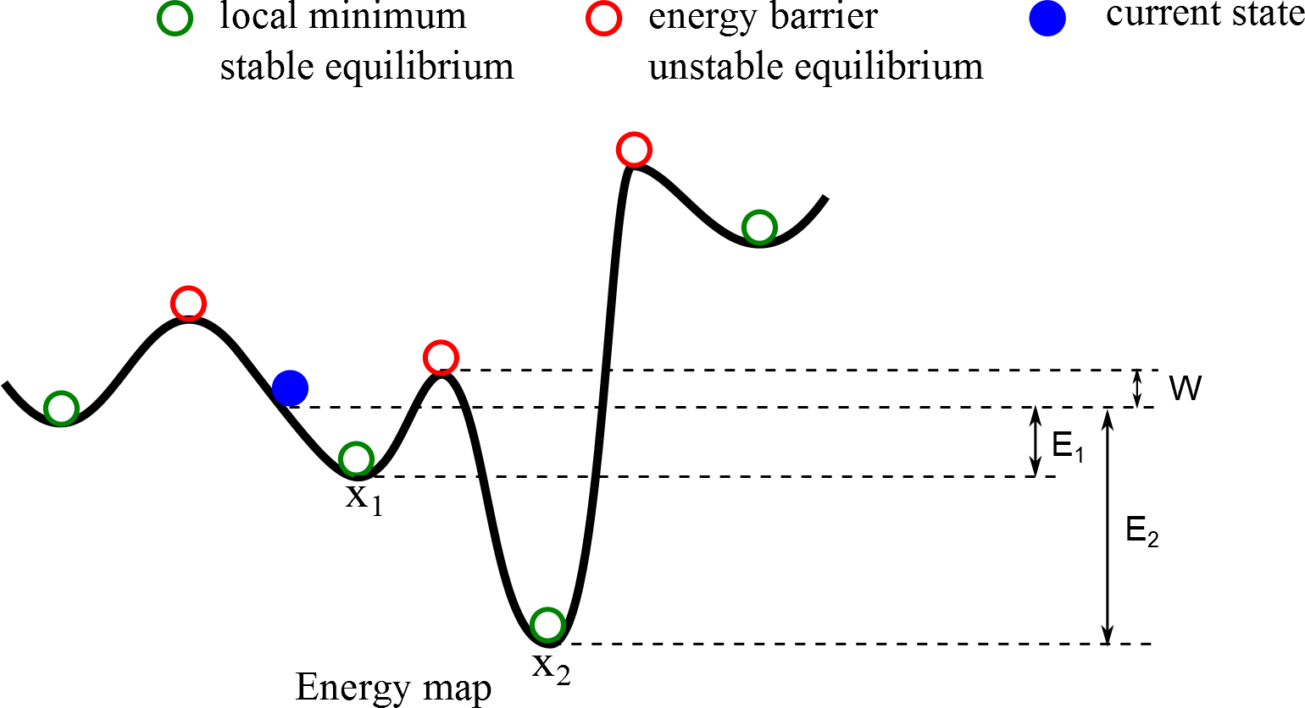
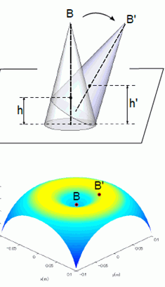
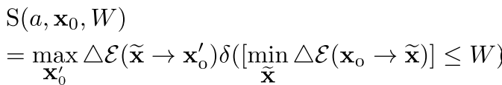
Defining stability
Stability is the maximum energy released after a minimum work to knock it off balance.

Slide 20
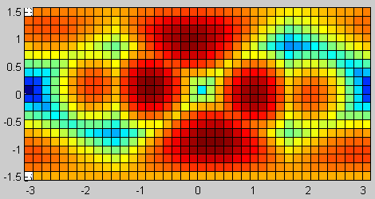
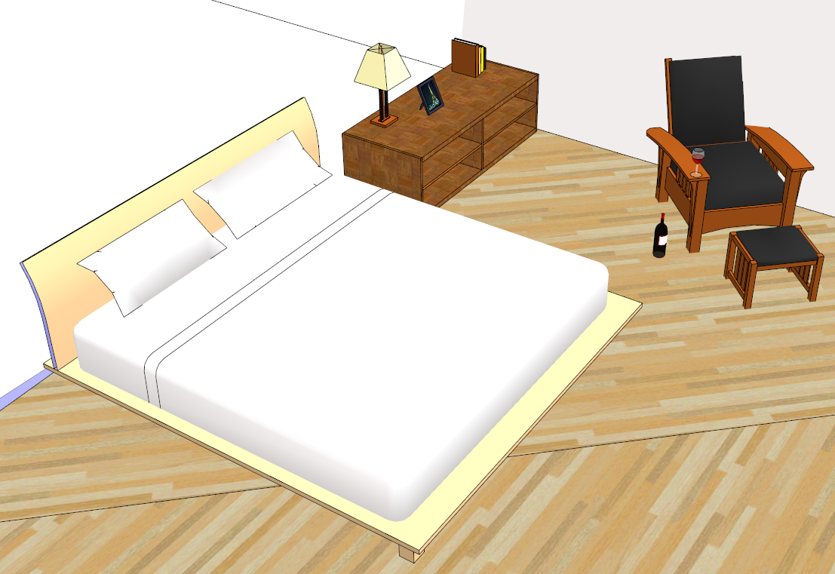

Example: potential energy map in a scene
Energy map by pose
Energy map by position

Slide 21
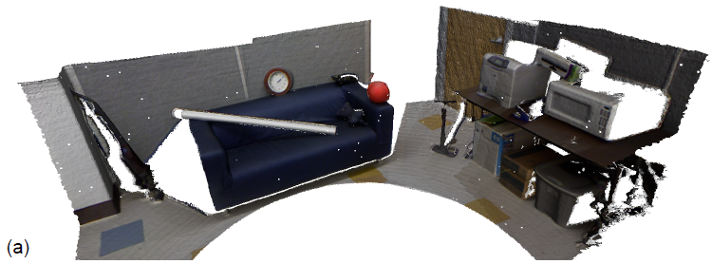
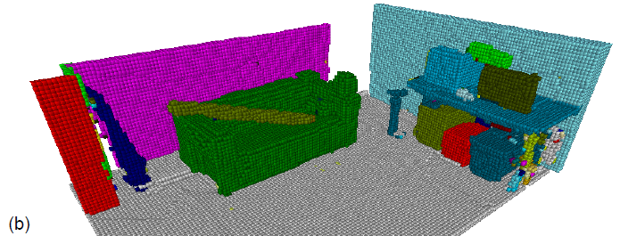
Reasoning results for large scale indoor scene
Input RGBD
Output parse

Slide 22
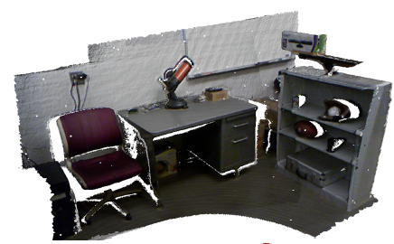
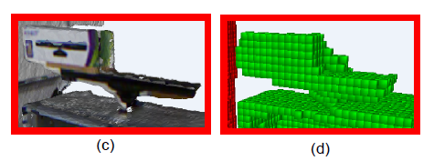
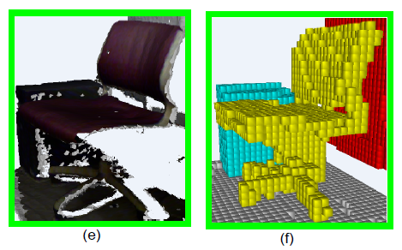
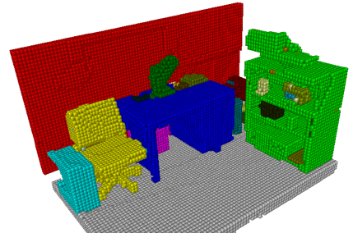
Reasoning results for large scale indoor scene

Slide 23
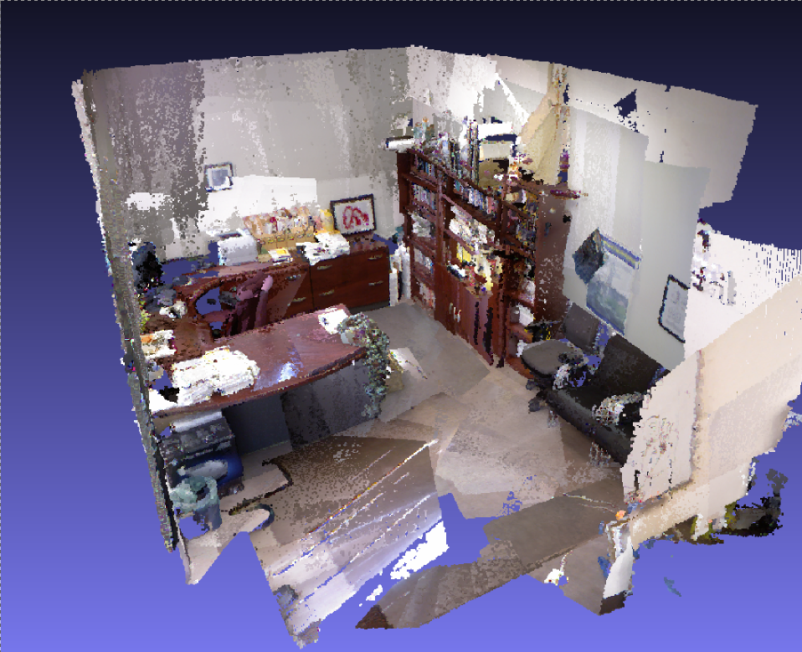
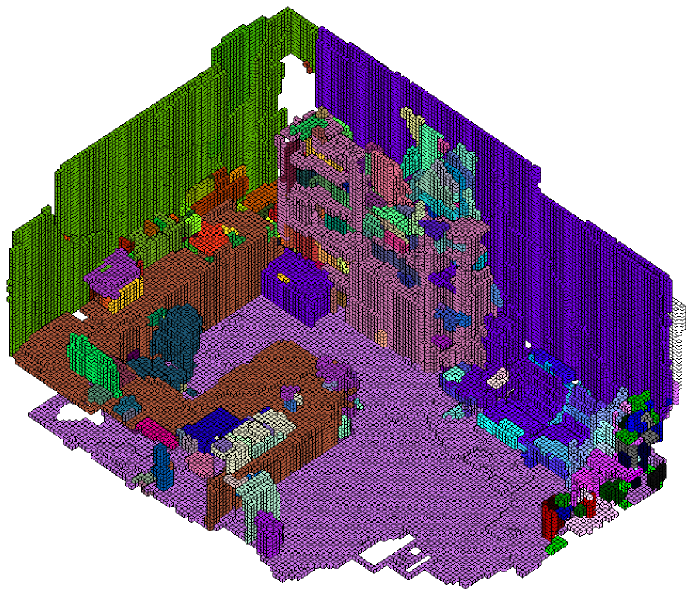
My office

Slide 24
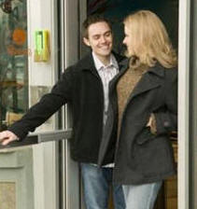

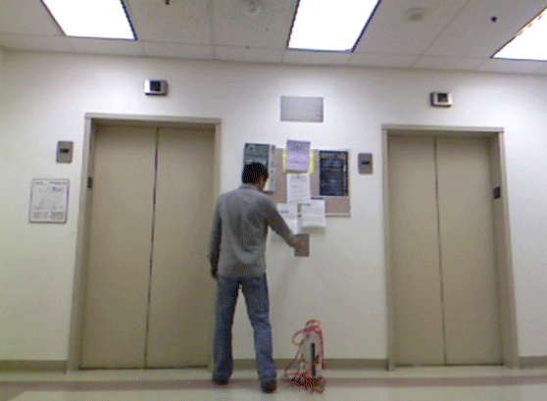



4. Reasoning causality in scene
Open a door:
Understanding the hidden causal relationships
Amy Fire and S.C. Zhu, “Using Causal Induction in Humans to Learn and Infer Causality from Video,” 35th Annual Cognitive Science Conference (CogSci), 2013.

Slide 25
Fluents are important variables in a scene
OPEN
Door Opens
Door Closes
Door
CLOSED
ON
Light
Light Turns Off
OFF
t
Fluents:
Time-varying transient states of objects: door open, cup full, cellphone ringing, …
of agents: thirsty, hungry, tired, …
In contrast, attributes are permanent, such as color, gender,….
Fluents in a video are like punctuation marks in a paper.

Slide 26

Representing causality by causal-and-or graph
Amy Fire and S.C. Zhu, “Using Causal Induction in Humans to Learn and Infer Causality from Video,” 35th Annual Cognitive Science Conference (CogSci), 2013

Slide 27
Unsupervised Learning of C-AoG
Fluent
Fluent Transit Action
fluent
Action or Precondition
Door fluent
Light fluent
Screen fluent
close
open
on
off
off
on
A₀
A₁
A₂
A₃
A₄
A₅
A₆
A₇
A₈
A₉
A₁₀
A₁₁
A₁₂
A₁₃
a₀
a₁
a₂
a₃
A₄₁
a₆
a₇
a₈
a₉
a₁₀
a₁₁
a₁₂
a₁₃
a₁₄
a₁₅
a₁₆
a₁₇
a₁₈
a₁₉
a₄
a₅
A₀: inertial action
a₀: precondition (door closed)
A₁: close door
a₁: pull/push
A₂: door closes inertially
a₂: leave door
A₃: inertial action
a₃: precondition (door open)
A₄: open door
A₄₁: unlock door
a₄: unlock by key
a₅: unlock by passcode
a₆: pull/push
A₅: open door from inside
a₇: person exits room
A₆: inertial action
a₈: precondition (light on)
A₇: turn on light
a₉: touch switch
a₁₀: precondition (light off)
A₈: inertial action
a₁₁: precondition (light off)
A₉: turn off light
a₁₂: touch switch
a₁₃: precondition (light on)
A₁₀: inertial action
a₁₄: precondition (screen off)
A₁₁ : turn off screen
a₁₅: push power button
A₁₂: inertial action
a₁₆: precondition (screen on)
A₁₃: turn on screen
a₁₇: touch mouse
a₁₈: touch keyboard
a₁₉: push power button

Slide 28


Reasoning hidden fluents in scene by causality
Amy Fire

Slide 29

Summary demo: Joint Spatial, Temporal, Causal Parsing
http://www.youtube.com/watch?feature=player_embedded&v=TrLdp_lir5M
Supported by ONR MURI and DARPA MSEE

Slide 30
Summary demo: Joint Spatial, Temporal, Causal Parsing
http://www.youtube.com/watch?feature=player_embedded&v=TrLdp_lir5M
Supported by ONR MURI and DARPA MSEE

Slide 31

Demo on Query answering:
What, Who, Where, When, and Why
http://www.youtube.com/watch?feature=player_embedded&v=XIGvwFM_RsI

Slide 32


Discussions
We need to agree that scene understanding is a hard problem !
----- if so, let’s be serious and aim at a long term comprehensive solution.
1, Need a joint representation to integrate the “visible” and the “dark”
2, Need more analytic and transparent datasets.
VS.
Eastern soup
Western soup

Slide 33
Acknowledgment:
The research presented here are supported by
ONR MURI program
DARPA MSEE program

