Slide 1
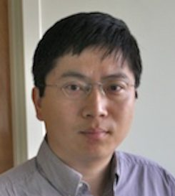
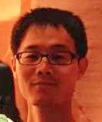
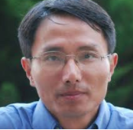
A Tale of Three Probabilistic Families
---Descriptive, Generative and Discriminative Image Models
Song-Chun Zhu
University of California, Los Angeles
ICIP, Beijing, September 19, 2017.
Yingnian Wu, Yang Lu, Zhuowen Tu

Slide 2









Popular practice in CV, PR, IP, ML:
Big-data for small-task
Tasks and Loss Functions
L_{a}
L_{b}
L_{c}
L_{d}
L_{e}
L_{f}
L_{g}
Using a model without understanding it is like
“crossing a mine field on a wild horse”.
$$I_{1}$$
human
$$I_{10}$$
Trained Models and Published Papers !
$$I_{{10}^{2}}$$
Image Data
Progress = $Δ×^{ \#}Data×^{ \#}Task$
$$I_{{10}^{3}}$$
performance
$$I_{{10}^{4}}$$
human
$$Δ$$
$$I_{{10}^{5}}$$
$$I_{{10}^{6}}$$

Slide 3
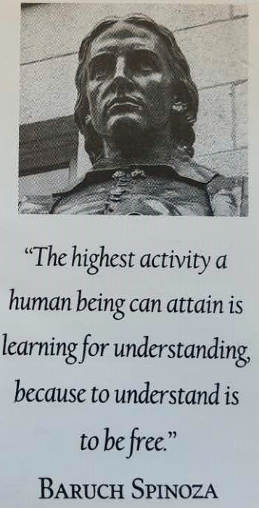
Questions that motivate this talk:
What are the structures of image space?
-- atomic concepts
-- topology or grammatic structures
-- regimes of models over scales
-- can we build a “telescope” ?
How tasks affect models?
-- across task training contaminating each other
-- roles of a neuron:
- filter, feature (descriptive)
- base function (generative)
- decision maker (discriminative)
-- IQ of the learner
Dutch philosopher
1632—1677

Slide 4
A Tale of Three Families:
Relations, interactions, and unification
descriptive
generative
discriminative

Slide 5
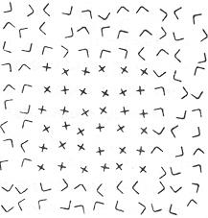

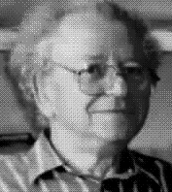
The tale starts with
Julesz’s quest I: What is a texture? 1962
“What features and statistics are characteristics of a
texture pattern, so that texture pairs that share the
same features and statistics cannot be told apart by
pre-attentive human visual perception?”
Bela Julesz [1928-2003]

Slide 6
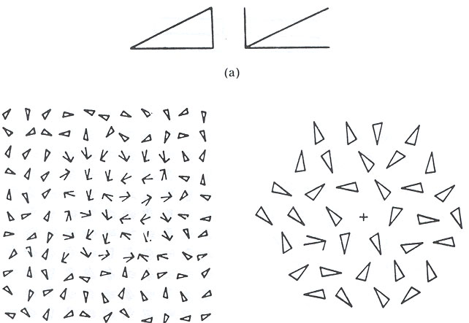
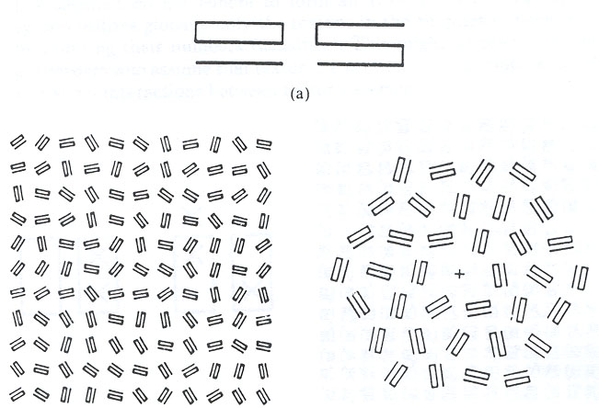
Julesz’s quest II: What is a texton? 1981
textons
Response time T
Julesz’s quests & random dot stereo-diagram
motivated Marr’s vision framework.
Distractors # n
textures
Response time T
Distractors # n

Slide 7
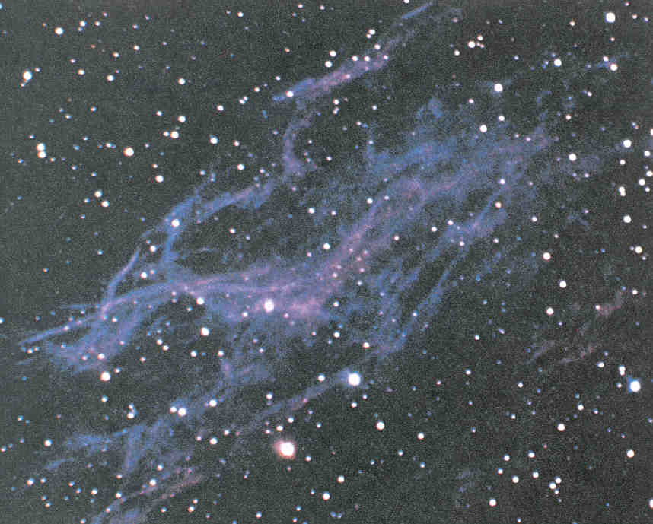
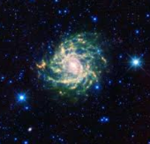
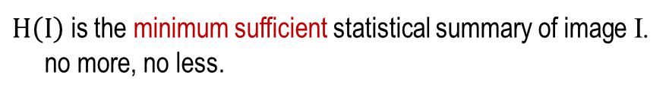


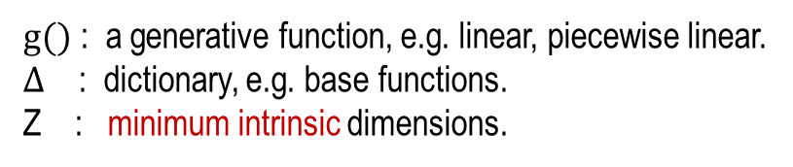
Atoms of perception
and atomic spaces in the image universe
A texture concept:
Family of Descriptive Models
$$Ω=\{I: H\left(I\right)=h_{o}\}$$
$H\left(I\right)$ is the minimum sufficient statistical summary of image I.
no more, no less.
A texton concept:
Family of Generative Models
$$Ω=\{I: I=g(z; Δ)\}$$
$g()$ : a generative function, e.g. linear, piecewise linear.
$Δ$ : dictionary, e.g. base functions.
Z : minimum intrinsic dimensions.
In general, images are compositional:
mixing texture and textons by Image grammar:
$$Ω^{com}=\{I: s→_{G}I\}$$

Slide 8
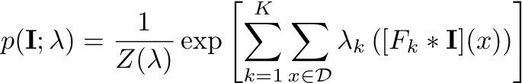

Family I: Descriptive models
A concept is a set or equivalence class of images:
$$Ω(h_{c})=\left\{I: H\left(I\right)=h_{c}\right\}.$$
$$+ ε for statistical fluctuation$$
This set derives a model:
MRF, Gibbs, Energy-based models, constraint satisfaction
Maximum entropy model
The set and model are equivalent.

Slide 9
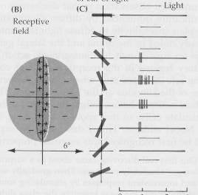
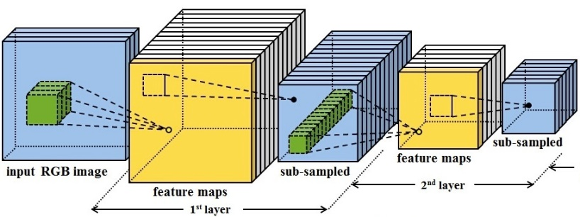


Searching for the minimum sufficient statistics of a texture
$$Ω(h_{c})=\{I: H\left(I\right)=h_{c}\}$$
$H\left(I\right)$ is the summary of image I.
1. Multi-pixel co-occurrence, cliques
k-gon statistics, Markov random fields 1970-80s
2. Linear filtering, Gabor, image pyramid,
Bergen and Adelson 1986,
Malik and Perona 1990.
Simoncelli et al. 1992.
3. Histograms of Gabor filters – V1
Heeger and Bergen, Siggraph 1995
Zhu, Wu, and Mumford 1996-98.
4. Responses of neurons in ConvNet
Lu, Zhu, Wu (2015)
Xie, Lu, Zhu, Wu (2016)

Slide 10
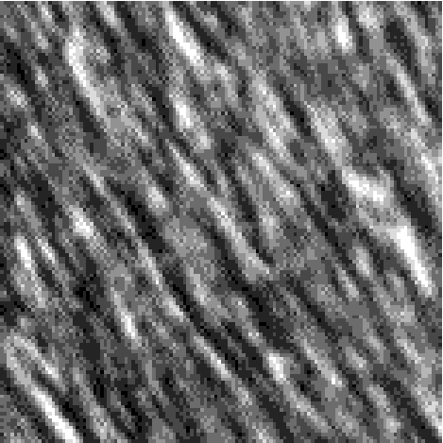
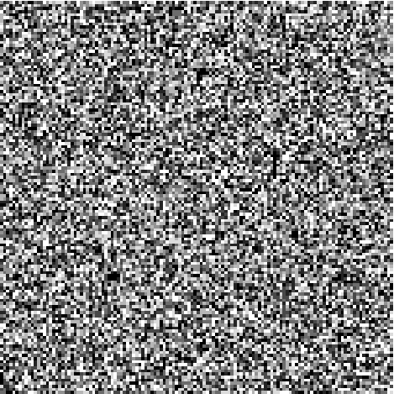
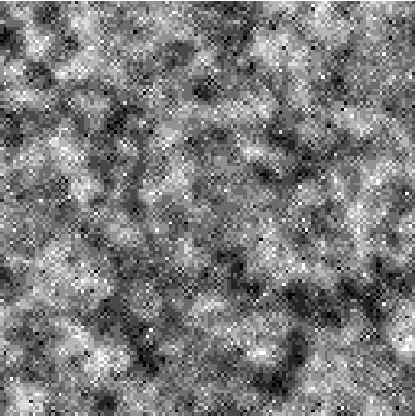
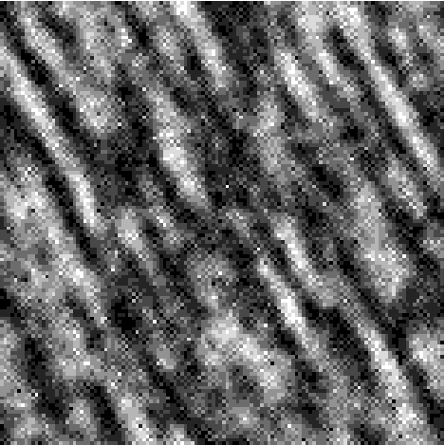
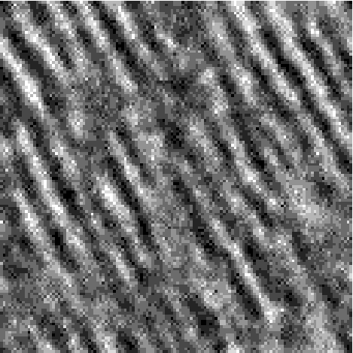
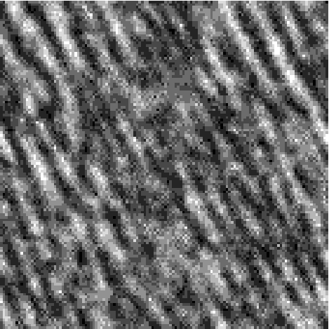
Pursuing the minimum sufficient feature statistics
h_{c} are histograms of Gabor filter responses
Analysis-by-synthesis
Pursue statistics until
you “cannot tell them apart
in pre-attentive vision”
-- Using neurons
pre-trained for general tasks.
I^{obs}
K=0
K=1
K=3
K=4
K=7
Zhu, Wu, and Mumford, “Minimax entropy principle and its applications to texture modeling,” 1996-97.

Slide 11
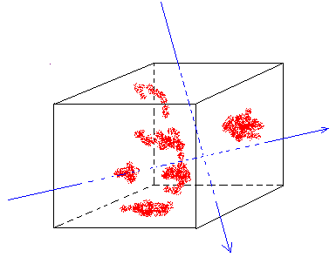
From the perspective of modeling and learning
Joint density (positive examples) in image space
projected (marginal)
densities 1D histograms
h₁
Non-linear
linear
h_{k}
h_{c} = (h₁, …, h_{k}).
Cramer and Wold theorem: Any continuous density is a linear combination
of its marginal distributions on the linear filter responses.

Slide 12
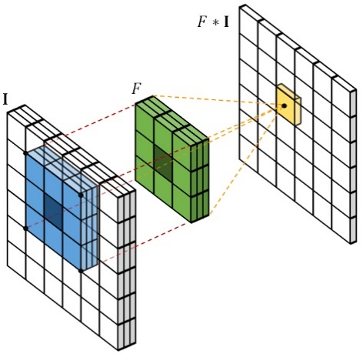
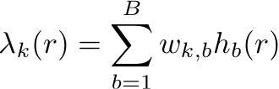
1-layer descriptive model: FRAME
-- Filters, Random field, And Maximum Entropy
h(): histogram bin indicator, rectification.
Markov random field, Gibbs distribution
Embedding neuron responses, not clique
Matching the marginal density of linear filter responses
Zhu, Wu, Mumford (1997)

Slide 13
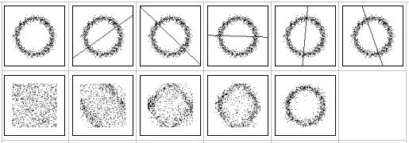
Toy Example II: Learning a 2D distribution
h₀=φ
+h₁
+h₂
+h₃
+h₄
+h₅ ?
Target
distribution
Model
pursuit
Matching marginal densities to learn a model in high-dimensional space !

Slide 14
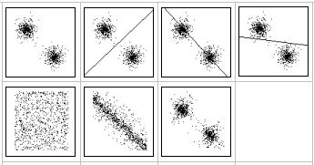
Toy Example I: Learning a 2D distribution
h₀=φ
+h₁
+h₂
+h₃ ?
Target
distribution
Model
pursuit
Matching marginal densities to learn a model in high-dimensional space !

Slide 15
Stochastic set is originated in statistical physics
Statistical physics studies macroscopic properties of systems.
e.g.: a tank of insulated gas or ferro-magnetic material
N = 10²³
A state of the system is specified by the position of the N elements X^{N} and their momenta p^{N}
S = (x^{N}, p^{N})
But we only care about some global properties
Energy E, Volume V, Pressure, ….
Micro-canonical Ensemble
Micro-canonical Ensemble = Ω(N, E, V) = { s : h(S) = (N, E, V) }
microscopic
state
macroscopic
summary

Slide 16
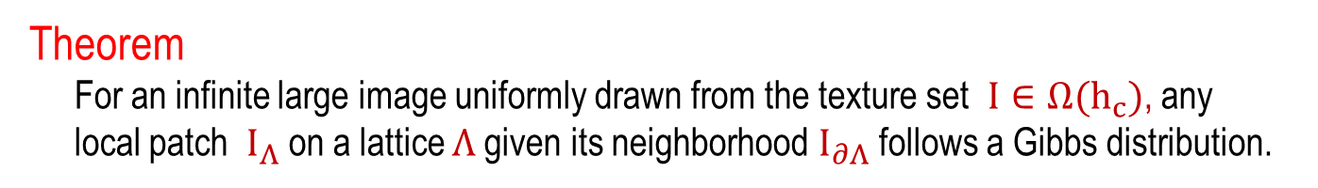
Equivalence of deterministic set and probabilistic models
“If a system of a great number of degrees of freedom is micro-canonically
distributed in phase, any very small part of it may be regarded as canonically
distributed” --- Gibbs, 1902.
Λ
Gibbs 1902,
Wu and Zhu, 2000
Z²
Theorem
For an infinite large image uniformly drawn from the texture set $I∈Ω(h_{c})$, any
local patch $I_{Λ}$on a lattice $Λ$given its neighborhood $I_{∂Λ}$ follows a Gibbs distribution.
Drop the neighborhood
and lattice for clarity.
a concept a set h_{c} a model λ
Y. N. Wu, S. C. Zhu, “Equivalence of Julesz Ensemble and FRAME models,” IJCV, 2000.

Slide 17
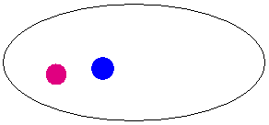
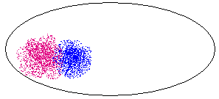


Relationship between a concept set and a model
statistical fluctuation
texture sets
texture models
$$Ω(h_{c})$$
Markov random fields and FRAME models on finite lattice (Zhu, Wu, Mumford, 1997):

Slide 18
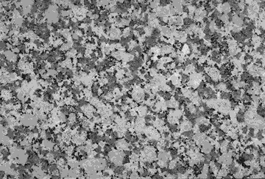
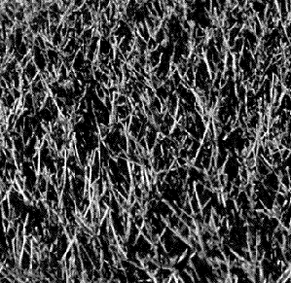
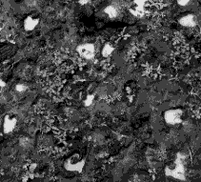
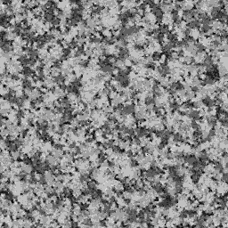
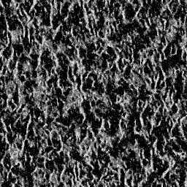
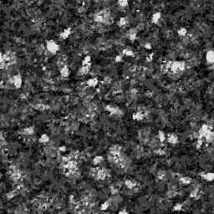
More examples: Analysis-by-synthesis
Learning descriptive model by matching histograms of Gabors
Zhu, Wu, Mumford, 1996-98
Observed
MCMC sample

Slide 19
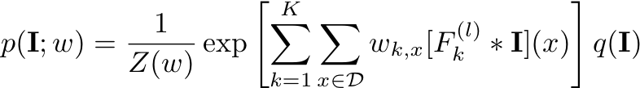
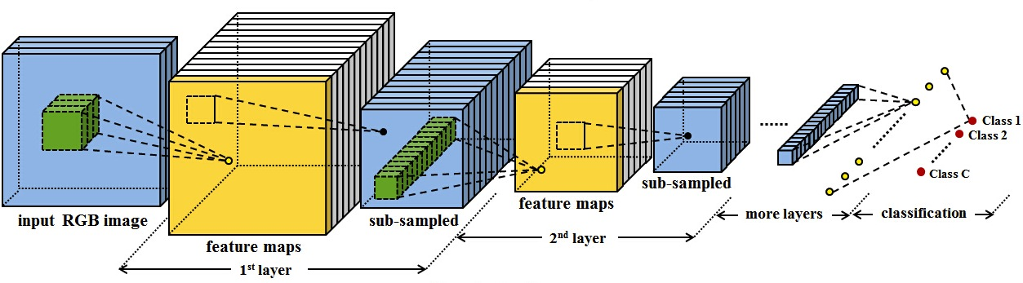
Multi-layer FRAME with pretrained CNN filters
q(I): reference (or negative) distribution, uniform or Gaussian
Pre-trained filters, e.g. VGG filters (after h() rectification)
More expressive than linear Gabor filters
Lu, Zhu, Wu (2015)
Bottom-up

Slide 20
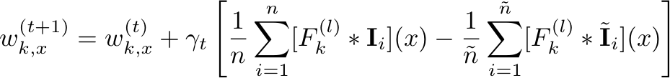
Learning deep FRAME: Analysis by synthesis
Observed statistics
Statistics of synthesis
Maximum likelihood learning algorithm (minimax entropy principle)
Generate synthetic examples from the current model
Update the model parameters based on the difference between
synthetic and observed data to make the dream data similar to real data
Lu, Zhu, Wu (2015)

Slide 21
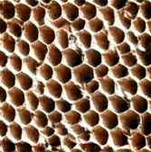
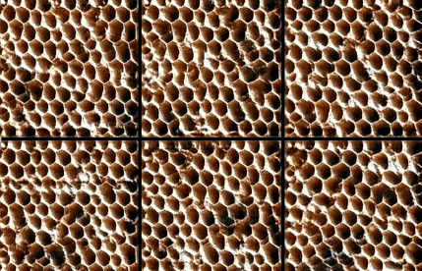
Learning deep FRAME with pre-trained CNN filters
Homogeneous model
Generate synthetic images from the current model by Langevin
Update the parameters to make synthetic examples similar to observed examples
Lu, Zhu, Wu (2015)

Slide 22
More examples: Learn a model for each category
1st image from training, 2nd and 3rd generated by learned model
Homogeneous model
obs
syn

Slide 23


Learning deep FRAME with pre-trained CNN filters
inhomogeneous model
Generate synthetic images from the current model by Langevin
Either cold start (from random) or warm start (from current)
Update the parameters to make synthetic examples similar to observed examples
Training examples: hummingbird images
Lu, Zhu, Wu (2015)

Slide 24
Learning deep FRAME with pre-trained CNN filters
inhomogeneous model
obs
syn
obs
syn
Learn a model for each category
top row 4 of training examples, bottom row 4 of synthesized examples

Slide 25
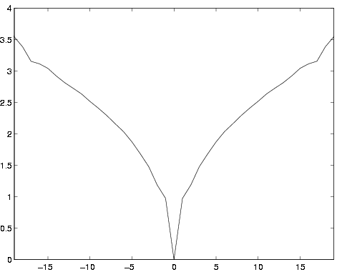
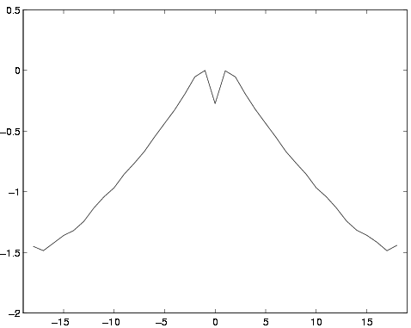
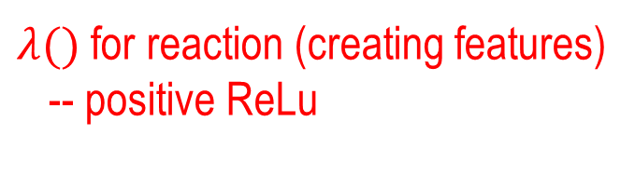
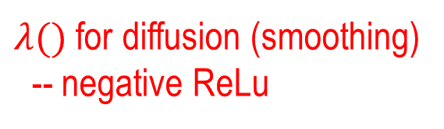
Learned free-form potential functions in 1-layer FRAME
$λ()$ for diffusion (smoothing)
-- negative ReLu
$λ()$ for reaction (creating features)
-- positive ReLu

Slide 26
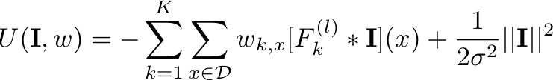
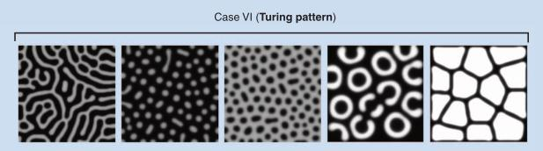
GRADE: Gibbs Reaction And Diffusion Equations
Zhu, Mumford (1998)
Langevin dynamics
U is energy function
U’ is derivative: computed efficiently by back-propagation
Sign of w:
reaction (creating patterns) and diffusion (smoothing)

Slide 27

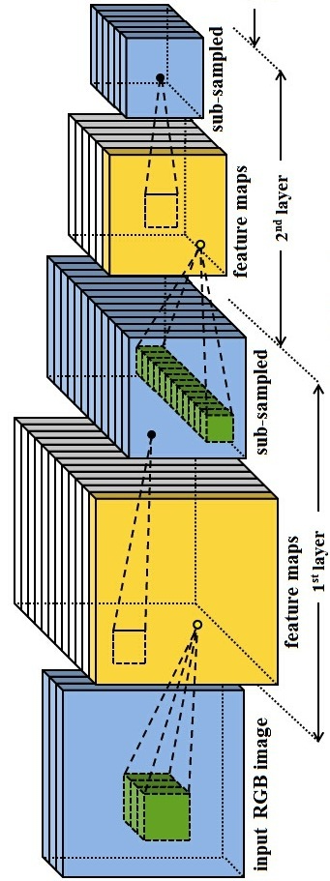
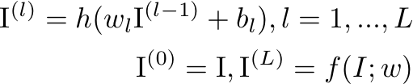
Deep FRAME: One step further
Learning all layers of filters from scratch
q(I): reference/negative, uniform or Gaussian white noise
f (I; w): bottom-up ConvNet with multiple layers of filters
h(): pointwise rectification, ReLU: binary decision
Xie, Lu, Zhu, Wu (2016)

Slide 28


Descriptive model: deep FRAME on ConvNet
For Gaussian white noise reference model q(I)

Slide 29
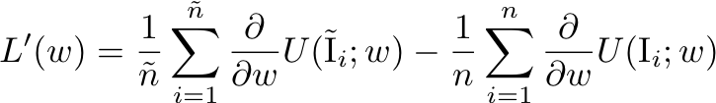

Maximum likelihood learning of Deep FRAME
Learning gradient
synthesized
observed
Sampling gradient
Langevin to synthesiz
Both gradients can be obtained by alternating back-prop (ABP).

Slide 30
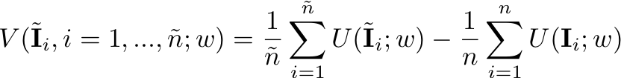
Adversarial interpretation: Both critic and actor are the same
Learning
gradient
sampling
gradient
Minimax game
Learning step seeks to increase V
Sampling step seeks to decrease V
Related to W-GAN, but unlike W-GAN, here the critic and actor are the same descriptive model

Slide 31


Deep FRAME: Learning all layers of filters from scratch
obs
syn
Learning a generative ConvNet/deep FRAME for each category
1st image: training; the rest 3: generated by the learned model
Layer-wise synthesis

Slide 32




Spatial-temporal Deep FRAME:
Learning spatial-temporal filters
obs
syn
Xie, Zhu, Wu (2017)
Learning a generative ConvNet/deep FRAME for each category
1st video: training; the rest 3: generated by the learned model

Slide 33




Deep FRAME: Learning all layers of filters from scratch
obs
syn

Slide 34




Property of the descriptive Deep FRAME model
Theorem: Deep FRAME model is piecewise Gaussian.
Yang Lu

Slide 35



Property of the descriptive Deep FRAME model
Theorem: The local modes of deep FRAME are auto-encoder
The deterministic part of Langevin dynamics
Yang Lu

Slide 36

Summary:
Model (set, concept) pursuit in the universe of images
f : target distribution; p: our model; q: initial model
image universe:
every point is an image.
1, q = unif()
2, q = δ()
3, q = negative
data set
model ~ image set ~ manifold ~ cluster
Shifting density (low energy regions) from synthetic data to observed data.

Slide 37

Family II: Generative Models
A texton concept:
$$Ω^{ex}=\{I: I=g(z; Δ)\}$$
$g()$ : a generative function, e.g. linear, piecewise linear.
$Δ$ : dictionary, e.g. base functions.
z : minimum intrinsic dimensions.

Slide 38

Sparse coding (Olshausen and Fields, 1995).
Learning an over-complete image basis from natural images
An image I is assumed to be a linear addition of some image bases
ψ_{i}, i=1,2, ……,n selected from an over-complete basis (dictionary).
I = Σ_{i} α _{i} ψ _{i} + n, α _{i} ~ p(α) iid
It was said that these learned bases resemble cells in primate V1.

Slide 39


Textons as lower dimensional sets or bounded subspaces
K is far smaller than the dimension n
of the image space.
ϕ is a basis function
from a dictionary.
subspace 2
subspace 1
e.g. Basis pursuit (Chen and Donoho 99), Lasso (Tibshirani 95),
Subspace learning (Yi Ma, Wain Wright).
1D
3D
2D

Slide 40








A second look at the atomic spaces
in the image universe
implicit manifolds
image space
+
+
+
explicit manifolds

Slide 41





Bigger textons: Active Basis, but still low dimensional
(a)
(b)
The elements are almost non-overlapping
Note: the template only represents an object at a fixed view and a fixed configuration.
When we allow the sketches to deform locally, the space becomes “swollen”.
Y.N. Wu, Z.Z. Si, H.F. Gong, and S.C. Zhu , “Learning Active Basis Model for Object Detection and Recognition,” IJCV, 2009.

Slide 42

Expanding to multi-layered ConvNet
Kingma, Welling, 2013 on VAE; Goodfellow, et al. 2014 on GAN
g is top-down generative ConvNet
Non-linear factor analysis
Cons:
The model is still a black-box,
without explicit multi-layer sparse variables.
Not parsing.

Slide 43



Learning generative model by MLE:
Notation swtich: X -- latent, Y -- image
Joint:
$$MLE minimizes KL\left(P_{data} \right| p_{G})$$

Slide 44


Alternating back-propagation: Langevin Inference and learning
Langevin inference:
Reconstruction:

Slide 45

Maximum likelihood by alternating back-prop
obs
syn
obs
syn
Alternating back-prop on latent variables and parameters:
More accurate inference than variational approximation,
but more computational cost.
Han, Lu, Zhu, Wu, 2017

Slide 46


Maximum likelihood by alternating back-prop
 | Chirp
Training
Synthesis

Slide 47
Comparison with other models: VAE and GAN
Langevin Inference
Regression to update
parameters
Variational auto-encoder (VAE)
Generative adversial network (GAN)
Cons:
Inaccurate inference.
Two sets of parameters.
Cons:
Only learns samples on classification boundary.
D.P. Kingma, M. Welling. Auto-Encoding Variational Bayes, ICLR, 2014.
Goodfellow et al. Generative Adversarial Nets. Advances, NIPS, 2014.

Slide 48
Family III: Discriminative models
Descriptive and generative models: unsupervised learning
with only positive examples.
Classifier, discriminative ConvNet
Bottom-up feature maps + softmax (logistic)
Need supervision via class labels
Bottom-up

Slide 49


Descriptive models ←→ descriminative boosting
FRAME
Zhu, Wu, and Mumford 1996-98
AdaBoost
Freund and Schapire 1995, Friedman et al. 1998
Both have the feature selection procedure (greedy).
Both follow the maximum-likelihood principle (arguable).
Generative models focus on single class of interest.
But Boosting is much easier to use since its normalization term is on y.

Slide 50



Descriptive ←→ discriminative ConvNets
Descriptive models for two classes:
2 categories, p1 and p0, prior for 1 is
Posterior prob = logistic regression ConvNet

Slide 51


Learning generative models via discriminative pursuit
Bayes rule:
Drop the prior ratio
Discriminative pursuit
Boosting
negative or uniform
Zhuowen Tu, “Learning Generative Models via Discriminative Approaches”, CVPR, 2007.

Slide 52










Toy Example III: Learning a 2D distribution
Reference Distribution
negatives
Bootstrapping/sampling
negatives
Bootstrapping/sampling
negatives
Discriminative Model
Discriminative Model
Discriminative Model
positives
positives
positives
Target Distribution
Learned Model
Zhuowen Tu, “Learning Generative Models via Discriminative Approaches”, CVPR, 2007.

Slide 53




Using CNN for discriminative training
Initial Classification (given training data)
Final Classification
Classification
Convolutional Neural Networks
synthesize pseudo-negative samples

Slide 54



Experiments: Outperforming ResNet
SVHN
MNIST
CIFAR

Slide 55


Experiments: Using descriptive model for classification
--- outperforming ResNet
ResNet as baseline.
Cifar-10 dateset
SVHN dateset
Jin, Lazarow, and Tu, “Introspective Learning for Discriminative Classification”, NIPS 2017.

Slide 56






Learning descriptive model by discriminative introspective networks.
Input
texture
texton
Learning

Slide 57
Summary: A Tale of Three Families
Flat concept
descriptive
CoopNet
generative
GAN
INN
discriminative
No hierarchical concept or parsing, even though many layers of ConvNet.
Not parsimoneous model.
The three models converges to one, based on MLE and Bayes rule.

Slide 58
Summary: A Tale of Three Families
Joint parsing
Context sensitive grammar
descriptive
generative
contextual
hierarchy
Bottom-up proposals for joint parsing
Data-Driven MCMC
discriminative
marginal posterior probability

Slide 59










Continuous entropy spectrum
Texton regime Texture regime
Scaling (zoom-out)
Scaling increases imperceptibility and triggers perceptual transitions !
A concept is perceptible (stably) only in a finite lifespan (scale interval).
Ref: Y.N. Wu, C.E. Guo, and S.C. Zhu, “From Information Scaling of Natural Images to Regimes of Statistical Models,” Quarterly of Applied Mathematics, 2007.

Slide 60






Simulation: regime transitions in scale space
scale 1
scale 2
scale 3
scale 4
scale 5
scale 6
scale 7
We need a seamless transition between different regimes of models

Slide 61
Most parsimoneous model over scales
Low Middle High
Number of clusters found

Slide 62
Building a “telescope” to look into the image space
Number of local minima & their energy levels
Depth of energy basin (perceptual stability)
Energy barriers between basins
Probability mass / volume of basins
Becker and Karplus, Chemical Physics, 1997.
Notes:
Why we care about the energy landscape
Energy Landscape Map (ELM) better name
Disconnectivity Graph (DG) from physics
Call it ELM
“DG is a term used for Dependency Grammar in our domain.
And disconnectivity Graph from Physics is not very intuitive.
Therefore I suggested you to use ELM.”

Slide 63



Building a “telescope” to look into the image space
probability mass
volume of basins
Povlovskia, Tu and Zhu, EMMCVPR, 2014.
Notes:
Why we care about the energy landscape
Energy Landscape Map (ELM) better name
Disconnectivity Graph (DG) from physics
Call it ELM
“DG is a term used for Dependency Grammar in our domain.
And disconnectivity Graph from Physics is not very intuitive.
Therefore I suggested you to use ELM.”

Slide 64

Landscape training on MNIST 0-9
(64x64 images, 8-dim latent space)

Slide 65



Slide 66



















Mapping the landscape of Ivy at multi image scales
scale 7
scale 4
Texture
Texton
Original Image
scale 1
32 x 32 patches

Slide 67

Landscape of Ivy at scale 4

Slide 68

Comparing landscape complexity and stability at scales 1, 4, 7
Scale 1 and 4 (Texton):
Landscapes collapse from
infinite minima to a single
basin at a similar rate
Scale 7 (Texture):
Landscape collapses quickly at first, but has the longest tail for stable basins
Log #basins at certain depth
Log depth of basin = perceptibility = stability

Slide 69
















Fully unsupervised learning with compositional model
Four common templates from 20 images
Hong, et al. “Compositional sparsity for learning from natural images,” 2013.

Slide 70

Unsupervised Learning of AND-OR Templates
Si and Zhu, PAMI, 2013

Slide 71
Summary: a unifying mathematical foundation
regimes of representations / models
Logics
Reasoning
Common Sense: Physics, Functions,
Causality, Intentionality, utility
Cognition
Stochastic grammar
partonomy,
taxonomy,
relations
Recognition
Generative
(low-D manifolds,
textons)
Descriptive
(hi-D manifolds,
textures)
Coding

