Slide 1
Visual Representation
Song-Chun Zhu
The Frontiers of Vision Workshop, August 20-23, 2011

Slide 2


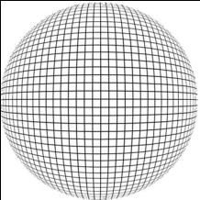

Marr’s observation: studying vision at 3 levels
Visual
Representations
Algorithms
Implementation
tasks
The Frontiers of Vision Workshop, August 20-23, 2011

Slide 3
Representing Two Types of Visual Knowledge
Axiomatic visual knowledge: ---- for parsing
e.g. A face has two eyes
Vehicle has four subtypes: Sedan, hunchback, Van, and SUV.
Domain visual knowledge: : ---- for reasoning
e.g. Room G403 has three chairs, a table, ….
Sarah ate cornflake with milk as breakfast, …
A Volve x90 parked in lot 3 during 1:30-2:30pm, …

Slide 4
Issues
1, General vs. task-specific representations
---- Do we need levels of abstraction between features and categories;
An observation: popular research in the past decade were mostly task-specific,
and had a big setback to general vision.
2, What are the math principles/requirements for a general representation?
---- Why are grammar and logic back to vision?
3, Challenge: unsupervised learning of hierarchical representations
---- How do we evaluate a representation, especially for unsupervised learning.

Slide 5
Deciphering Marr’s message
The backbone for general vision
where
2.1D
Sketch
2.5D
Sketch
3D
Sketch
Scaling
Texture
Primal Sketch
Texton
(primitives)
HiS
Parts
Objects
Scenes
what
In video, one augments it with event and causality.

Slide 6
Textures and textons in images
texture clusters (blue)
primitive clusters (pink).
Zhu, Shi and Si, 2009

Slide 7
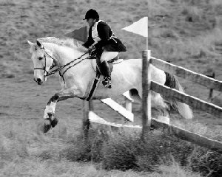

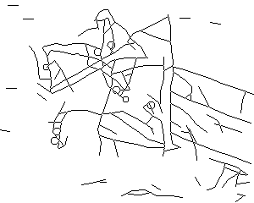

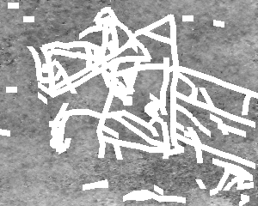
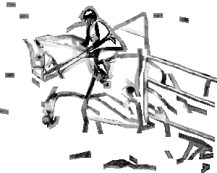
Primal sketch: a token representation conjectured by Marr
org image
sketching pursuit process
sketches
=
+
syn image
synthesized textures
sketch image

Slide 8
Mathematics branches for visual representation
regimes of representations / models
Reasoning
Logics
(common sense, domain knowledge)
Cognition
Stochastic grammar
partonomy,
taxonomy,
relations
Recognition
Sparse coding
(low-D manifolds,
textons)
Markov, Gibbs Fields
(hi-D manifolds,
textures)
Coding/Processing

Slide 9
Schedule
Erik Learned-Miller | Low level Vision
Benjamin Kimia | Middle level vision
Alex Berg | middle level Vision
Derek Hoiem | high level vision
Song-Chun Zhu | Conceptualization by Stochastic sets
Pedro Felzenszwalb | Grammar for objects
Sinisa Todorovic | Probabilistic 1st Order Logic
Trevor Darrel
Josh Tenenbaum | Probabilistic programs
Discussion 25 minutes

Slide 10
Visual Conceptualization with Stochastic Sets
Song-Chun Zhu
The Frontiers of Vision Workshop, August 20-23, 2011.

Slide 11

Cognition: how do we represent a concept ?
In Mathematics and logic, concepts are equal to deterministic sets, e.g. Cantor, Boole, or spaces in continuous domain, and their compositions through the “and”, “or”, and “negation” operators.
But the world to us is fundamentally stochastic !
Especially, in the image domain !
Ref. [1] D. Mumford. The Dawning of the Age of Stochasticity. 2000.
[2] E. Jaynes. Probability Theory: the Logic of Science. Cambridge University Press, 2003.

Slide 12
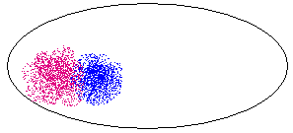
Stochastic sets in the image space
How do we define concepts as sets of image/video:
e.g. noun concepts: human face, willow tree, vehicle ?
verbal concept: opening a door, making coffee ?
image space
What are the characteristics of such sets ?
A point is an image or a video clip
Observation: This is the symbol grounding problem in AI.

Slide 13
1, Stochastic set in statistical physics
Statistical physics studies macroscopic properties of systems
that consist of massive elements with microscopic interactions.
e.g.: a tank of insulated gas or ferro-magnetic material
N = 10²³
A state of the system is specified by the position of the N elements X^{N} and their momenta p^{N}
S = (x^{N}, p^{N})
But we only care about some global properties
Energy E, Volume V, Pressure, ….
Micro-canonical Ensemble
Micro-canonical Ensemble = Ω(N, E, V) = { s : h(S) = (N, E, V) }

Slide 14






It took us 30-years to transfer this theory to vision
h_{c} are histograms of Gabor filters
I^{obs}
I^{syn} ~ Ω(h) k=0
I^{syn} ~ Ω(h) k=1
I^{syn} ~ Ω(h) k=3
I^{syn} ~ Ω(h) k=4
I^{syn} ~ Ω(h) k=7
(Zhu,Wu, Mumford 97,99,00)

Slide 15
Equivalence of deterministic set and probabilistic models
Gibbs 1902,
Wu and Zhu, 2000
Λ
Z²
Theorem 1
For a very large image from the texture ensemble any
local patch of the image given its neighborhood follows a conditional
distribution specified by a FRAME/MRF model
Theorem 2
As the image lattice goes to infinity, is the limit of the
FRAME model , in the absence of phase transition.
Ref. Y. N. Wu, S. C. Zhu, “Equivalence of Julesz Ensemble and FRAME models,” Int’l J. Computer Vision, 38(3), 247-265, July, 2000

Slide 16
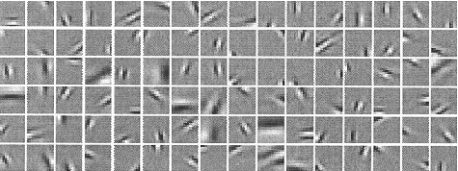














2, Stochastic set from sparse coding (origin: harmonic analysis)
Learning an over-complete image basis from natural images
I = Σ_{i} α _{i} ψ _{i} + n
(Olshausen and Fields, 1995-97)
Textons
.
B. Olshausen and D. Fields, “Sparse Coding with an Overcomplete Basis Set: A Strategy Employed by V1?” Vision Research, 37: 3311-25, 1997.
S.C. Zhu, C. E. Guo, Y.Z. Wang, and Z.J. Xu, “What are Textons?” Int'l J. of Computer Vision, vol.62(1/2), 121-143, 2005.

Slide 17

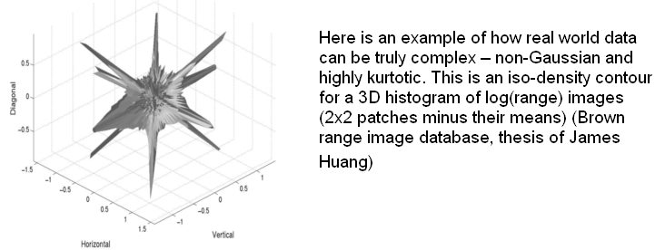
Lower dimensional sets or subspaces
K is far smaller than the dimension
of the image space.
ϕ is a basis function
from a dictionary.
subspace 2
subspace 1

Slide 18



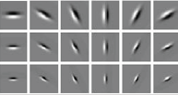
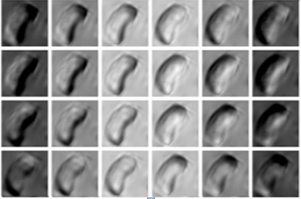



A second look at the space of images
implicit manifolds
image space
+
+
+
explicit manifolds

Slide 19
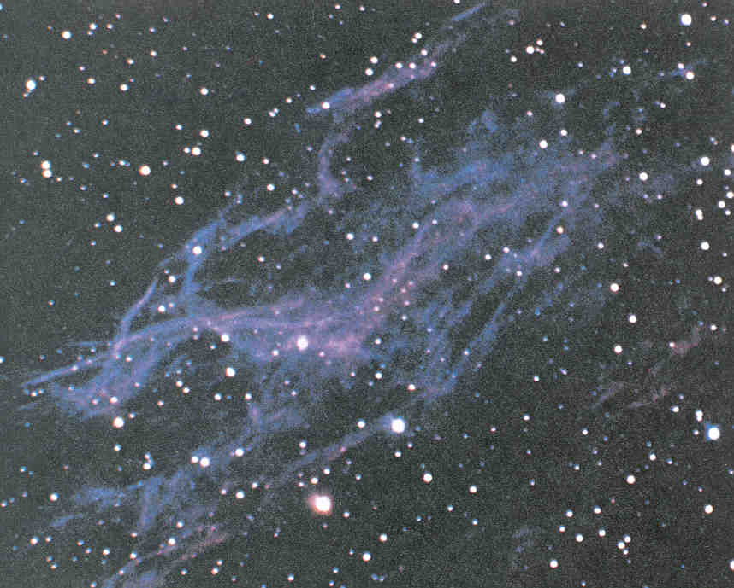





Two regimes of stochastic sets
I call them
the implicit vs. explicit manifolds

Slide 20



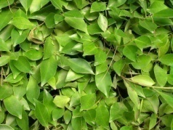
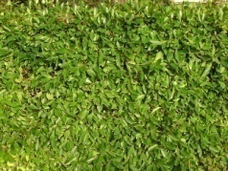
Supplementary: continuous spectrum of entropy pattern
Scaling (zoom-out) increases the image entropy (dimensions)
Where are the HoG, SIFT, LBP good at?
Ref: Y.N. Wu, C.E. Guo, and S.C. Zhu, “From Information Scaling of Natural Images to Regimes of Statistical Models,”
Quarterly of Applied Mathematics, 2007.

Slide 21
3, Stochastic sets by And-Or composition (Grammar)
A
Or-node
A ::= aB | a | aBc
A production rule
can be represented by
an And-Or tree
A₁
A₂
A₃
And-nodes
B₁
B₂
Or-nodes
a₁
a₂
a₃
c
terminal nodes
The language is the set of all valid configurations derived from a note A.

Slide 22
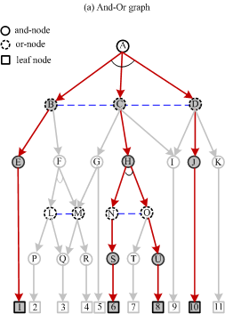
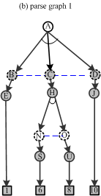
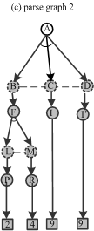
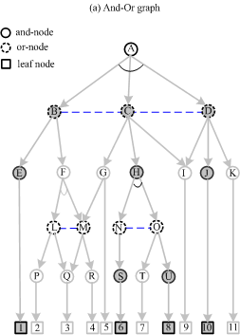


And-Or graph, parse graphs, and configurations
Zhu and Mumford, 2006

Slide 23
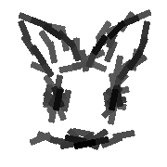

Each category is conceptualized to a grammar whose language defines a set or “equivalence class” of all valid configurations
How does the space of a compositional set look like?
Union space (OR)
f
a
g
d
b
e
a
d
Product space (AND)
c
e
By Zhangzhang Si 2011

Slide 24

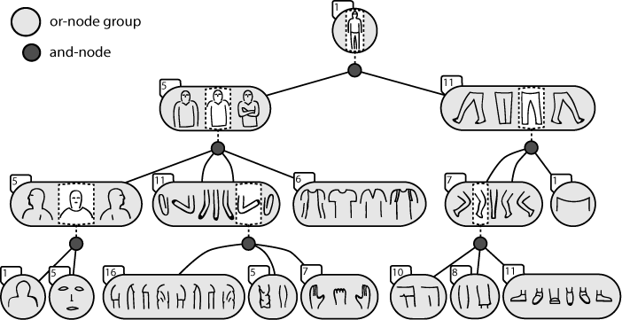
Spatial-AoG for objects: Example on human figures
Rothrock and Zhu, 2011

Slide 25
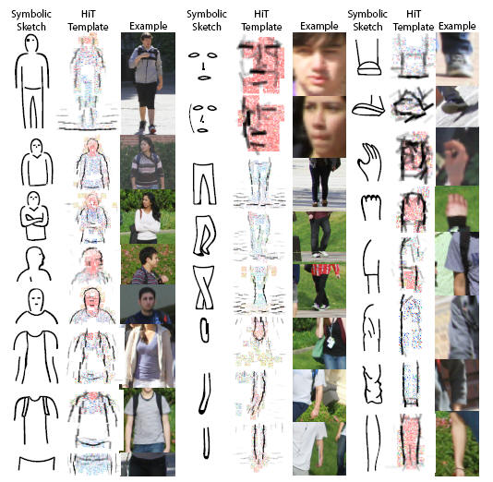
Appearance model for terminals, learned from images
Grounding the symbols

Slide 26
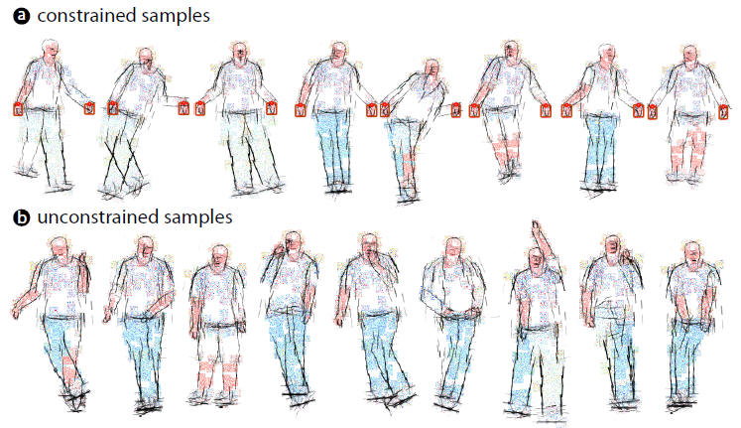
Synthesis (Computer Dream) by sampling the S-AoG
Rothrock and Zhu, 2011

Slide 27
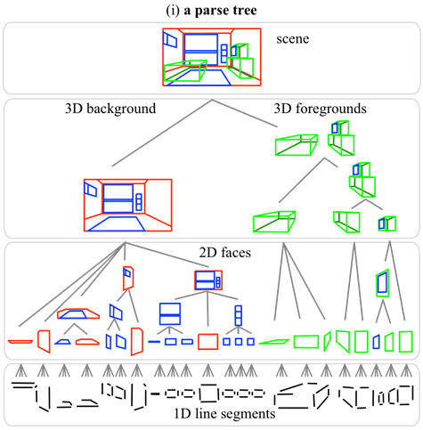
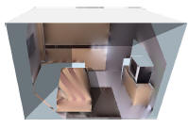
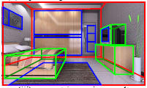
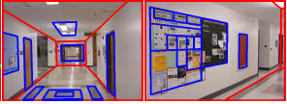
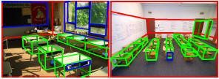
Spatial-AoG for scene: Example on indoor scene configurations
3D reconstruction
Results on the UCLA dataset
Zhao and Zhu, 2011

Slide 28
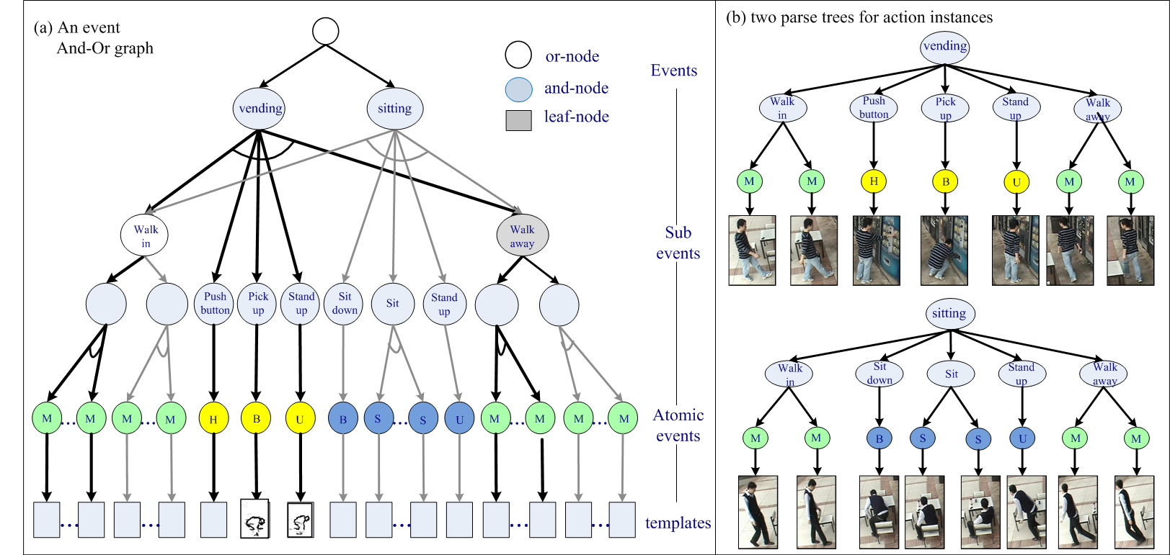
Temporal AoG for action / events
Ref. M. Pei and S.C. Zhu, “Parsing Video Events with Goal inference and Intent Prediction,” ICCV, 2011.

Slide 29
Causal-AOG: learned from from video events
Causality between actions and fluent changes.
Fluent
fluent
Fluent Transit Action
Action
Door fluent
Light fluent
Screen fluent
close
open
on
off
off
on
A₀
A₁
A₀
A₂
A₀
A₃
A₀
A₄
A₀
A₅
A₀
A₆
a₀
a₁
a₀
a₁
a₀
a₆
a₀
a₇
a₀
a₁₀
a₀
a₈
a₉
a₁₀
a₂
a₃
a₄
a₅
a₃

Slide 30
Summary: Visual representations
Axiomatic knowledge: textures, textons + S/T/C And-Or graphs
Domain Knowledge: parse graphs
Temporal
[ parse graphs]
Causal
Spatial

Slide 31
Capacity and learnability of the stochastic sets
1, Structures of the image space
2, Structures and capacity of the model (hypothesis) space
3, Learnability of the concepts
Image space
Representation space
H_{ε}
H(smp(m))

Slide 32

Learning = Pursuing stochastic sets in the image universe
f : target distribution; p: our model; q: initial model
image universe:
every point is an image.
1, q = unif()
2, q = δ()
model ~ image set ~ manifold ~ cluster

Slide 33
A unified foundation for visual knowledge representation
regimes of representations / models
Reasoning
Logics
(common sense, domain knowledge)
Cognition
Stochastic grammar
partonomy,
taxonomy,
relations
Recognition
Sparse coding
(low-D manifolds,
textons)
Markov, Gibbs Fields
(hi-D manifolds,
textures)
Coding

