Slide 1
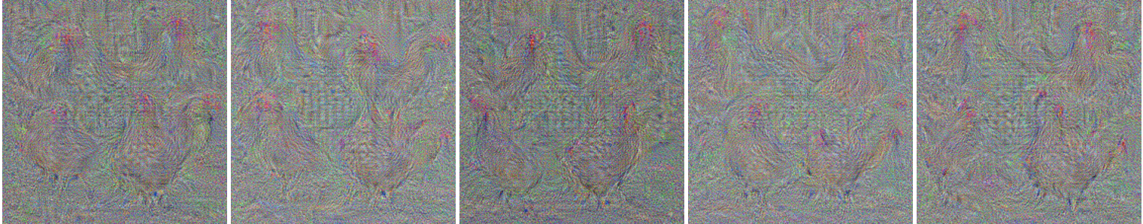
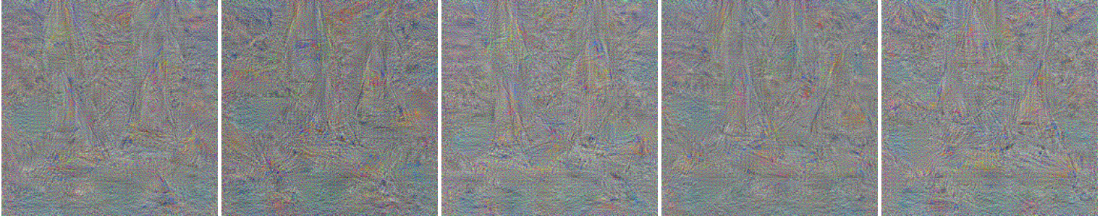
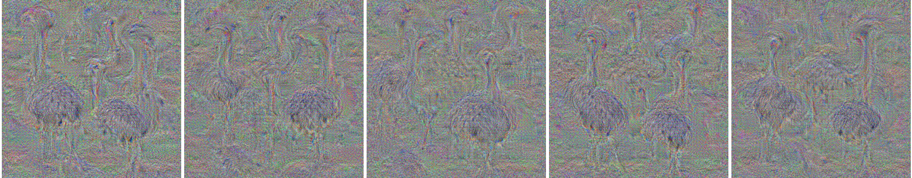
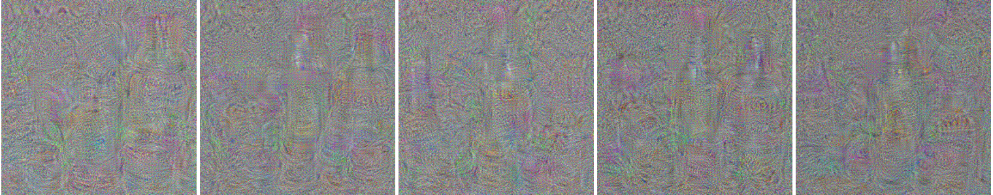
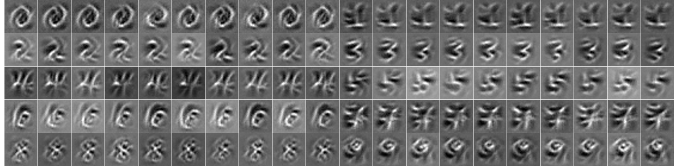
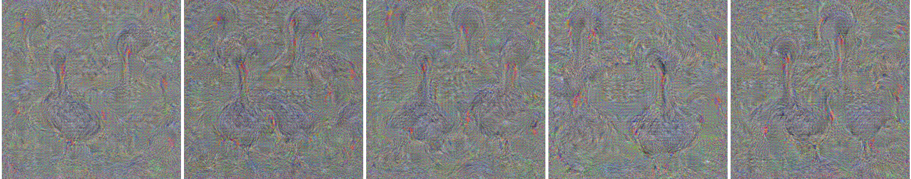
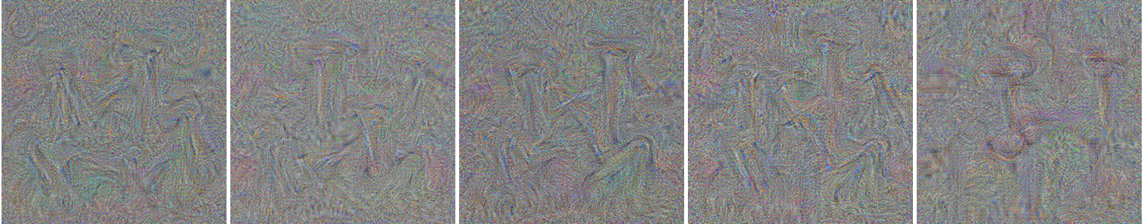
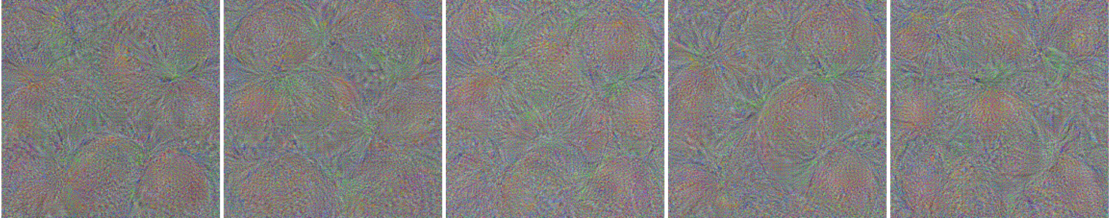
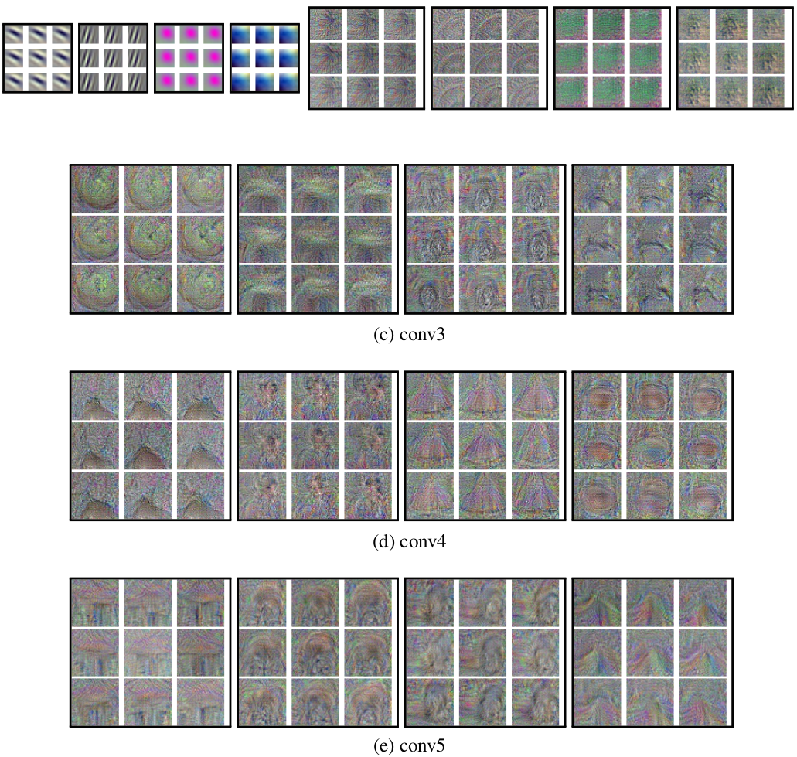
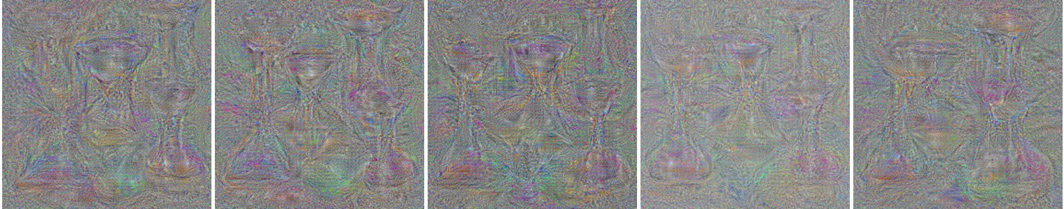
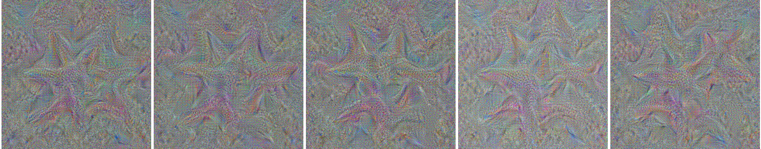
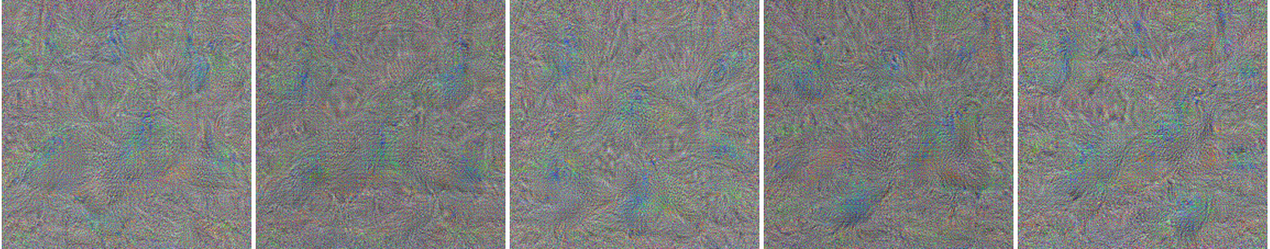
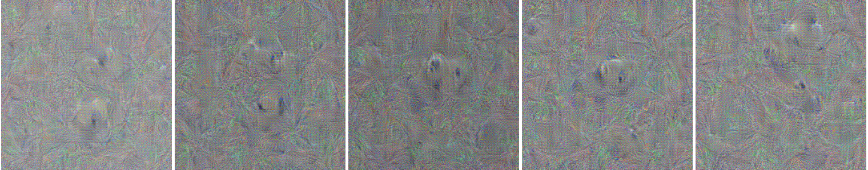
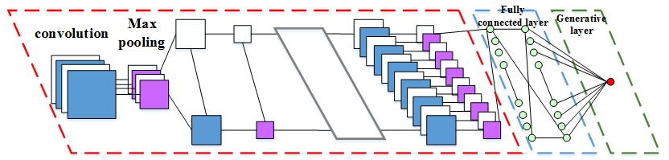
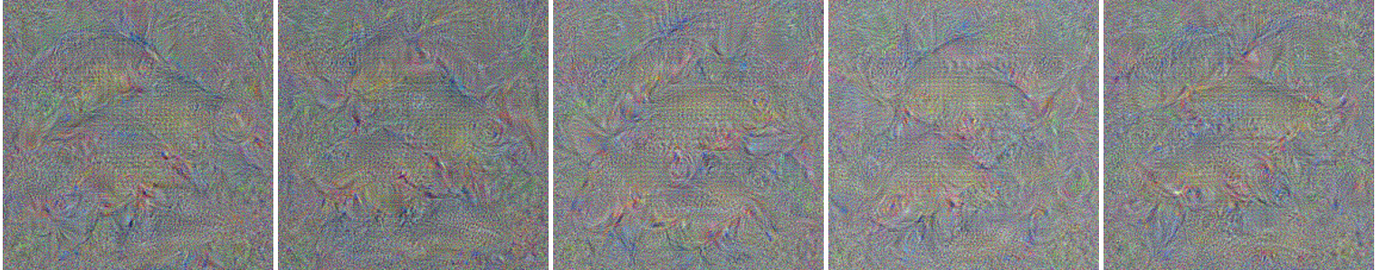
Generative Modeling of Convolutional Neural Networks
Jifeng Dai¹, Yang Lu² and Ying Nian Wu²
1 Microsoft Research, 2 University of California, Los Angeles
Objectives
Results
Results
Results
Generative Modeling CNN using exponential family model.
Non-parametric generative gradient for pre-training CNN.
Visualizing CNN by drawing samples from parametric generative CNN.
Generative pre-training on MNIST
Generative pre-training on Image-Net
Visualization on MNIST via HMC
Visualization on Alexnet via HMC
Layer 1
Layer 2
Layer 3
Layer 4
Layer 5
Visualization via HMC/Langevin (Category)
Hen
Ostrich
Goose
Orange
Hour-Glass
Star Fish
Peacock
Panda
Tench Fish
Boat
Lotion
Nail
Methods | DG | GG | GG+DG
Error | 1.03 | 0.85 | 0.78
Methods | DG | GG | GG+DG
AlexNet | 40.7 | 45.8 | 39.6
ZelierNet | 38.4 | 44.3 | 37.4
Methods
Probability distribution of generative CNN.
Discriminative gradient
Generative gradient
Generative gradient based on importance sampling.
Batch training and generative layer
Discussions
We show that a simple generative model can be constructed based on the CNN. The generative model helps to pre-train the CNN. It also helps to visualize the knowledge of the learned CNN.
The proposed visualizing scheme can sample from the generative model, and it may be turned into a parametric generative learning algorithm, where the generative gradient can be approximated by samples generated by the current model.
References
Erhan, Dumitru, Bengio, Yoshua, Courville, Aaron, and Vincent, Pascal. Visualizing higher-layer features of a deep network. Dept. IRO, Universite de Montreal, Tech. Rep, 2009. 8
Hinton, Geoffrey, Osindero, Simon, Welling, Max, and Teh, Yee-Whye. Unsupervised discovery of nonlinear structure using contrastive backpropagation. Cognitive science, 30(4):725–731, 2006b.
Krizhevsky, Alex, Sutskever, Ilya, and Hinton, Geoffrey E. Imagenet classification with deep convolutional neural networks. In Advances in neural information processing systems, pp. 1097–1105, 2012.
Simonyan, Karen, Vedaldi, Andrea, and Zisserman, Andrew. Deep inside convolutional networks: Visualising image classification models and saliency maps. Workshop at International Conference on Learning Representations, 2014.
Acknowledgement
The work is supported by NSF DMS 1310391, ONR MURI N00014-10-1-0933, DARPA MSEE FA8650-11-1-7149.

