Slide 1

A look at statistical models for the spread of Covid-19 in Los Angeles County.
1. LA County modeling group and its goals.
2. SEIR and Hawkes models.
3. LA County projections.
4. Pros and cons of SEIR and Hawkes models.
5. Doubling time.
6. Triggering time.
Frederic Schoenberg, UCLA. www.stat.ucla.edu/~frederic
Thanks to Adam Chaffee, Joshua Gordon, Ryan Harrigan, Marc Hoffmann,
Andy Kaplan, Conor Kresin, Junhyung Park, Baichuan Yuan.

Slide 2
1. LA County Modeling Group.
Team.
Purpose.

Slide 3
….

Slide 4
Healthcare System Capacity
Excluding NICU, Behavioral Health, and Rehabilitation
19,778
2,264
255
976
18,576
1,799
198
745
Non-DHS
465
57
DHS
1,202
* Excludes 141 in EMS Agency Warehouse

Slide 5
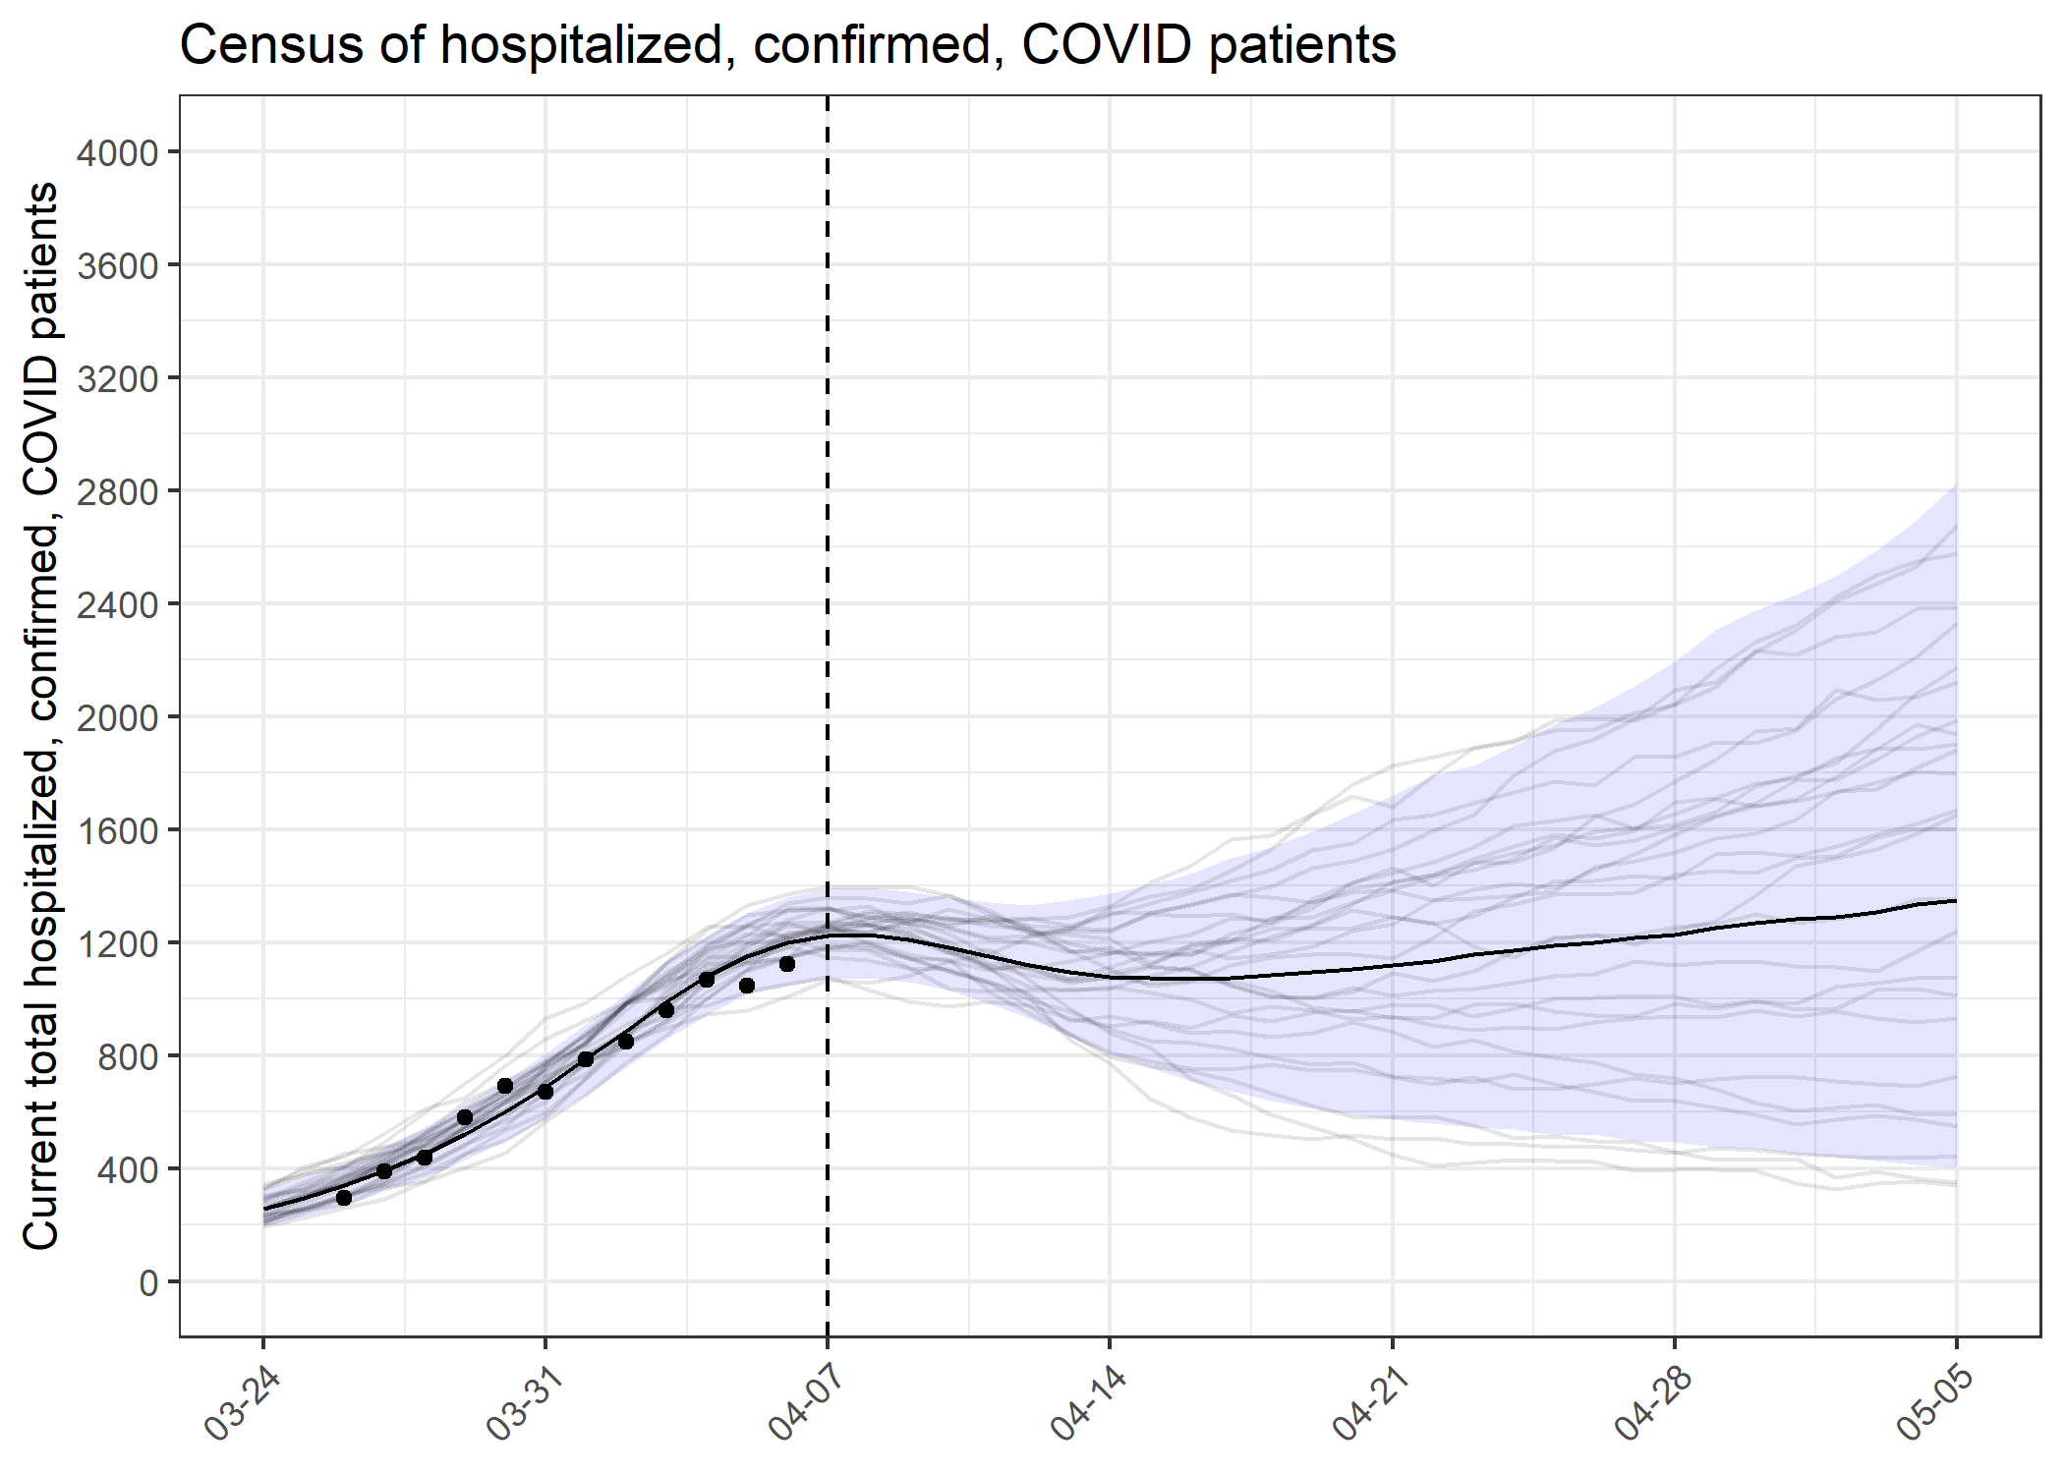
Predictions of Demand in LA County: Hospital Beds
Capacity: 2,264 plus Current Patients
Caveat: Simultaneous demand strongly depends on average length of stay

Slide 6
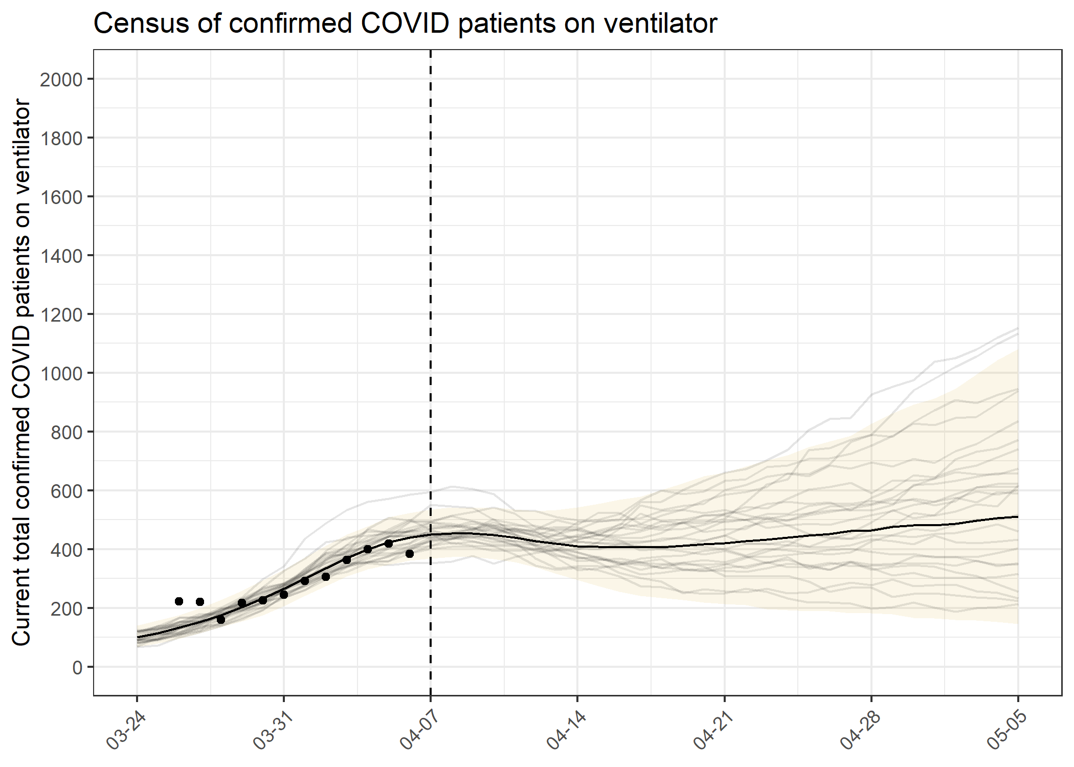
Predictions of Demand in LA County: Ventilators
Capacity: 976 plus Current Patients
Caveat: Simultaneous demand strongly depends on average length of time on ventilator

Slide 7
2. SEIR and Hawkes models.
SEIR type models commonly used and standard.
Hawkes models have smaller forecast errors.

Slide 8
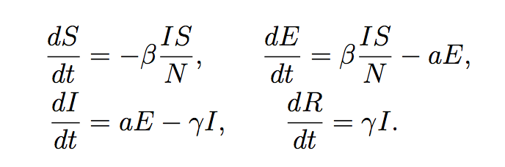

2. SEIR compartmental models and Hawkes models.
Susceptible
Exposed
(incubation
2-12 days)
Infectious
(10 to 30 days)
Recovered
….
R is the reproduction number, or productivity.

Slide 9
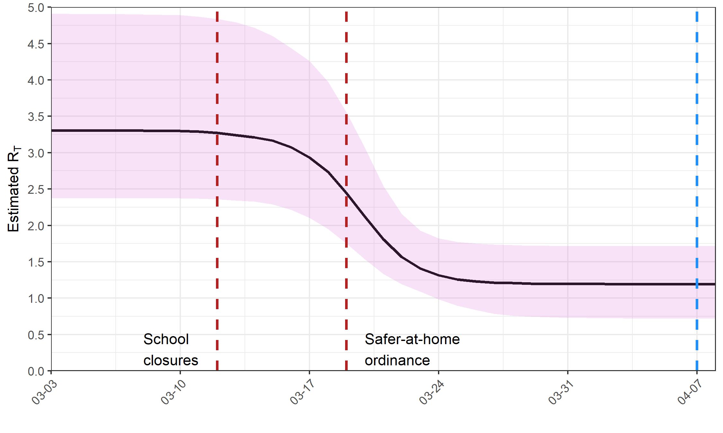
Fall in Effective R₀ from Social Distancing

Slide 10

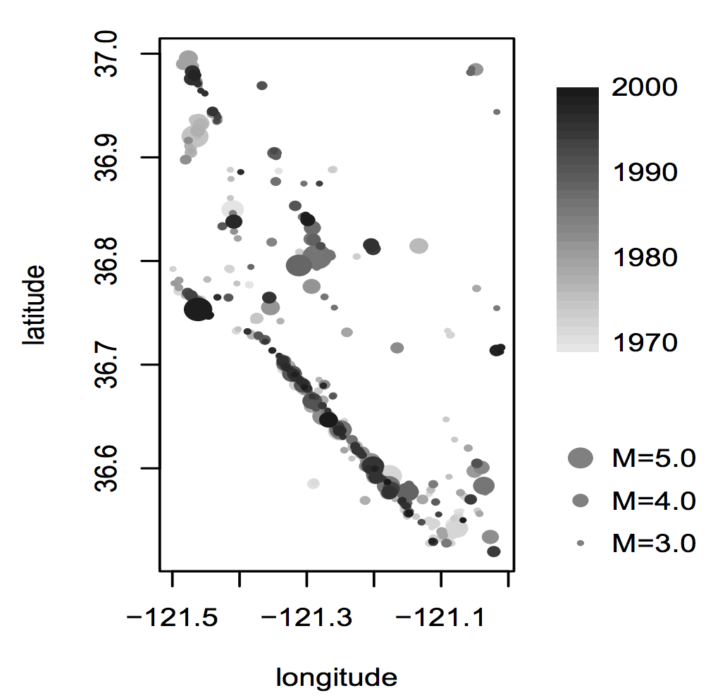
Hawkes and recursive models.
A Hawkes process or self-exciting process
has conditional rate
λ(t,x,y) = µ(x,y) + κ∑_{{t',x',y':} _{t'} _{< t}} g(t-t',x-x',y-y').
Alan Hawkes
g is called the triggering density and κ is the productivity.
If κ is constant, then κ is the expected fraction of points attributed to triggering.
κ is the expected number of points triggered directly by each point.
Each background point, associated with µ(x,y),
is expected to generate κ + κ² + κ³ + ... = 1/(1-κ) - 1
triggered points, so the exp. fraction of background
pts is 1-κ.
For HawkesN, the rate is multiplied by
1 – the proportion of the population already infected.
For the recursive model, K(t) = λ(t)^{-p}.

Slide 11
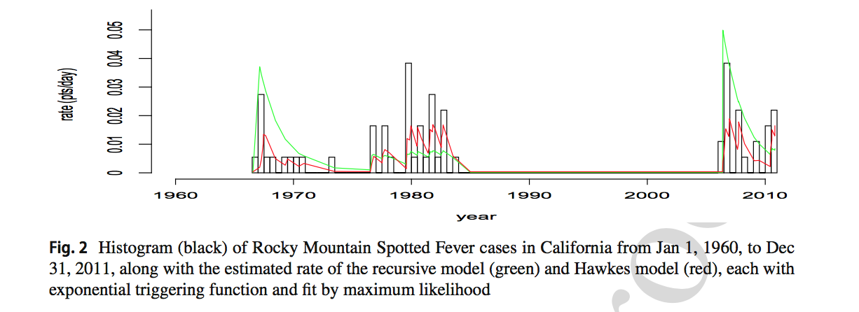
Recursive process.
When the epidemic is at its peak, the infection rate is high and one might expect the rate of transmission per infected person to be lower due to human efforts at containment, intervention, awareness, and herd immunity.
Consider a model where the productivity at time t is inversely related to the conditional rate at time t. Since the conditional rate in turn depends critically on this productivity, we call the model recursive.
For the Recursive model, K(t) = λ(t)^{-p}.

Slide 12
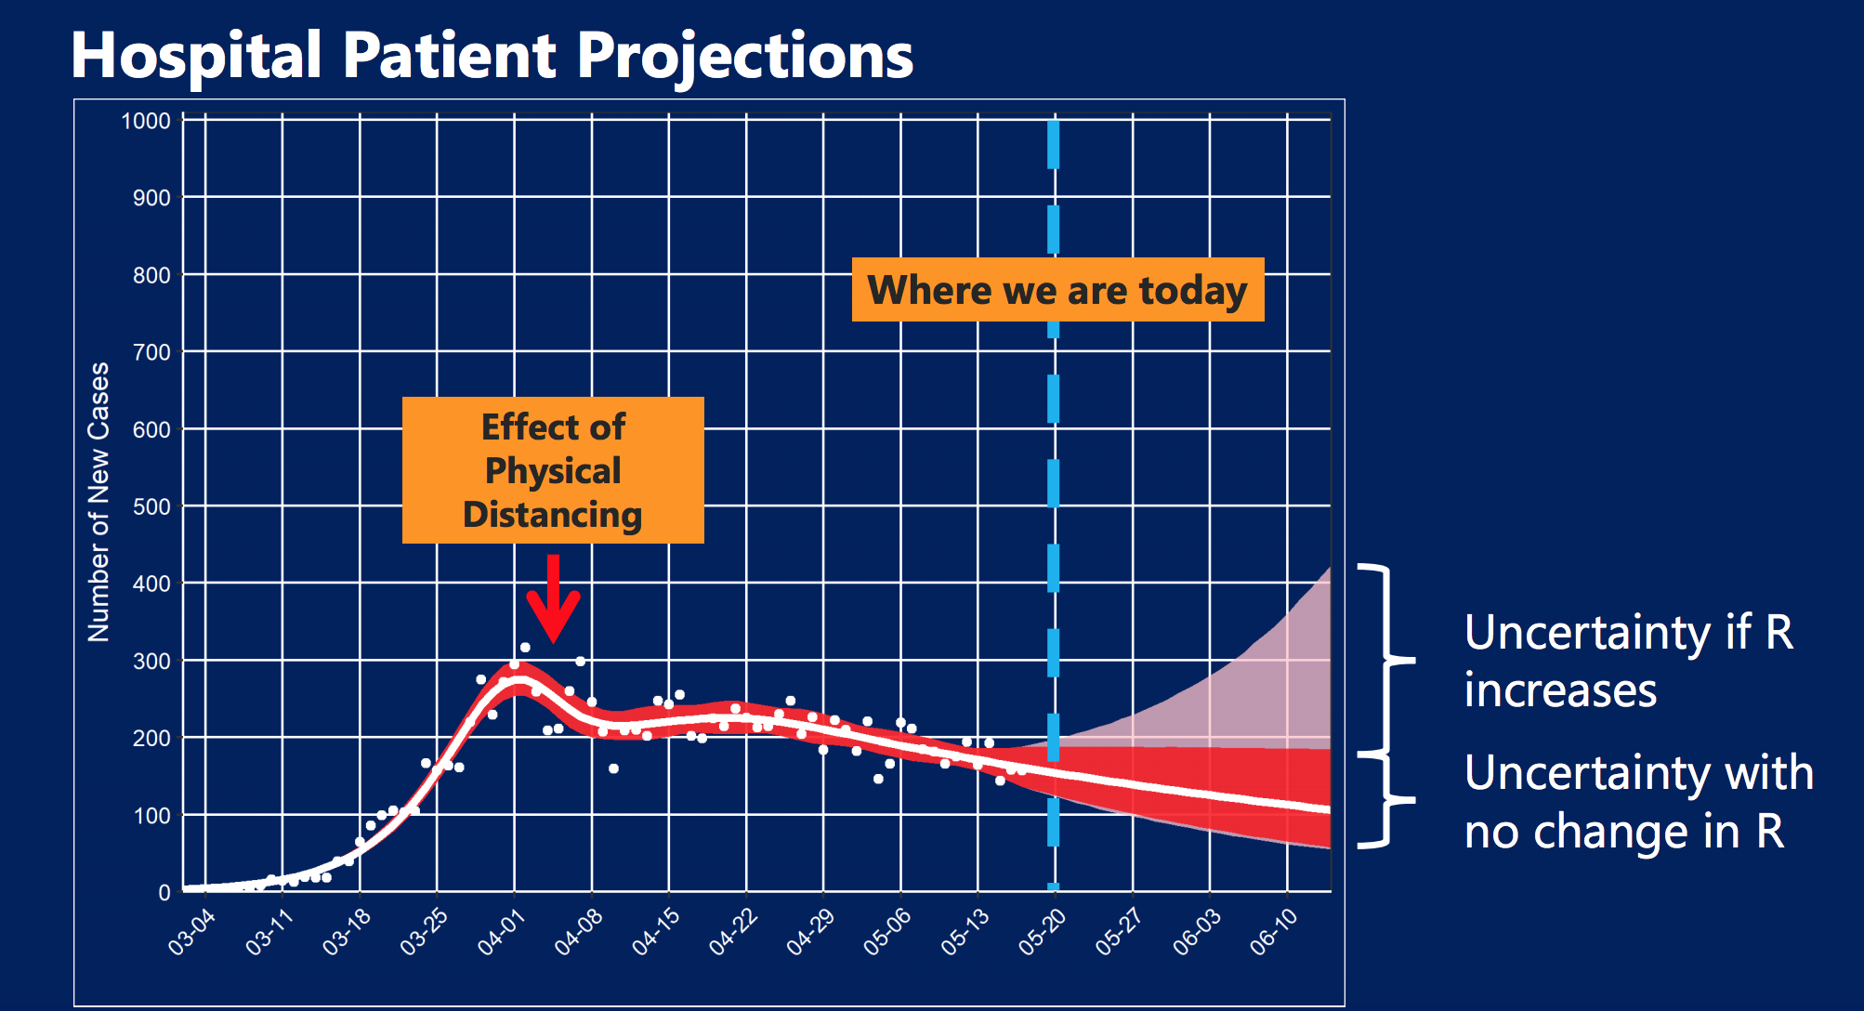

Slide 13
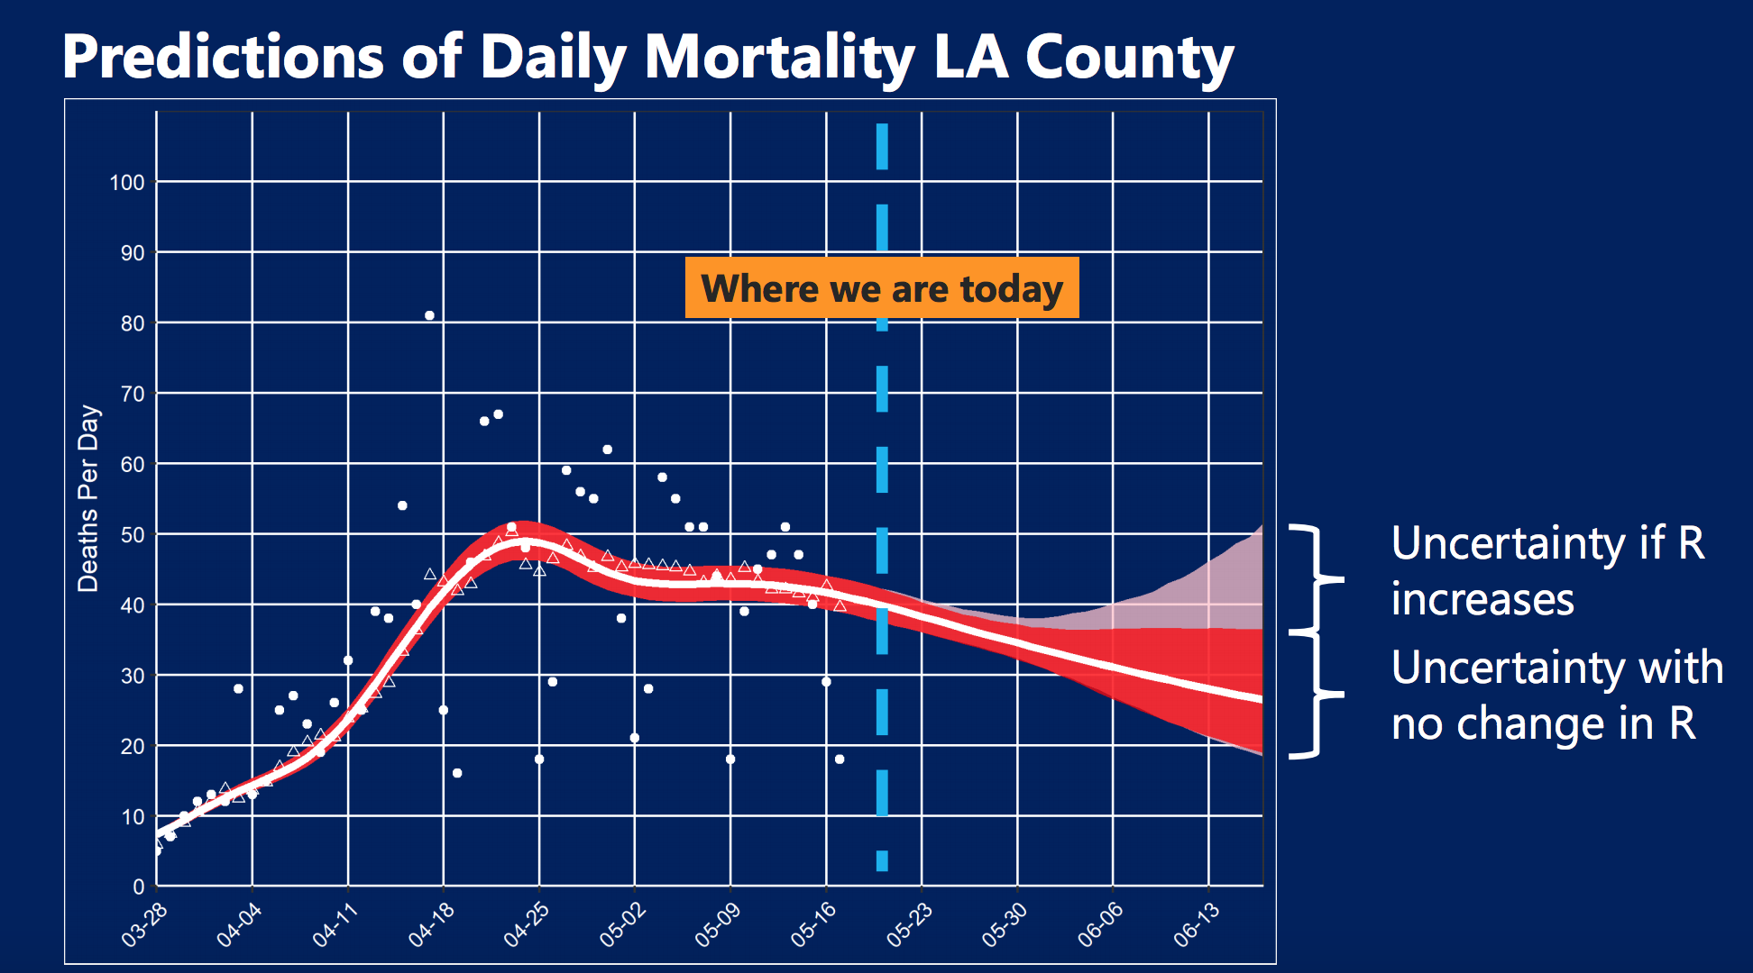

Slide 14
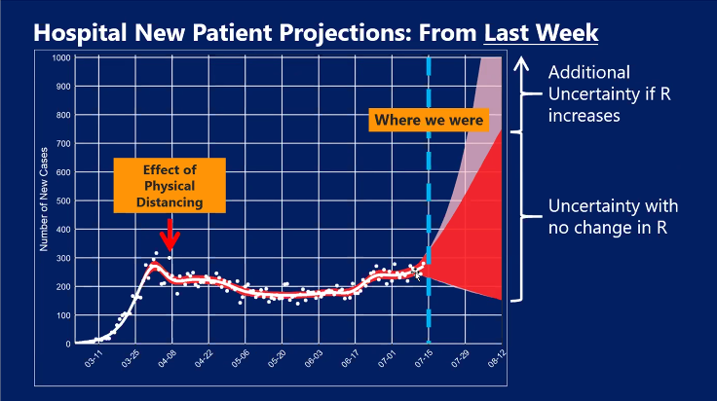


Slide 15
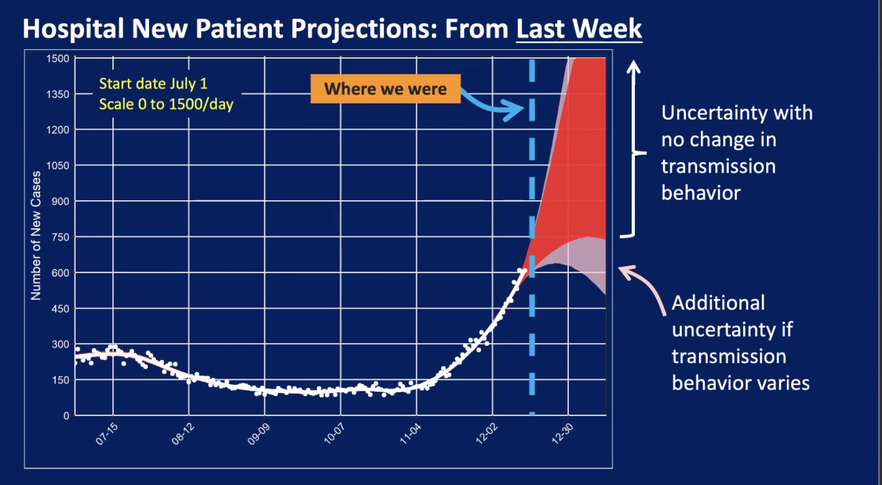

Slide 16
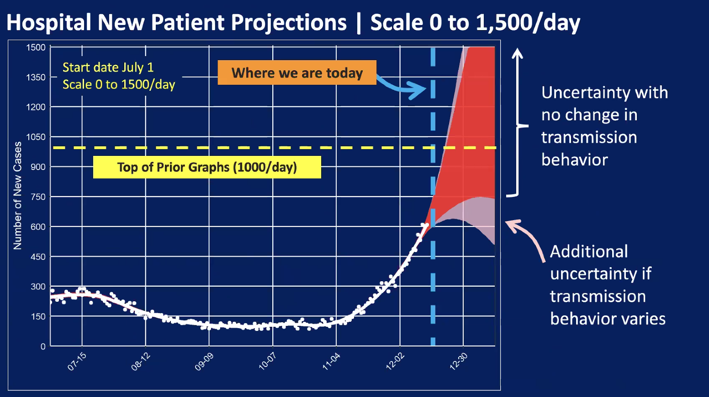

Slide 19
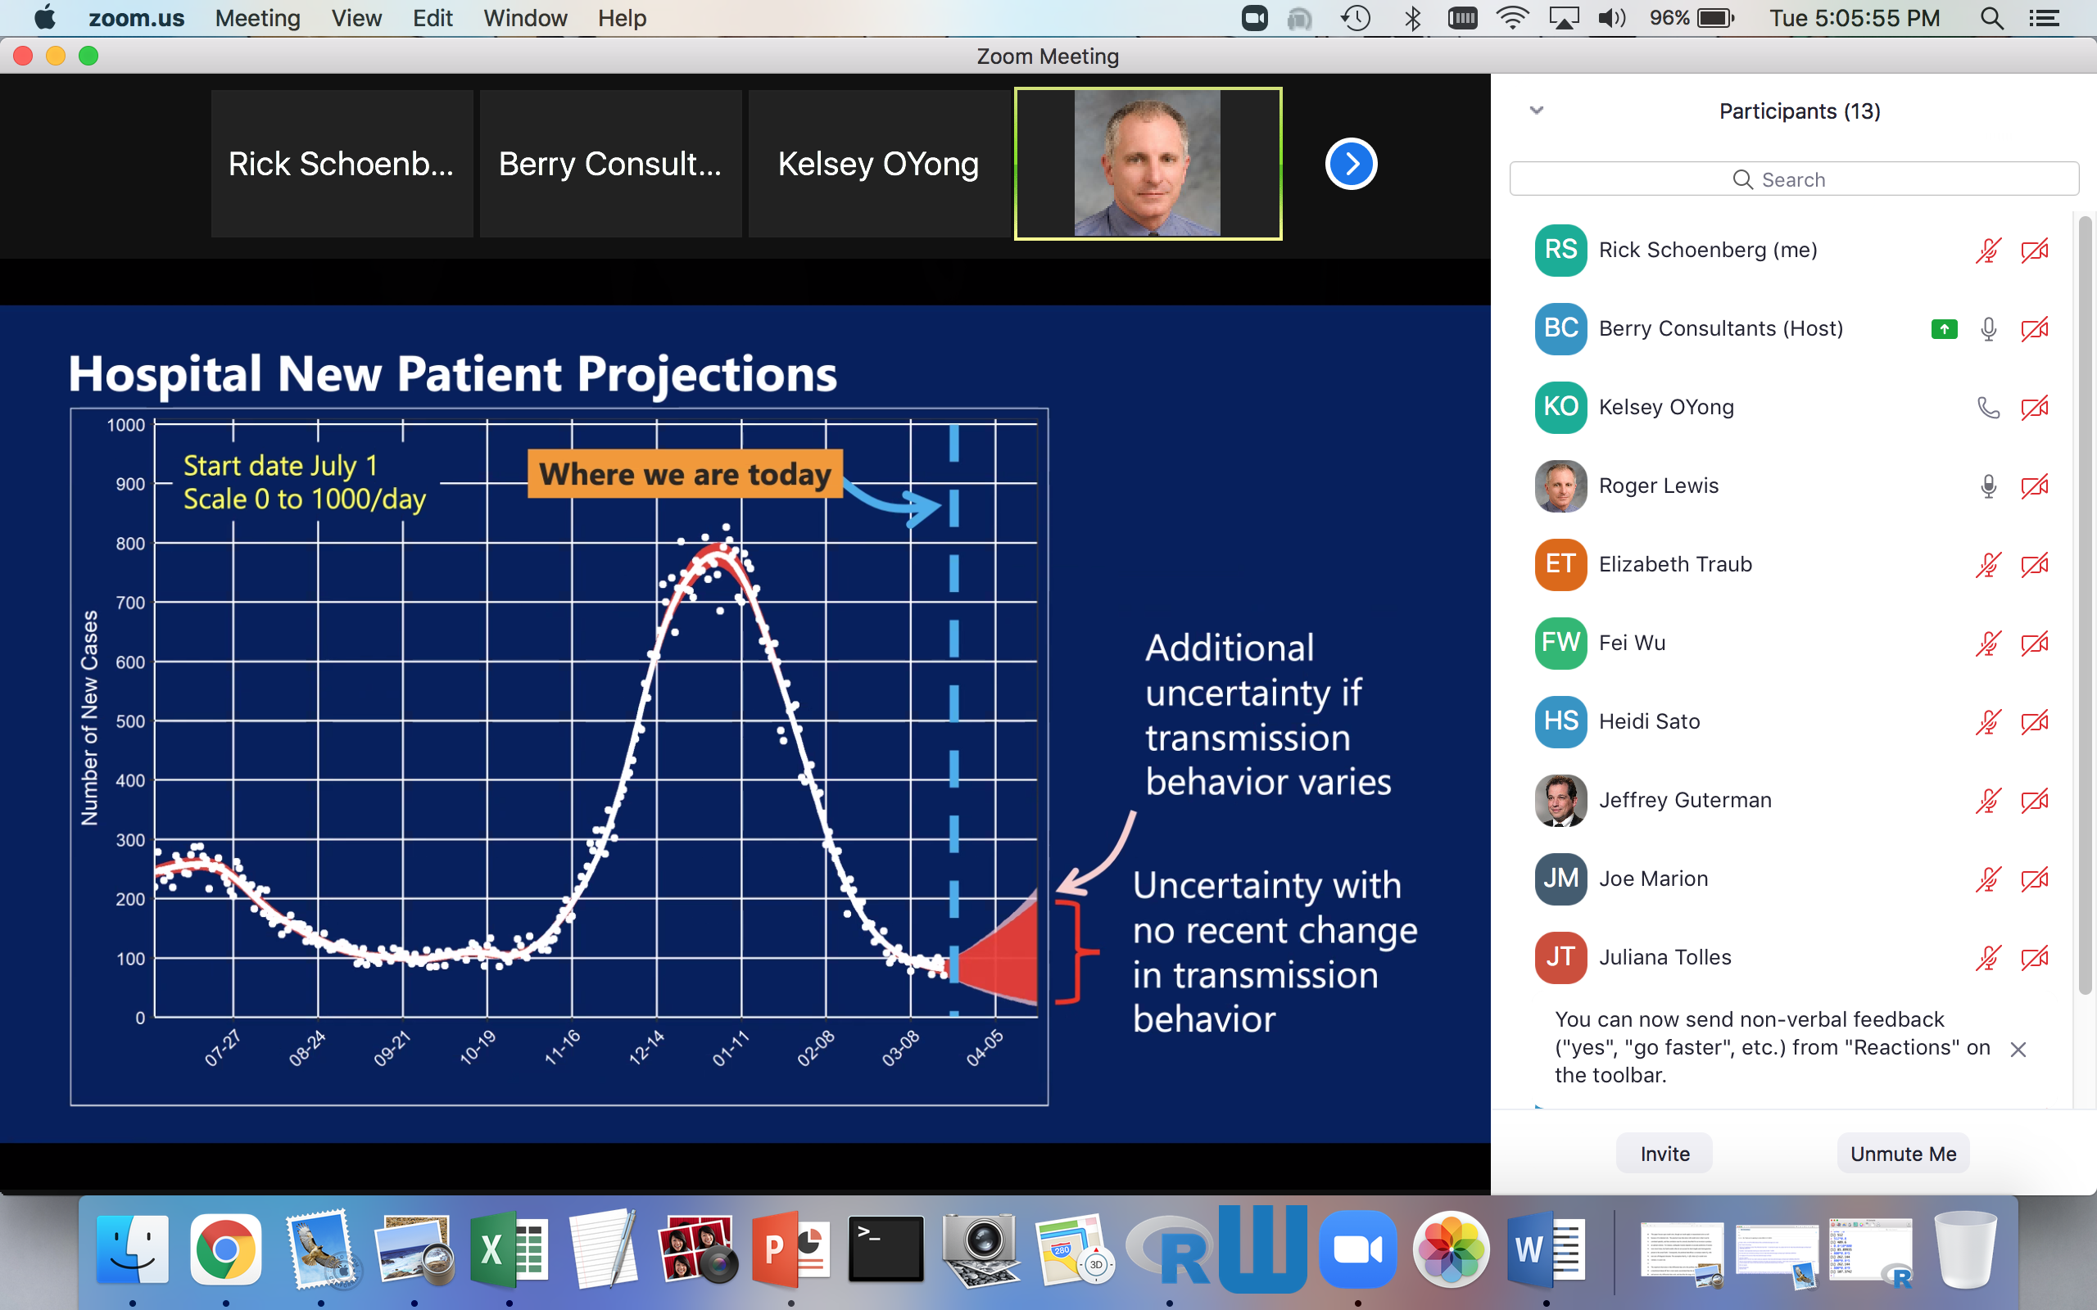

Slide 20
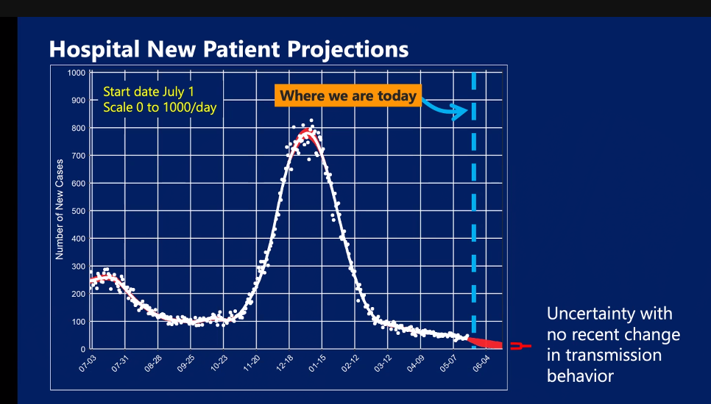

Slide 22
4. Pros and cons of SEIR models.
Good things about SEIR.
-- very widely used.
-- physically sensible.
-- forecast pretty well during the onset of an outbreak.
-- surprisingly accurate in LA County around 4/15/20.
Problems with SEIR.
-- Prone to mis-specification.
-- critical dependence on highly uncertain quantities,
such as estimates of the number of asymptomatic cases.
-- poor calibration, e.g. Italy, 6 day forecast/observed ~ 86%.
-- low accuracy, especially for long-term forecasts.

Slide 23
SEIR models applied to the spread of SARS in China in 2003 estimated 30,000 to 10 million SARS cases would occur in the first 4 months of the spread of disease in China (Myers 2007). Ultimately, only 782 cases were reported in China (World Health Organization 2003).

Slide 24
Pros and cons of SEIR models.
Good things about SEIR.
-- very widely used.
-- physically sensible.
-- forecast pretty well during the onset of an outbreak.
-- surprisingly accurate in LA County around 4/15/20.
Problems with SEIR.
-- Prone to mis-specification.
-- critical dependence on highly uncertain quantities,
such as estimates of the number of asymptomatic cases.
-- poor calibration, e.g. Italy, 6 day forecast/observed ~ 86%.
-- low accuracy, especially for long-term forecasts.

Slide 25
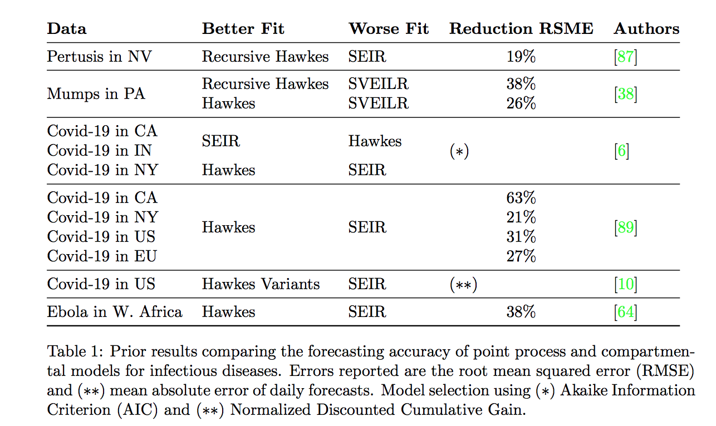
Model fit comparison of SEIR and Hawkes.
RMSE

Slide 26
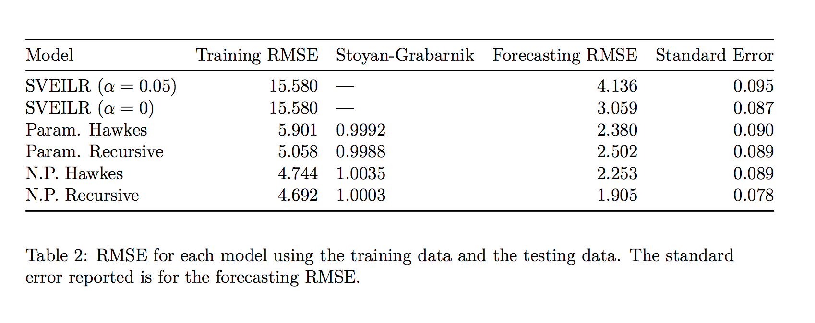

Slide 27
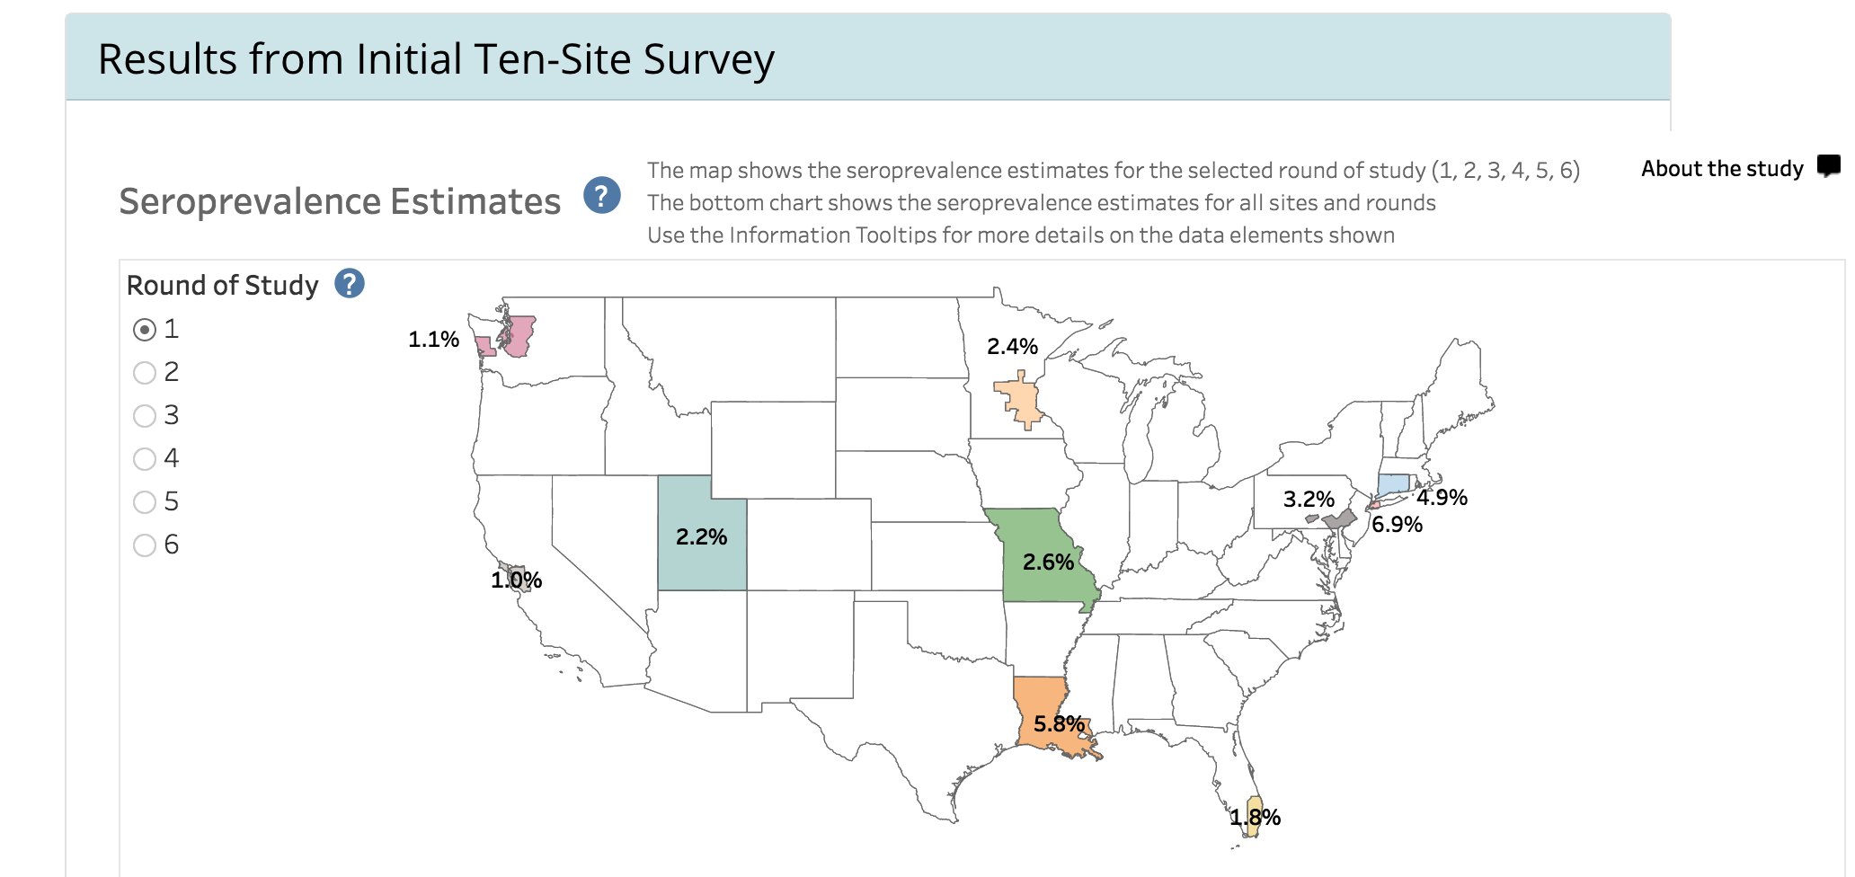
Percent asymptomatic.

Slide 28
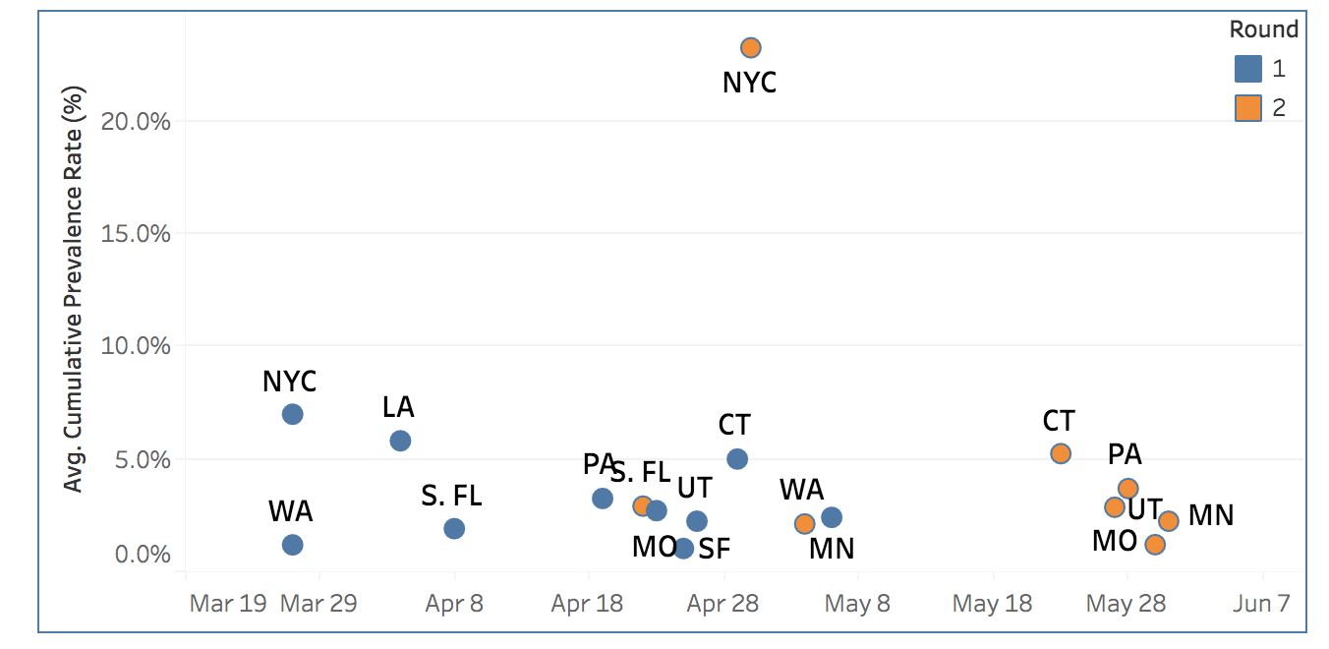

Slide 29
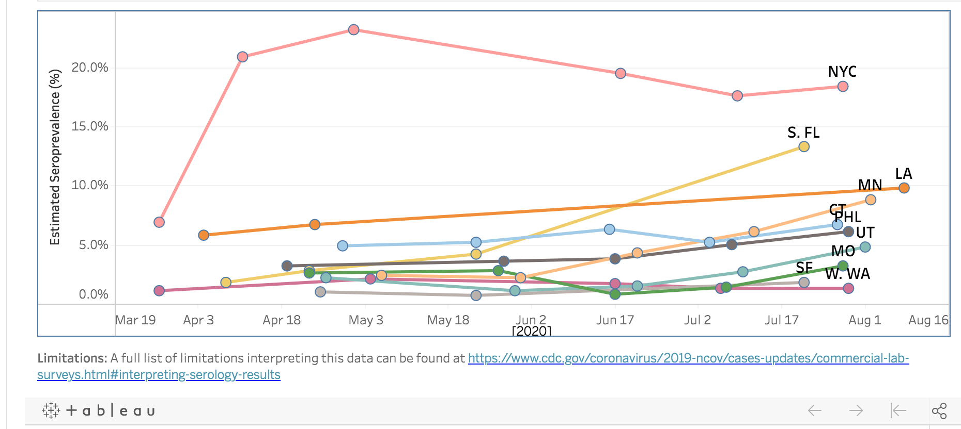
www.cdc.gov/coronavirus/2019-ncov/cases-updates/commercial-lab-surveys.html

Slide 30
www.cdc.gov/coronavirus/2019-ncov/cases-updates/commercial-lab-surveys.html
State Infected/Confirmed. Infected/Deaths.
Washington. 11. 280.
NY. 12. 138.
Florida. 11. 484.
Missouri. 24. 506.
Utah. 11. 1454.
Connecticut. 6. 65.

Slide 31
Pros and cons of SEIR models.
Good things about SEIR.
-- very widely used.
-- physically sensible.
-- forecast pretty well during the onset of an outbreak.
-- surprisingly accurate in LA County around 4/15/20.
Problems with SEIR.
-- Prone to mis-specification.
-- critical dependence on highly uncertain quantities,
such as estimates of the number of asymptomatic cases.
-- poor calibration, e.g. Italy, 6 day forecast/observed ~ 86%.
-- low accuracy, especially for long-term forecasts.

Slide 32
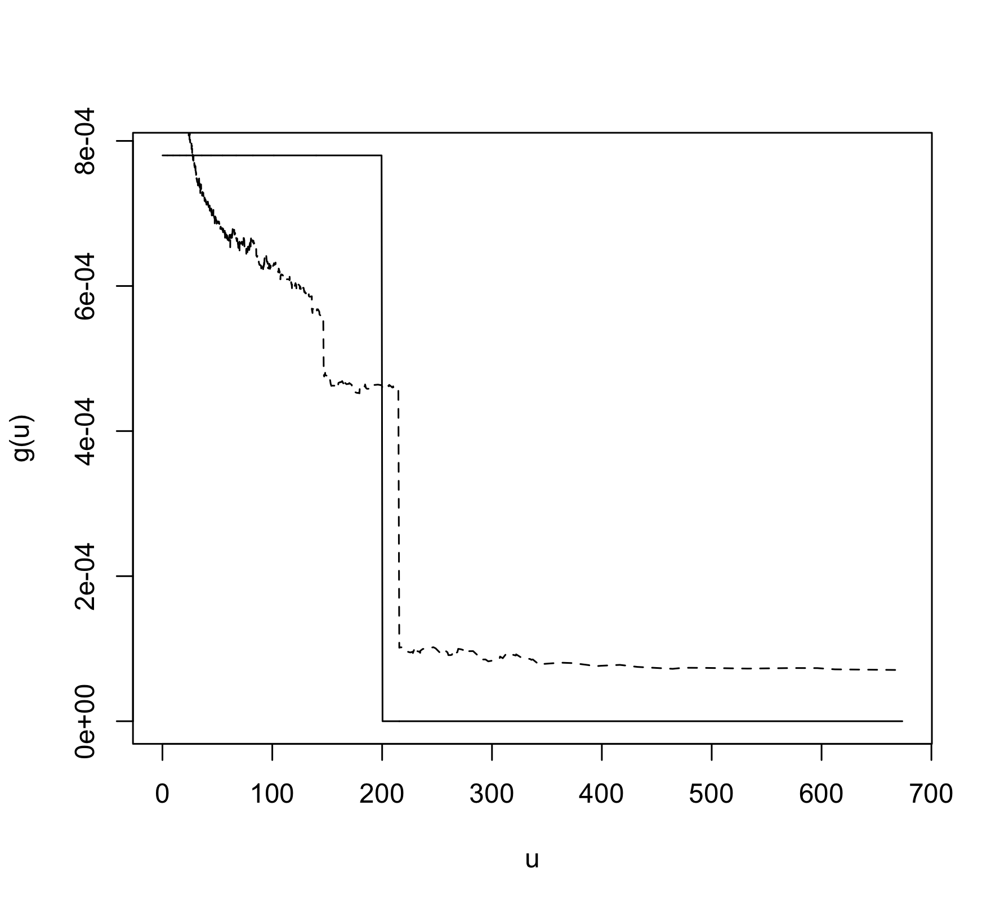
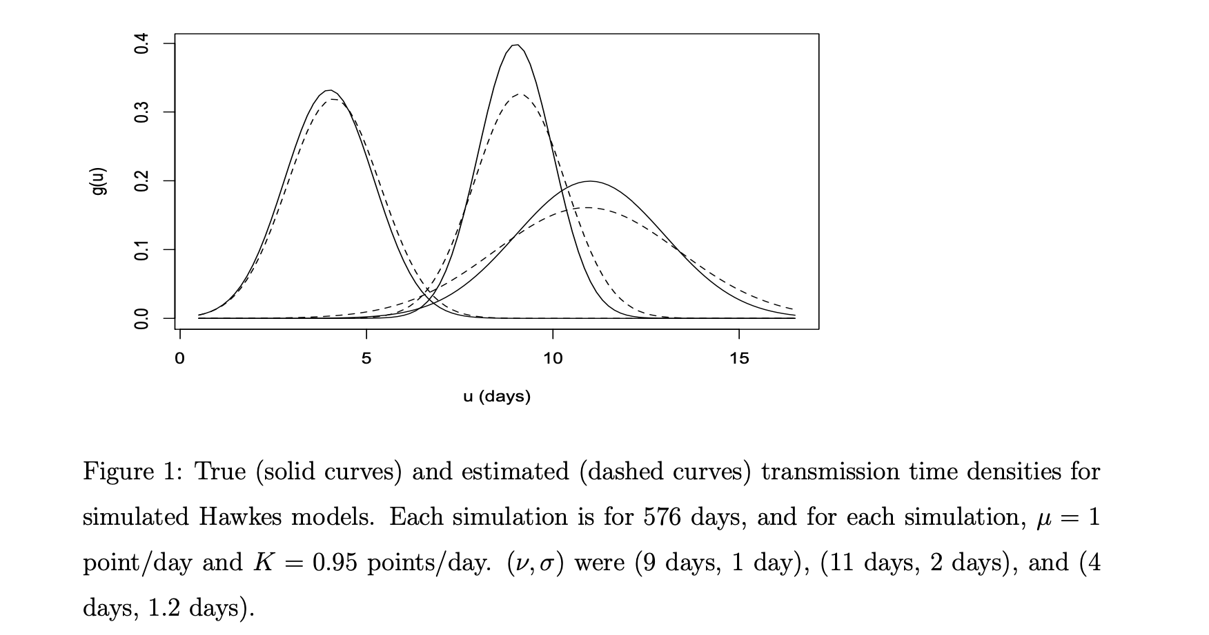

Slide 33
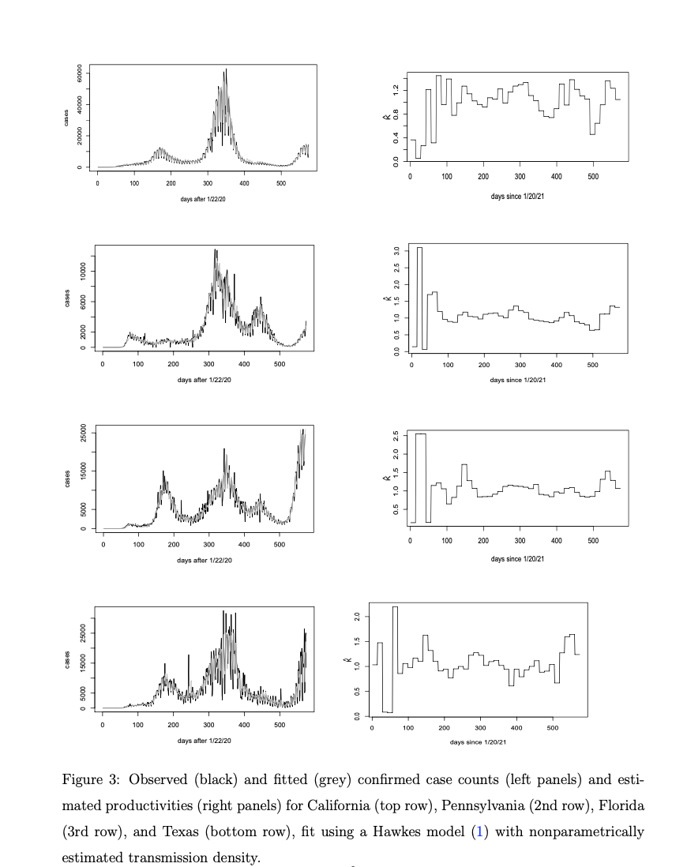

Slide 34
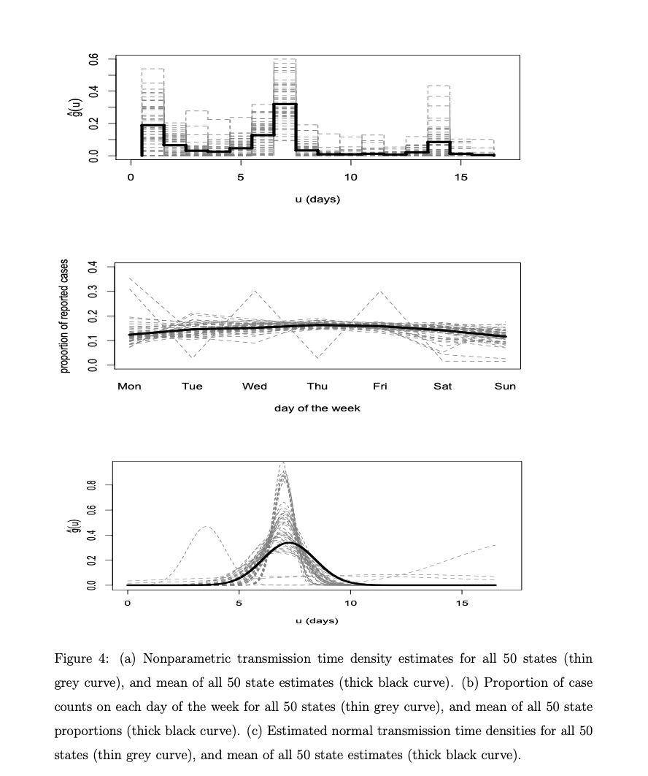

Slide 35
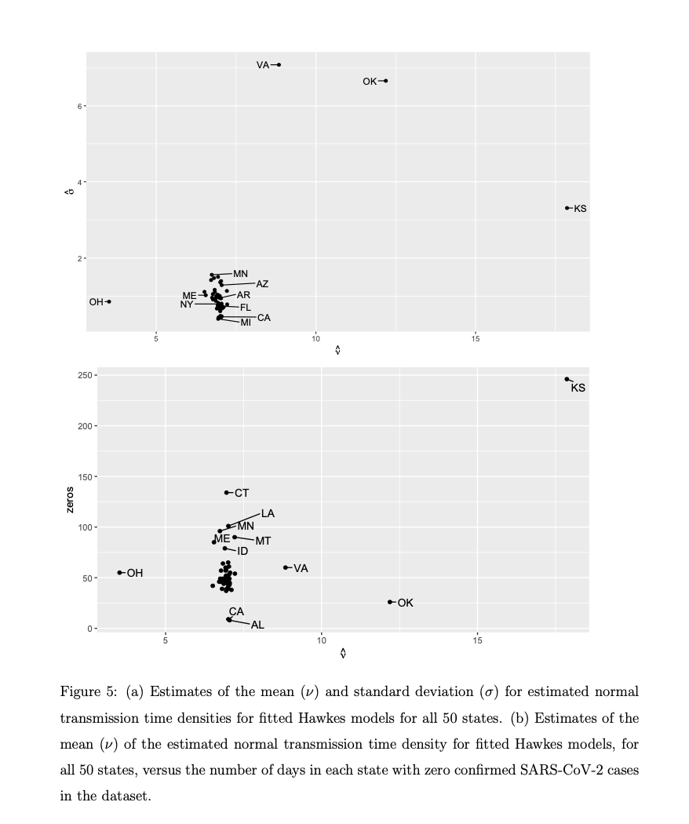

Slide 36
Other diseases and clustered phenomena.
a. Influenza.
b. Pertussis.
c. Ebola.
d. Chlamdyia.
e. Mumps.

Slide 37
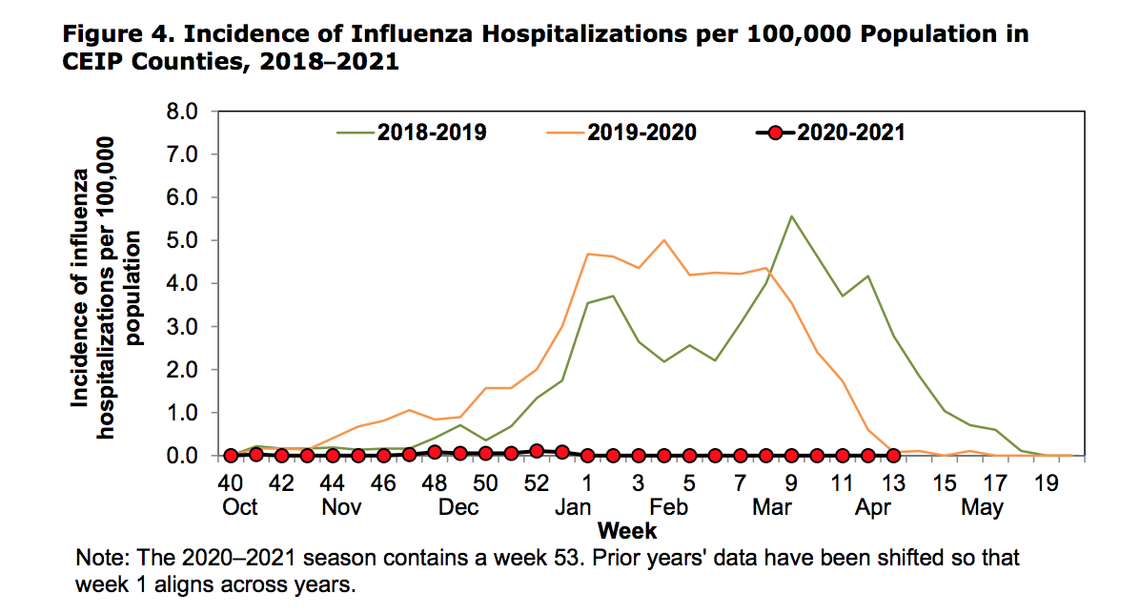

Slide 38
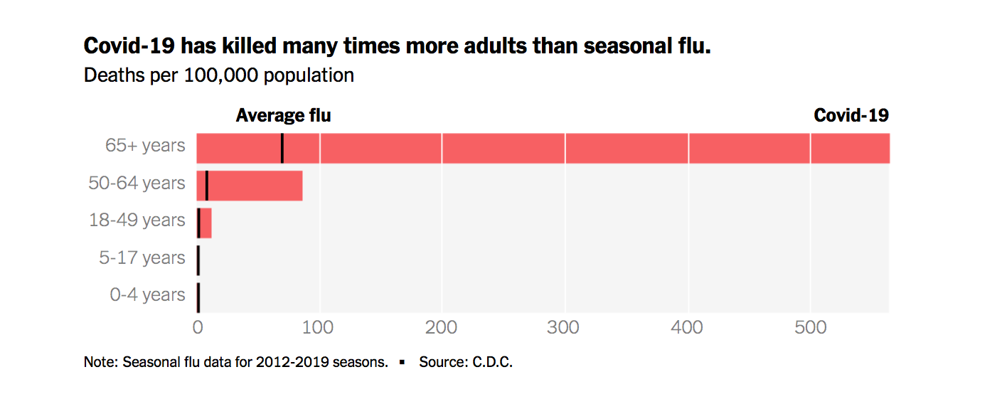
from New York Times.

Slide 39
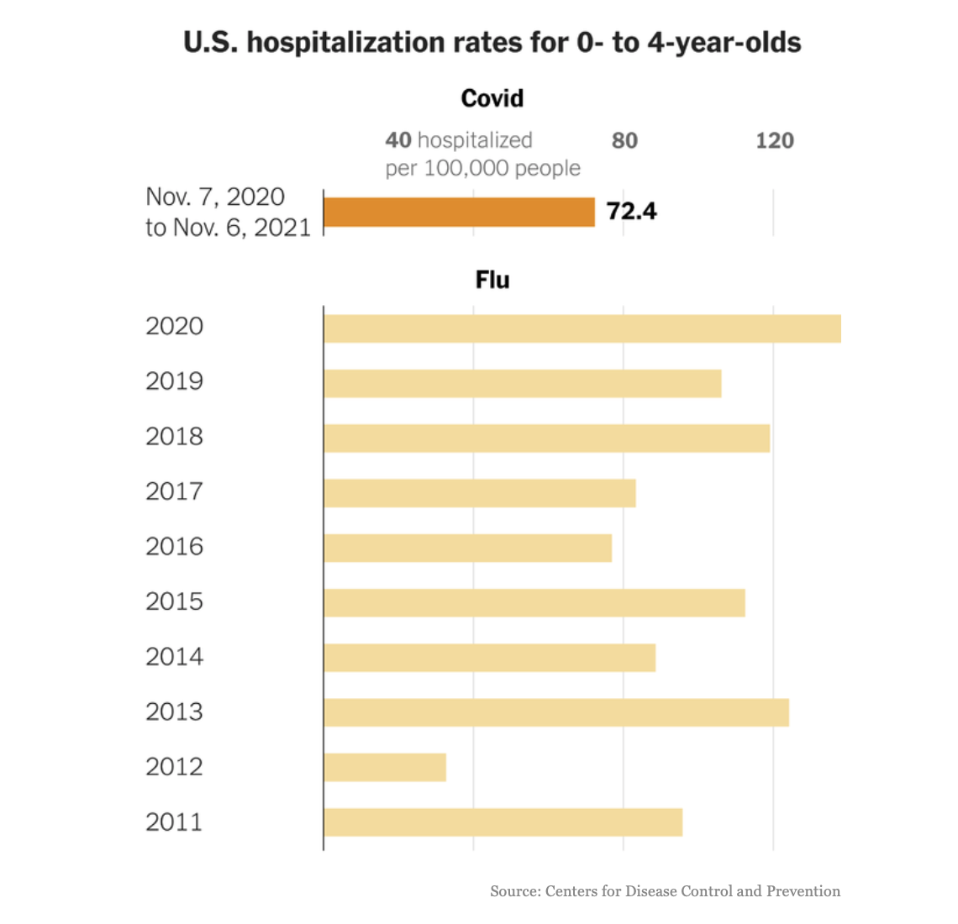

Slide 40
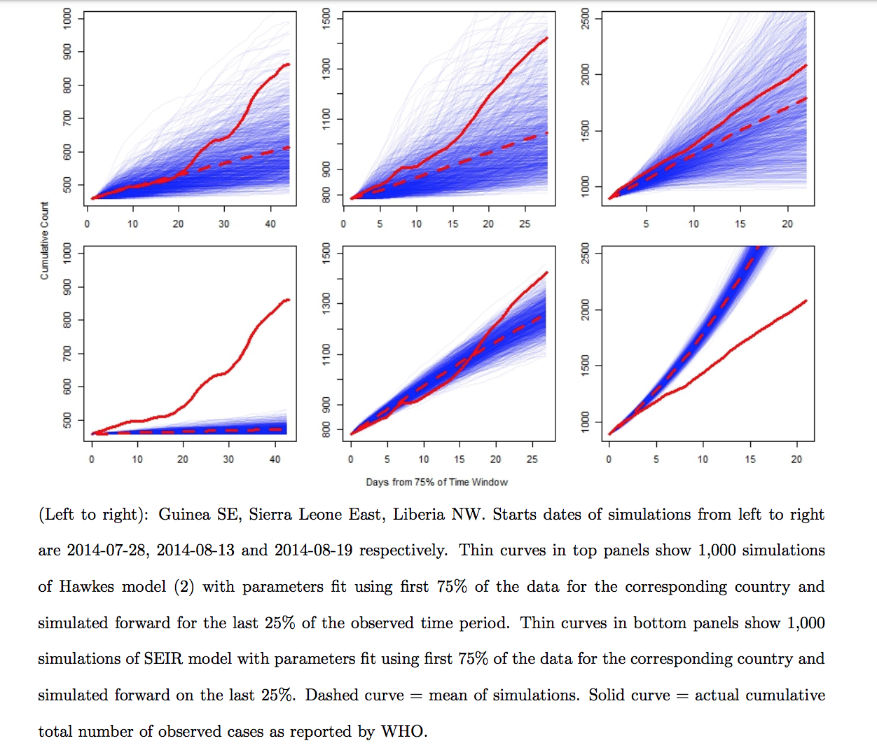
W. African Ebola data, 2014-17.

Slide 41
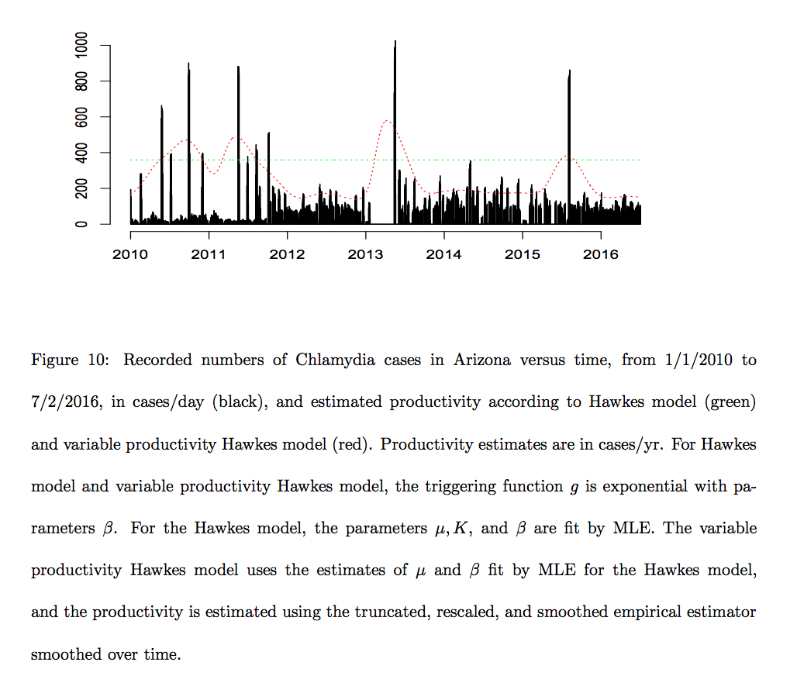
Chlamydial infections in Arizona, USA, 201—2016,
according to WHO (data thanks to Project Tycho).

Slide 42
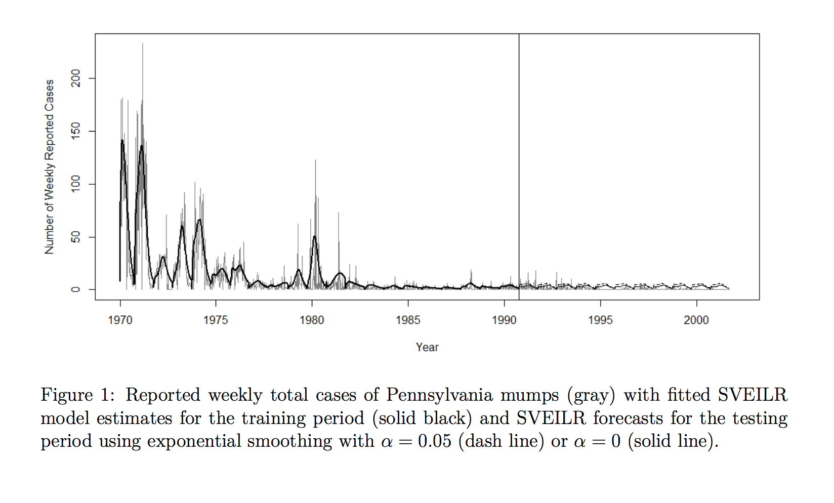

Slide 43
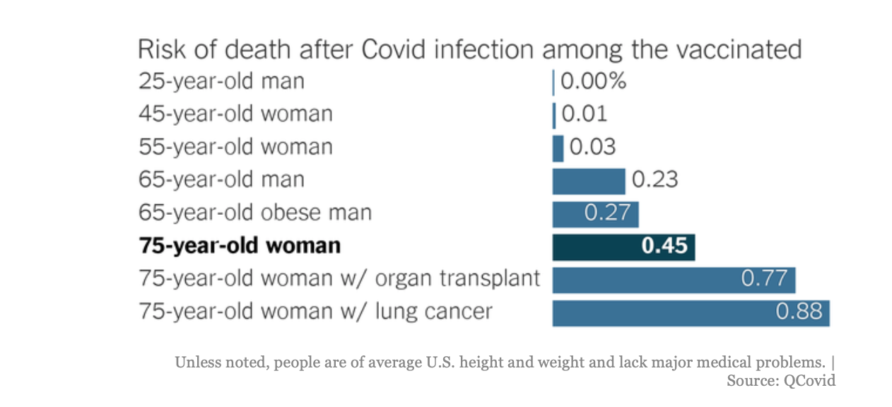

Slide 44
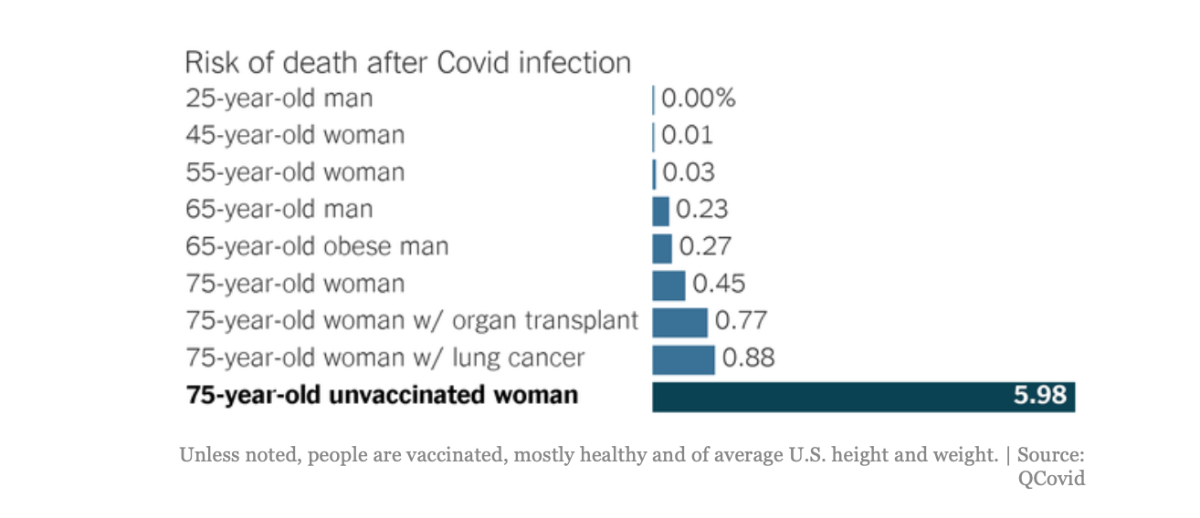

Slide 45
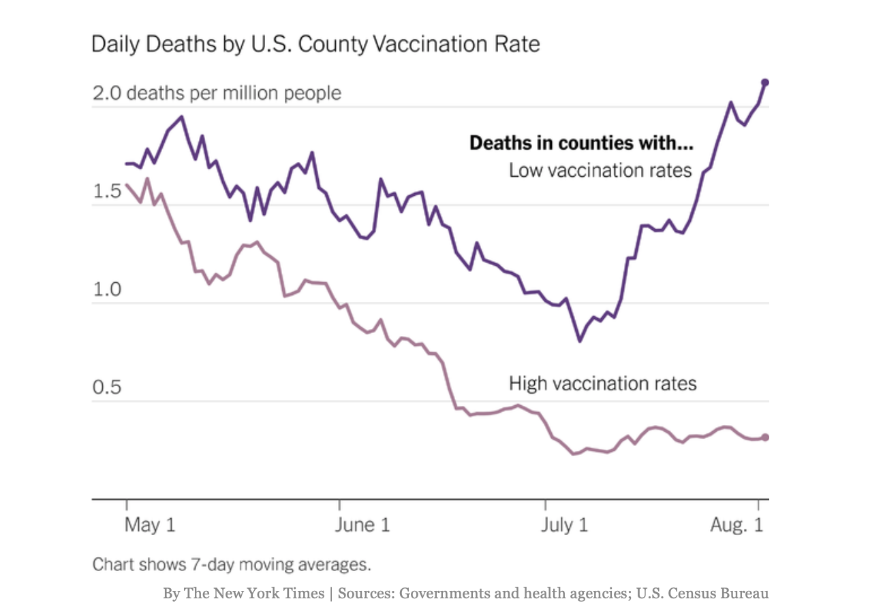

Slide 46
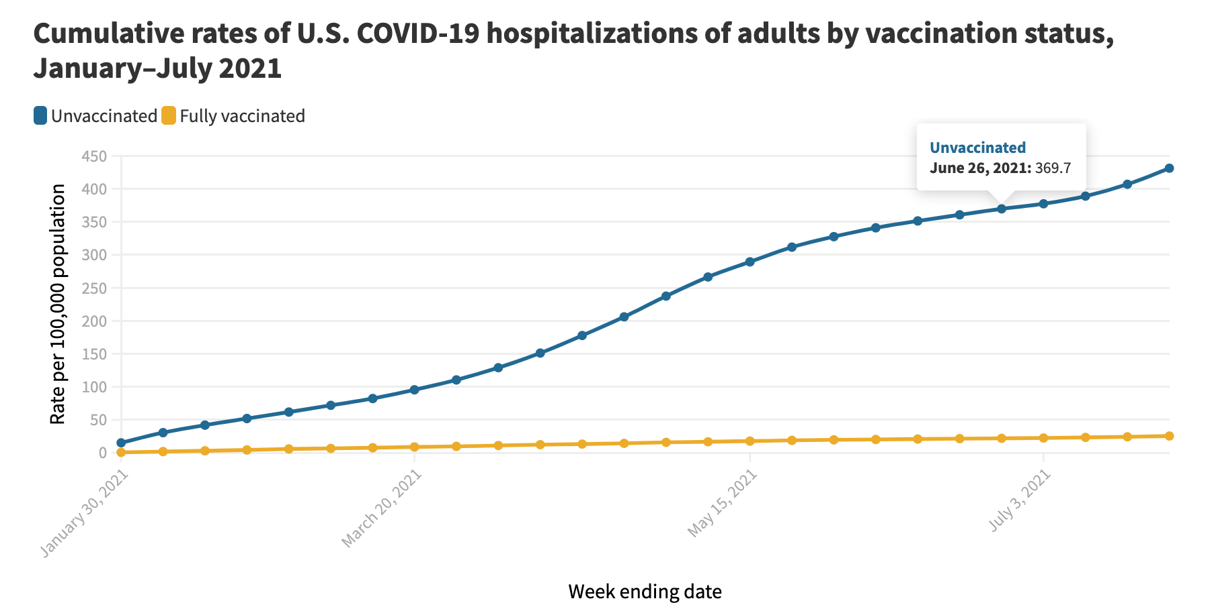

Slide 47
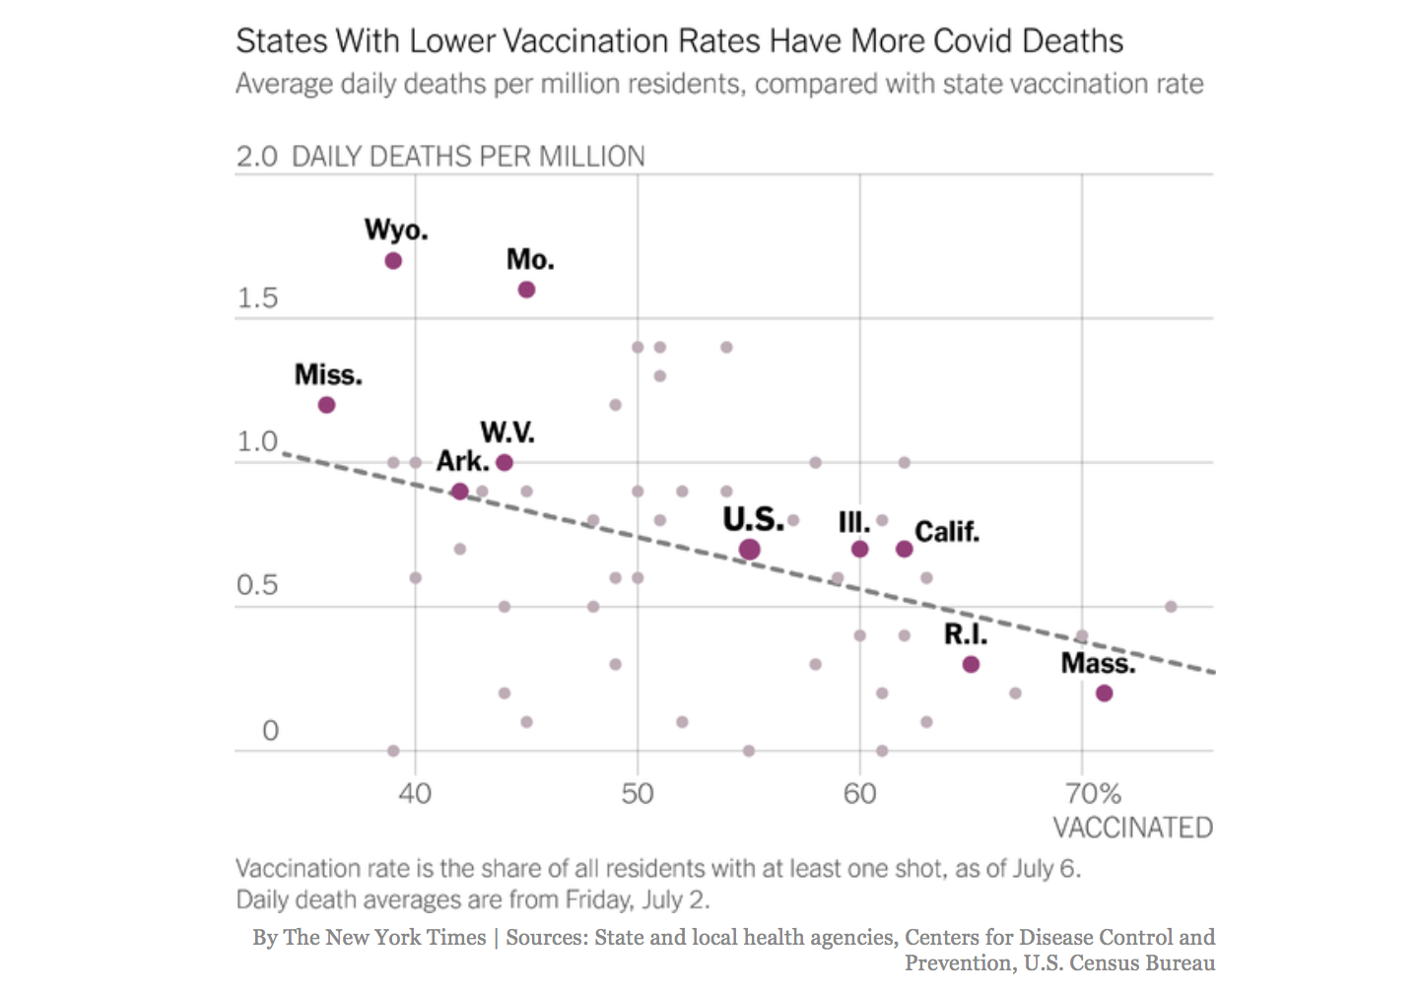

Slide 48
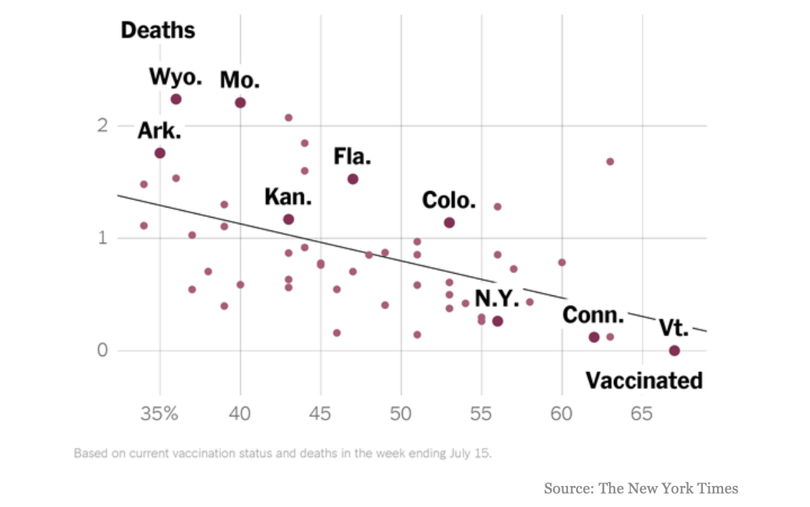

Slide 49
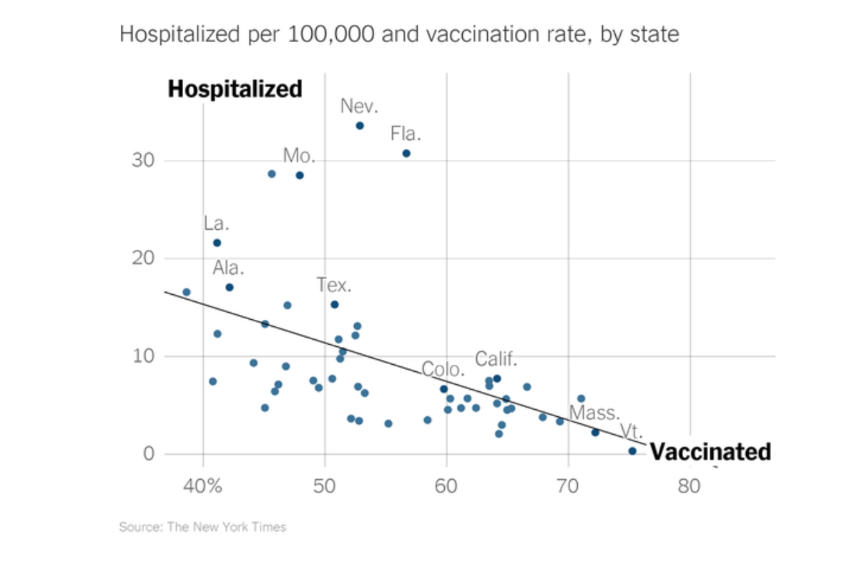

Slide 50
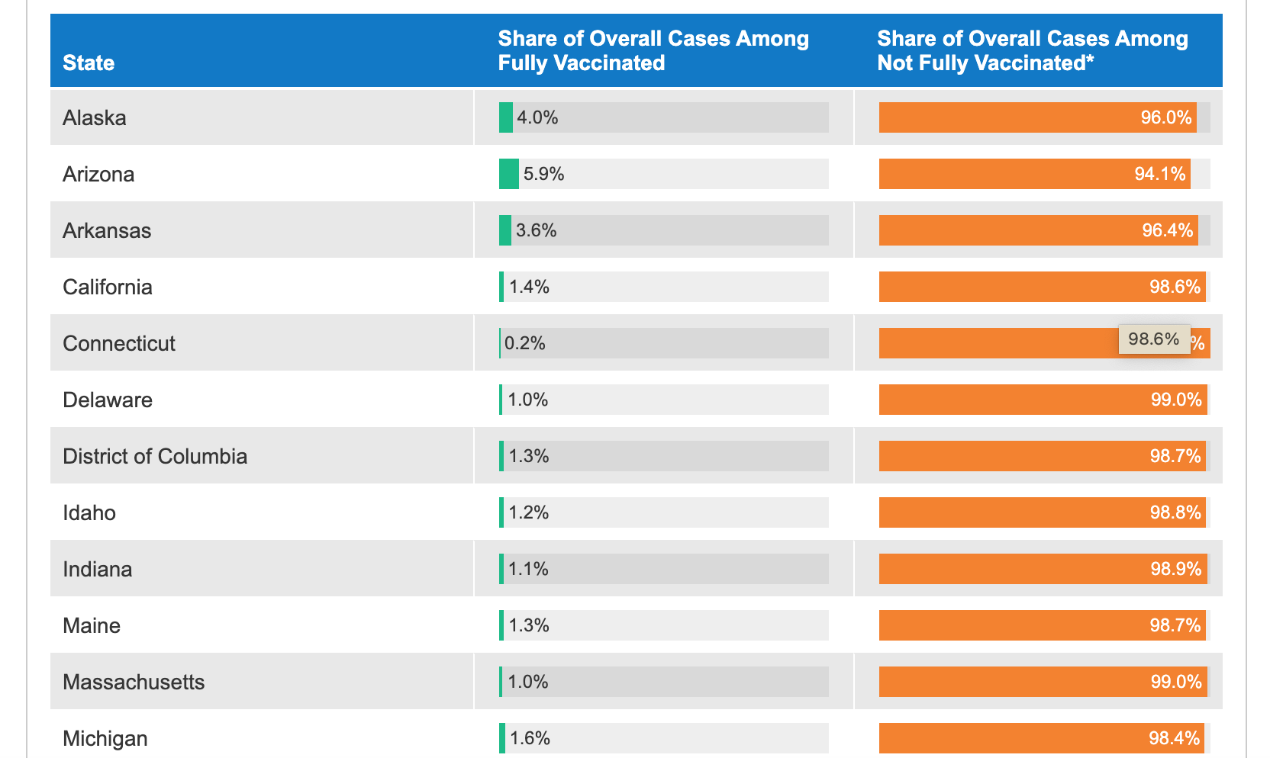

Slide 51
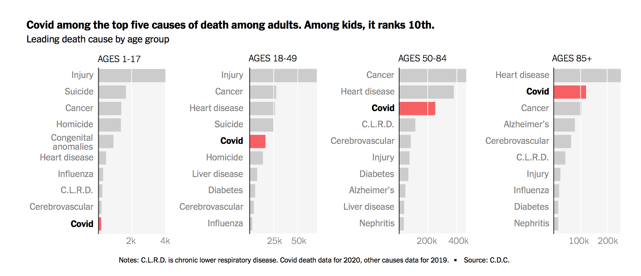
from New York Times.

Slide 52
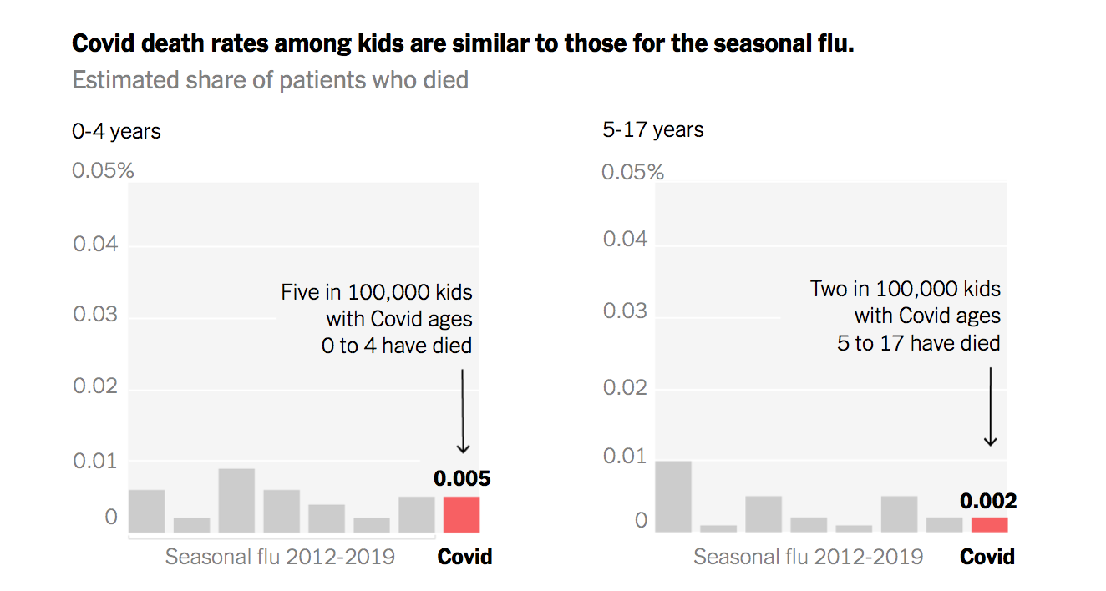
from New York Times.

Slide 53
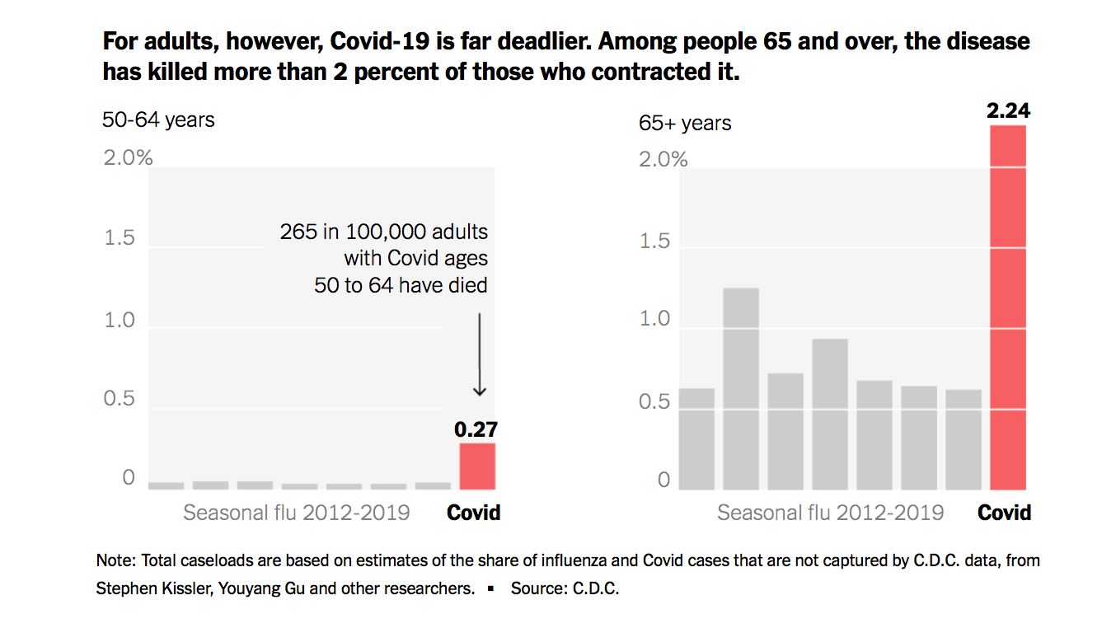
from New York Times.

Slide 54
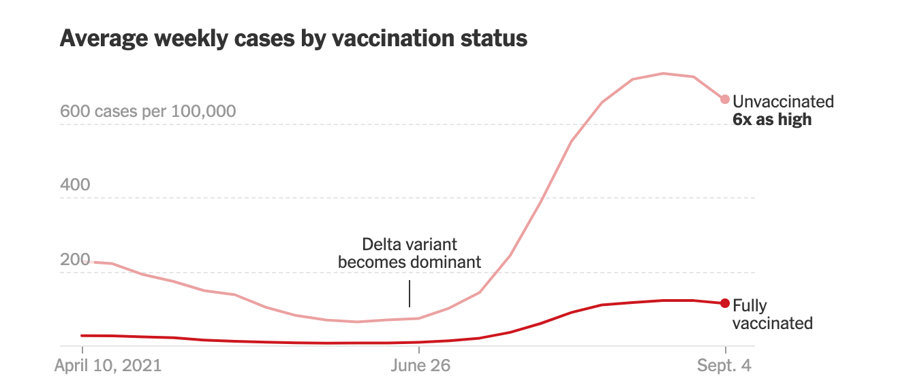

Slide 55
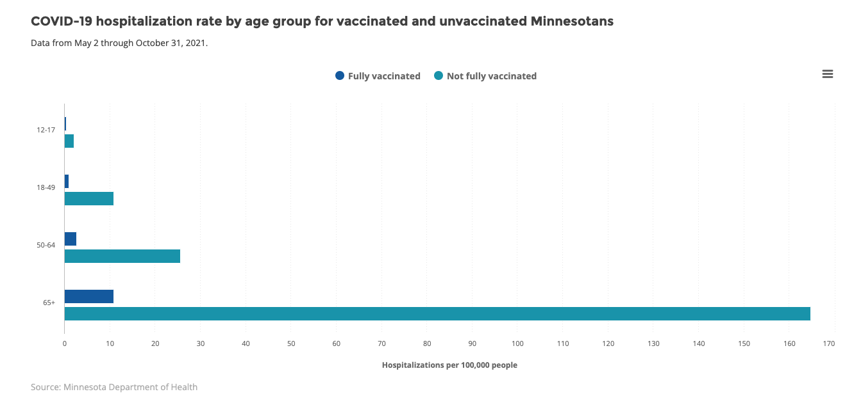

Slide 56
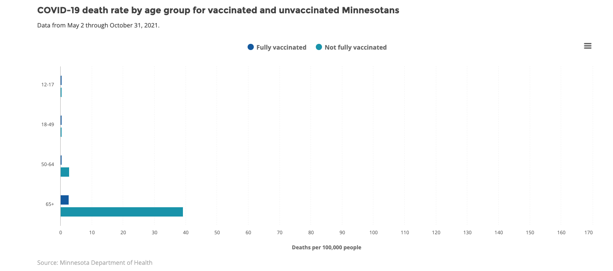

Slide 57
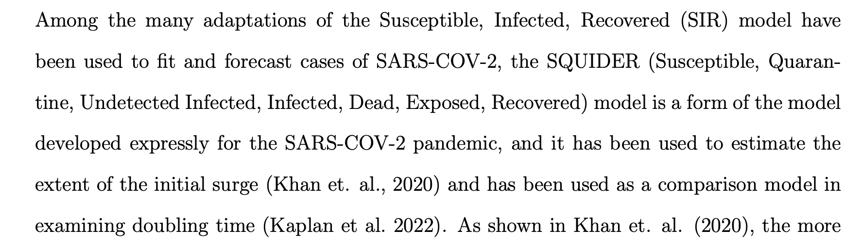
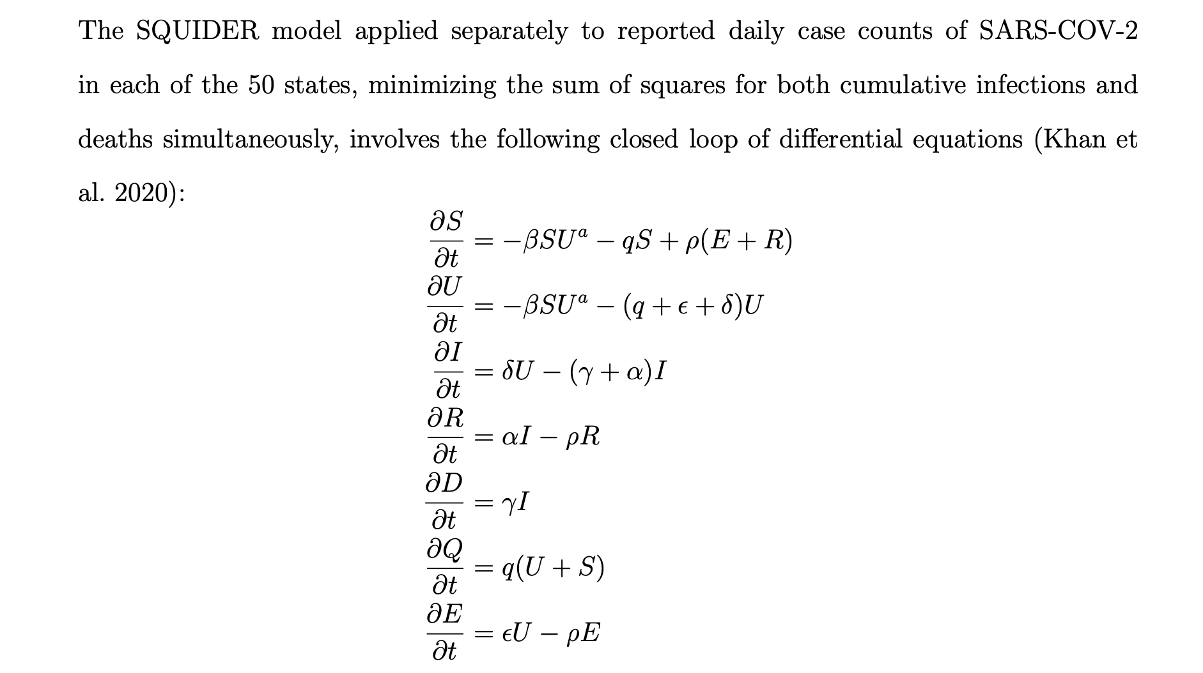

Slide 58
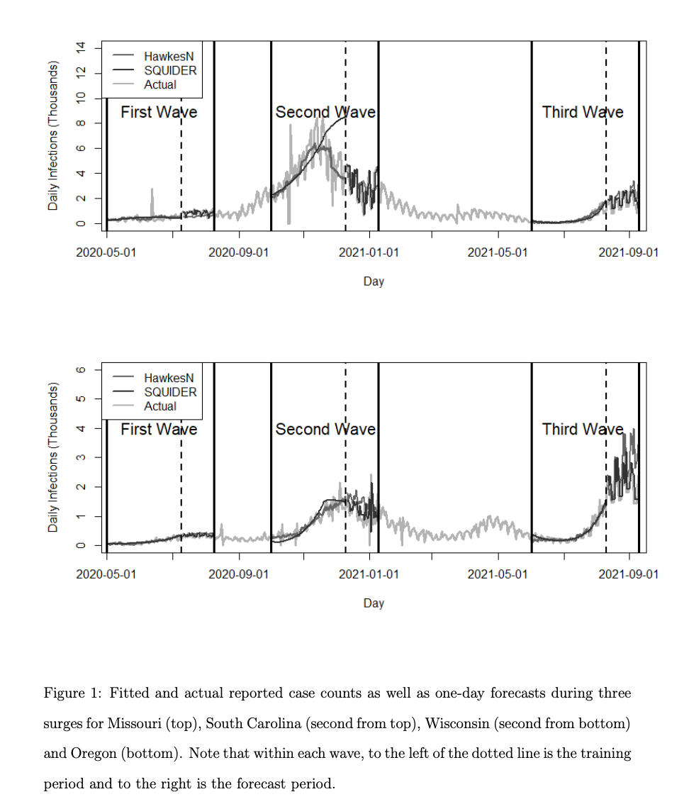

Slide 59
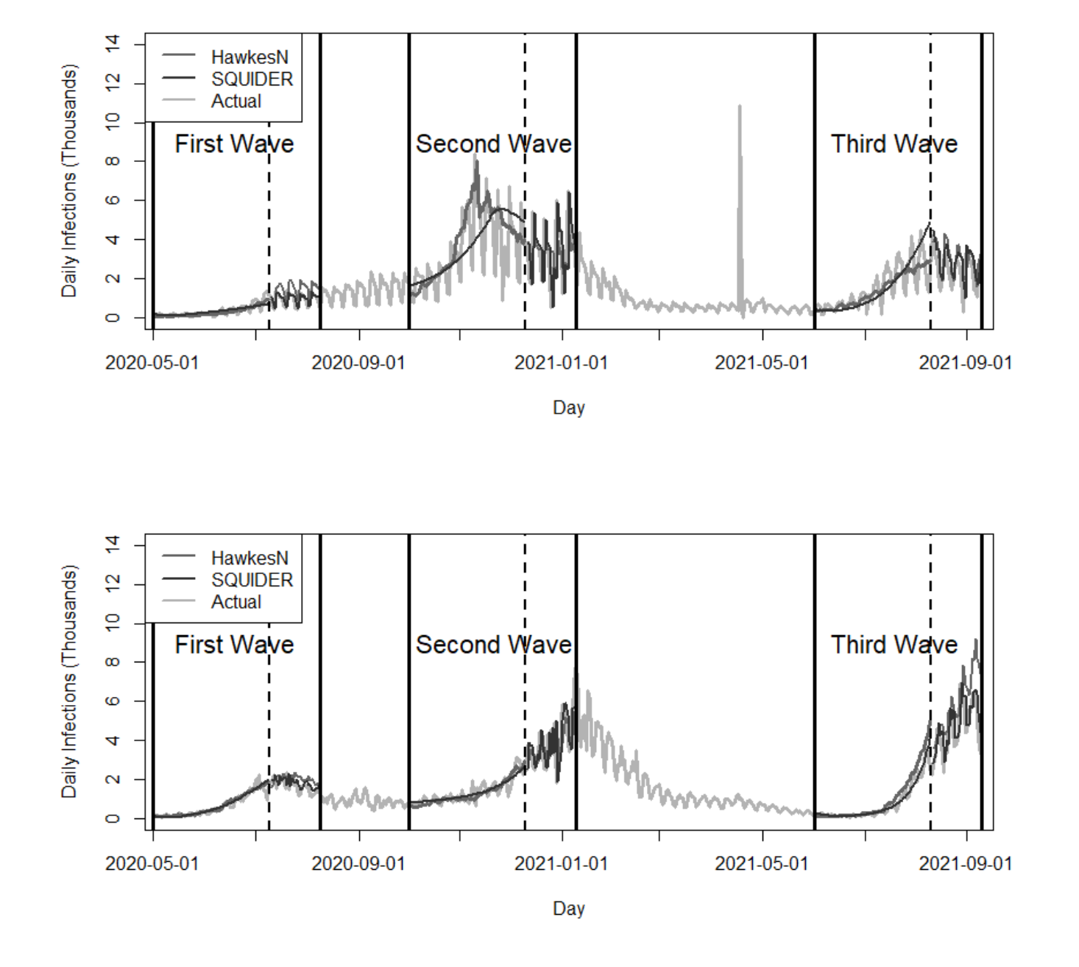

Slide 60
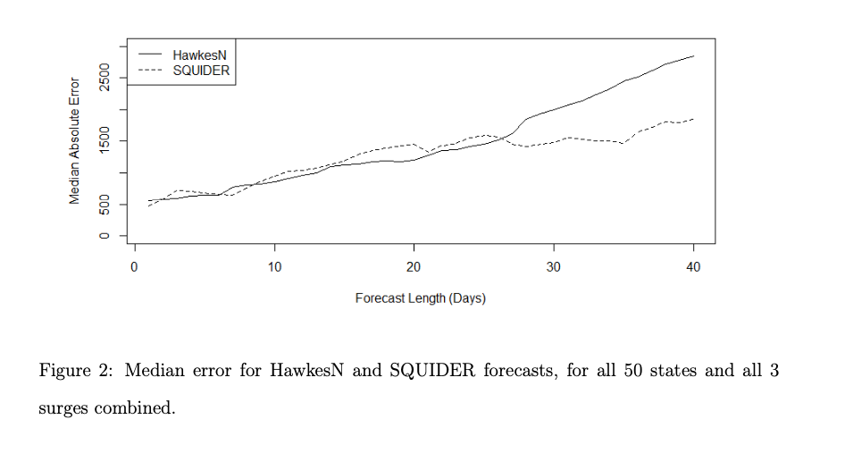

Slide 61
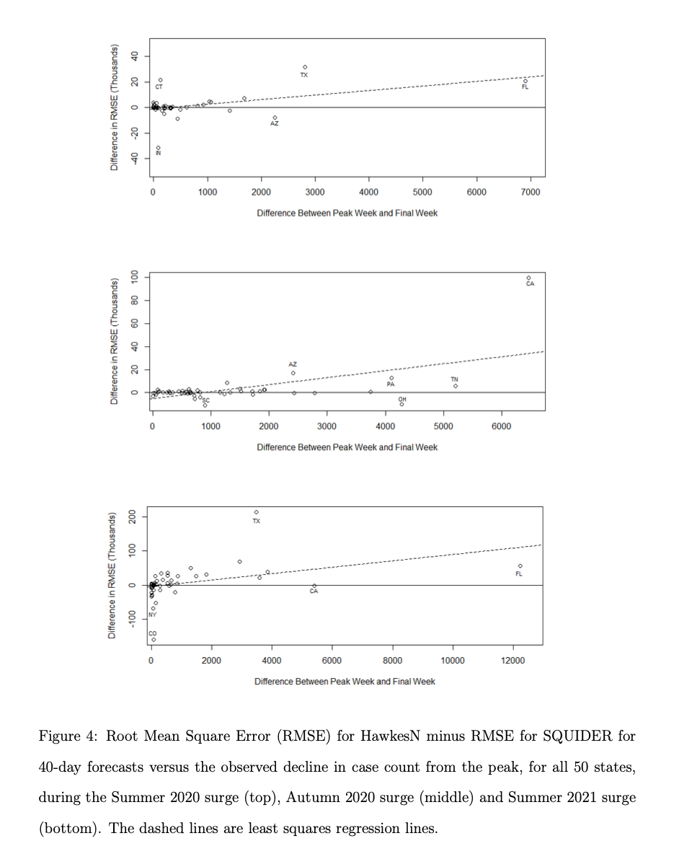

Slide 62
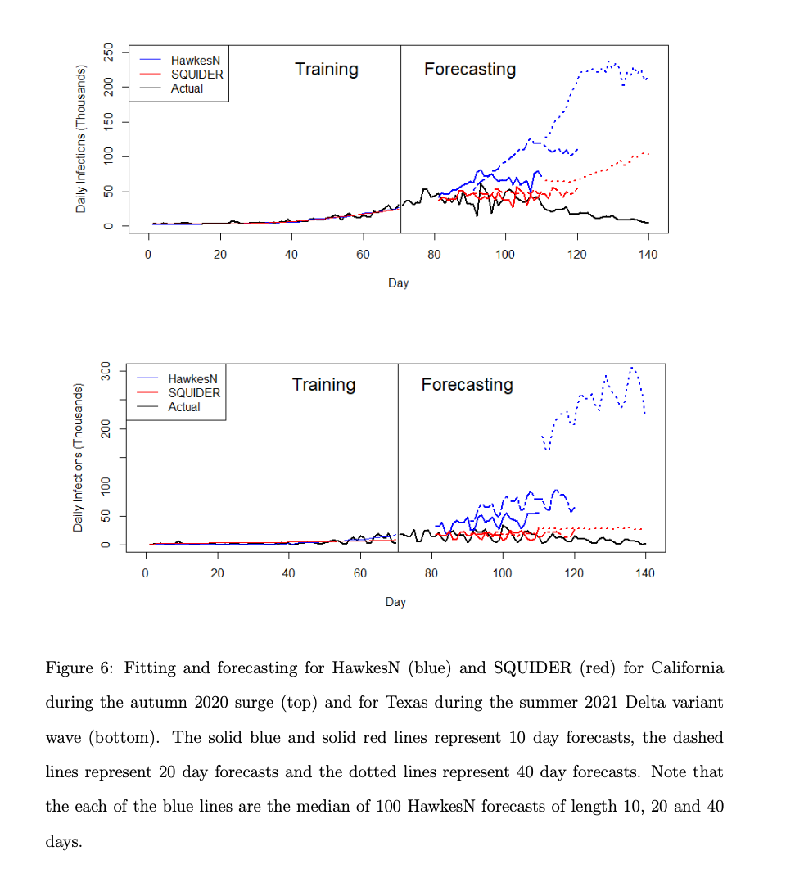

Slide 63


Slide 64


Slide 65


Slide 66


Slide 67


Slide 68


