Slide 1
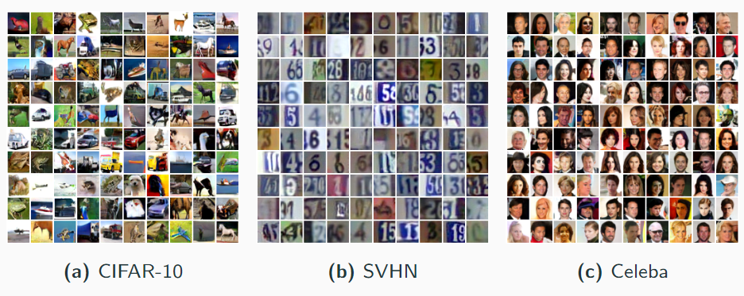
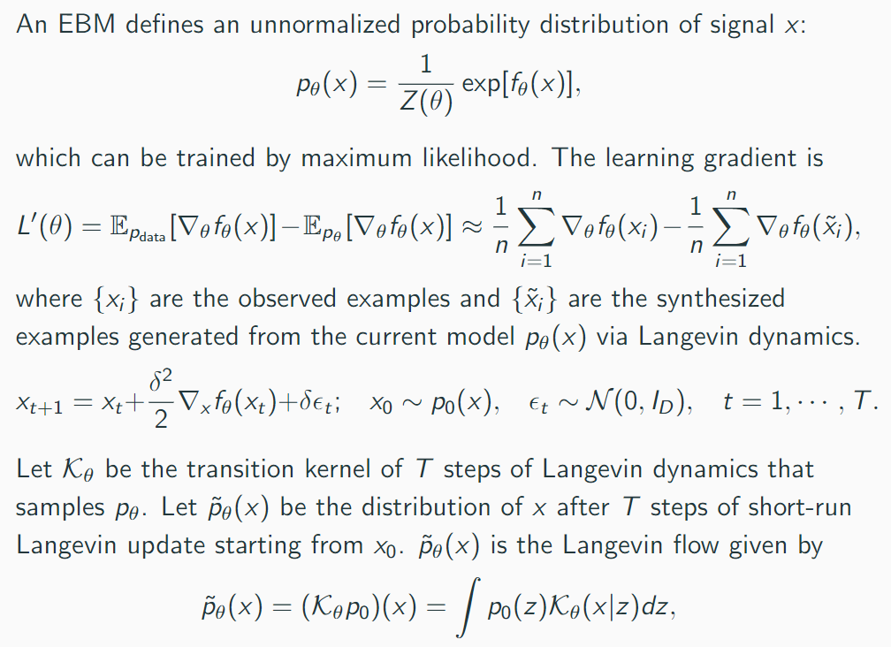
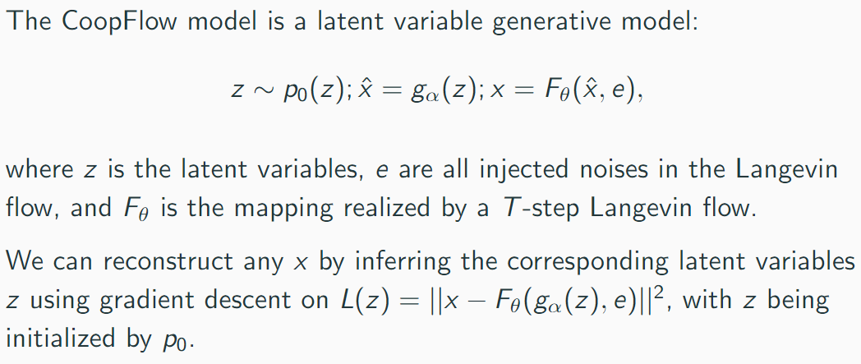
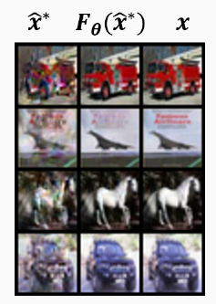
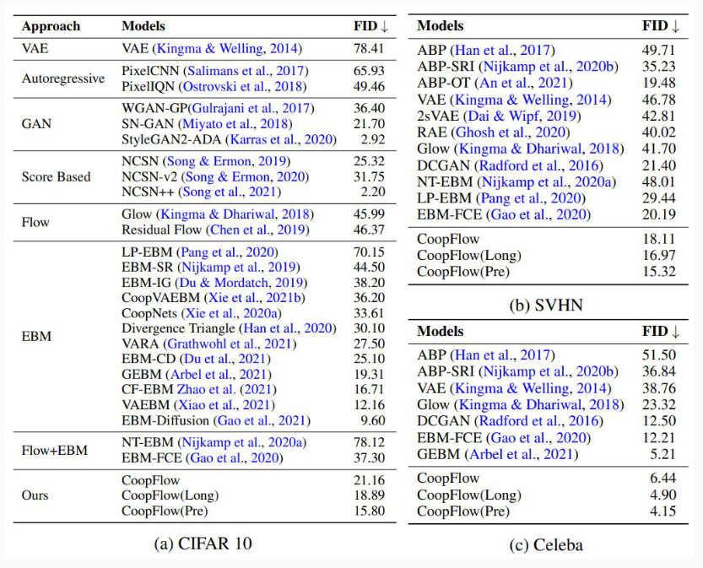
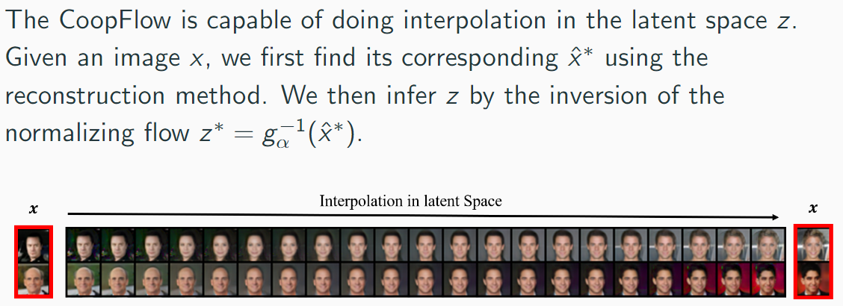
A Tale of Two Flows: Cooperative Learning of
Langevin Flow and Normalizing Flow Toward
Energy-Based Mode
Jianwen Xie, Yaxuan Zhu, Jun Li, Ping Li
Cognitive Computing Lab, Baidu Research
1. Langevin Flow
3. CoopFlow: Cooperative Learning of Langevin Flow and Normalizing Flow
Generated examples (32 × 32 pixels) by CoopFlow models trained from CIFAR-10, SVHN and Celeba datasets respectively. Samples are obtained from the setting of CoopFlow(pre)
4.2 Experiment 2: Image Reconstruction and Inpainting
4. Experiments
4.1 Experiment 1: Image Generation
Reconstruction of images
2. Normalizing Flow
Image inpainting on Celeba dataset (32 × 32). Each row represents one different initialization. The last two columns display the masked and original images respectively. From the 1st column to the 17th column, we show the inpainted images at different optimization iterations.
4.3 Experiment 3: Interpolation in the Latent Space
Image interpolation results on Celeba dataset (32 × 32). The leftmost and rightmost columns represent the images we observed. The columns in the middle represent the interploation results between the inferred latent vectors of the observed images
References
Jianwen Xie et al. (2016). “A Theory of Generative ConvNet”. In: ICML.
Durk P. Kingma et al. (2018). “Glow: Generative Flow with Invertible 1x1 Convolutions.” In: NeurIPS.
Jianwen Xie et al. (2018). “Cooperative Learning of Energy-Based Model and Latent Variable Model via MCMC Teaching.” In: AAAI.
FID scores on CIFAR-10, SVHN and Celeba datasets. Images are resized to 32×32 pixels

