Slide 1
Learning Dynamic Generator by Alternating Back-propagation Through Time
Jianwen Xie*, Ruiqi Gao*, Zilong Zheng, Song-Chun Zhu, Ying Nian Wu
Hikvision Research Institute, UCLA
AAAI-2019 Oral Presentation

Slide 2
Summary
Introduction
Model: dynamic generator
Learning and inference: alternating back-propagation through time
Experiments on synthesis and inpainting
Conclusion

Slide 3
Introduction
Learning dynamic model for dynamic textures and action sequences
Non-linear generalization of state-space model
Sub-model 1: transition model in state space
Sub-model 2: generator model from state vector to image frame
Maximum likelihood learning algorithm
Step 1: inferring latent noise vectors by Langevin dynamics
Step 2: updating model parameters by gradient descent

Slide 4
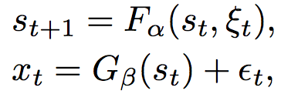
Dynamic generator model
Let be the observed video sequence. The dynamic generator model consists of two components:
(1) transition model, (2) emission model
is the hidden state vector, is the noise vector.
are independent. follows a non-linear auto-regress model. is a feedforward neural network.
is a top-down convolutional network. is the residual error.
are all the model parameters.

Slide 5
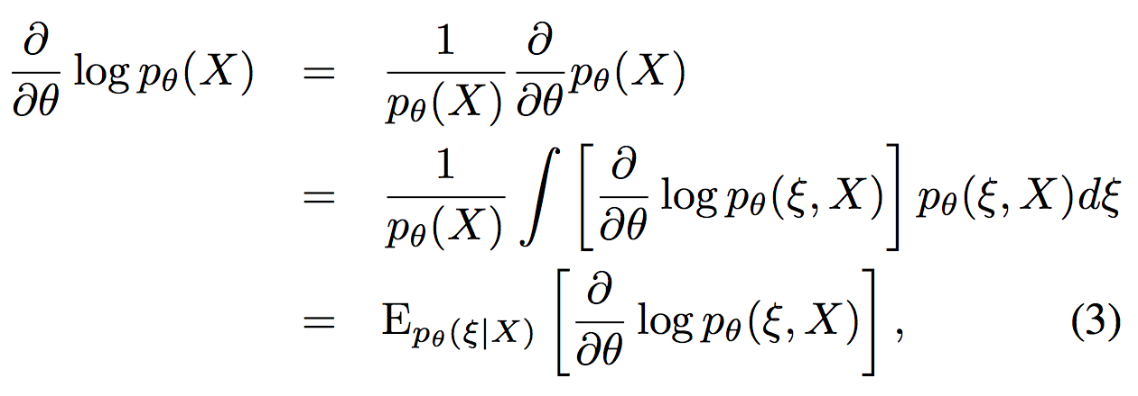
Alternating Back-prop Through Time
We estimate the model parameter : by maximizing the observed log-likelihood . The gradient of the log-likelihood is
is the complete-data log-likelihood.
is the posterior distribution of given .
The expectation can be approximated by Monte Carlo average.

Slide 6
Alternating Back-prop Through Time
The learning algorithm iterates the following two steps:
Inference step: given the current , sample from by the Langevin dynamics
Learning step: given , update by stochastic gradient descent
Both steps involves derivatives of
“alternating back-propagation though time”

Slide 7
Learning from multiple sequences
We can learn the model from multiple sequences of different appearances but of similar motion patterns.
appearance
is the -th training sequence,
is the appearance vector, fixed over time for each sequence.
We can introduce to account for the variations of motion patterns. The transition model becomes

Slide 8
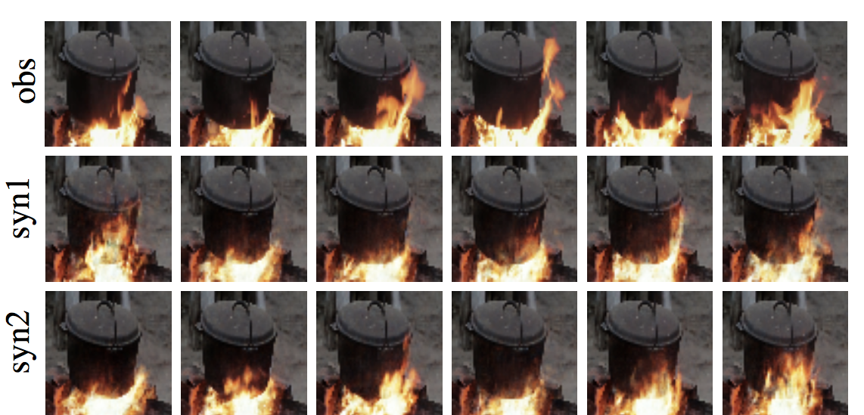
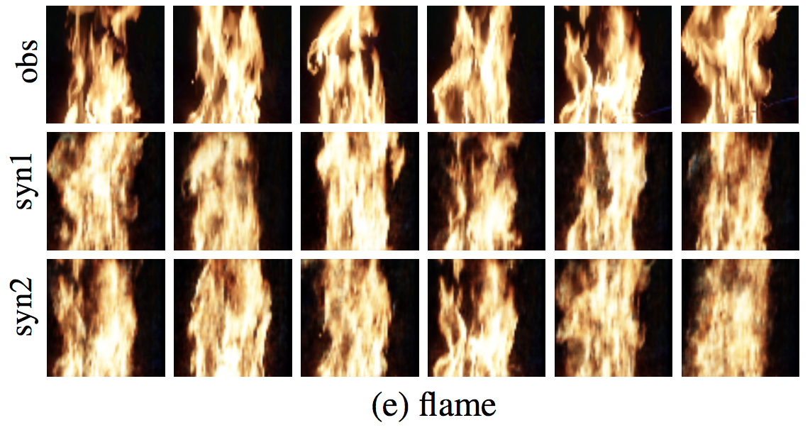
Experiment 1: learning to generate dynamic textures
We learn a separate model from each example.
Synthesized dynamic textures from the learned model:
(a) burning fire heating a pot
(b) flame

Slide 9
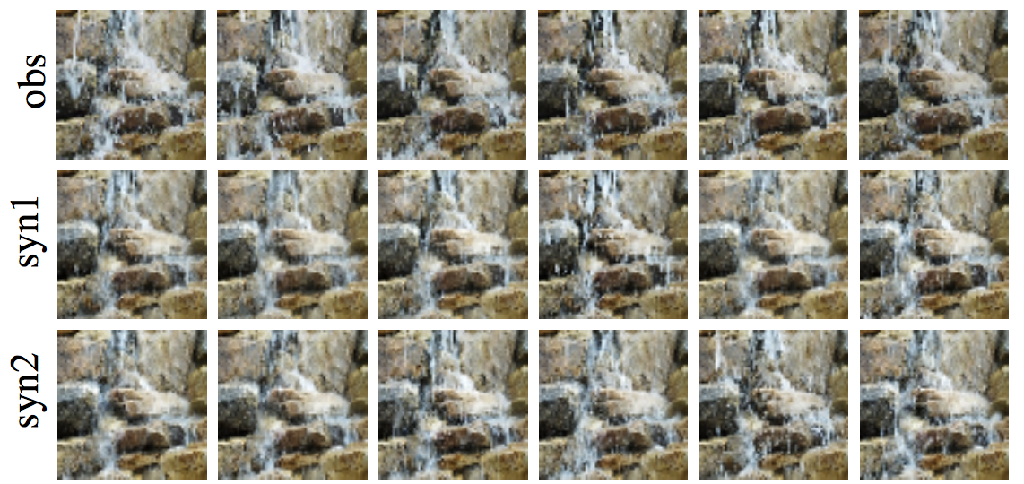
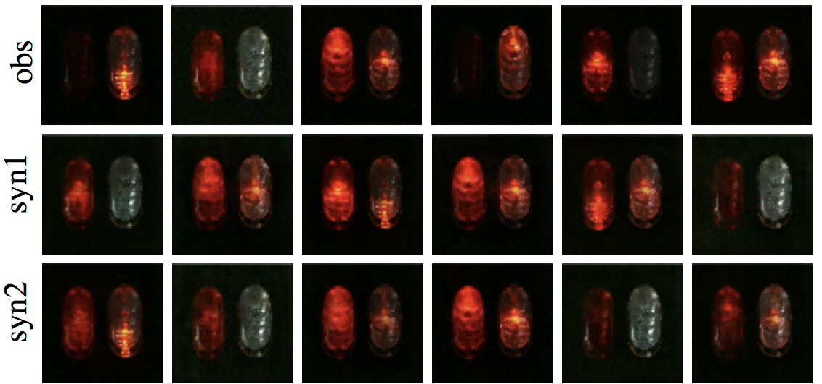
Experiment 1: learning to generate dynamic textures
Synthesized dynamic textures from the learned model:
(c) waterfall
(d) flashing lights

Slide 10
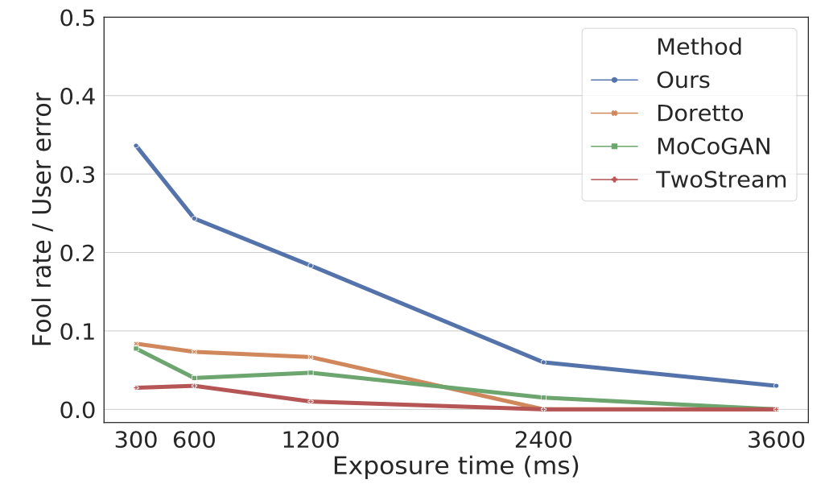
Experiment 1: learning to generate dynamic textures
A human perceptual study to evaluate the perceived realism of the synthesized examples: each user is asked to select which one is fake after viewing a pair of synthesized and real dynamic textures.
“fooling rate” (user error rate) over exposure times

Slide 11
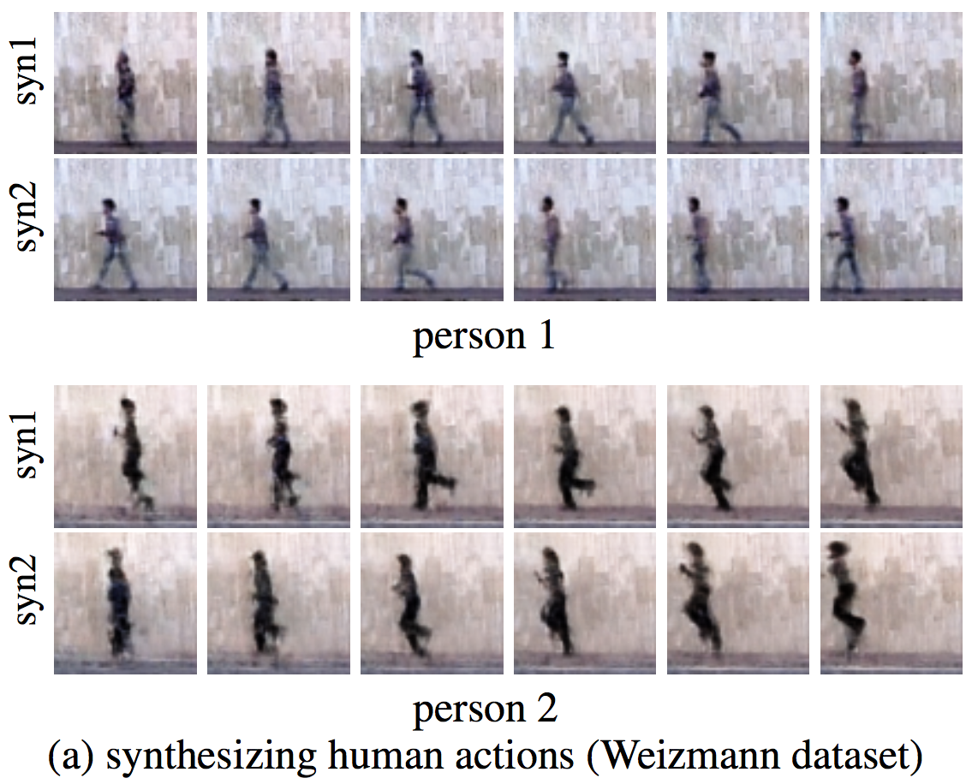
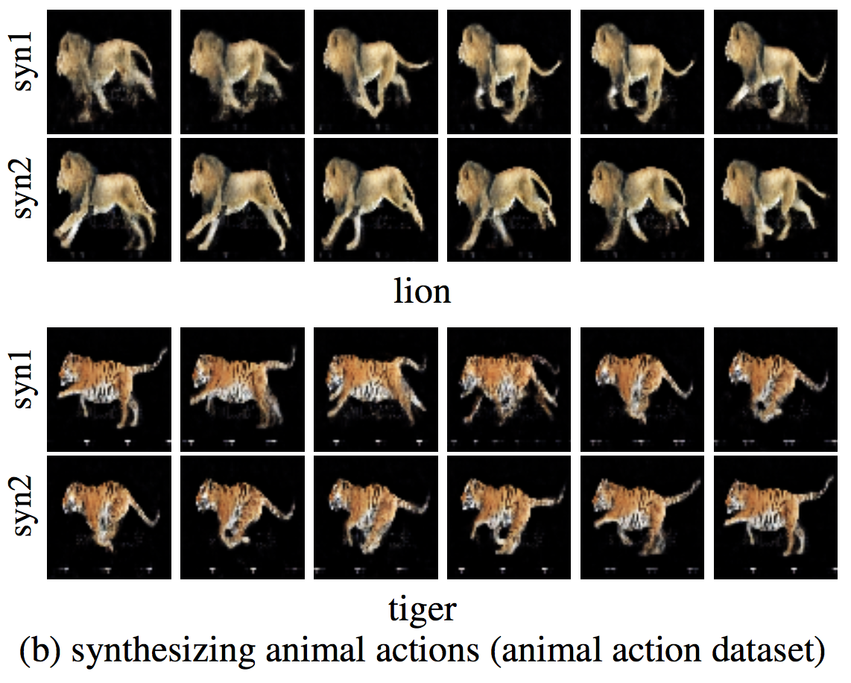
Experiment 2: learning to generate action sequences
Learn the model from multiple examples with different appearances. A single model is trained on the whole dataset without annotations.
After learning, we pick an appearance vector inferred from the observed video and generate new motion pattern:

Slide 12
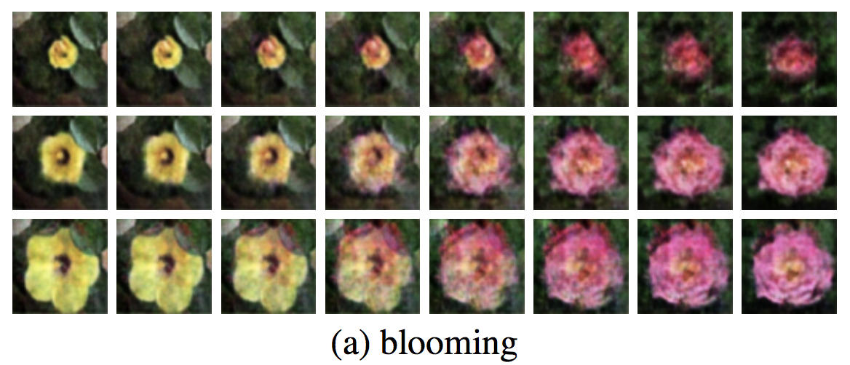
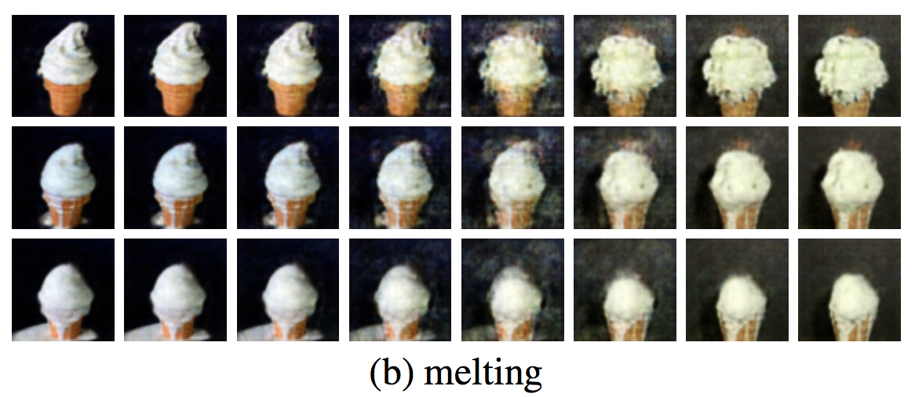
Experiment 2: learning to generate action sequences
Video interpolation by interpolating between appearance latent vectors of videos at the two ends.
Train on 9 categories of videos in the UCF101 database and compute the inception score.

Slide 13
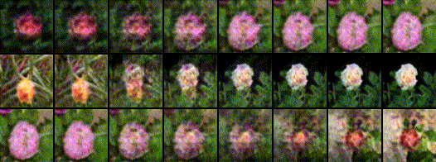
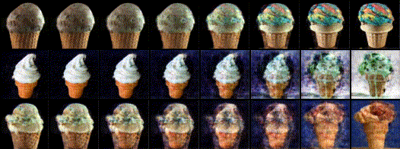
Experiment 2: learning to generate action sequences
Video interpolation by interpolating between appearance latent vectors of videos at the two ends.

Slide 14
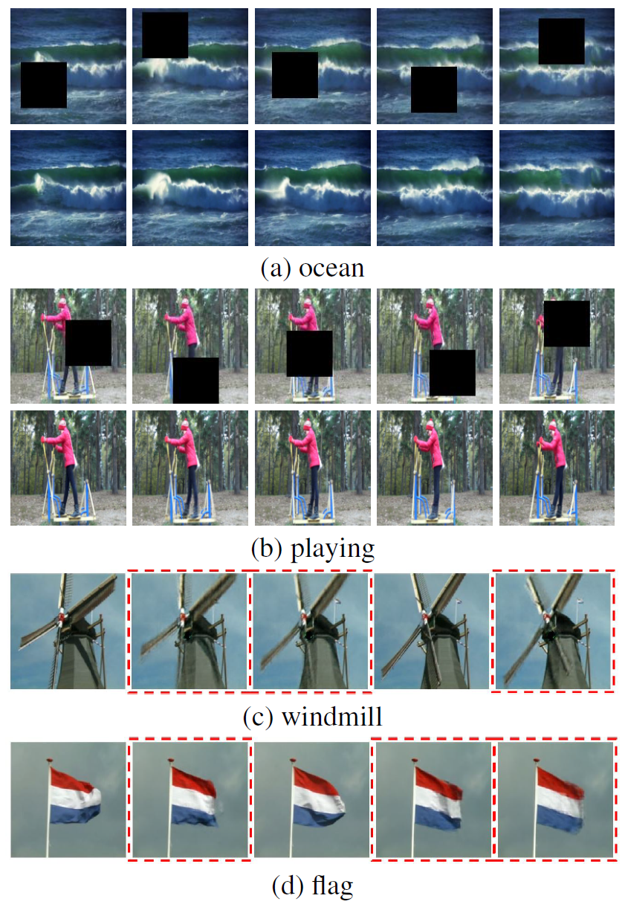
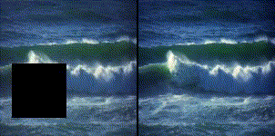
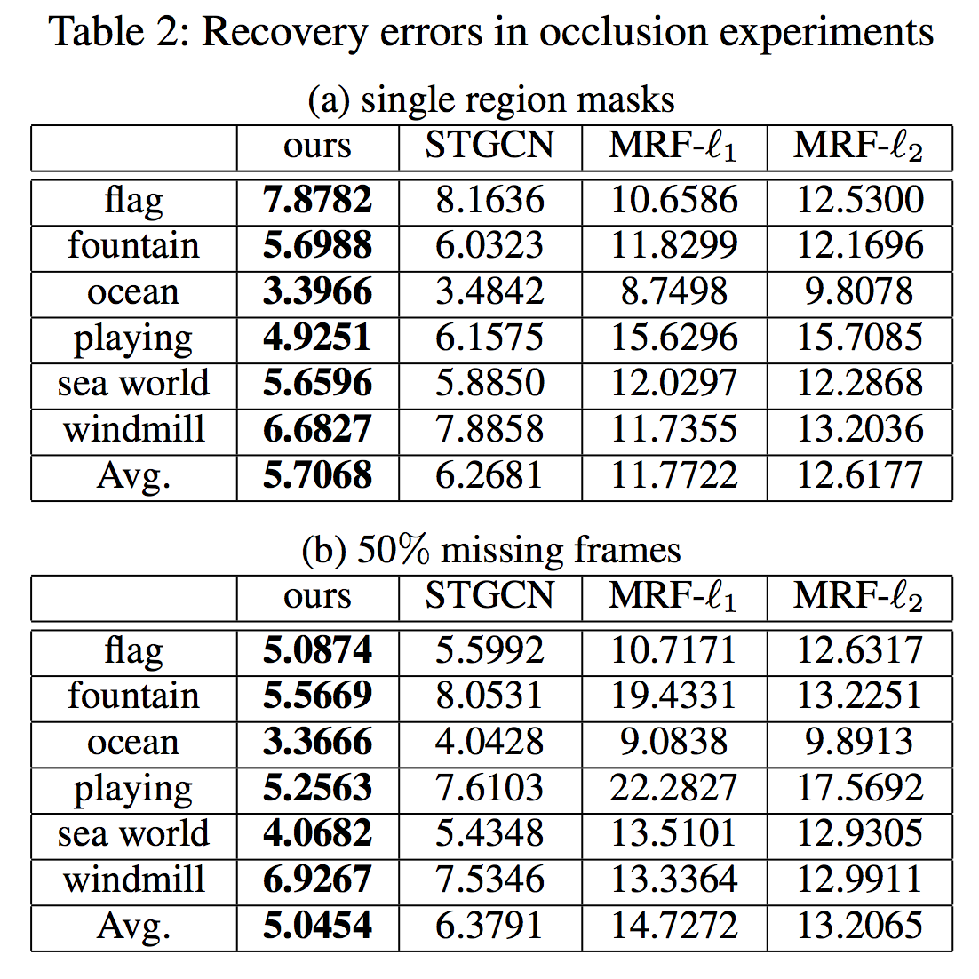
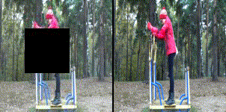
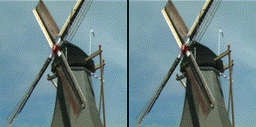
Experiment 3: learning from incomplete data
We compute by summing over only the visible pixels. With inferred and , and learned and , the occluded pixels can be recovered by .

Slide 15
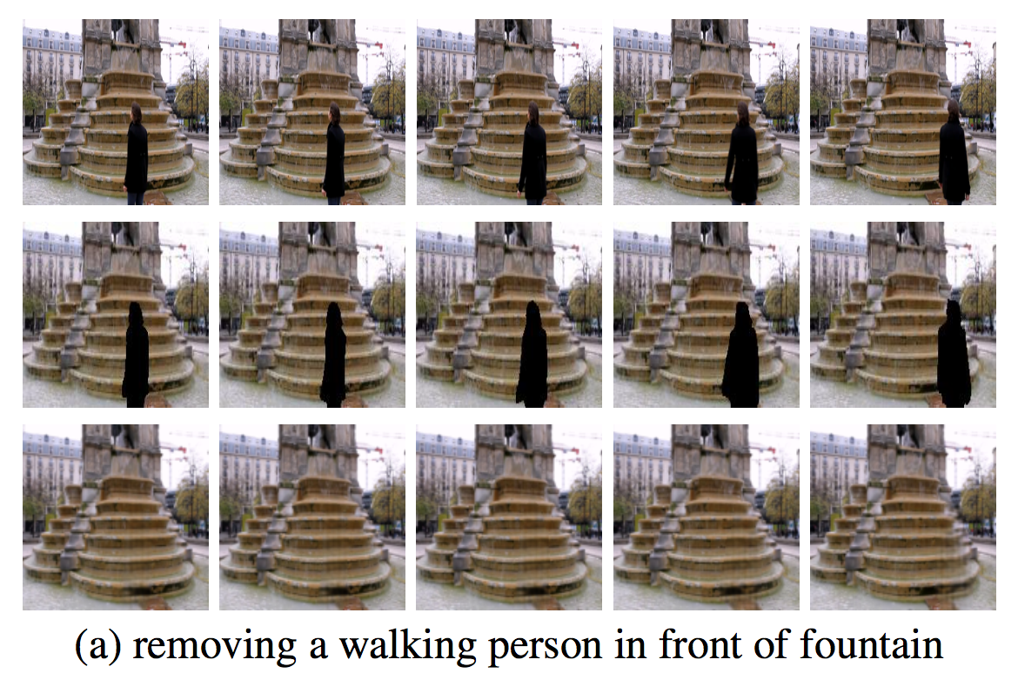
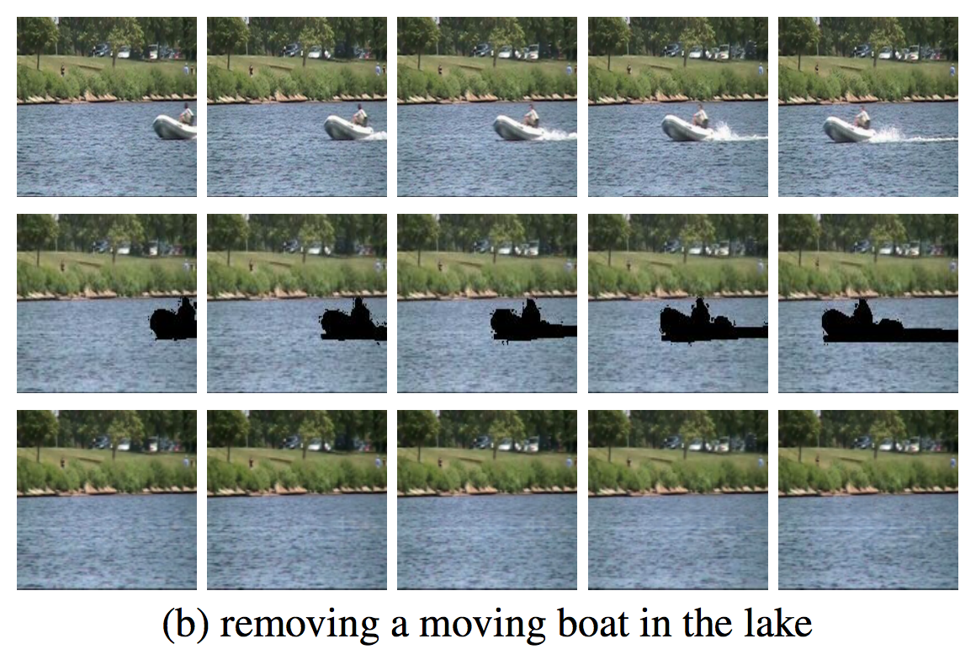
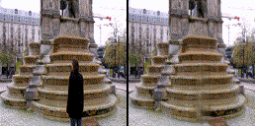
Experiment 4: learning to inpaint
We manually mask the undesirable moving object in each frame, and learn the model from the masked video with the recovery algorithm in Exp 3.

Slide 16
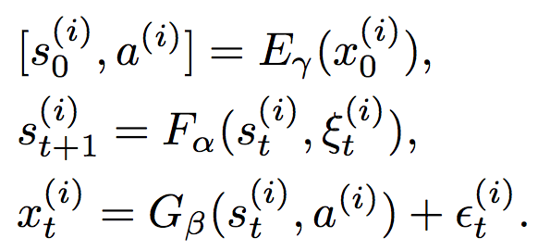
Experiment 5: learning to predict from static image
Incorporate an extra encoder to map the first frame into its appearance latent vector and state vector .

Slide 17
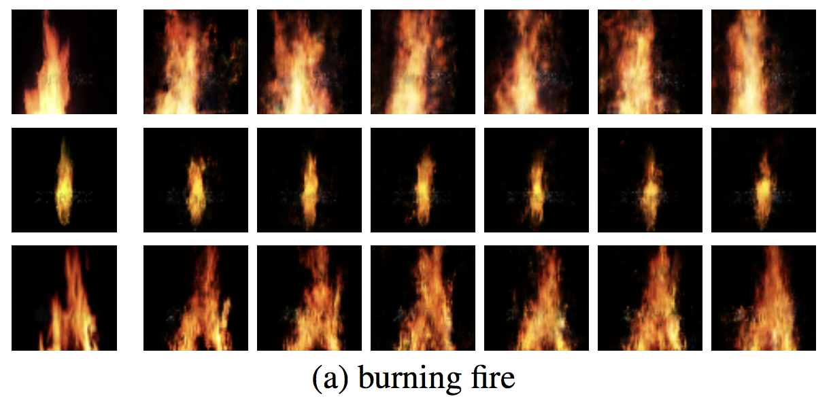
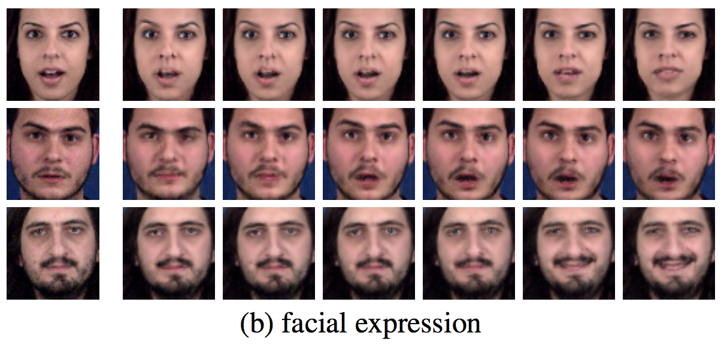
Experiment 5: learning to predict from static image
Image to video prediction. For each example, the first image is the static image frame, and the rest are 6 frames of the predicted sequence.

Slide 18
Related work
Dynamic texture model (directly inspired our work)
Chaos model, deterministic with observed latent vectors
VAE: require extra inference model, non-trivial, non-adaptive input
GAN: require extra discriminator, no inference
Spatial-temporal energy-based model or generator: non-causal

Slide 19
Conclusion
Non-linear state space model
Simple and efficient learning and inference algorithm
Synthesis, inpainting, prediction
Action, dynamics, control, policy
Vector field, optical flow, mental physics, real physics

Slide 20
References
Doretto, G.; Chiuso, A.; Wu, Y. N.; and Soatto, S. 2003. Dynamic textures. International Journal of Computer Vision 51(2):91–109.
Saito, M.; Matsumoto, E.; and Saito, S. 2017. Temporal generative adversarial nets with singular value clipping. In IEEE International Conference on Computer Vision (ICCV).
Tulyakov, S.; Liu, M.-Y.; Yang, X.; and Kautz, J. 2017. Mocogan: Decomposing motion and content for video generation. arXiv preprint arXiv:1707.04993.
Xie, J.; Zhu, S.-C.; and Wu, Y. N. 2017. Synthesizing dynamic patterns by spatial-temporal generative convnet. In Proceedings of the IEEE Conference on Computer Vision and Pattern Recognition (CVPR), 7093–7101.
Tesfaldet, M.; Brubaker, M. A.; and Derpanis, K. G. 2018. Twostream convolutional networks for dynamic texture synthesis. In IEEE Conference on Computer Vision and Pattern Recognition (CVPR).
Han, T.; Lu, Y.; Xing, X.; and Wu, Y. N. 2019. Learning generator networks for dynamic patterns. In IEEE Winter Conference on Applications of Computer Vision (WACV).

Slide 21
Acknowledgement
Part of the work was done while R. G. was an intern at Hikvision Research Institute during the summer of 2018. She thanks Director Jane Chen for her help and guidance.
The work is supported by Hikvision gift fund, DARPA SIM- PLEX N66001-15-C-4035, ONR MURI N00014-16-1-2007, and DARPA ARO W911NF-16-1-0579.
We gratefully acknowledge the support of NVIDIA Corporation with the donation of the Titan Xp GPU used for this research.

