Slide 1
Inducing Wavelets into Random Field
Ying Nian Wu
UCLA Department of Statistics
with Jianwen Xie, Yang Lu, Song-Chun Zhu
Oct 2015

Slide 2
Outline
Theme 1: Wavelets and sparse representation
Theme 2: Markov random fields
Our work: Inducing wavelets into random fields

Slide 3
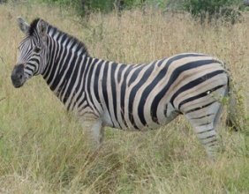
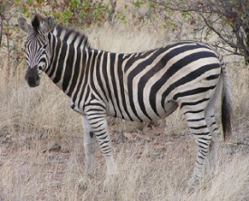
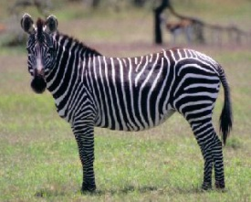
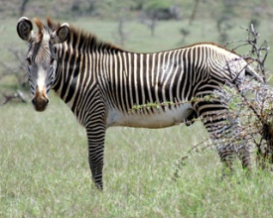
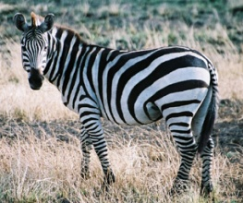
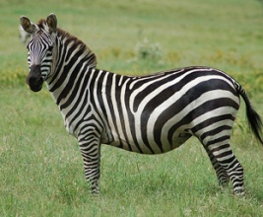
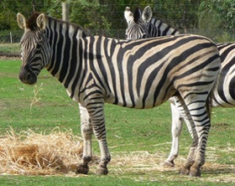
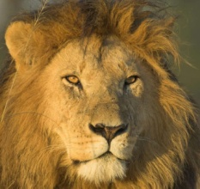
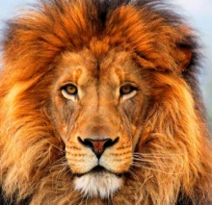
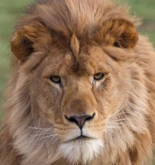
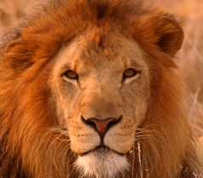
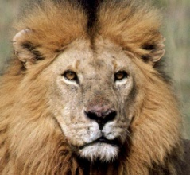
Statistical Models of Image Patterns
There are a large number of object patterns in natural scenes

Slide 4
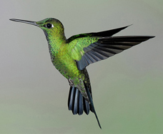
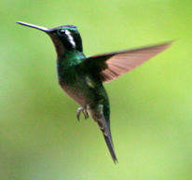
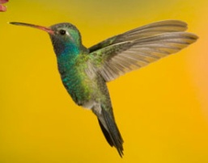
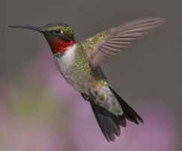
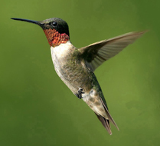
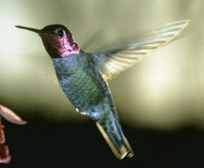
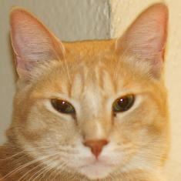
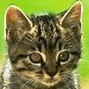
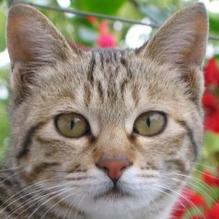
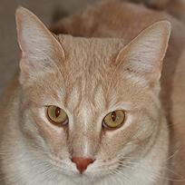
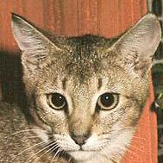
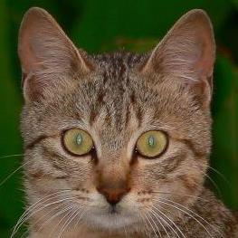
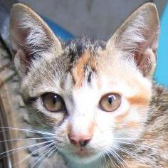
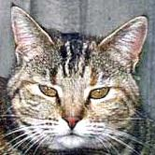
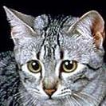
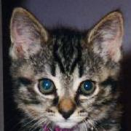
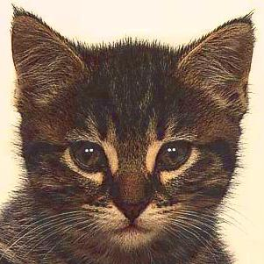
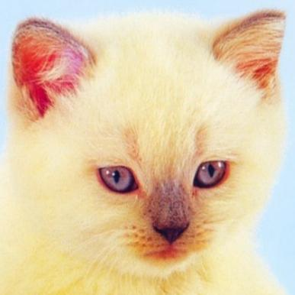
Statistical Models of Image Patterns

Slide 5
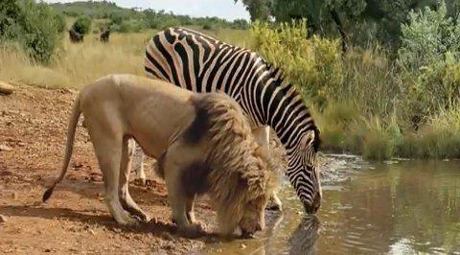
It is important to recognize these patterns
The lion and zebra should recognize each other for their survival

Slide 6
Statistical Models of Image Patterns
Learn a generative model of zebra
What a zebra looks like?

Slide 7
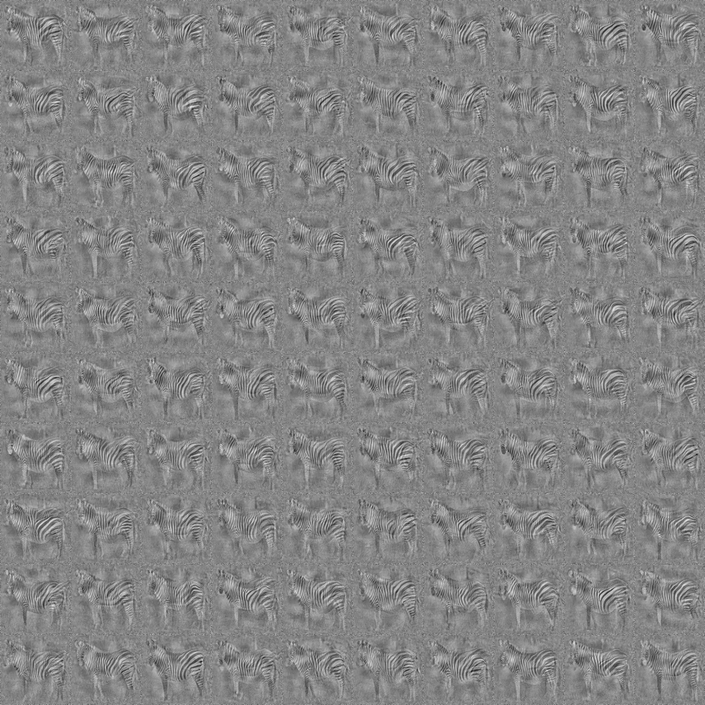
Images generated by the learned model

Slide 8
Statistical Models of Image Patterns
Learn a generative model of lion
What a lion looks like?

Slide 9
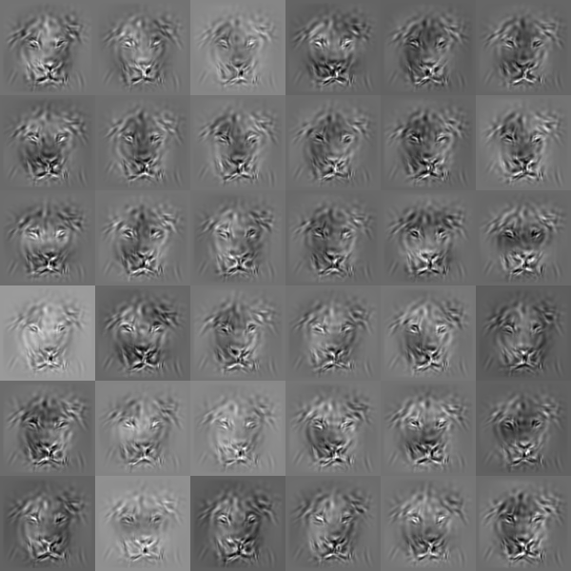

Slide 10
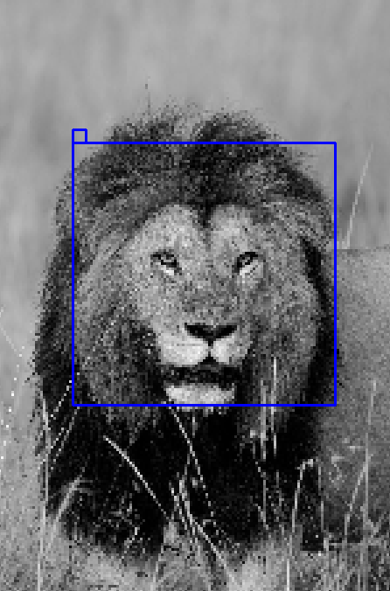
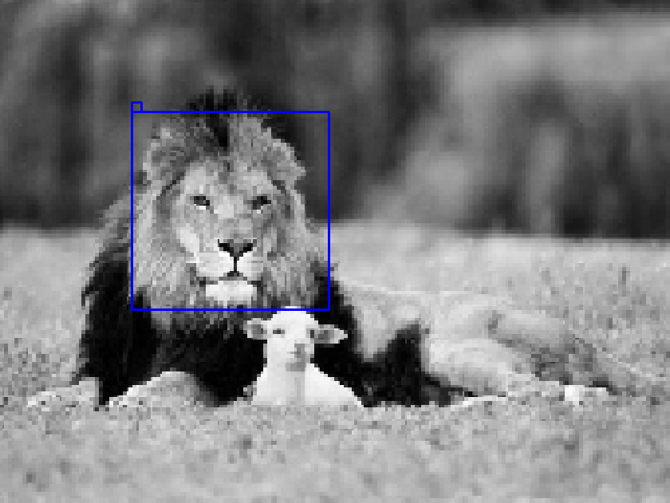
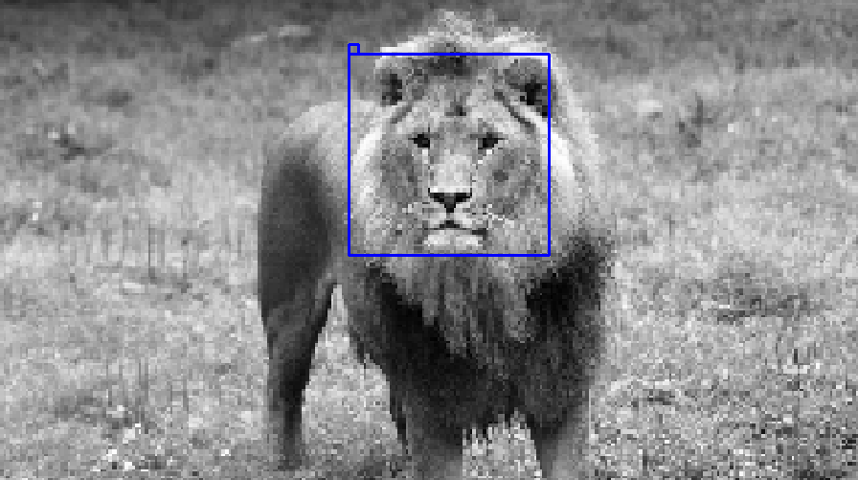
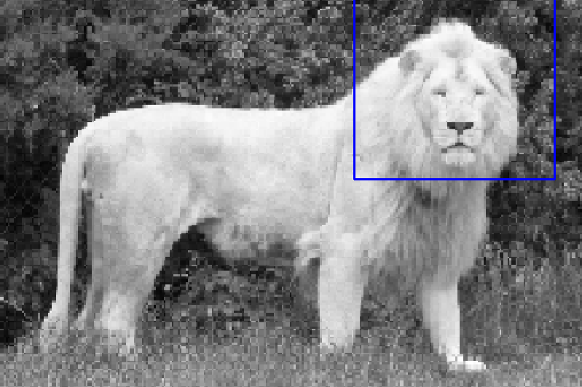
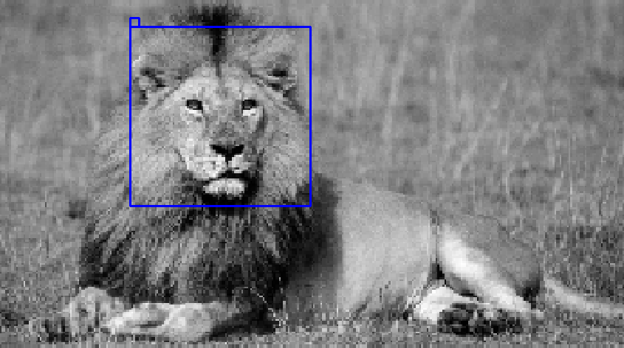
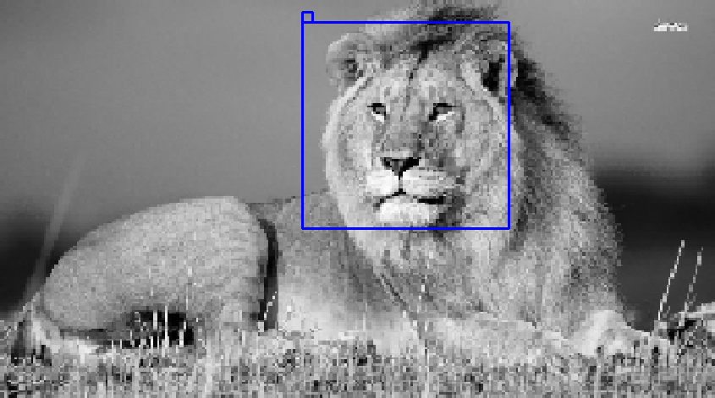
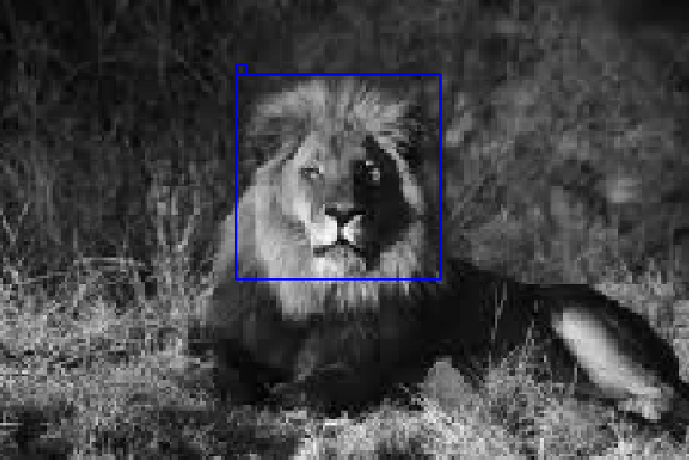
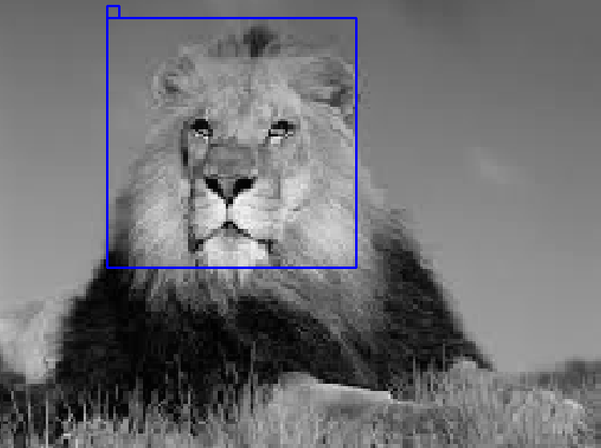
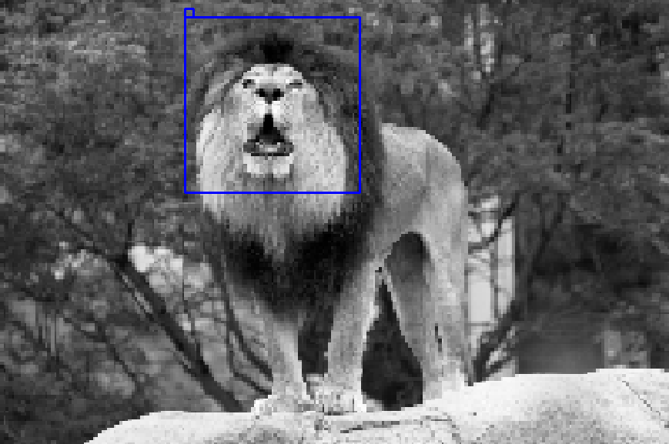
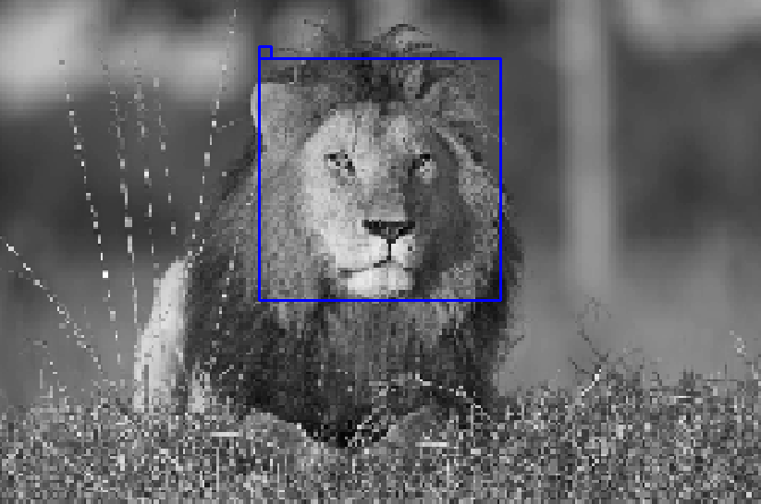
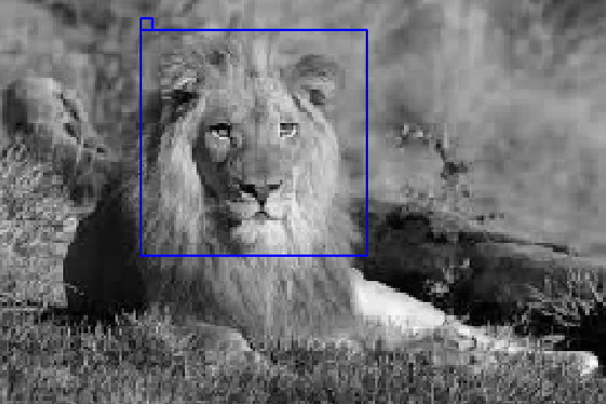
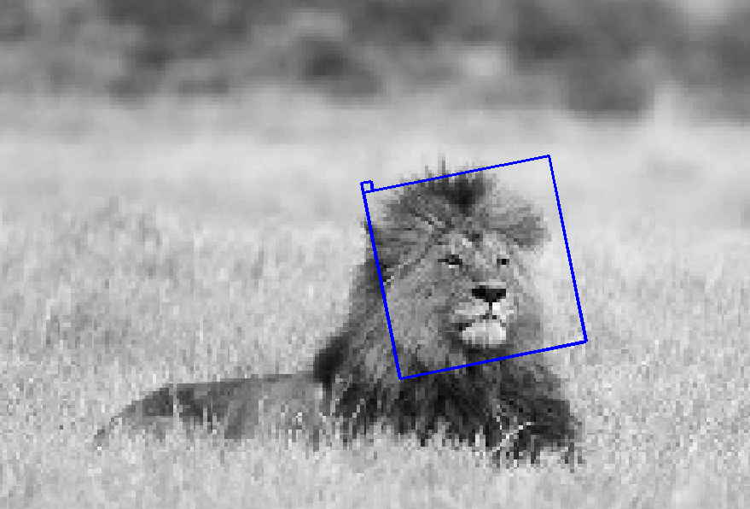
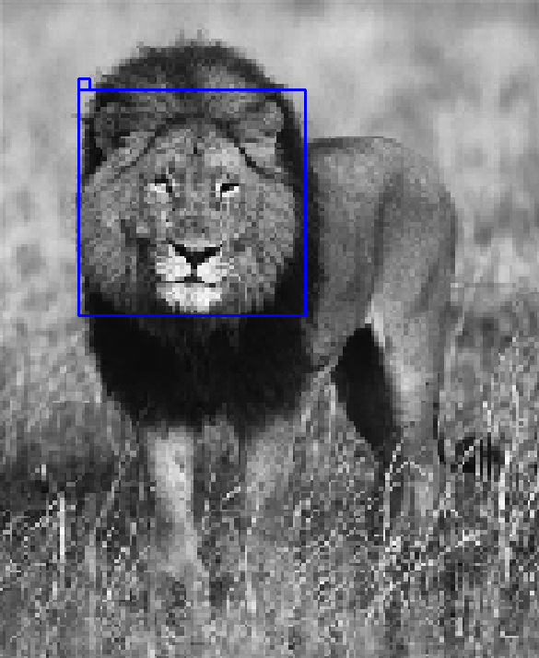
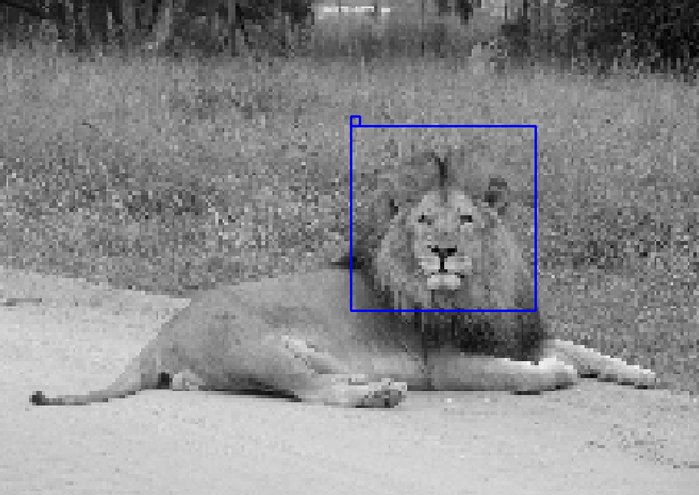
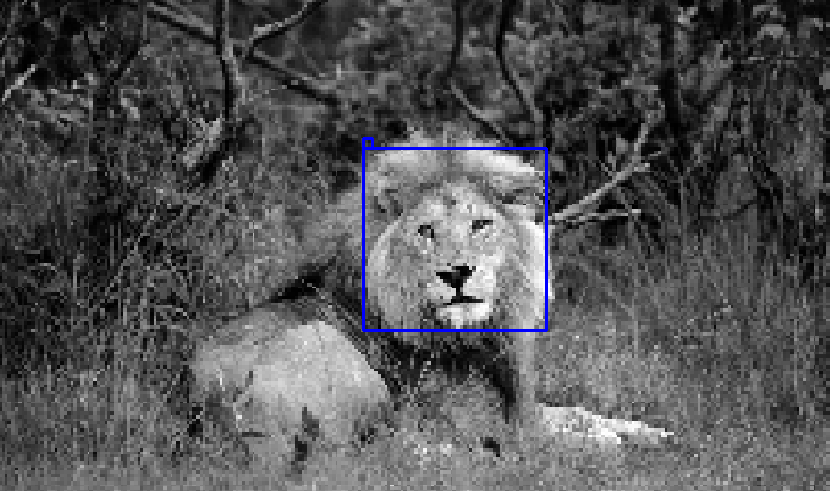
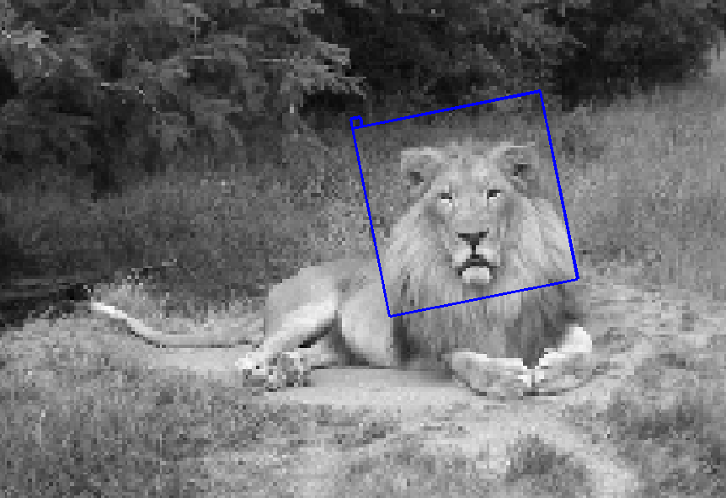
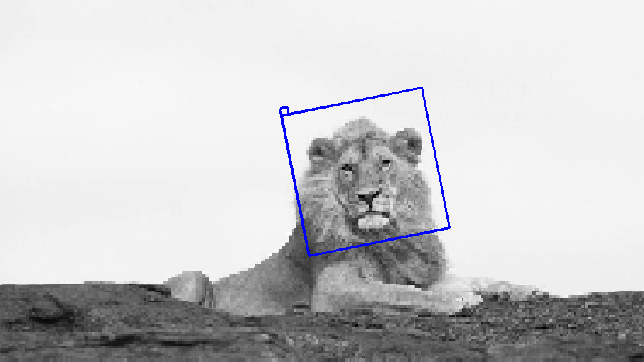
The learned model can be used to detect the pattern in testing images

Slide 11
Wavelets

Slide 12

Inducing Wavelets into Random Field
Each black bar is a Gabor wavelet, darker for smaller
Each circle is a Difference of Gaussian wavelet
Like an artist painting a picture

Slide 13

Inducing Wavelets into Random Field

Slide 14

Convolutional Neural Networks
Le Cun, Hinton, et al.
Source: http://www.es.ele.tue.nl/~dshe/Education/Dmm2012
convolution + point-wise non-linear + max-pooling + subsampling
bottom-up classifier (how), features at different layers, increasing abstract
what has been learned by CNN? top-down generative model (what), unsupervised learning
imagine, dream, fantasize

Slide 15

Multi-layer structure
Half devoted to vision
How knowledge is represented
and learned
Source: Scientific American, 1999

Slide 16
Statistical Models of Image Patterns

Slide 17
Statistical Models of Image Patterns

Slide 18
Statistical Models of Image Patterns

Slide 19
Statistical Models of Image Patterns

Slide 20
Statistical Models of Image Patterns

Slide 21
Outline
Theme 1: Wavelets and sparse representation
Theme 2: Markov random fields
Our work: Inducing wavelets into random fields

Slide 22


UCLA Bruin Walk
Basic notation: an image defined on a lattice of pixels, x is 2D coordinate
I can be considered a vector
or a function on a 2D domain

Slide 23

Gabor wavelets: Gaussian modulated sine waves
localized, elongate and oriented
x: location, s: scale, a: orientation
They serve as basis functions or filters

Slide 24

Filtering operation: inner product, extract local features

Slide 25


Representation: each image is a linear combination of a small number of
basis functions selected from a given dictionary

Slide 26


This can be mapped to
Linear regression model in statistics
Each image is a response vector
Each basis function is a predictor vector

Slide 27

Sparse coding of natural image patches
Dictionary
Localized, elongated, oriented
Wavelets
Basis functions
Atoms
Olshausen, Field, 96

Slide 28
What is beyond sparsity?
Visual cortex
layers above V1
Harmonic analysis
beyond wavelets
Statistical modeling
beyond sparse coding
Source: Scientific American, 1999

Slide 29
Outline
Theme 1: Wavelets and sparse representation
Theme 2: Markov random fields
Our work: Inducing wavelets into random fields

Slide 30







Markov Random Fields
Markov Property
all the other pixels
Nearest neighborhood, first order neighborhood
From Slides by S. Seitz - University of Washington

Slide 31





Markov Random Fields
Second order neighborhood

Slide 32


Markov Random Fields
What is

Slide 33



Hammersley-Clifford Theorem
normalizing constant, partition function
potential functions of cliques
Cliques for this neighborhood
From Slides by S. Seitz - University of Washington

Slide 34

Hammersley-Clifford Theorem
Gibbs distribution
a clique: a set of pixels, each member is the neighbor of any other member
Cliques for this neighborhood
From Slides by S. Seitz - University of Washington

Slide 35
Hammersley-Clifford Theorem
Gibbs distribution
a clique: a set of pixels, each member is the neighbor of any other member
Cliques for this neighborhood
……etc, note: the black lines are for illustrating 2D grids, they are not edges in the graph

Slide 36




Ising model
Cliques for this neighborhood
From Slides by S. Seitz - University of Washington

Slide 37
Sampling from MRF Models
Markov Chain Monte Carlo (MCMC)
Gibbs sampler (Geman & Geman 84)
Metropolis algorithm (Metropolis et al. 53)
Swedeson & Wang (87)
Langvine dynamics
Hybrid (Hamiltonian) Monte Carlo

Slide 38


Need more sophisticated model
i.e. clique functions

Slide 39
Outline
Theme 1: Wavelets and sparse representation
Theme 2: Markov random fields
Our work: Inducing wavelets into random fields

Slide 40
We start from the above filtering operation and we will use the linear representation later

Slide 41


FRAME (Filters, Random field, and Maximum Entropy)
Zhu, Wu, Mumford, 97, Wu, Zhu, Liu, 00
Xie, Hu, Zhu, Wu, 14
q is a known reference density
Gaussian white noise
Exponential family model, Markov random field, Gibbs distribution, energy-based
Inhomogeneous version for object patterns, roughly aligned

Slide 42



Inhomogeneous FRAME (Xie, Hu, Zhu, Wu, 14)
Maximum likelihood
Matching model to data in terms of sufficient stat

Slide 43
Inhomogeneous FRAME (Xie, Hu, Zhu, Wu, 13)
The fitted model is an approximation to the unknown distribution

Slide 44






Maximum entropy (minimum divergence)

Slide 45









Stochastic gradient descent (Younes, 97)
Analysis by synthesis

Slide 46









Hamiltonian Monte Carlo (Neals, 97)
Bottom-up convolution + top-down convolution
Can also use Langevin dynamics

Slide 47

Normalizing constant
Needed when there are multiple models competing

Slide 48

































Slide 49























Slide 50








Sparse FRAME (Xie, Hu, Zhu, Wu, 14)
statistical efficiency and computational efficiency
explicit composition: each black bar is a Gabor wavelet, darker for smaller

Slide 51

Sparse FRAME (Xie, Hu, Zhu, Wu, 14)

Slide 52



Sparse FRAME = shared sparse coding
Perturbations for shape deformation
Selecting basis functions

Slide 53










Slide 55




Slide 56

Shared matching pursuit
explaining-away

Slide 57
Sparse FRAME (Xie, Hu, Zhu, Wu, 14)
Two-stage learning:
(1) selecting the basis functions by shared matching pursuit
(2) estimating parameters, modeling the coefficients

Slide 58


Sparse FRAME (Xie, Hu, Zhu, Wu, 14)
Given selected basis functions
Deformable template
Template matching
Separating shape and appearance

Slide 59


Slide 60
Sparse FRAME (Xie, Hu, Zhu, Wu, 14)

Slide 61



Gibbs sampler on coefficients（Xie, Zhu, Wu, 14)
Liu and Wu, orbit
Markov random field, neighborhood system
Coefficients close to independent, fast mixing, role of sparsity

Slide 62



Generative epsilon-boosting（Xie, Lu, Zhu, Wu, 15)
Friedman: epsilon-boosting, stagewise
L1 solution path LARS
Slower than LARS for L1 penalized least squares
Good combination with generalized Gibbs sampler
Information projection
Learning hierarchical compositional models

Slide 63





Slide 64


Slide 65


















































Learning from non-aligned image: less supervision
Hong, Si, Hu, Zhu, Wu, 2014

Slide 66








Unsupervised learning of visual words
Generalize to testing images
Hong, Si, Hu, Zhu, Wu, 2014

Slide 67
















Unsupervised learning of visual words

Slide 68



Compositional sparse code
strokes → characters

Slide 69
Convolutional Neural Networks
Le Cun, Hinton, et al.
Source: http://www.es.ele.tue.nl/~dshe/Education/Dmm2012
convolution + point-wise non-linear + max-pooling + subsampling
bottom-up, features at different layers, increasing abstract

Slide 70

Convolution
Source: https://developer.apple.com/library/
applying the same linear combination of pixels everywhere
shift-invariant connection weights as filter

Slide 71

Generalized Linear Model
Source: http://dataminingtheworld.blogspot.com
different neurons have different sets of weights
Intercept term: bias or threshold

Slide 72

Non-linear Link Function
Source: http://static.googleusercontent.com/media/
logistic/sigmoid: logistic regression, generalized linear model
rectificed linear unit: detect and report score

Slide 73
Convolutional Neural Networks
Source: http://www.es.ele.tue.nl/~dshe/Education/Dmm2012
compositions of the same form of operations
logistic regressions (GLM) on top of logistic regressions (GLM)
function approximation by composite function
distributed representation, shared features, reusable parts
million or billions of parameters (weights & intercepts)
trained by gradient descent on loss function
chain rule, back-propagation of error
loss function highly multimodal, local mode

Slide 74

Feifei Li, et al
CNN has million or billions of parameters
needs big data to train, go through small batches, stochastic gradient descent
Imagenet: organized according to word net (nouns)
one version: 1000 categories, each has 1000 images
Source: http://image-net.org/index
http://karpathy.github.io/

Slide 75







Generative Convolutional Neural Net
Texture model: stationary
Object model: non-stationary
Generative CNN: 2nd layer unit, sparsely wired, unsupervised learning
Dai, Lu, Wu, 2015; Lu, Zhu, Wu, 2015

Slide 80
Summary
Wavelets and sparse representation
Markov random fields
FRAME (Filters, Random field, And Maximum Entropy) model
Learning sparse and deep generative models from big data

