Slide 1
Generative Models of Image Patterns
Ying Nian Wu
UCLA Department of Statistics
with Jianwen Xie, Wenze Hu, Song-Chun Zhu
Nov 20, 2013 @ UCLA Biostat

Slide 2

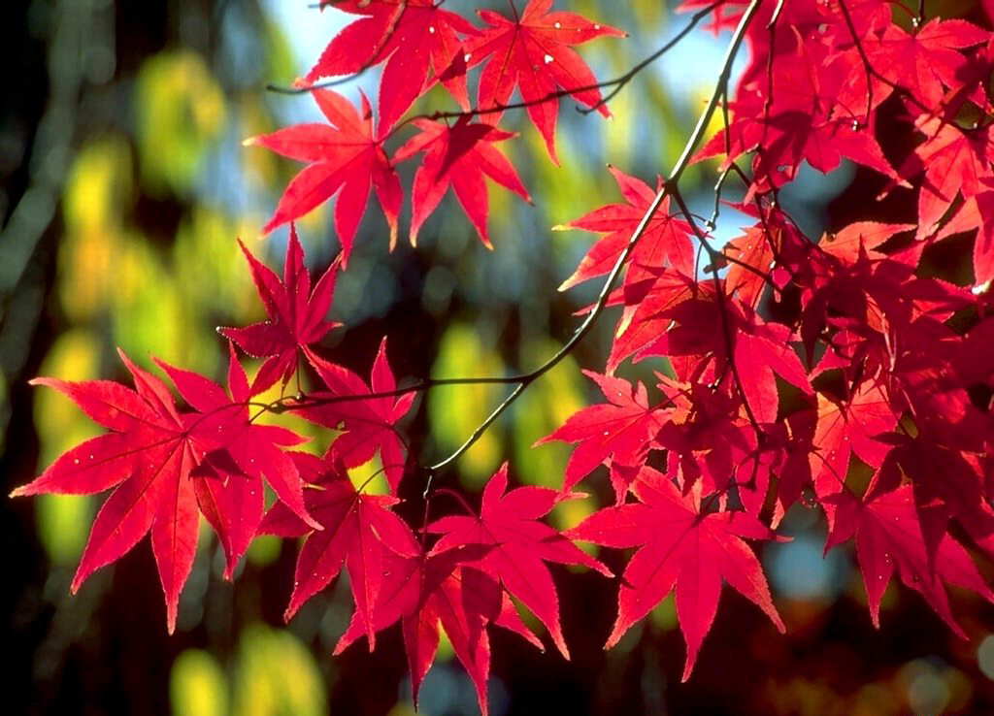
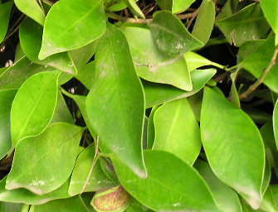
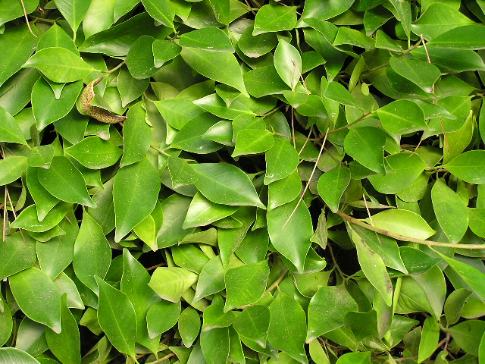
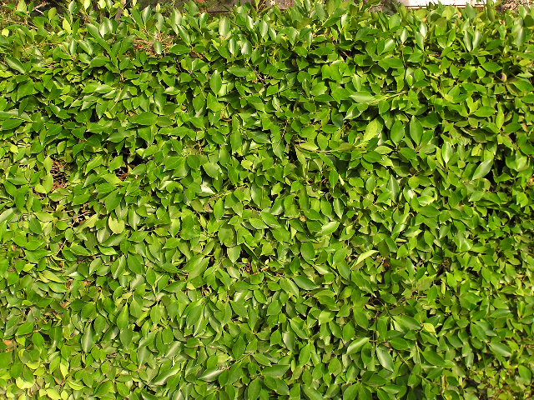
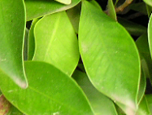

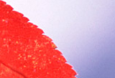
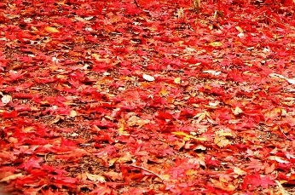
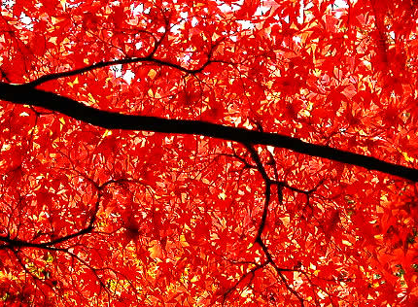
Wu, Zhu, Guo, 04,07
fine
coarse

Slide 3
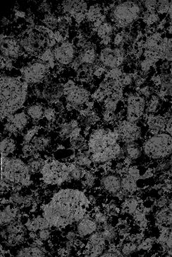
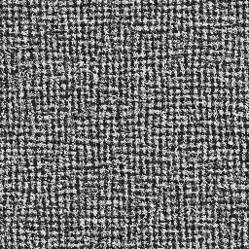
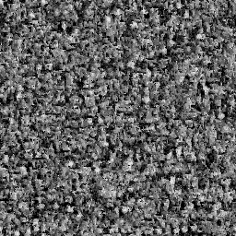
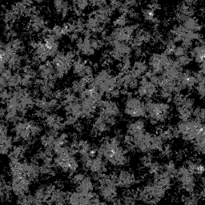
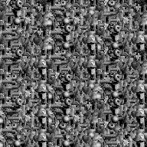
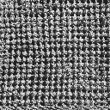
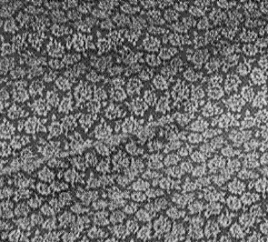
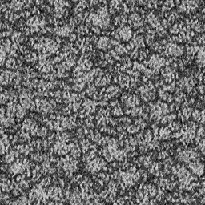
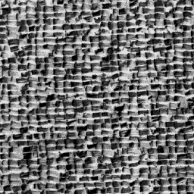
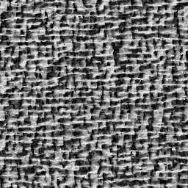
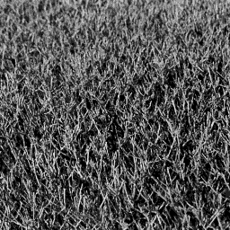
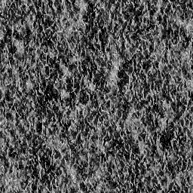
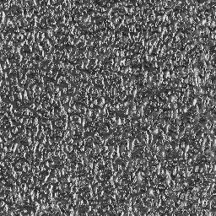
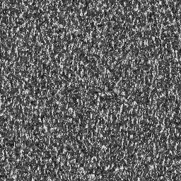
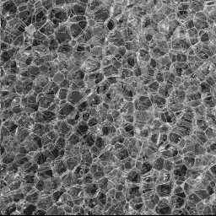
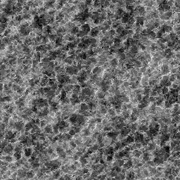
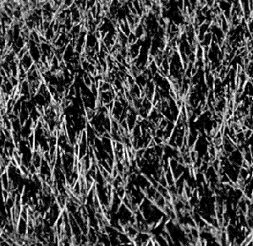
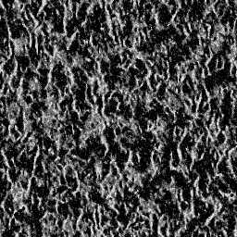
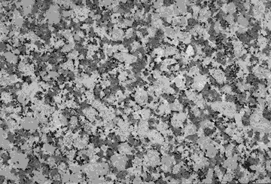
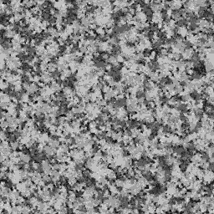
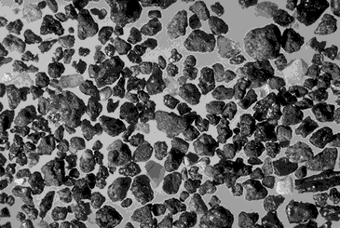
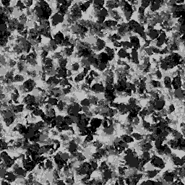
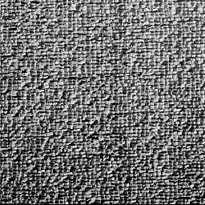
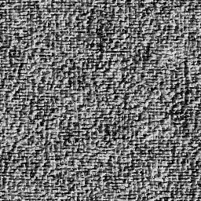
Zhu,Liu,Wu,00
Wu,Zhu,Liu,00

Slide 4
Wu, Zhu, Guo, 04,07
fine
coarse

Slide 5
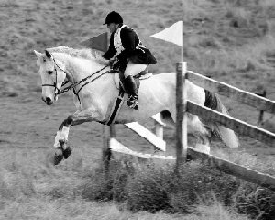
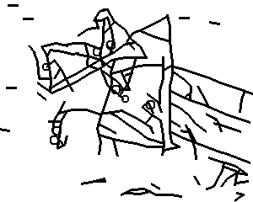
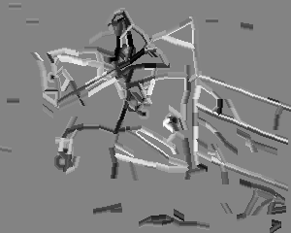
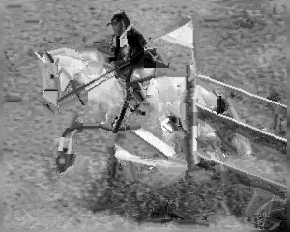
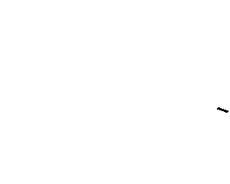
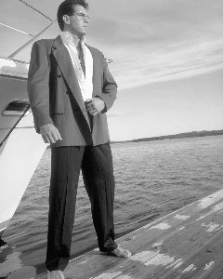
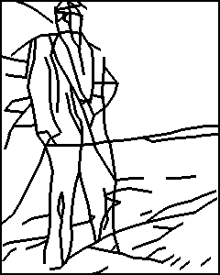
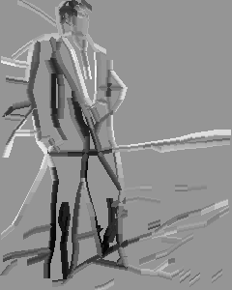
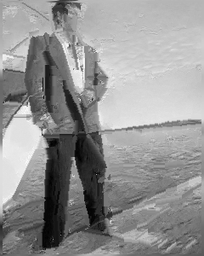

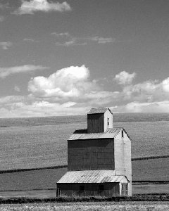
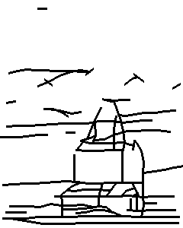
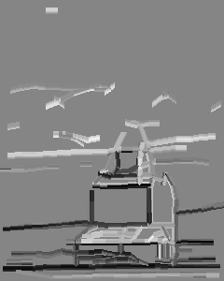
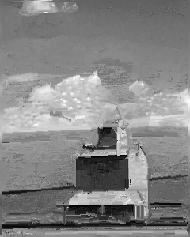
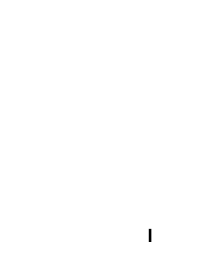
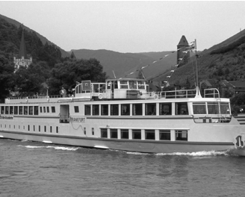
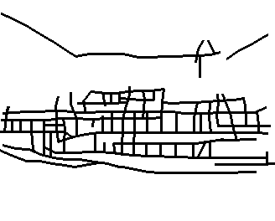
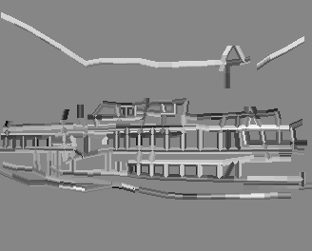
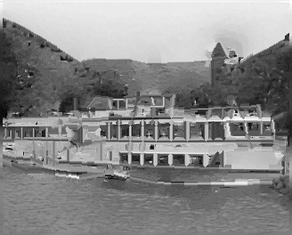






Guo, Zhu, Wu, 03,07

Slide 6
Wu, Zhu, Guo, 04,07
fine
coarse

Slide 7













Slide 8



















Slide 9


Slide 11


Slide 12












Slide 14






Slide 15





































Slide 16


















Slide 17


Slide 18

Dictionary: basis functions, filters

Slide 19


Slide 20



Slide 21



Slide 23


FRAME (Filters, Random field, and Maximum Entropy)
Zhu, Wu, Mumford, 97, Wu, Zhu, Liu, 00

Slide 24



Inhomogeneous FRAME (Xie, Hu, Zhu, Wu, 13)
Maximum likelihood

Slide 25
Inhomogeneous FRAME (Xie, Hu, Zhu, Wu, 13)

Slide 26






Maximum entropy (minimum divergence)

Slide 27









Stochastic gradient descent (Younes, 97)

Slide 28









Hamiltonian Monte Carlo (Neals, 97)

Slide 29

Normalizing constant

Slide 31














Slide 32











Slide 33


















Slide 34














Slide 35














Slide 36








Sparse FRAME (Xie, Hu, Zhu, Wu, 13)

Slide 38

Sparse coding of natural image patches
Dictionary
Localized, elongated, oriented
Wavelets
Basis functions
Elementary signals
Atoms
Olshausen, Field, 96

Slide 39




Sparse FRAME (Xie, Hu, Zhu, Wu, 13)

Slide 40



Sparse FRAME = shared sparse coding

Slide 41










Slide 43




Slide 44

Shared matching pursuit

Slide 46
Sparse FRAME (Xie, Hu, Zhu, Wu, 13)

Slide 47


Sparse FRAME (Xie, Hu, Zhu, Wu, 13)

Slide 48































Slide 49


Slide 50












Slide 51





































Slide 52










Slide 53










Slide 54
















Slide 55










Slide 56







Slide 57







Slide 58


Slide 59










Slide 60































Slide 61


Slide 62


Slide 63

























Slide 64


Slide 65


Slide 66


Compositional sparse code
strokes → characters

Slide 67








Compositional sparse code (Hong, Si, Hu, Zhu, Wu, 13)
Generalize to testing images

Slide 68



Compositional sparse code

Slide 69
Unsupervised learning
Image encoding (E-like step)
Dictionary re-learning (M-like step)

Slide 70





Slide 71




Slide 72




Slide 73





Slide 74









Slide 75













Slide 76
Domain Adaption Dataset
Images are coming from four different sources: Caltech256, Amazon, DSLR and Webcam
Train a classifier on images from one source and test on images from another source
Bag-of-words using SIFT+SPM+SVM performs poorly in this settings

Slide 77
Typical monitor images from different sources
Copy from the paper: "Geodesic Flow Kernel for
Unsupervised Domain Adaptation", B. Gong, Y. Shi, F. Sha and K. Grauman

Slide 78


Slide 79


Slide 80
Conclusion
Markov random fields
Sparse linear regression
Modeling shared sparsity

