Slide 1
Stochastic Sets and Regimes of Mathematical Models of Images
Song-Chun Zhu
University of California, Los Angeles
Tsinghua Sanya Int’l Math Forum, Jan, 2013

Slide 2
Outline
1, Three regimes of image models and stochastic sets
2, Information scaling ---- the transitions in a continuous entropy spectrum.
High entropy regime --- (Gibbs, MRF, FRAME) and Julesz ensembles;
Low entropy regime --- Sparse land and bounded subspace;
Middle entropy regime --- Stochastic image grammar and its language; and
3, Spatial, Temporal, and Causal and-or-graph
Demo on joint parsing and query answering

Slide 3

How do we represent a concept in computer?
Mathematics and logic has been based on deterministic sets (e.g. Cantor, Boole)
and their compositions through the “and”, “or”, and “negation” operators.
But the world is fundamentally stochastic !
e.g. the set of people who are in Sanya today, and
the set of people in Florida who voted for Al Gore in 2000
are impossible to know exactly.
Ref. [1] D. Mumford. The Dawning of the Age of Stochasticity. 2000.
[2] E. Jaynes. Probability Theory: the Logic of Science. Cambridge University Press, 2003.

Slide 4
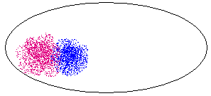
Stochastic sets in the image space
Can we define visual concepts as sets of image/video ?
e.g. noun concepts: human face, human figure, vehicle;
verbal concept: opening a door, drinking tea.
image space
A point is an image or a video clip
Symbol grounding problem in AI:
ground abstract symbols on the sensory signals

Slide 5
1. Stochastic set in statistical physics
Statistical physics studies macroscopic properties of systems
that consist of massive elements with microscopic interactions.
e.g.: a tank of insulated gas or ferro-magnetic material
N = 10²³
A state of the system is specified by the position of the N elements X^{N} and their momenta p^{N}
S = (x^{N}, p^{N})
But we only care about some global properties
Energy E, Volume V, Pressure, ….
Micro-canonical Ensemble
Micro-canonical Ensemble = Ω(N, E, V) = { s : h(S) = (N, E, V) }

Slide 6



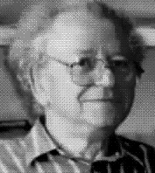



It took 30-years to transfer this theory to vision
h_{c} are histograms of Gabor filter responses
We call this the
Julesz ensemble
I^{obs}
I^{syn} ~ Ω(h) k=0
I^{syn} ~ Ω(h) k=1
I^{syn} ~ Ω(h) k=3
I^{syn} ~ Ω(h) k=4
I^{syn} ~ Ω(h) k=7
(Zhu, Wu, and Mumford, “Minimax entropy principle and its applications to texture modeling,” 97,99,00)

Slide 7






More texture examples of the Julesz ensemble
Observed
MCMC sample from the micro-canonical ensemble

Slide 8
Equivalence of deterministic set and probabilistic models
Gibbs 1902,
Wu and Zhu, 2000
Λ
Z²
Theorem 1
For an infinite (large) image from the texture ensemble any
local patch of the image given its neighborhood follows a conditional
distribution specified by a FRAME/MRF model
Theorem 2
As the image lattice goes to infinity, is the limit of the
FRAME model , in the absence of phase transition.
Ref. Y. N. Wu, S. C. Zhu, “Equivalence of Julesz Ensemble and FRAME models,” Int’l J. Computer Vision, 38(3), 247-265, July, 2000.

Slide 9

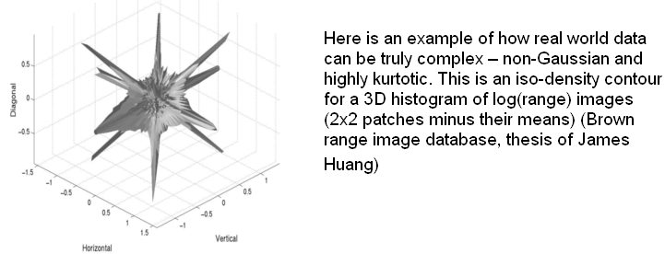
2. Lower dimensional sets or bounded subspaces
K is far smaller than the dimension n
of the image space.
ϕ is a basis function
from a dictionary.
subspace 2
subspace 1
e.g. Basis pursuit (Chen and Donoho 99), Lasso (Tibshirani 95), (yesterday: Ma, Wright, Li).

Slide 10
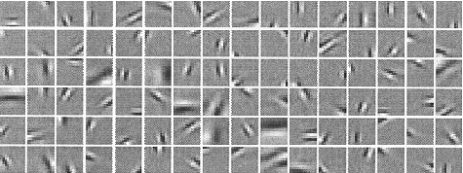














Learning an over-complete basis from natural images
I = Σ_{i} α _{i} ψ _{i} + n
(Olshausen and Fields, 1995-97)
Textons
.
B. Olshausen and D. Fields, “Sparse Coding with an Overcomplete Basis Set: A Strategy Employed by V1?” Vision Research, 37: 3311-25, 1997.
S.C. Zhu, C. E. Guo, Y.Z. Wang, and Z.J. Xu, “What are Textons?” Int'l J. of Computer Vision, vol.62(1/2), 121-143, 2005.

Slide 11
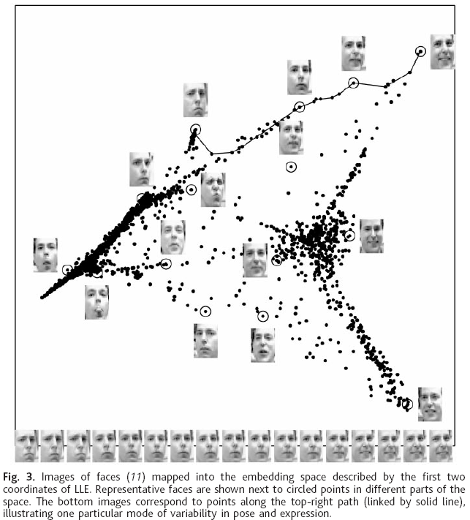
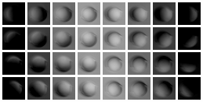
Examples of low dimensional sets
Sampling the 3D elements under varying lighting directions
3
2
4
1
Saul and Roweis, 2000.
4 lighting directions

Slide 12


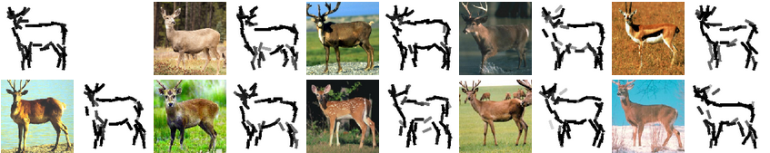
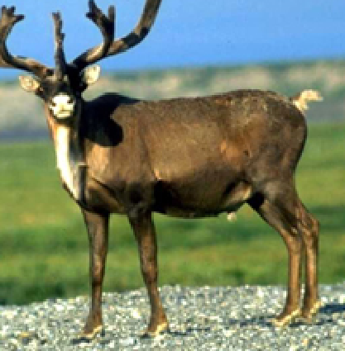

Bigger textons: object template, but still low dimensional
(a)
(b)
The elements are almost non-overlapping
Note: the template only represents an object at a fixed view and a fixed configuration.
When we allow the sketches to deform locally, the space becomes “swollen”.
Y.N. Wu, Z.Z. Si, H.F. Gong, and S.C. Zhu , “Learning Active Basis Model for Object Detection and Recognition,” IJCV, 2009.
Notes:
Use the word template to stress the fact that this AND-OR structure is shared by examples.

Slide 13





Summary: two regimes of stochastic sets
I call them
the implicit vs. explicit sets

Slide 14
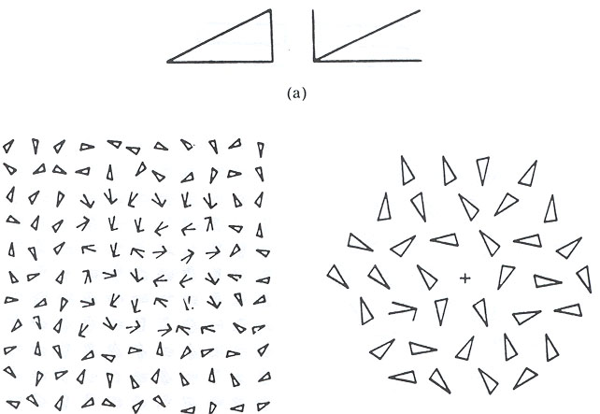
Relations to the psychophysics literature
The struggle on textures vs textons (Julesz, 60-80s)
Textons: coded explicitly
Response time T
Distractors # n

Slide 15
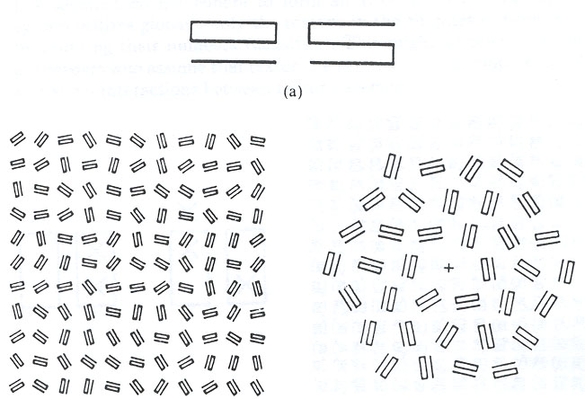
Textons vs. Textures
Textures: coded up to an equivalence ensemble.
Response time T
Distractors # n
Actually the brain is plastic, textons are learned over experience.
e.g. Chinese characters are texture to you first, then they become textons if you can recognize them.

Slide 16
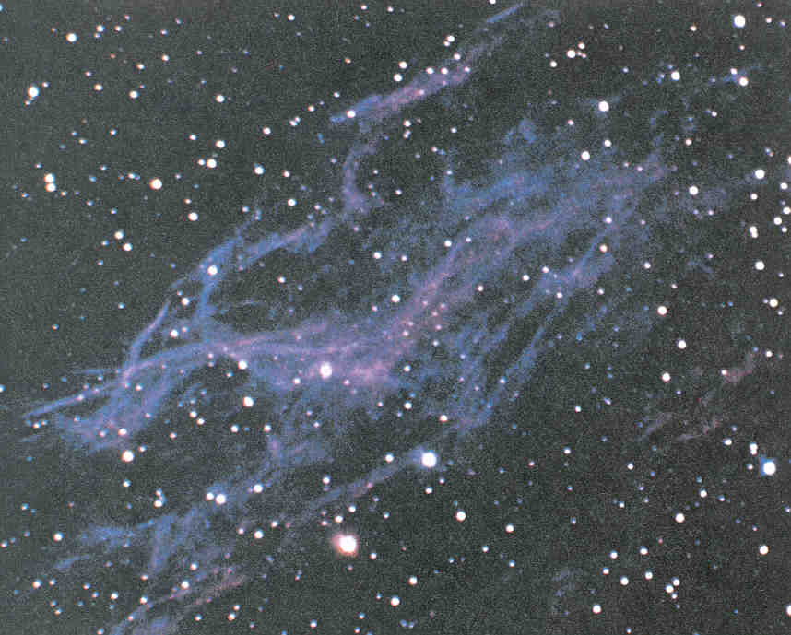



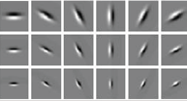
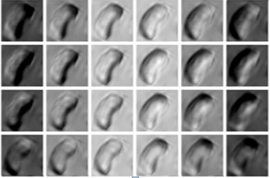



A second look at the space of images
implicit manifolds
image space
+
+
+
explicit manifolds

Slide 17

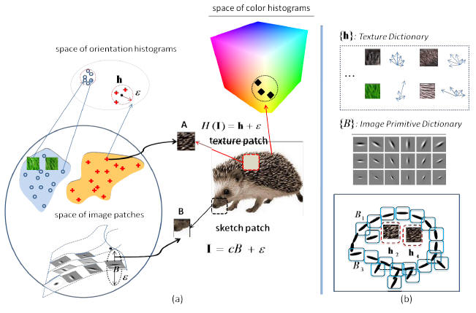
3. Stochastic sets by composition: mixing im/explicit subspaces
Product:

Slide 18
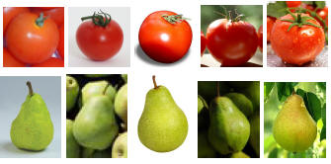
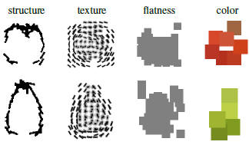
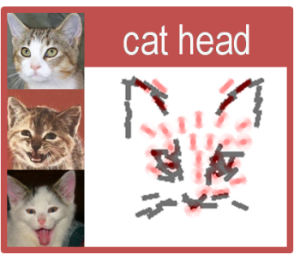
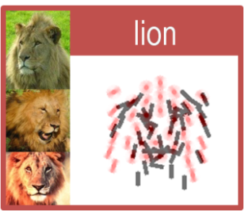
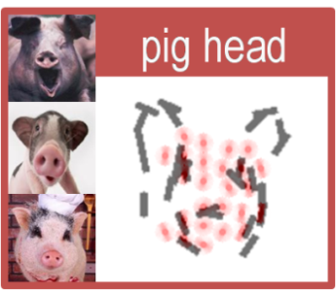
Examples of learned object templates
Zhangzhang Si, 2010-11
Ref: Si and Zhu, Learning Hybrid Image Templates for object modeling and detection, 2010-12..

Slide 19
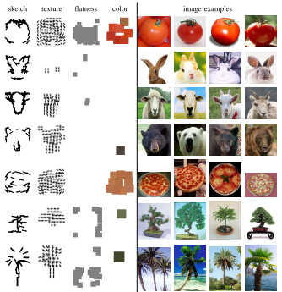
More examples
rich appearance, deformable, but fixed configurations

Slide 20





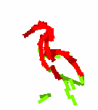



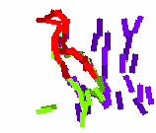

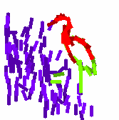

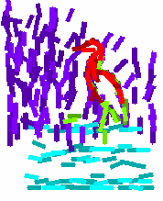

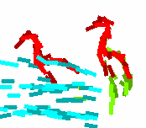
Fully unsupervised learning with compositional sparsity
Four common templates from 20 images
Hong, et al. “Compositional sparsity for learning from natural images,” 2013.

Slide 21

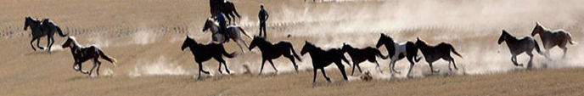
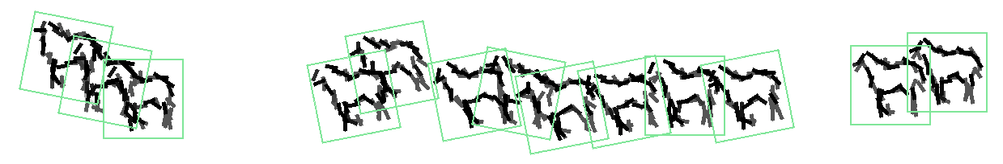
Fully unsupervised learning
According to the Chinese painters, the world has only one image !

Slide 22
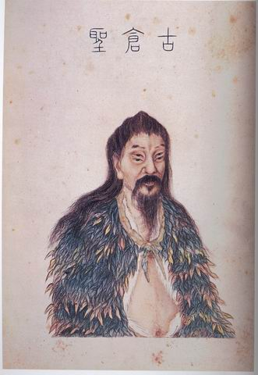

Isn’t this how the Chinese characters were created for objects and scenes?
Sparsity, Symbolized Texture, Shape Diffeomorphism, Compositionality
--- Every topic in this workshop is covered !

Slide 23
4. Stochastic sets by And-Or composition (Grammar)
We put the previous templates as terminal nodes, and compose new
templates through And-Or operations.
A
Or-node
A ::= aB | a | aBc
A₁
A₂
A₃
And-nodes
A production rule in grammar
can be represented by
an And-Or tree
B₁
B₂
Or-nodes
a₁
a₂
a₃
c
terminal nodes

Slide 24

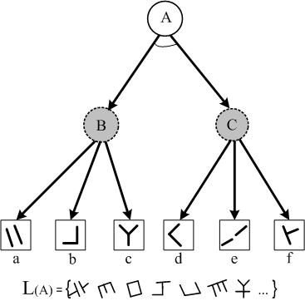
The language of a grammar is a set of valid sentences
A grammar production rule:
A
Or
-
node
And
-
node
leaf
-
node
B
C
a
b
c
c
The language is the set of all valid configurations derived from a note A.

Slide 25
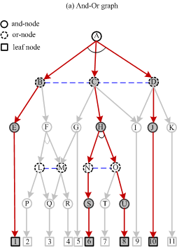
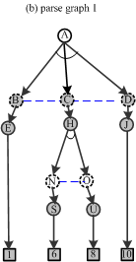
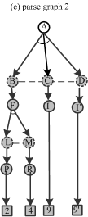
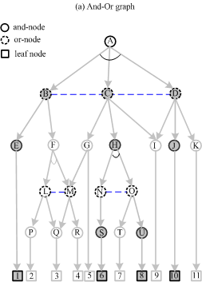


And-Or graph, parse graphs, and configurations
Each category is conceptualized to a grammar whose language defines a set or
“equivalence class” for all the valid configurations of the each category.

Slide 26
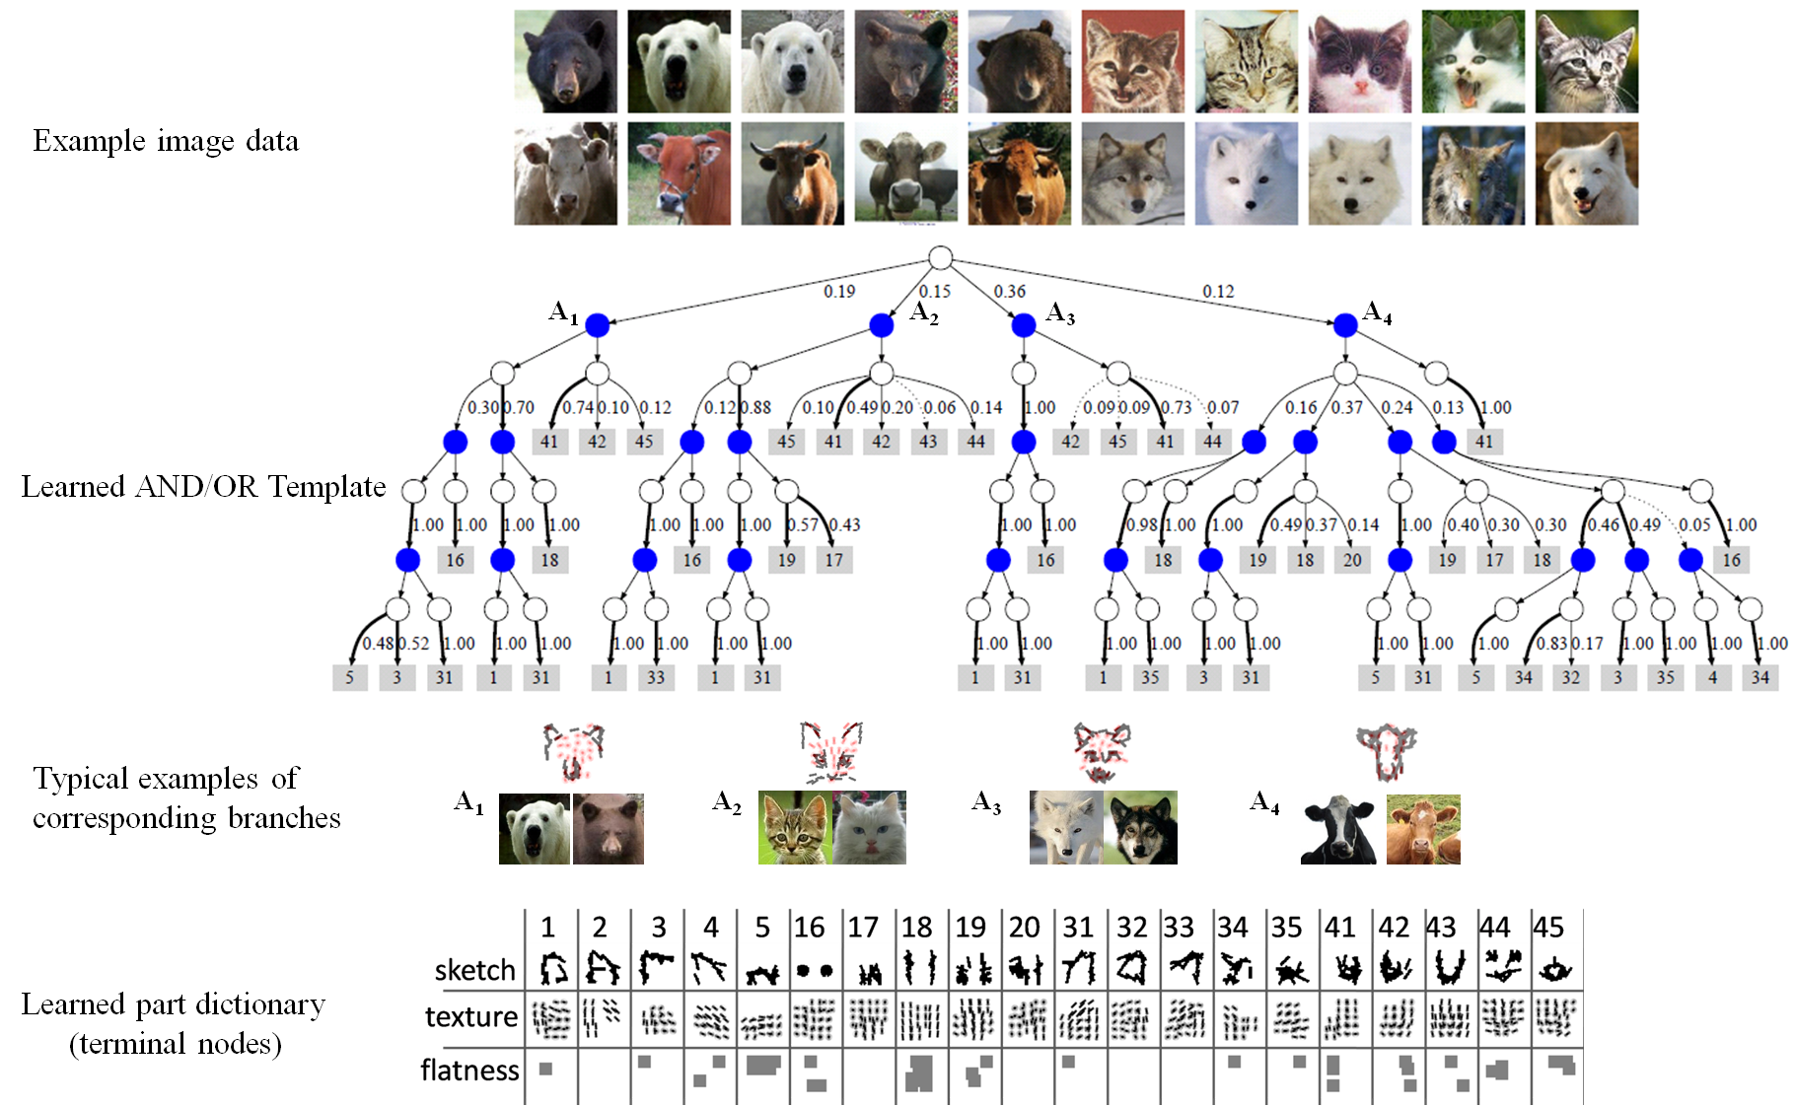
Unsupervised Learning of AND-OR Templates
Si and Zhu, PAMI, to appear

Slide 27

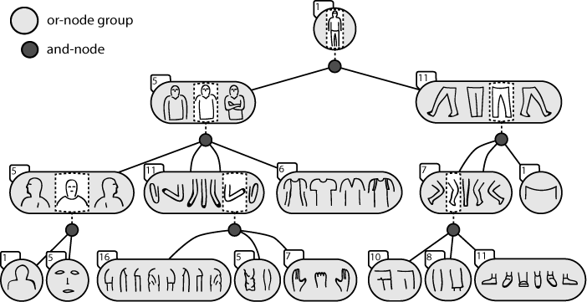
A concrete example on human figures

Slide 28
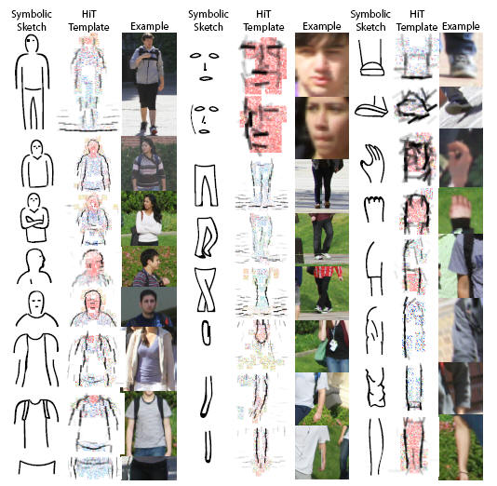
Templates for the terminal notes at all levels
symbols are grounded !

Slide 29
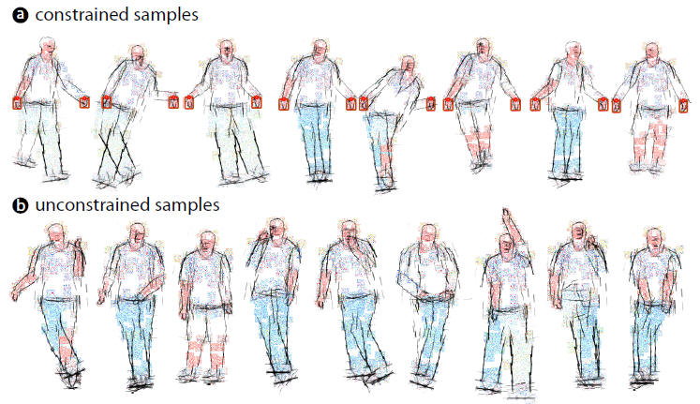
Synthesis (Computer Dream) by sampling the language
Rothrock and Zhu, 2011

Slide 30
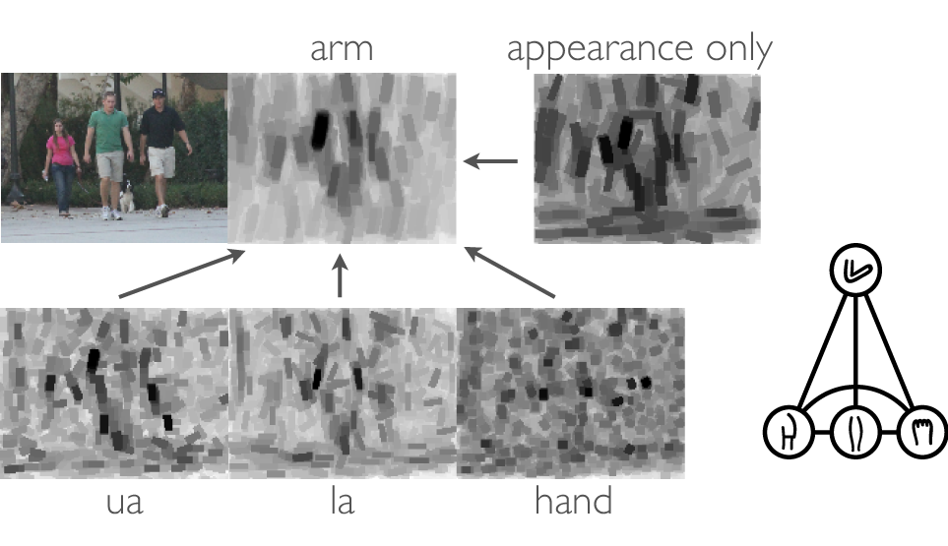
Local computation is hugely ambiguous
Dynamic programming and re-ranking

Slide 31
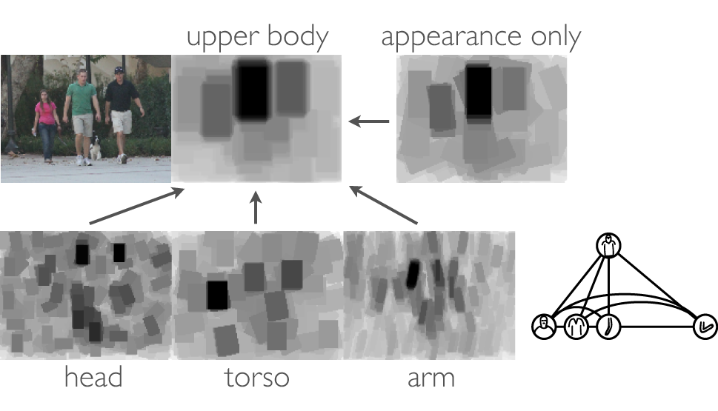
Composing Upper Body

Slide 32
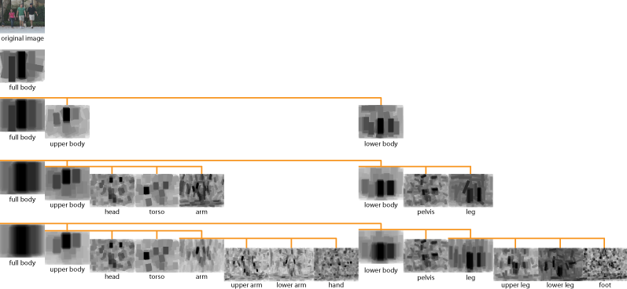
Composing parts in the hierarchy

Slide 33
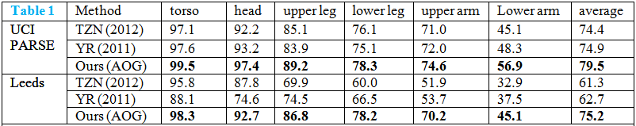
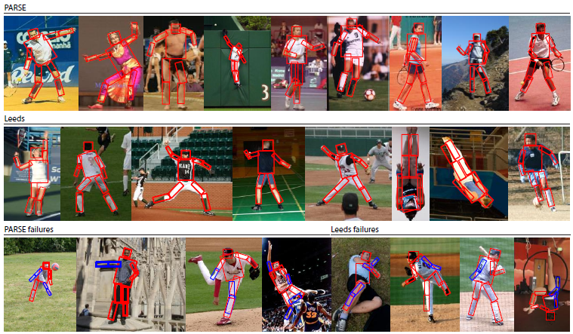

Slide 34




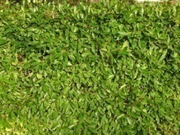
5. Continuous entropy spectrum
Scaling (zoom-out) increases the image entropy (dimensions)
Ref: Y.N. Wu, C.E. Guo, and S.C. Zhu, “From Information Scaling of Natural Images to Regimes of Statistical Models,”
Quarterly of Applied Mathematics, 2007.

Slide 35
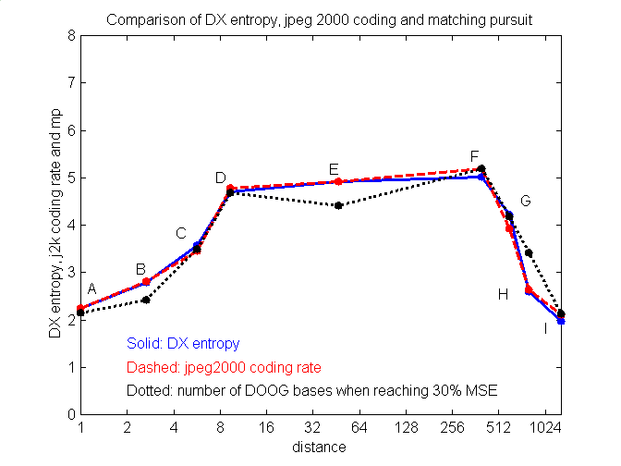
Entropy rate (bits/pixel) over distance on natural images
entropy of I_{x}
JPEG2000
3. #of DooG bases
for reaching 30% MSE

Slide 36






Simulation: regime transitions in scale space
scale 1
scale 2
scale 3
scale 4
scale 5
scale 6
scale 7
We need a seamless transition between different regimes of models

Slide 37
Coding efficiency and number of clusters over scales
Low Middle High
Number of clusters found

Slide 38
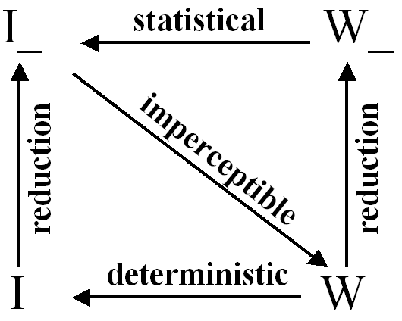
Imperceptibility: key to transition
Let W be the description of the scene (world), W ~ p(W)
Assume: generative model I = g(W)
Theorem:
1. Scene Complexity is defined as the entropy of p(W)
2. Imperceptibility is defined as the entropy of posterior p(W|I)
Imperceptibility = Scene Complexity – Image complexity

Slide 39
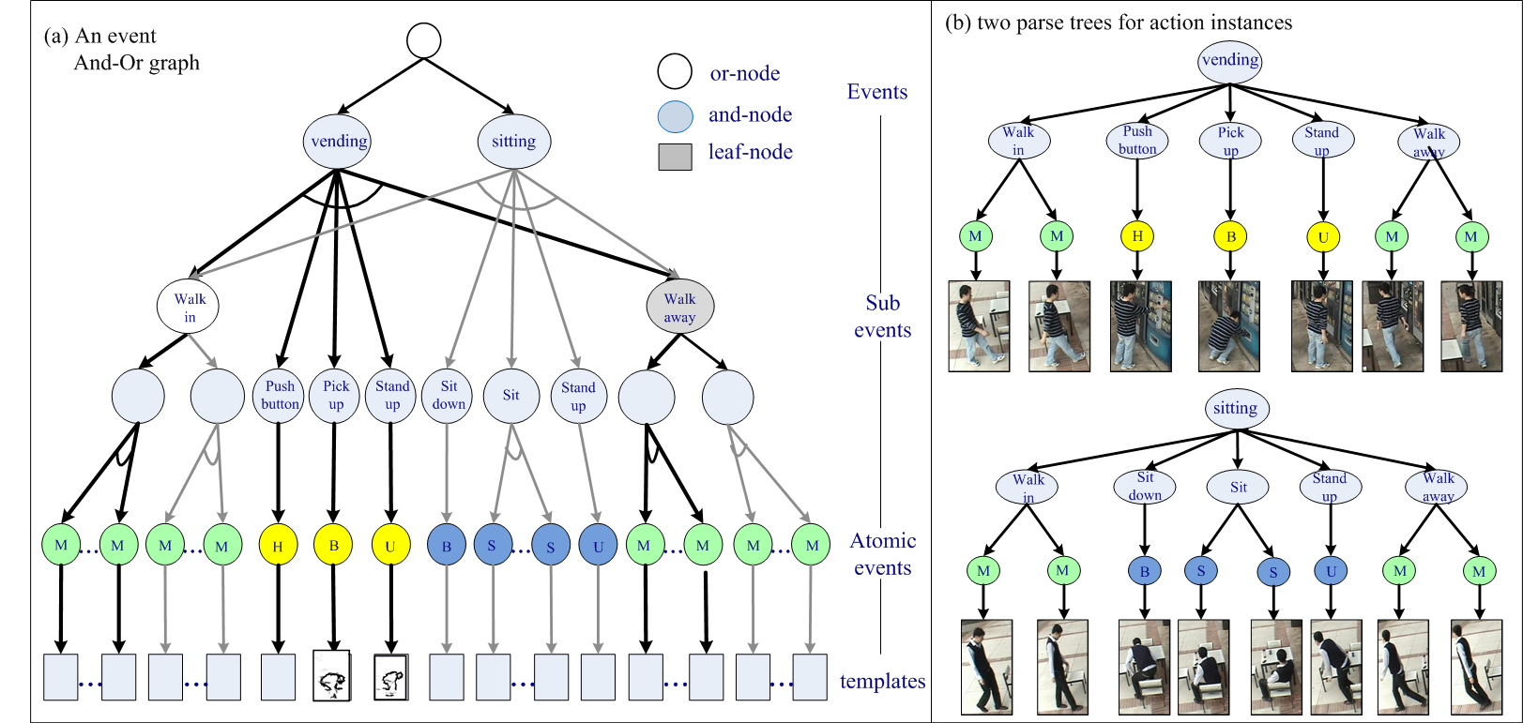
6. Spatial, Temporal, Causal AoG– Knowledge Representation
Temporal-AOG for action / events (express hi-order sequence)
Ref. M. Pei and S.C. Zhu, “Parsing Video Events with Goal inference and Intent Prediction,” ICCV, 2011.

Slide 40
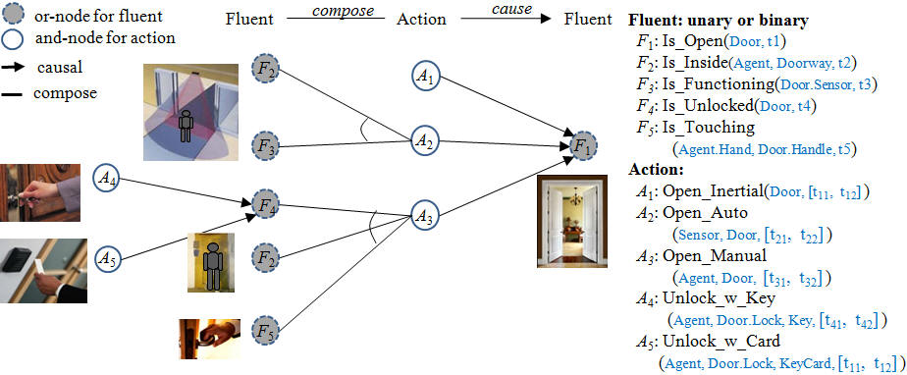
Representing causal concepts by Causal-AOG
Spatial, Temporal, Causal AoG for Knowledge Representation

Slide 41
Summary: a unifying mathematical foundation
regimes of representations / models
Reasoning
Logics
(common sense, domain knowledge)
Cognition
Stochastic grammar
partonomy,
taxonomy,
relations
Recognition
Sparse coding
(low-D manifolds,
textons)
Markov, Gibbs Fields
(hi-D manifolds,
textures)
Coding
Two known grand challenges: symbol grounding, semantic gaps.

