Slide 1
Learning Visual Knowledge by Information Projection
Song-Chun Zhu
Center of Vision, Cognition, Learning and Arts
University of California, Los Angeles

Slide 2
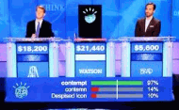
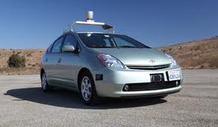
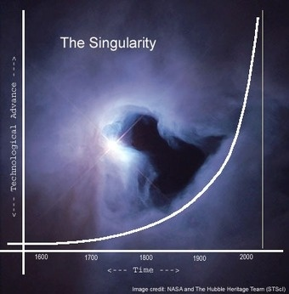
1, Motivation
2011 Jennings and Rutter vs Watson 2011 Google Autonomous Vehicle
Man vs machine: singularity by 2045? --- Ray Kurzweil

Slide 3
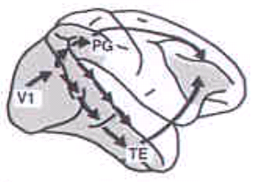
We are hardwired for image understanding
1 bottom-up connection vs. 10 top-down and lateral connections
Dorsal Pathway
(“where”)
From Brain Anatomy
Ventral Pathway
(“what”)
The core issue is: representing vast amount of visual knowledge!

Slide 4
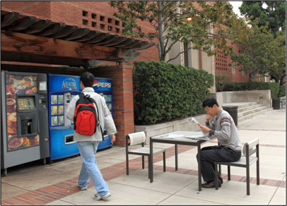
What do we see in a single image?
Vision is a continuous (literally infinite) computing process.
The more you look, the more you see.

Slide 5
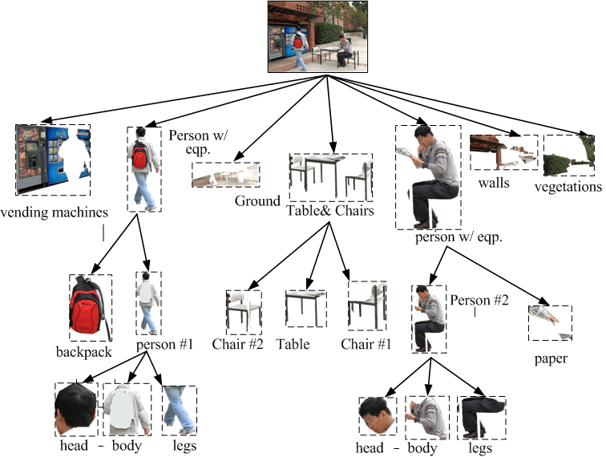

Image parsing
Reasoning about scene attributes:
[outdoor, plaza, food court,..]
Event and goal:
[man#1 sitting, reading newspaper,
man#2 walking to vending machine, will purchase, ...]
[coffee, soda]
Natural language description from the parse graph:
It is a scene with 2 peoples, 1 table, 2 chairs, vending machines , ground (paved) , walls (red, brick) and vegetation (green). The person #1 (male) is carrying a backpack, (red) walking on the ground towards the vending machines. The person #2 (male) is holding a (news)paper, sitting on the chair #1, …...
More text after reasoning:
It is an outdoor scene, probably a plaza or food court. Person #1 looks like a student, likely going to make a purchase at the vending machines. Person #2 is likely reading newspaper.

Slide 6
Where are we? let’s see some examples
From image parsing to text description
Automatic sensor control
Z. Yao, et al, “I2T: Image Parsing to Text Description,” Proceedings of IEEE, Issue 99, pp1-24, 2010.

Slide 7
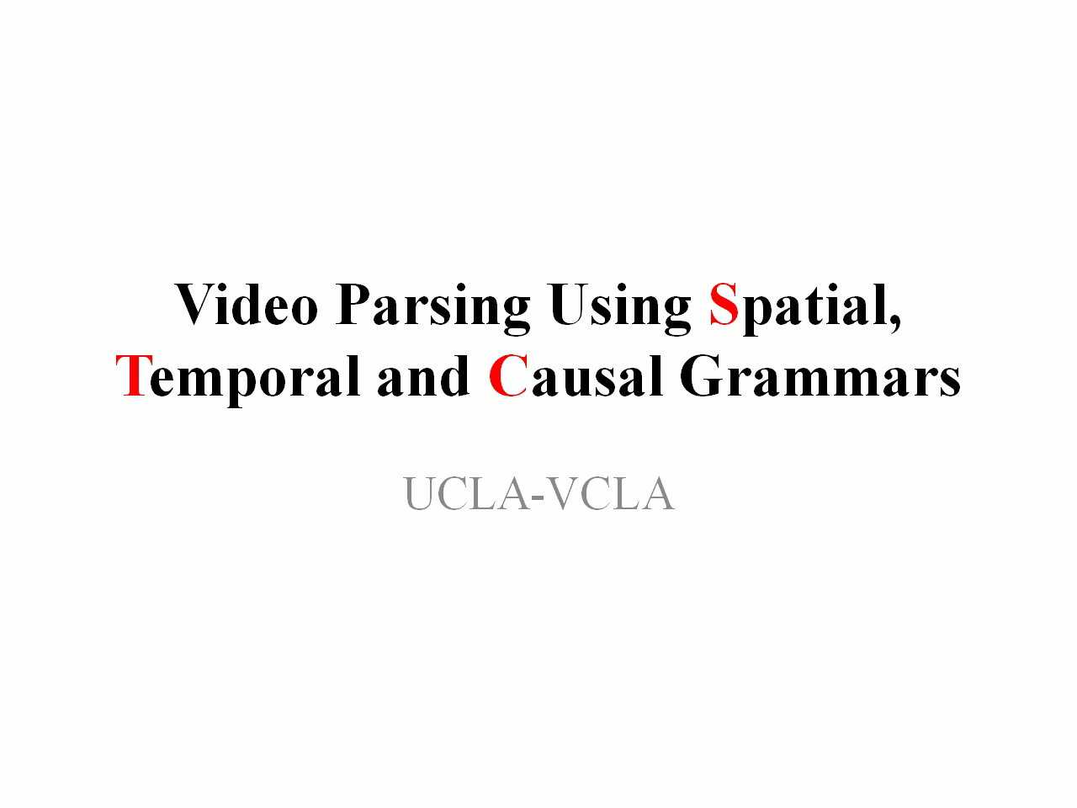

Slide 8

2, Can we learn visual knowledge automatically?
Looking at a raw image
Unsupervised learning
1, What are the perceptual units? Visual concepts
2, Is there a unified learning principle?
3, What is the “core intelligence” to jump start?
A numeric image from my Harvard homework assignment, 1993.

Slide 9

Visual Concepts – the units of visual knowledge
In Mathematics and logic, concepts are equal to deterministic sets, e.g. Cantor, Boole, or spaces in continuous domain, and their compositions through the “and”, “or”, and “negation” operators.
But the world to us is fundamentally stochastic …
Especially, in the image domain !
Ref. [1] D. Mumford. The Dawning of the Age of Stochasticity. 2000.
[2] E. Jaynes. Probability Theory: the Logic of Science. Cambridge University Press, 2003.

Slide 10
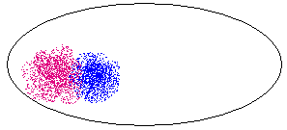
Stochastic sets in the image space
How do we define concepts as sets of image/video:
e.g. noun concepts: human face, vehicle, chair?
verbal concept: opening door, making coffee?
image space
A point is an image or a video clip

Slide 11
Method 1, Stochastic set in statistical physics
Statistical physics studies macroscopic properties of systems
that consist of massive elements with microscopic interactions.
e.g.: a tank of insulated gas or ferro-magnetic material
N = 10²³
A state of the system is specified by the position of the N elements X^{N} and their momenta p^{N}
S = (x^{N}, p^{N})
But we only care about some global properties
Energy E, Volume V, Pressure, ….
Micro-canonical Ensemble
Micro-canonical Ensemble = Ω(N, E, V) = { s : h(S) = (N, E, V) }

Slide 12






It took 30-years to transfer this theory to vision
h_{c} are histograms of Gabor filters
I^{obs}
I^{syn} ~ Ω(h) k=0
I^{syn} ~ Ω(h) k=1
I^{syn} ~ Ω(h) k=3
I^{syn} ~ Ω(h) k=4
I^{syn} ~ Ω(h) k=7
(Zhu,Wu, Mumford 97,99,00)

Slide 13
Equivalence of deterministic set and probabilistic models
Gibbs 1902,
Wu and Zhu, 2000
Λ
Z²
Theorem 1
For a very large image from the texture ensemble any
local patch of the image given its neighborhood follows a conditional
distribution specified by a FRAME/MRF model
Theorem 2
As the image lattice goes to infinity, is the limit of the
FRAME model , in the absence of phase transition.
Ref. Y. N. Wu, S. C. Zhu, “Equivalence of Julesz Ensemble and FRAME models,” Int’l J. Computer Vision, 38(3), 247-265, 2000.

Slide 14

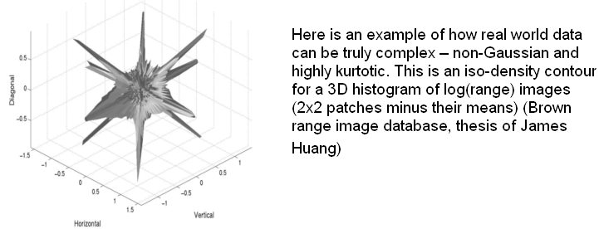
Method 2, Lower dimensional sets or subspaces
K is far smaller than the dimension
of the image space.
ϕ is a basis function
from a dictionary.
subspace 2
subspace 1
Sparsity and harmonic analysis

Slide 15
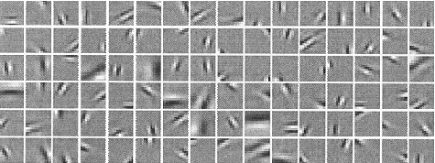
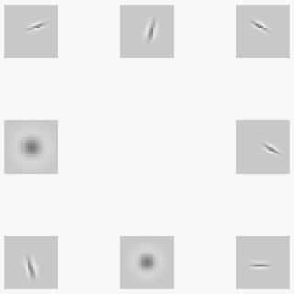













Stochastic set from sparse coding
Learning an over-complete image basis from natural images
I = Σ_{i} α _{i} ψ _{i} + n
(Olshausen and Fields, 1995-97)
Textons
.
B. Olshausen and D. Fields, “Sparse Coding with an Overcomplete Basis Set: A Strategy Employed by V1?” Vision Research, 37: 3311-25, 1997.
S.C. Zhu, C. E. Guo, Y.Z. Wang, and Z.J. Xu, “What are Textons?” Int'l J. of Computer Vision, vol.62(1/2), 121-143, 2005.

Slide 16



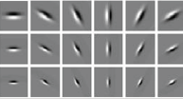
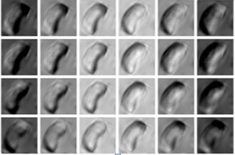



Look at the space of image patches
implicit manifolds
image space
+
+
+
explicit manifolds

Slide 17
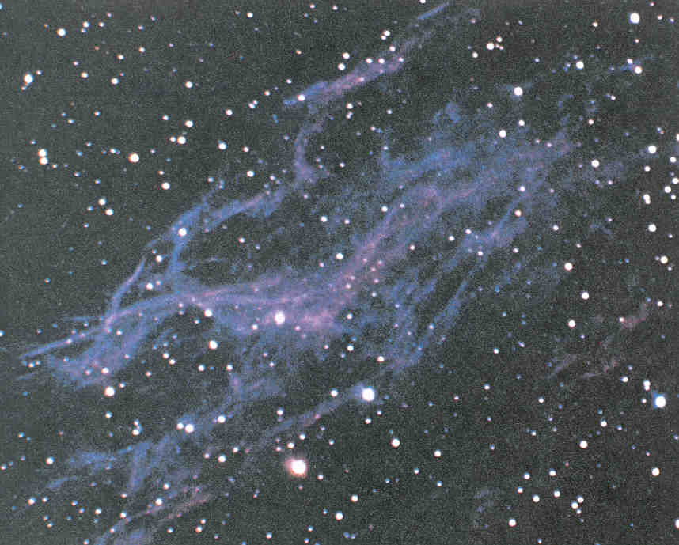





Two regimes of stochastic sets
I call them
the implicit vs. explicit manifolds
Ref. Zhu et al. “learning implicit and explicit manifold by information projection, PRL, 2009.

Slide 18
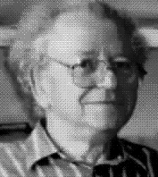
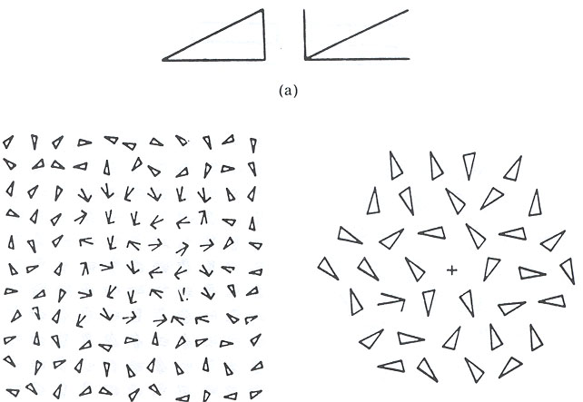
Relations to psychophysics
(1) textures vs textons (Julesz, 60-70s)
textons
Response time T
Distractors # n

Slide 19
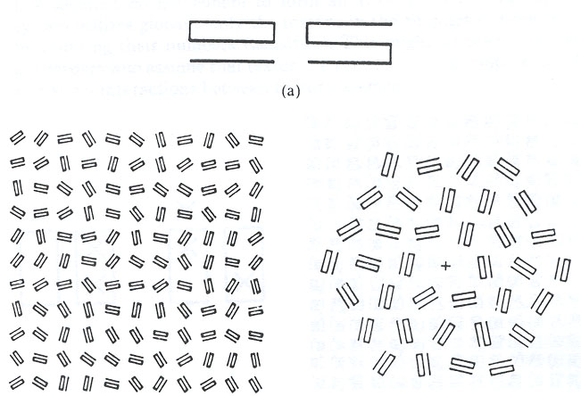
Textons vs. Textures
textures
Response time T
Distractors # n

Slide 20

3, Model pursuit in the universe of images
f : target distribution; p: our model; q: initial model
image universe:
every point is an image.
1, q = unif()
2, q = δ()
model ~ image set ~ manifold ~ cluster

Slide 21
Intuitive idea: a professor grading an exam
The full score (like dimension in our case) is 100. You have two ways:
For top students (high dimensional manifolds), you start from 100 and deduct points :
100 – 2 – 0 – 0 – 3 – 0– 2 – 0 – 0 – 0 – 0 – 0 – 1 = 92
For bottom students (low dimensional manifolds), you start from 0 and add points
0 + 8 + 0 + 0 + 3 + 0 + 2 + 0 + 0 + 5 + 0 + 0 + 1 = 19
In reality, suppose the exam is very long (just like the large image has >1M pixels), a student may
have mixed performance, e.g. doing excellent in the 1st half and doing poorly in the 2nd half. Thus
a most effective way is to use the two methods for different sections of the exam.
(50 – 2 – 0 – 0 – 3 – 0) + (0 + 5 + 3 + 0 + 0 + 2) = 45 + 10 = 55
In fact, most of the object categories are middle entropy manifolds and have mixed structures.

Slide 22


Manifold pursuit by information projection
Given only positive examples from a class c
We pursue a series of models p to approach a underlying “true” probability f
At each step, we augment the current model p to a new model
Subject to a projection constraint:

Slide 23





Information projection
DellaPietra, DellaPietra,Lafferty, 97
Zhu, Wu, Mumford, 97
So the KL-divergence decreases monotonically.

Slide 24


A unified Learning Principle
max-step: choosing a distinct feature and statistics
min-step: given the selected feature constraint, computing the parameter
Claim: this learning procedure unifies almost all we know in visual modeling
PCA, sparse coding,
MRF, Gibbs, FRAME,
Adaboost (when h() is binary),
Stochastic grammar

Slide 25
Ex/implicit manifolds in natural images
implicit texture clusters (blue),
explicit primitive clusters (pink).

Slide 26


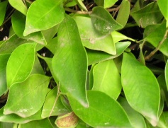

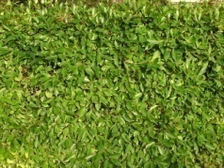
In fact, it is a continuous spectrum
Scaling (zoom-out) increases the image entropy (dimensions)

Slide 27
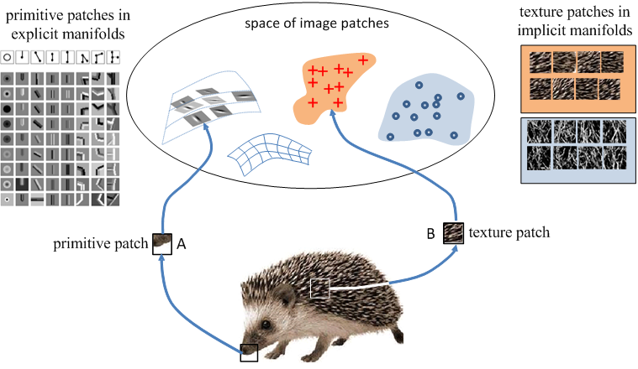
Object template: mixing the textures and textons
Z. Si and S.C. Zhu 2009

Slide 28
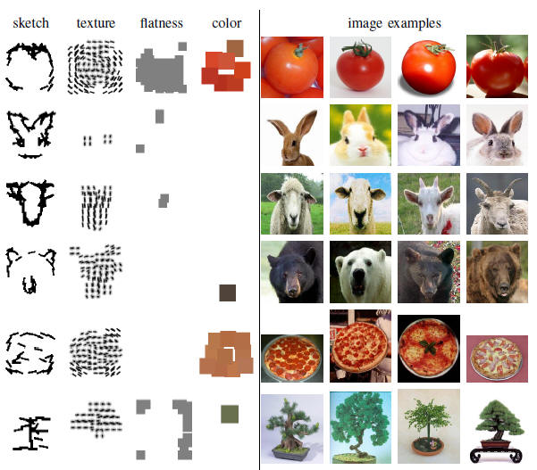
Unsupervised Learning of Hybrid Object Templates
Z. Si and S.C. Zhu 2010

Slide 29






Learning compositional concepts --- And-Or templates
Data matrix
0.9
1.0
0.7
0.9
0.9
0.8
0.9
0.7
0.9
0.1
0.1
0.0
0.3
0.2
0.4
0.2
0.7
0.6
0.4
0.5
0.7
0.6
1.0
1.0
1.0
1.0
0.9
1.0
0.1
0.0
0.1
0.6
0.1
0.0
0.1
0.0
0.1
0.0
0.8
0.8
0.7
1.0
0.8
1.0
1.0
0.6
0.8
0.2
0.0
0.2
0.6
0.3
0.0
0.5
0.1
0.2
0.1
0.7
1.0
0.7
1.0
1.0
1.0
1.0
0.8
1.0
0.3
0.2
0.3
0.1
0.3
0.2
0.3
0.2
0.6
0.5
0.7
0.9
1.0
0.8
0.7
0.3
0.9
0.6
0.8
0.2
0.0
0.2
0.6
0.3
0.0
0.5
0.1
0.2
0.1

Slide 30
Revisit: Information projection
The key issue: what and where to look at ?

Slide 31
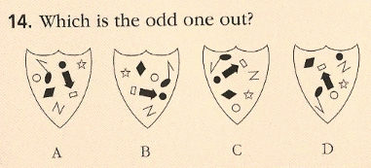
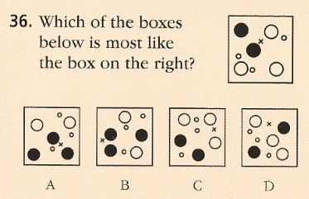
This is like IQ test: what and where do you look?

Slide 32
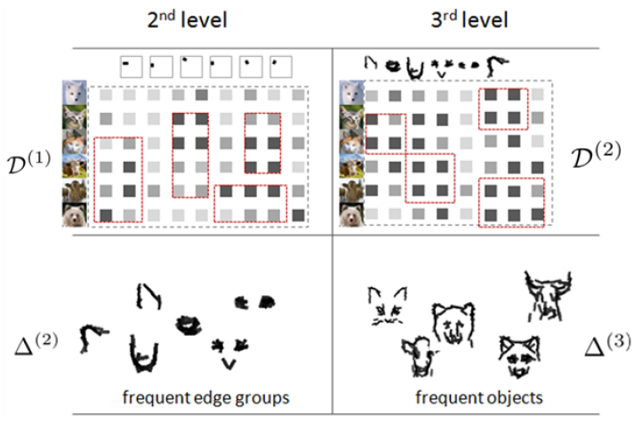

Learning compositional concepts --- And-Or templates
Notes:
Add animated illustrations.

Slide 33
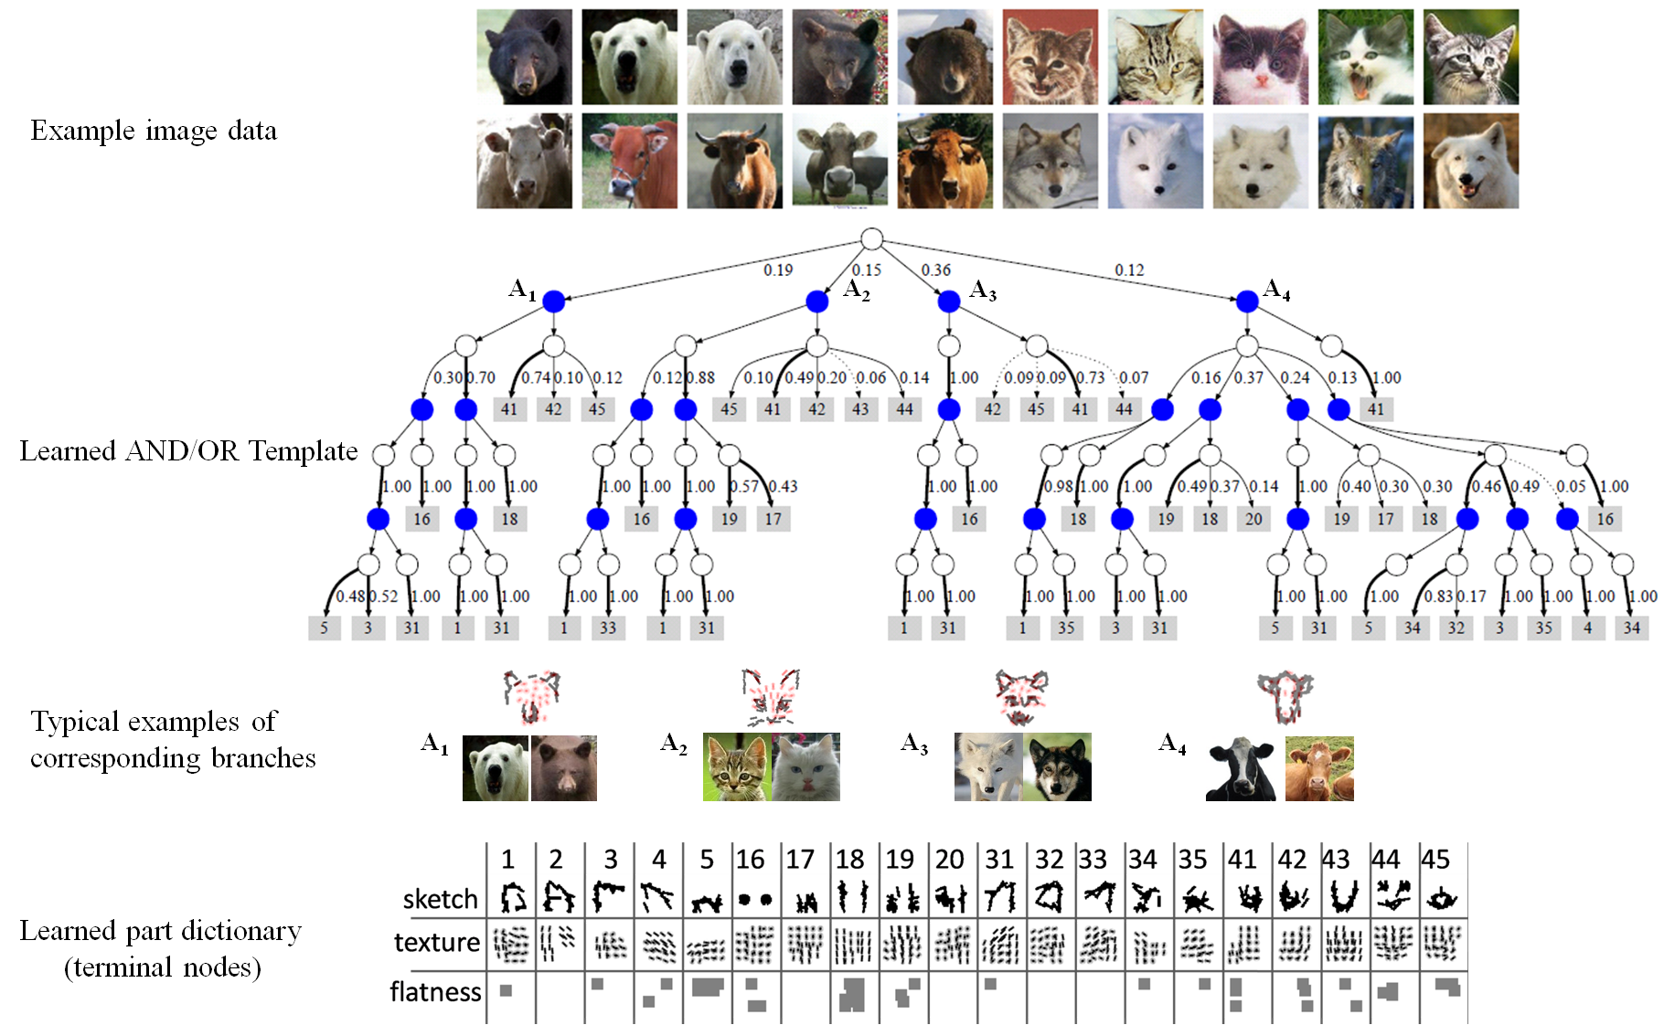
And-Or templates

Slide 34
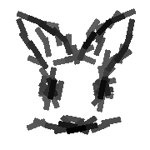

How does a compositional set look like?
Union space (OR)
f
a
g
d
b
e
a
d
Product space (AND)
c
e
By Zhangzhang Si 2011

Slide 35
Method 3, Stochastic sets by And-Or composition (Grammar)
A
Or-node
A ::= aB | a | aBc
A production rule
can be represented by
an And-Or tree
A₁
A₂
A₃
And-nodes
B₁
B₂
Or-nodes
a₁
a₂
a₃
c
terminal nodes
The language is the set of all valid configurations derived from a note A.

Slide 36
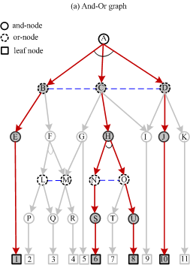
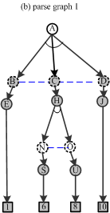
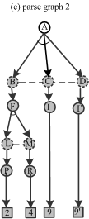
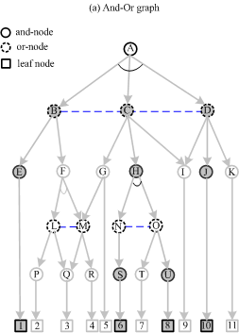


And-Or graph, parse graphs, and configurations
Zhu and Mumford, 2006

Slide 37

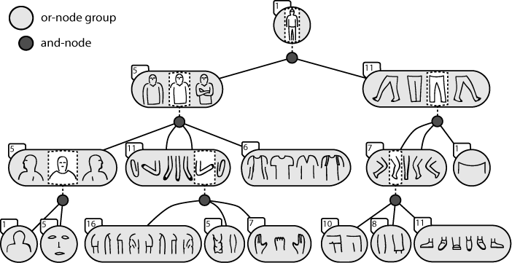
Example: Spatial-AoG for human figure
Rothrock and Zhu, 2011

Slide 38
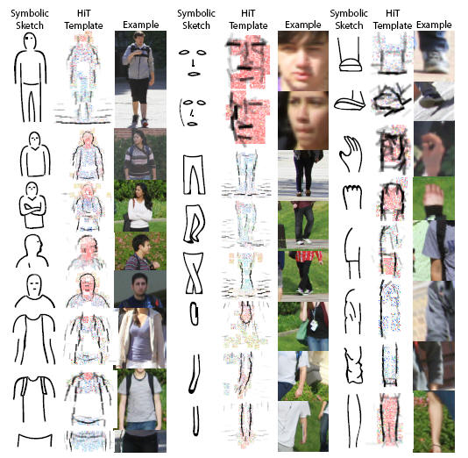
Appearance model for terminals learned from images
Grounding the symbols

Slide 39
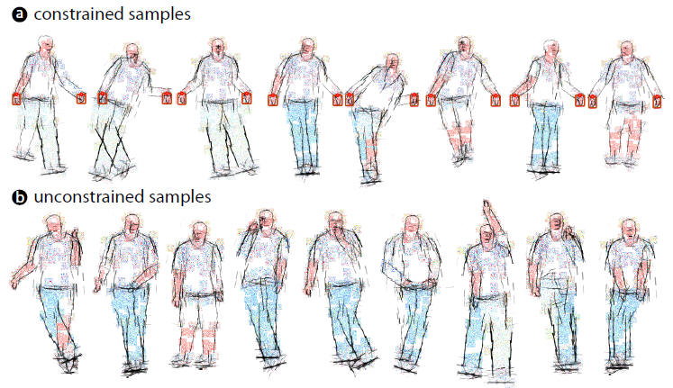
Synthesis (Computer Dream) by sampling the S-AoG
Rothrock and Zhu, 2011

Slide 40
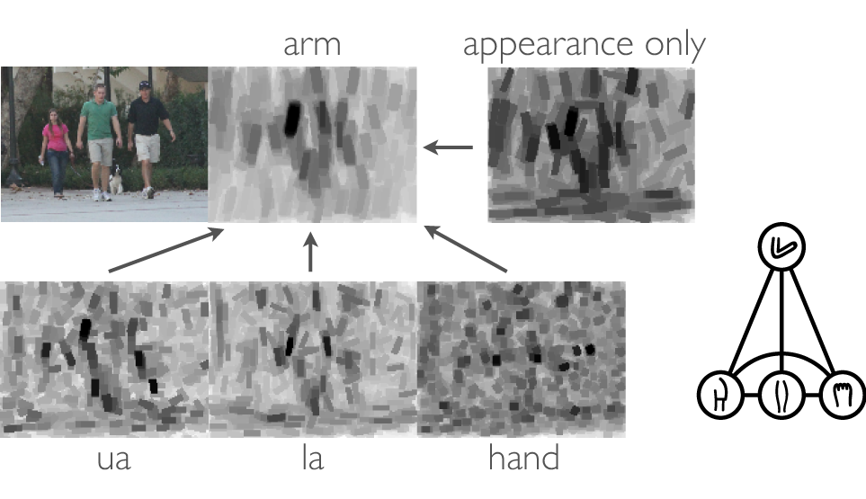
Local computation is hugely ambiguous
Dynamic programming and re-ranking

Slide 41
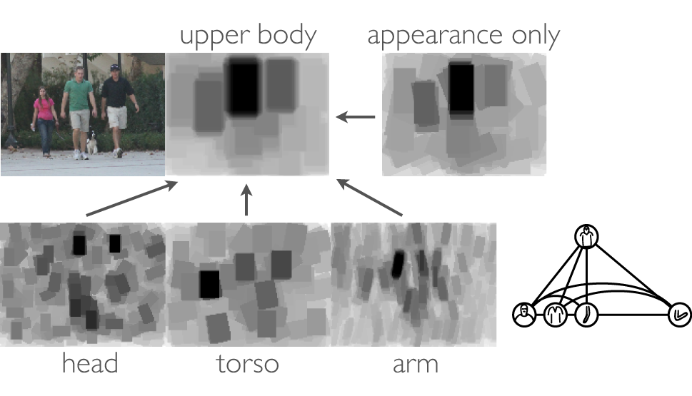
Composing Upper Body

Slide 42
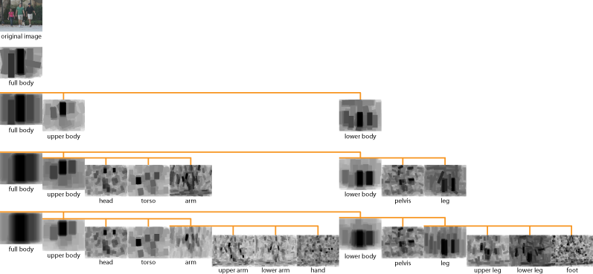
Composing parts in the hierarchy

Slide 43
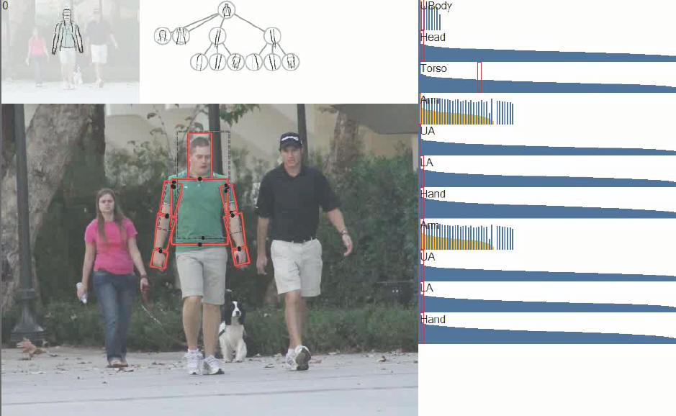
Top-down / bottom-up inference

Slide 44
Top-down / bottom-up inference
DP + re-ranking
by Brandon Rothrock, 2011.

Slide 45
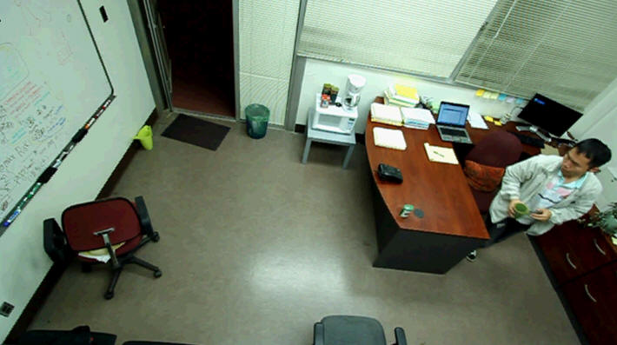
Learning temporal- concepts
e.g. events in an office
Work by Mingtao Pei, UCLA
Notes:
Video analysis, in retrospective, (after we have watched the entire video), what kind of events happened in this video
Refill tea
Make a phone call (answer a phone call)?
In a classification perspective, what kinds of possible events that could happen, but didn’t happen in this video clip,
use laptop
read a paper
write on board, etc. etc.
On the other side, if I stop the video in the middle, we might want to ask a different set of questions, want is the event he is currently doing, or what is his intention, and probably predict the next move.
Be able to answer this kind of questions are actually more usefully than retrospective, we can imagine applications including intelligent household control, or intelligent medicare for elderly people.

Slide 46
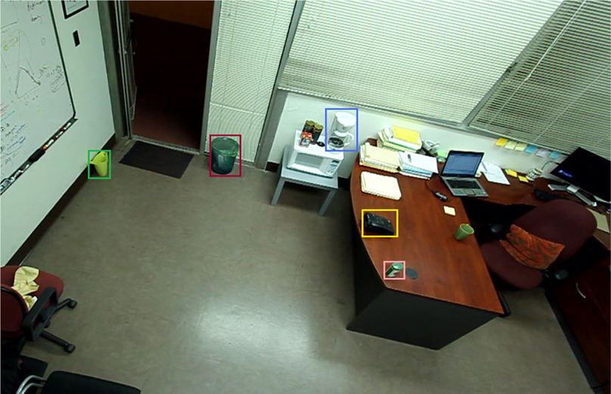









Spatial-Temporal parse graph
Video
Background objects
events
Refill tea
make phone call
Water collector
Trash can
Water boiler
Phone
Tea canister
Empty the cup
Renew tea leaf
Refill water
Arrive trashcan
Bend & dump
Leave
trashcan
Arrive tea can
Grab
tea can
Leave
tea can
Arrive boiler
Bend &
pour
Leave
boiler
Notes:
Therefore, our approach proceeds in two domains, first image parsing of static objects, such as, second temporal parsing of events, such as refill tea, and it can further decomposed into atomic actions such as “empty the cup”, “renew tea leaves”, “refill water”. Each of which can be further decomposed into measurable moments such as “arrive at the trashcan” measurable poses such as “bend down”

Slide 47
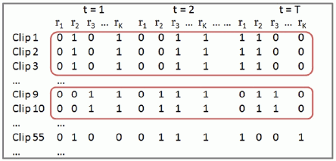
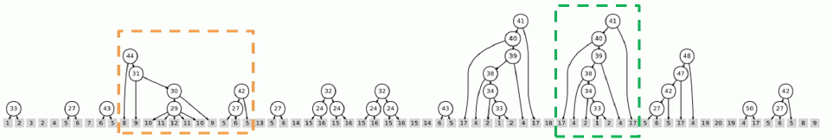
Block pursuit for temporal co-occurrence patterns

Slide 48
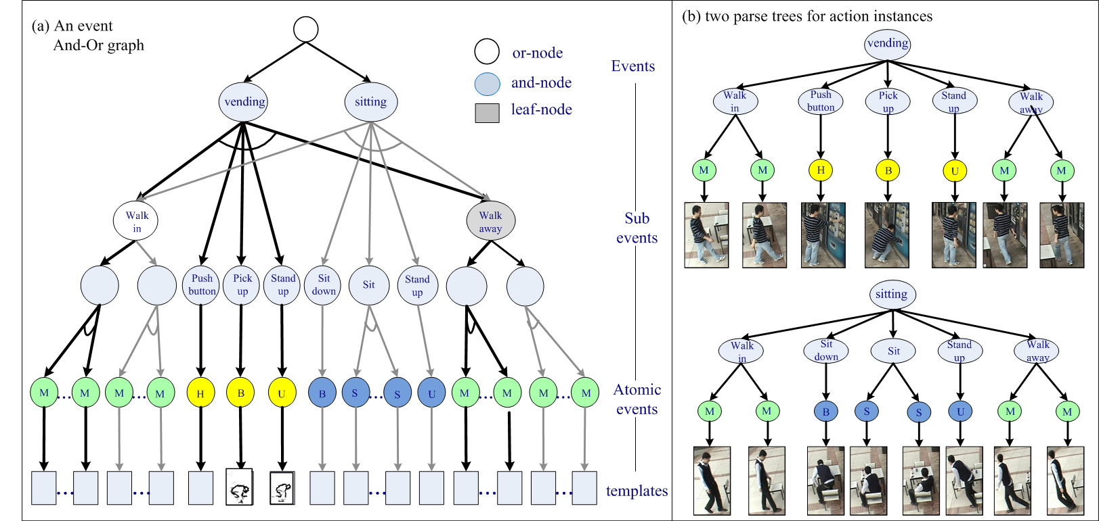
Temporal AoG for action / events
Ref. M. Pei and S.C. Zhu, “Parsing Video Events with Goal inference and Intent Prediction,” ICCV, 2011.

Slide 49
Event representation by Temporal AoG
Refill tea
And-node
Or-node
Leaf-node
Prepare the cup
Renew tea leaf
Refill water
Dump
old tea
Dump water
Null
Renew tea leaf
Refill water
Arrive
trashcan
Bend
down
Leave
trashcan
Bend
down
Leave
collector
Get close to tea can
Grab
tea can
Leave tea-can
Arrive
boiler
Bend
down
Leave
boiler
Arrive
collector
NULL
Notes:
We use it from a slightly different aspect that we take it as a grammar model, where And nodes repesent decompositon rules of grammar and Or nodes for switches between equivalent phrases. ( for example, the process of empty the cup)
At this point the And-Or-graph are manually designed
We use And-Or-Graph for three properties
It has hierarchical decomposition, which allow us to add temporal relations that is from coarse to fine in scale.
It Or-nodes so that is handles alternative routes naturally
An generative model that naturally handles tasks such as intention inference and predictions.

Slide 50
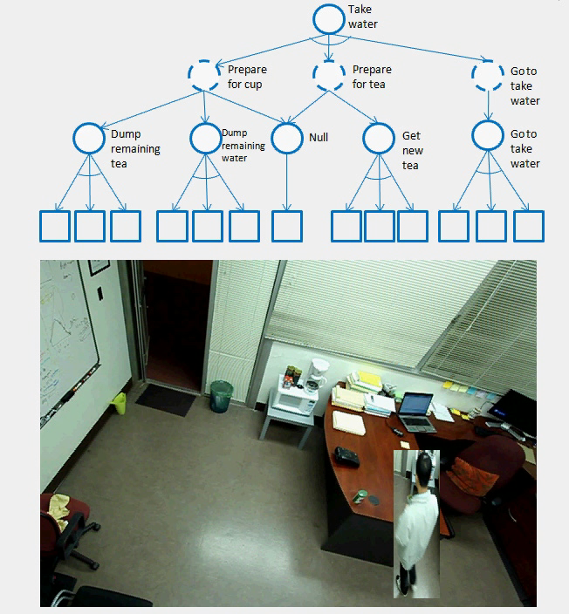
Synthesizing events by sampling the T- AoG (computer dreaming)*
* We use stored foreground windows and a background frame to synthesize videos.

Slide 51
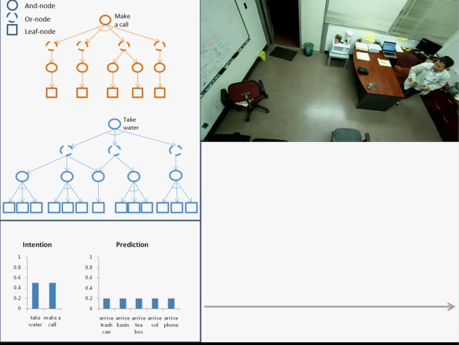
Event parsing with T-AoG: goal and intent inference

Slide 52
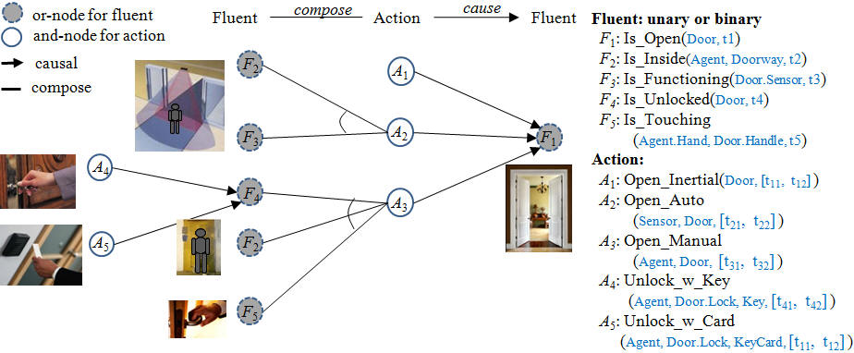
Causality concepts by Causal-AoG

Slide 53
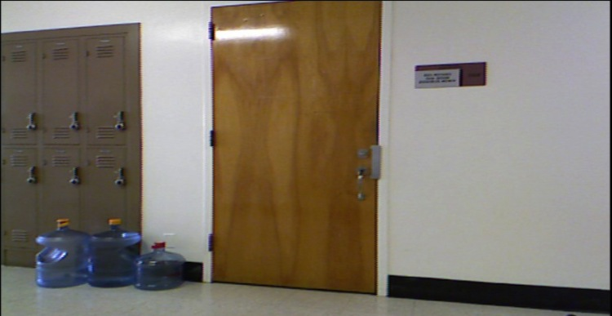
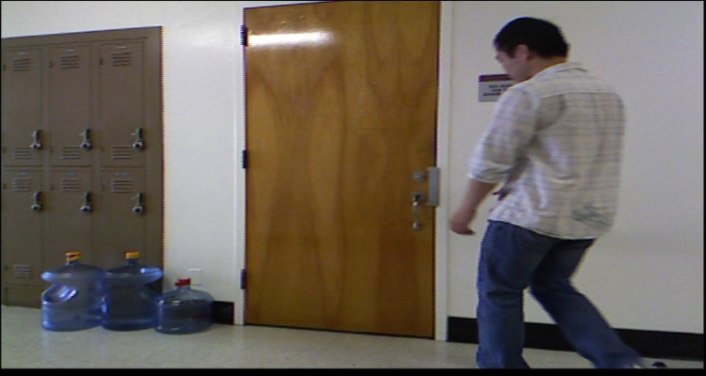
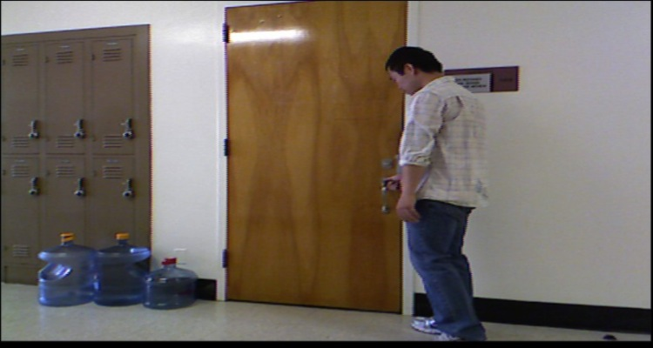
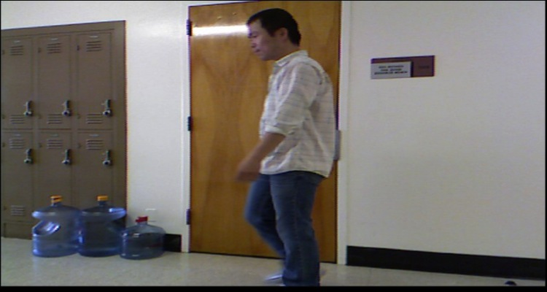
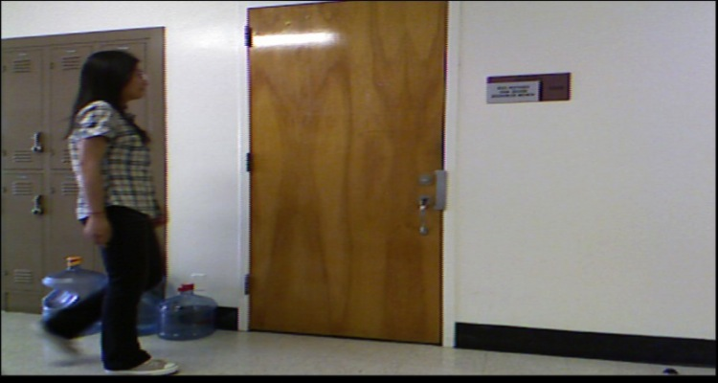


Learning Causal-AoG from video
Notes:
Frame 892
Goal: Framework for unsupervised learning of causal relations, learning which actions cause which actions to change status
Infer answer questions such as those posed

Slide 54






Learning Causal-AoG: linking fluent changes to actions
Notes:
Focus: INUS conditions. Many conditions work together to form cause the fluent change, we focus on the actions.

Slide 55
What is a fluent change?
OPEN
Door Opens
Door Closes
Door
Door Closed Inertially
Door Open Inertially
CLOSED
ON
Light Turns On
Light
Light Off Inertially
Light Turns Off
Light On Inertially
OFF
t
Notes:
Mention partition. A lack of change inducing action gives inertial.

Slide 56

Pursuing causal relations
ST-AOG
Or-Node
S
And-Node
A₁
A₃
A₁₀
A₁₁
A₁₂
a₁₁
a₃₁
a₃₂
a₃₃
a_{10,1}
a_{11,1}
a_{12,1}
Parse tree
Actions
A₃
A₁₀
A₁
Sub-Actions
a₃₁
a₃₃
a_{10,,1}
a₁₁
t
t₁
t₂
t₃
t₄
t₅
t₆
t₇
t₈
Door = Open
Door = Closed
Notes:
Vision so far: the who, what, where, when. We add: the why

Slide 57
Pursuing Causal Relations
 | F(t+1) = Open | F(t+1) = Closed
F(t) = Open | O → O | O → C
F(t) = Closed | C → O | C → C
 | ¬ (C → O) | C → O
do(A₂ =0) | c_{o} | c₂
do(A₂=1) | c₁ | c₃
Notes:
There are 4 ways it could be

Slide 58



Pursuing Causal Relations
T(ΔF) = k | do(A) | Model | Observed
0 | 0 | h₀ | f₀
0 | 1 | h₁ | f₁
1 | 0 | h₂ | f₂
1 | 1 | h₃ | f₃

Slide 59
Learned C-AoG
Fluent
Fluent Transit Action
fluent
Action or Precondition
Door fluent
Light fluent
Screen fluent
close
open
on
off
off
on
A₀
A₁
A₂
A₃
A₄
A₅
A₆
A₇
A₈
A₉
A₁₀
A₁₁
A₁₂
A₁₃
a₀
a₁
a₂
a₃
A₄₁
a₆
a₇
a₈
a₉
a₁₀
a₁₁
a₁₂
a₁₃
a₁₄
a₁₅
a₁₆
a₁₇
a₁₈
a₁₉
a₄
a₅
A₀: inertial action
a₀: precondition (door closed)
A₁: close door
a₁: pull/push
A₂: door closes inertially
a₂: leave door
A₃: inertial action
a₃: precondition (door open)
A₄: open door
A₄₁: unlock door
a₄: unlock by key
a₅: unlock by passcode
a₆: pull/push
A₅: open door from inside
a₇: person exits room
A₆: inertial action
a₈: precondition (light on)
A₇: turn on light
a₉: touch switch
a₁₀: precondition (light off)
A₈: inertial action
a₁₁: precondition (light off)
A₉: turn off light
a₁₂: touch switch
a₁₃: precondition (light on)
A₁₀: inertial action
a₁₄: precondition (screen off)
A₁₁ : turn off screen
a₁₅: push power button
A₁₂: inertial action
a₁₆: precondition (screen on)
A₁₃: turn on screen
a₁₇: touch mouse
a₁₈: touch keyboard
a₁₉: push power button

Slide 60
Summary: An unifying math foundation for visual knowledge
regimes of representations / models
Reasoning
Logics
(common sense, domain knowledge)
Cognition
Stochastic grammar
partonomy,
taxonomy,
relations
Recognition
Sparse coding
(low-D manifolds,
textons)
Markov, Gibbs Fields
(hi-D manifolds,
textures)
Coding

