Slide 1
Hack, Math and Stat --- call for a reconciliation between extreme views
Song-Chun Zhu
The Frontiers of Vision Workshop, August 20-23, 2011.

Slide 2
Hack, Math and Stat: co-existing ingredients
Hack: something, somehow, works better somewhere.
Math: under certain conditions, things can be said analytically.
Stat: is, essentially, regression, fitting by weighted features.
breadth
Hack
Stat
depth
Math

Slide 3
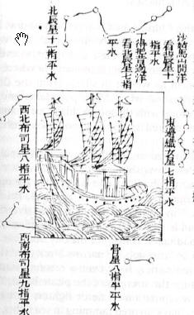
For example, when people looked at the sky
Hack: Celestial navigation
e.g. the Chinese expedition in Ming Dynasty, 1405-1433.
Math: Newtonian Gravitational Theory. 1680s
Newton reportedly told Halley that lunar theory
(to represent mathematically the motion of moon )
“made his head ache and kept him awake so often that he would think of it no more”.*
Stat: Rescue the solar system by lsq (Mayer, Legendre, Laplace, Euler)
n
x₁, x₂, …, x_{k} y
1
2
.
.
.
75
** Euler 1749
* Berry 1898, A Short History of Astronomy, p.240. ** Stigler 1986,The History of Statistics, p.26.

Slide 4
When people look at images
Hack: --- good features (corner, SIFT, HoG, LBP, …),
algorithms that are not supposed to apply …
(such as Loopy Belief Propagation)… BTW, true for most vision algorithms,
it is unclear what state spaces they are operating on, and whether or how it may converge.
Math: --- 3D geometry, lighting models, PDEs, …
Pattern Theory.
Stat: --- Boosting, Support vector machines
(Regression with various loss functions and algorithms.)
What makes research exciting are the “discoveries” that connection them !

Slide 5
Case study I: Development of MRF/texture models
Julesz 1960-70s
Bergen, Adelson
Heeger … 1991, 95
Julesz ensemble, 1999
Daugman1985
equivalence, 1999
FRAME, 1996
Ising 1920
Potts 1957
Cross and
Jain 1983
Besag 1973
Gibbs 1902
Lewis etc. 95

Slide 6
Case study II: Dev. MCMC/optimizing algorithms
Waltz 1972 (labeling)
Metropolis 1946
Rosenfeld, Hummel, Zucker 1976 (relaxation-labeling)
Hastings 1970
Kirkpatrick, 1983
Jump-diffusion,
Miller & Grenander,1994
Geman brothers 1984, (Gibbs sampler)
Swendsen-Wang 1987 (cluster sampling)
Reversible jump, Green 1995
Swendsen-Wang Cut 2003
DDMCMC 2001-2005
C4: Clustering w. +/- Constraints, 2009

Slide 7
Historic trends in vision, based on my perception
Before 1990
Math
Stat
Hack
1990-2000
Math
Stat
Hack
2000-2005
Math
Stat
Hack

Slide 8
The field is out of balance and polarized
Vision = Classification + ε
= Datasets + Features + Classifiers + Curves + ε
2006-now
Math
Stat
Hack
Not only that hacks have become dominating, but original work
on stat and math have been diminishing. A longer term problem
is its impacts on student training.

Slide 9
Quotes from review comments
From the far-right wing:
Why not you compare against X1, X2, X3 on datasets Y1, Y2, Y3 ???
Mathematically rigorous methods usually do not work !
I have no interest reading your theory until you show me performance better than the state-of-the-art.
If you are smart, why aren’t you rich?

Slide 10
Quotes from review comments
From the far-left wing.
Your method is trained and tested only on a finite, artificial dataset,
therefore it does not contribute to the solution of any real vision problem
I am talking with mathematical certainty that it is impossible to reconstruct
a 3D scene from a single image. So this paper must be rejected.
With so many sub-problems unsolved, it makes no sense to solve a problem
as complex as image parsing.
“Professor, your question was wrong …”

Slide 11
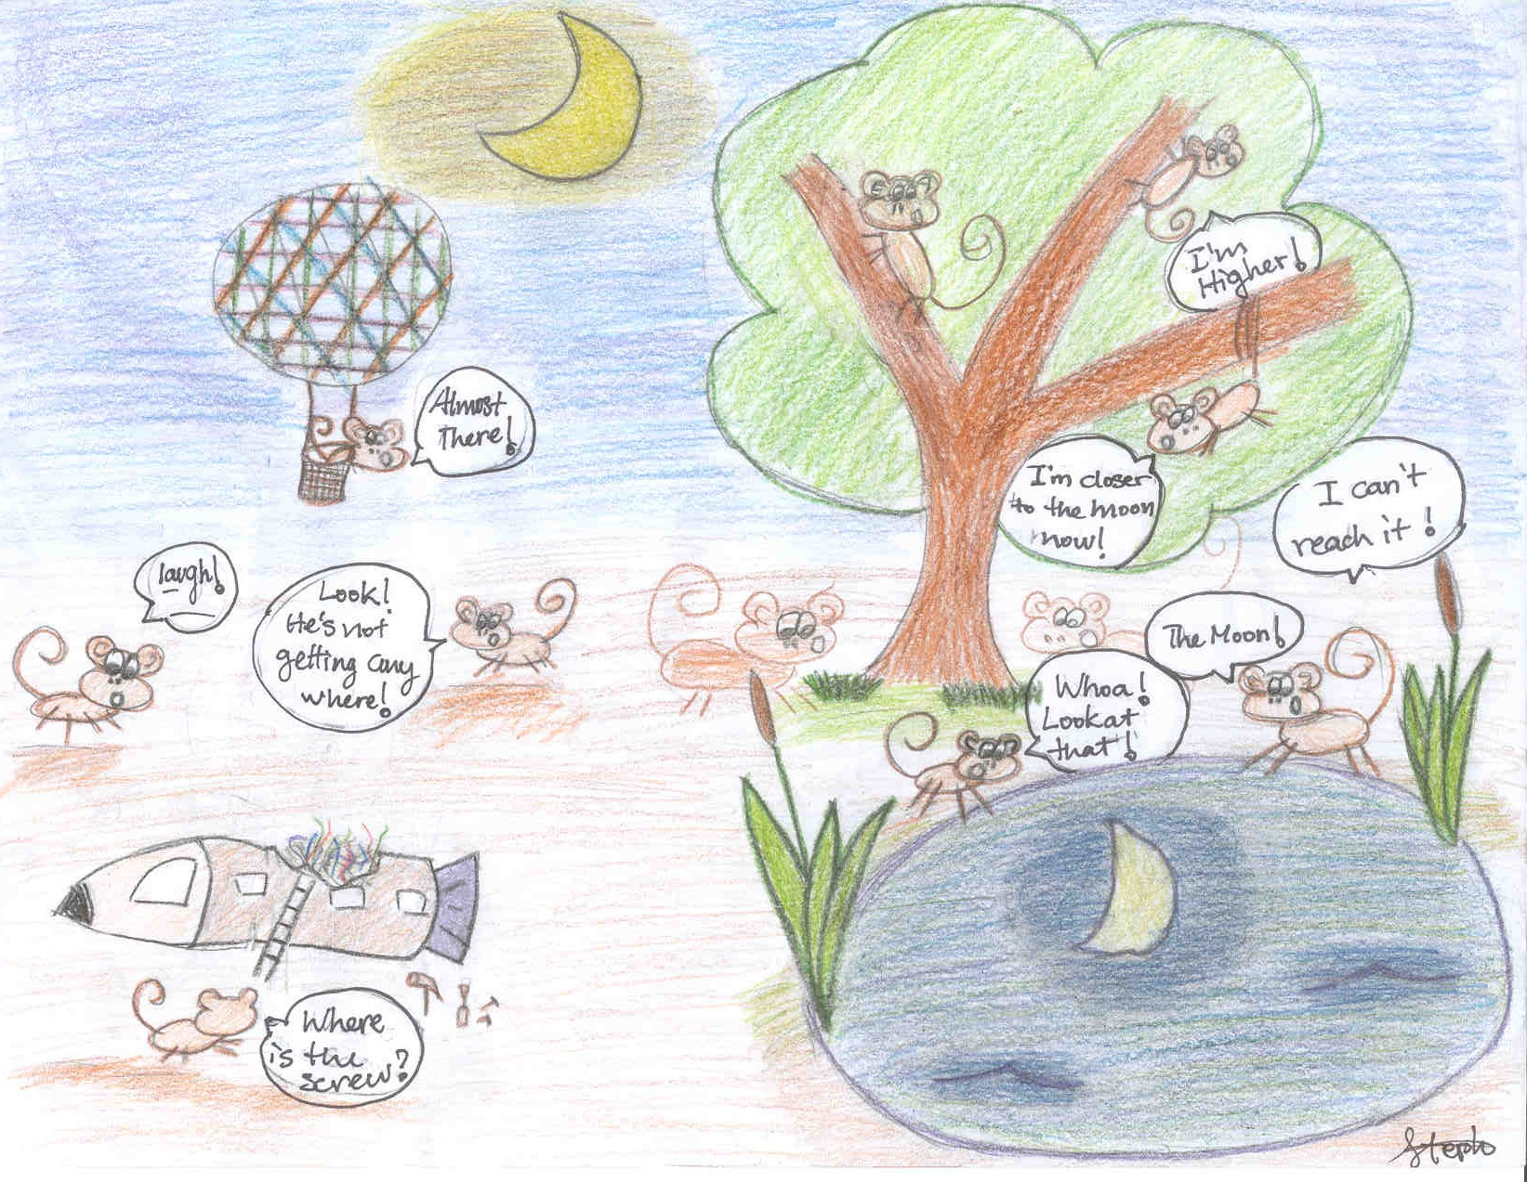
Finally: How to reach the moon, in 20 years?

