Slide 1
STATS 100A: Probability
Instructor: Ying Nian Wu
Email: ywu@stat.ucla.edu
Office hour: before lecture or by appointment
http://www.stat.ucla.edu/~ywu/teaching.html

Slide 2
Goal: Introduce basic concepts and methods in probability theory
Pre-requisite: Calculus (and linear algebra)
Coursework: Weekly homework assignments (70%)
Final Exam (30%)

Slide 3
Textbooks
No required textbooks.
Slides/videos will be posted.
Reference: Ross, S., A First Course in Probability
(download from internet)

Slide 4
Plan
Part 1: basic concepts and rules through examples
Part 2: random variables --- one at a time
Part 3: two or more random variables

Slide 5
Emphases
Concepts, intuitions
Calculations in precise notation
Scientific applications

Slide 6
Homework
Assigned Friday
Due next Friday (upload pdf)
Mainly based on the lectures
Important calculations in lectures in more details
Extensions and explorations

Slide 7
Why do we need probability theory?
In the following, all the pictures are taken from internet and all the credits belong to the authors
The content of this lecture will not be in the homework assignments and final exam

Slide 8
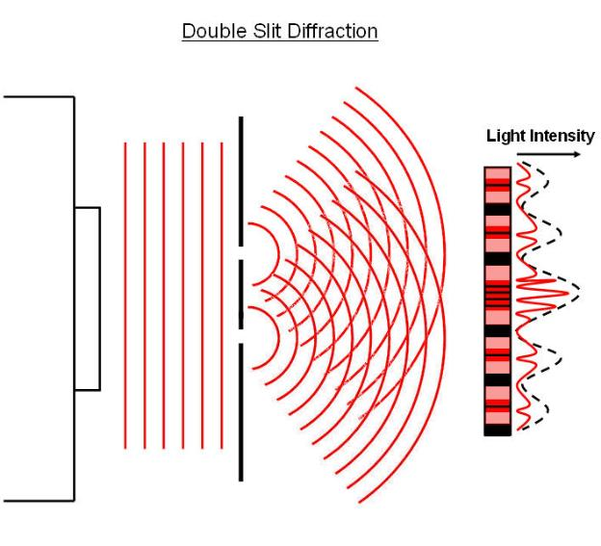
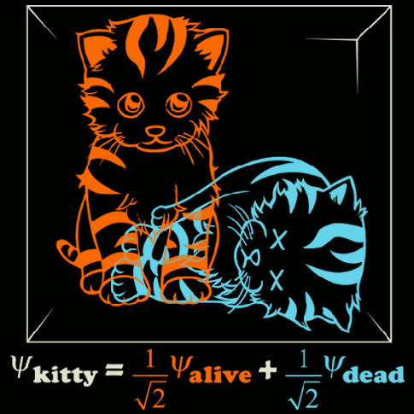
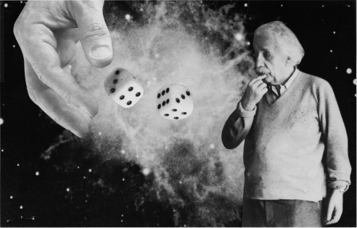
At the most fundamental level, the physical laws are probabilistic
Two-slit experiment: an electron goes through two slits simultaneously
like water waves that can be superposed
The evolution of wave function is governed by Schrodinger equation
Born: |wave function|^2 = probability density function
Observer’s measurement, wave function collapses
Heisenberg uncertainty principle
Bohr: wave-particle duality
Einstein (against probabilistic interpretation): God does not play dice
Schrodinger (also against) cat paradox: superposition of alive and dead

Slide 9
Two-slit experiment

Slide 10
Wave function → probability density

Slide 11
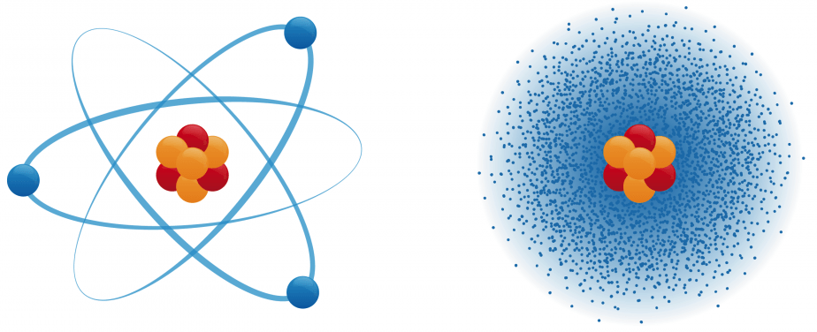
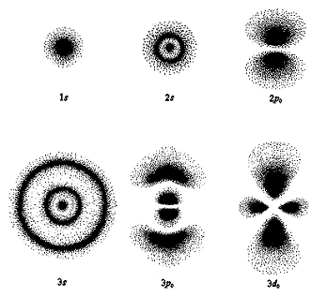
Electron cloud: population of possibilities
probability density

Slide 12
Particle decay

Slide 13
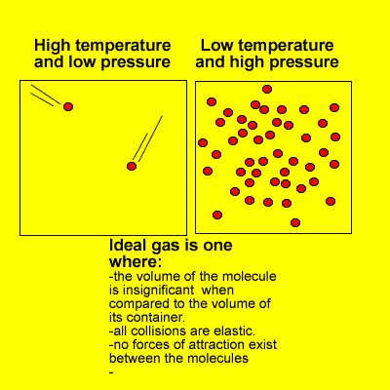
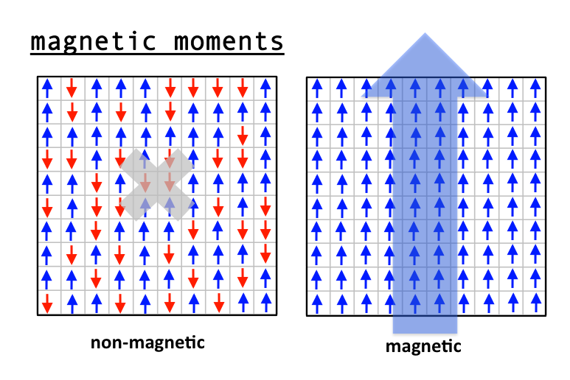
Even if physical laws are deterministic
If we study the motions of 10^23 elements, we need statistical models
Configuration X in Omega = {X: energy(X) = fixed}
X(t) evolves in Omega and traverses every configuration with equal frequency
at a random time t, X(t) ~ uniform(Omega) → subsystem x(t) of X(t)
Ideal gas: temperature, pressure etc. are statistical properties
Ferromagnetism: Ising model, magnetism is also statistical property
Phase transition: water/ice/gas, same model →different distributions
Arrow of time: increase in entropy, again a statistical property

Slide 14
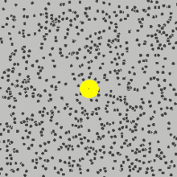
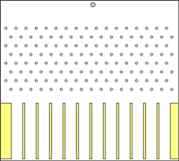
Brownian motion: dust particles in water show zig-zag paths
Einstein: caused by bombardments from invisible water molecules
established existence of molecules and atoms
Left: 2D; Right: 1D simplified, Galton board/quincunx, Gaussian, CLT
Stochastic differential equation
Finance, Black-Scholes equation
Diffusion models for generative AI

Slide 15
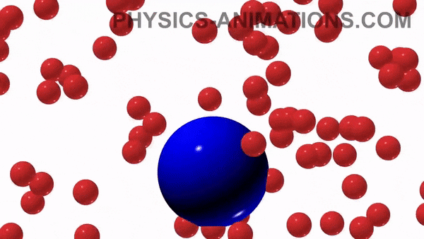

Slide 16
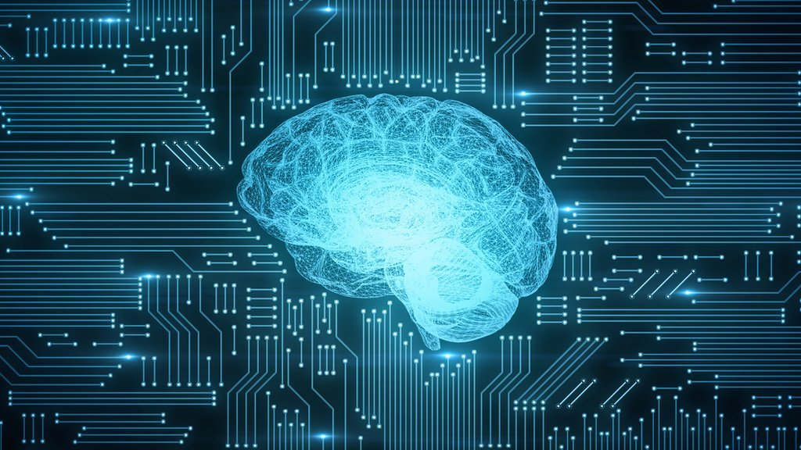
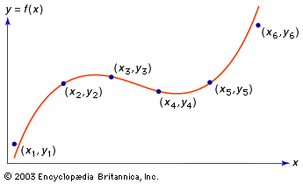
Artificial intelligence, machine learning, deep learning,
computer vision, natural language processing, robotics …
All based on probabilistic framework
Training data come from a probability distribution
Learn about this probability distribution
Generalize to testing data: x: instruction, y: completion
Memorization and generalization

Slide 17
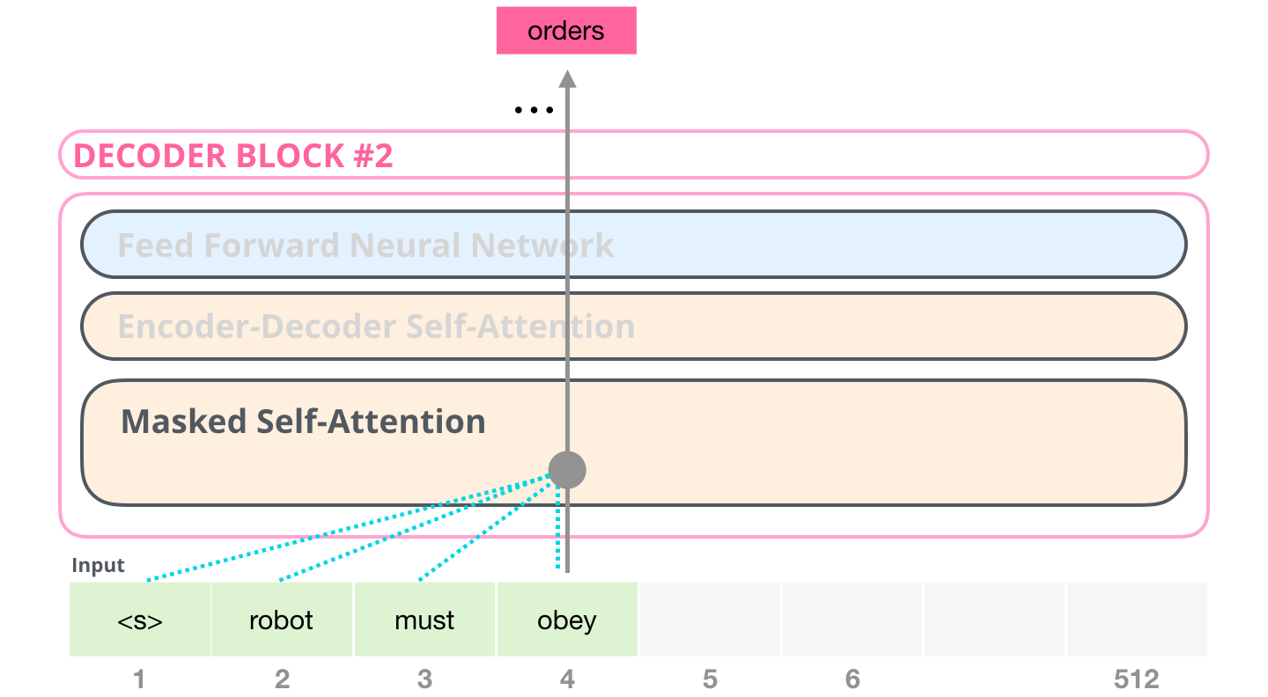
next word prediction

Slide 18
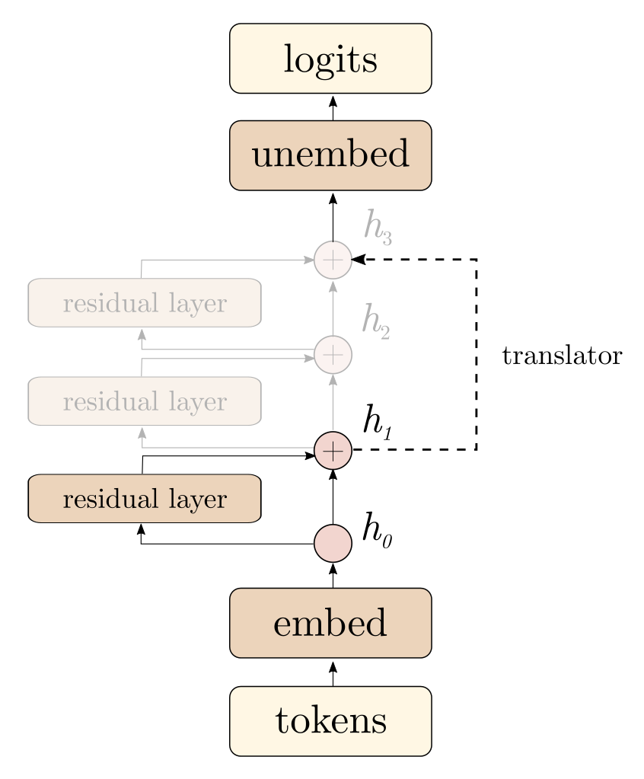
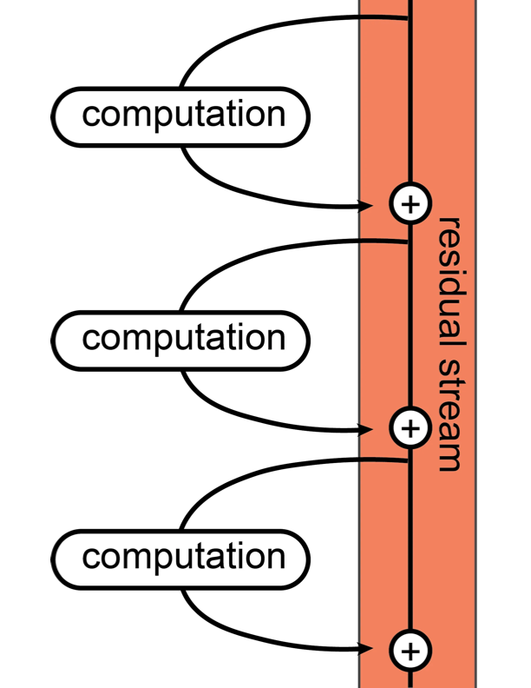

Slide 19
Diffusion denoising probability model

Slide 20
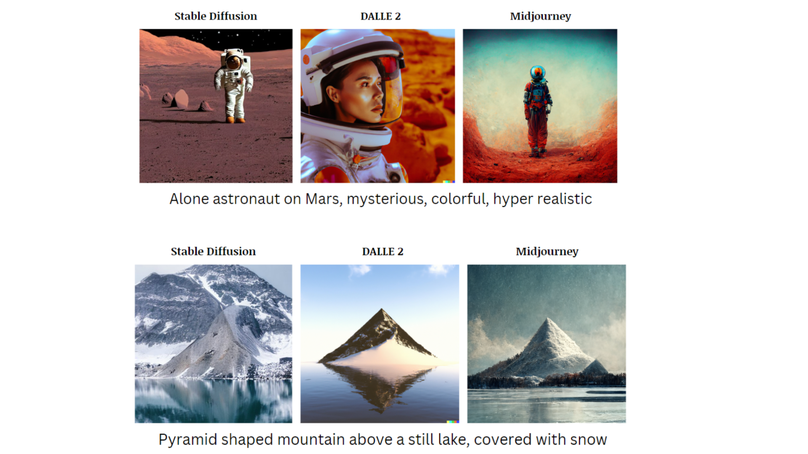

Slide 22
Prompt: A stylish woman walks down a Tokyo street filled with warm glowing neon and animated city signage. She wears a black leather jacket, a long red dress, and black boots, and carries a black purse. She wears sunglasses and red lipstick. She walks confidently and casually. The street is damp and reflective, creating a mirror effect of the colorful lights. Many pedestrians walk about.

Slide 26
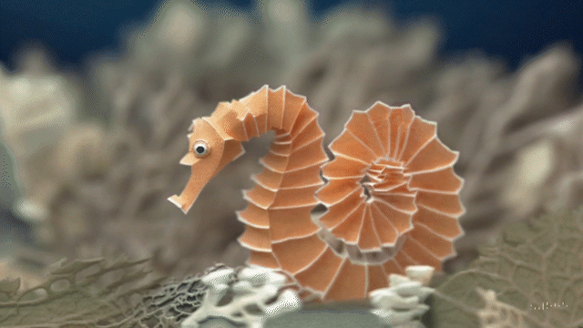

Slide 27
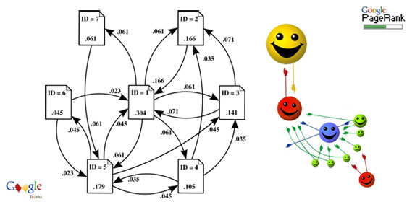
Google page-rank, random surfing model
85% probability, randomly click a link to the next page
15% probability, randomly go to another page
Markov chain → stationary distribution
Imagine 1 billion people follow the same random walk
Eventually they will be distributed over all the webpages
Popularity of a page is based on its stationary distribution

Slide 28
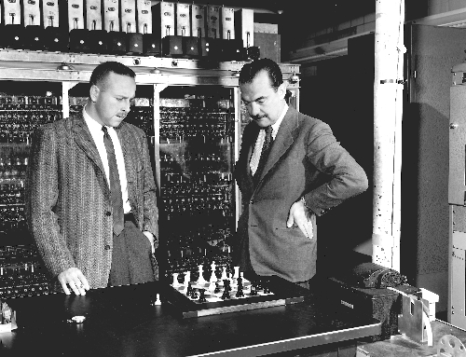
Monte Carlo algorithm
Monte Carlo – European Las Vegas
Stan Ullman: uncle going to Monte Carlo
Metropolis: Monte Carlo algorithm
High-dimensional integration or optimization
Ironically, the most accurate algorithms may be based on randomness
Avoid the curse of dimensionality
population (e.g., 300 million) → sample (e.g., 1000 examples)
Metropolis algorithm: ranked #1 algorithm in scientific computing
The first computers: MANIAC
Manhattan project: atomic bomb, hydrogen bomb
Markov chain Monte Carlo

Slide 29
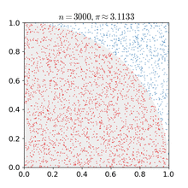

Slide 30
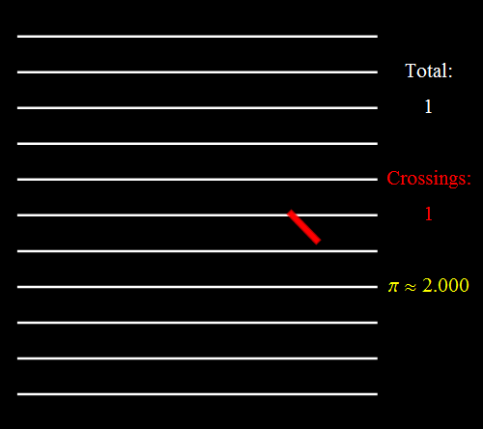
Buffon needle

Slide 31
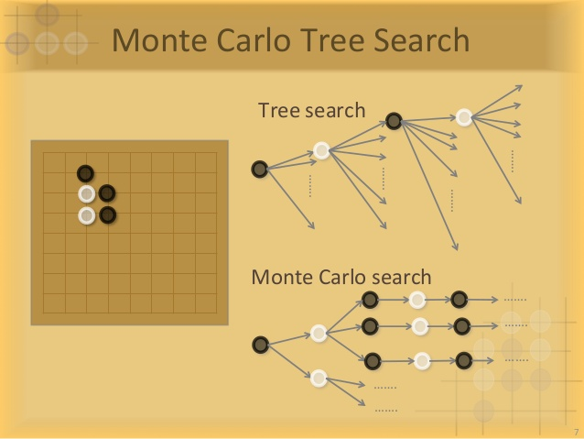
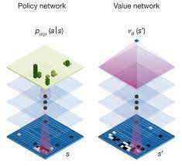
fast thinking
memory, intuition
slow thinking
reasoning, planning

Slide 32
Foundation for statistics, machine learning, AI, etc.
Applications in many other areas and disciplines
Importance only comes after calculus and linear algebra

Slide 33
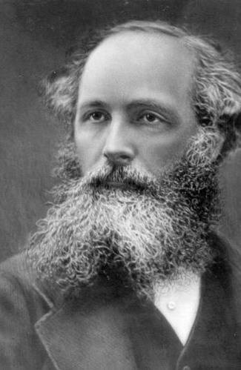
Maxwell: The true logic of this world is in the calculus of probabilities

Slide 34
Counting population or repetitions
a population of equally likely possibilities (e.g., US population)
sample one example from the population (e.g., a person)
population → one example
probability = population proportion (e.g., P(male) = proportion of males)
conditional probability = proportion in sub-population (e.g., P(tall|male))
a large number of independent repetitions
e.g., population → sample of many examples
sample proportion / frequency (fluctuate) → probability
e.g., survey / poll before election, Monte Carlo
expectation = population average
sample average (fluctuate) → expectation

