Slide 1
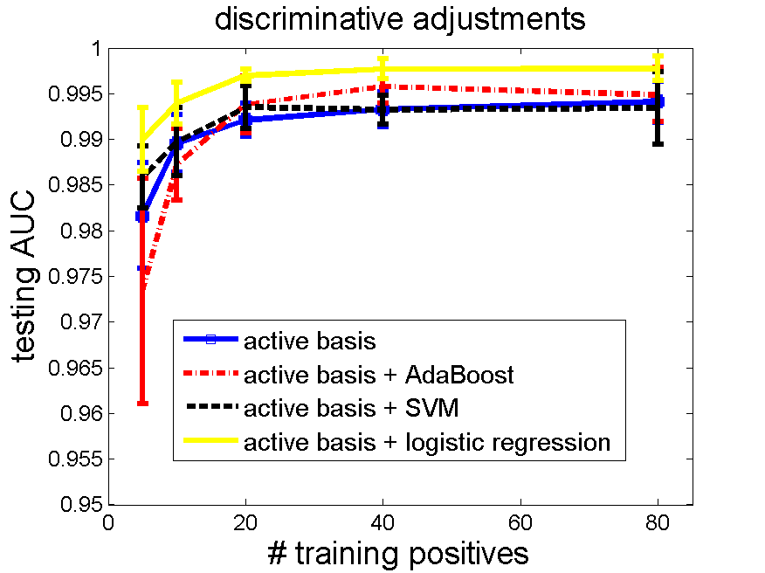
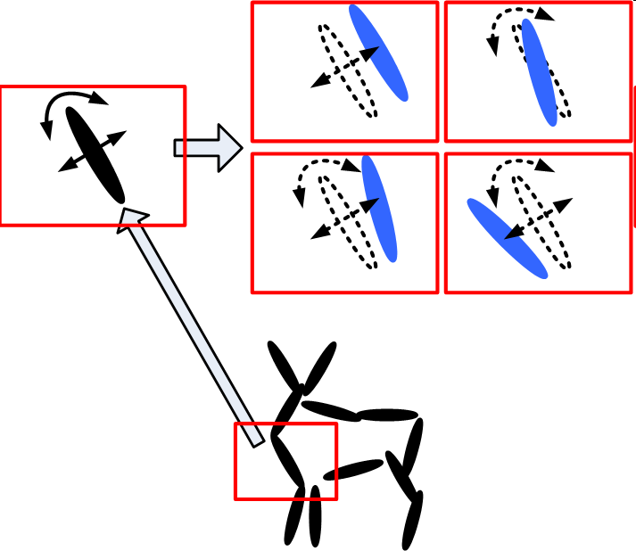
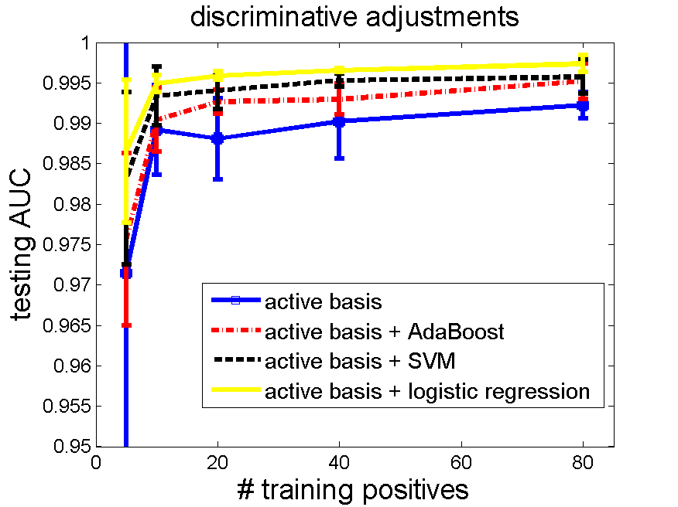
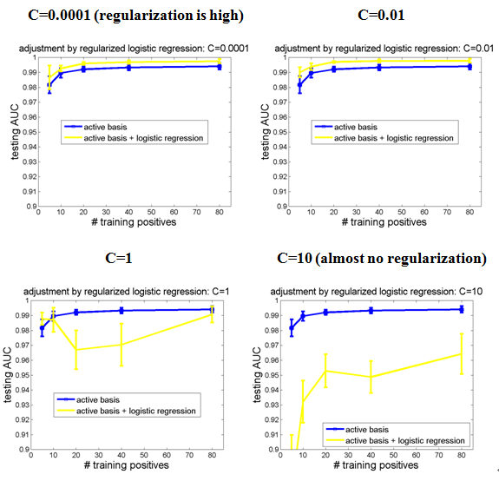
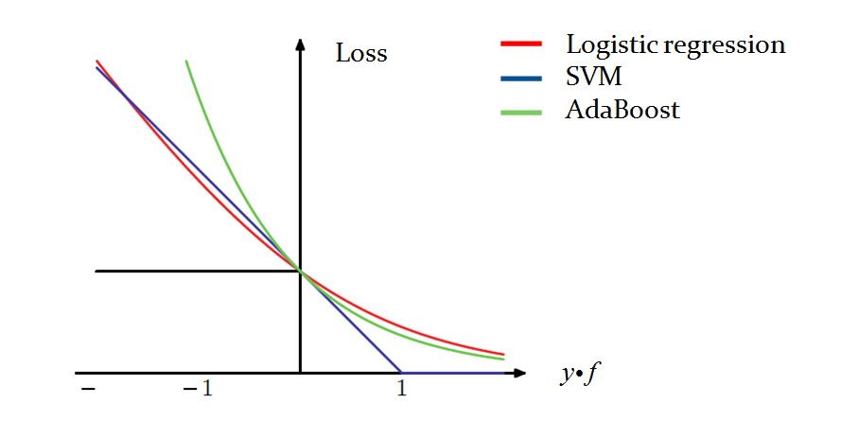
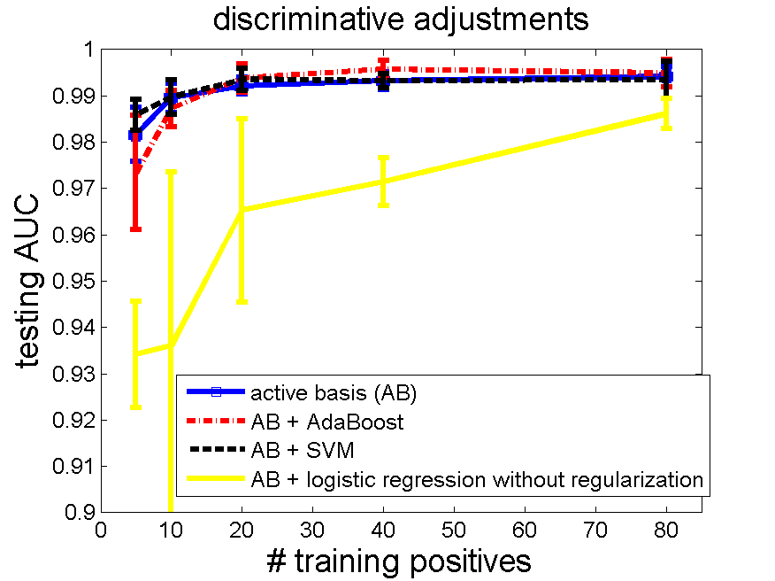
Adjusting Active Basis Model by Regularized Logistic Regression
Ruixun Zhang
Peking University, Department of Statistics and Probability
Abstract
Results
Active basis model is a generative model seeking a common wavelet sparse coding of images from the same object category, where the images share the same set of selected wavelet elements, which are allowed to perturb their locations and orientations to account for shape deformations. This work applies discriminative methods to adjust λ’s of selected basis elements, including logistic regression, SVM and AdaBoost. Results on supervised learning show that discriminative post-processing on active basis model improves its classification performance in terms of testing AUC. Among the three methods the L2-regularized logistic regression is the most natural one and performs the best.
Classification Experiment
Template size = 80. Tuning parameter = 0.01.
Head_shoulder data: training negatives 160, testing negatives 471.
Guitar data: training negatives 160, testing negatives 855.
Introduction
Intel Core i5 CPU, RAM 4GB, 64bit windows
# pos | Learning time (s) | LR time (s)
5 | 0.338 | 0.010
10 | 0.688 | 0.015
20 | 1.444 | 0.015
40 | 2.619 | 0.014
80 | 5.572 | 0.013
Active Basis – Generative Model
a common template for a set of images:
perturbed to match each image. where
Basis perturbation A set of images share an active basis
Unsupervised Learning
Unknown categories:
Unknown locations and scales:
Intel Core i5 CPU, RAM 4GB, 64bit windows
# pos | Learning time (s) | LR time (s)
5 | 0.478 | 0.011
10 | 0.852 | 0.014
20 | 1.749 | 0.015
40 | 2.643 | 0.015
80 | 5.827 | 0.014
Hidden variables
Discussion
Tuning Parameter
Small tuning parameters
imply high regularization
guarantee high performances
Future Work
Extend to unsupervised learning – adjust mixture model
Generative learning by active basis
Discriminative adjustment on feature weights
Methods
Discriminative Adjustment
Adjust λ’s of the template by:
L2-regularized logistic regression:
SVM and AdaBoost:
Over-fitting without regularization.
Model:
Loss function:
Acknowledgements
Thanks to my mentor Prof. Ying Nian Wu and PhD fellow Zhangzhang Si, for their instructions to my project, as well as to my self developing. I have learned a lot from the project. It is a fantastic summer for me. Also thanks to Dr. Chih-Jen Lin for his liblinear software package and his detailed suggestions about how to adjust the software for our experiment.
References
Wu, Y. N., Si, Z., Gong, H. and Zhu, S.-C. (2009). Learning Active Basis Model for Object Detection and Recognition. International Journal of Computer Vision.
R.-E. Fan, K.-W. Chang, C.-J. Hsieh, X.-R. Wang, and C.-J. Lin. (2008). LIBLINEAR: A Library for Large Linear Classification. Journal of Machine Learning Research.
Lin, C. J., Weng, R.C., Keerthi, S.S. (2008). Trust Region Newton Method for Large-Scale Logistic Regression. Journal of Machine Learning Research.
Vapnik, V. N. (1995). The Nature of Statistical Learning Theory. Springer.
Joachims, T. (1999). Making large-Scale SVM Learning Practical. Advances in Kernel Methods - Support Vector Learning, MIT-Press.
Freund, Y. and Schapire, R. E. (1997). A Decision-Theoretic Generalization of On-Line Learning and an Application to Boosting. Journal of Computer and System Sciences.
Viola, P. and Jones, M. J. (2004). Robust real-time face detection. International Journal of Computer Vision.
Rosset, S., Zhu, J., Hastie, T. (2004). Boosting as a Regularized Path to a Maximum Margin Classifier. Journal of Machine Learning Research.
Zhu, J. and Hastie, T. (2005). Kernel Logistic Regression and the Import Vector Machine. Journal of Computational and Graphical Statistics.
Hastie, T., Tibshirani, R. and Friedman, J. (2001) Elements of Statistical Learning; Data Mining, Inference, and Prediction. New York: Springer.
Bishop, C. (2006). Pattern Recognition and Machine Learning. New York: Springer.
L. Fei-Fei, R. Fergus and P. Perona. (2004). Learning generative visual models from few training examples: an incremental Bayesian approach tested on 101 object categories. IEEE. CVPR, Workshop on Generative-Model Based Vision.
Friedman, J., Hastie, T. and Tibshirani, R. (2000). Additive logistic regression: A statistical view of boosting (with discussion). Ann. Statist.

