Slide 1
Adjusting Active Basis Model by Regularized Logistic Regression
Ruixun Zhang
Peking University
Mentor: Prof. Ying Nian Wu
Direct supervisor: Zhangzhang Si
Department of Statistics

Slide 2
Outline
Active Basis model as a generative model
Supervised and unsupervised learning
Hidden variables and maximum likelihood
Discriminative adjustment after generative learning
Logistic regression, SVM and AdaBoost
Over-fitting and regularization
Experiment results

Slide 3
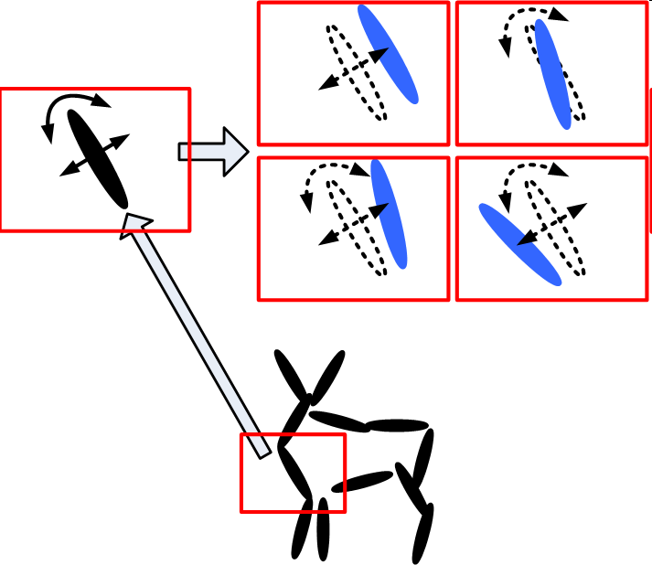
Active Basis – Representation
An active basis consists of a small number of Gabor wavelet elements at selected locations and orientations

Slide 4
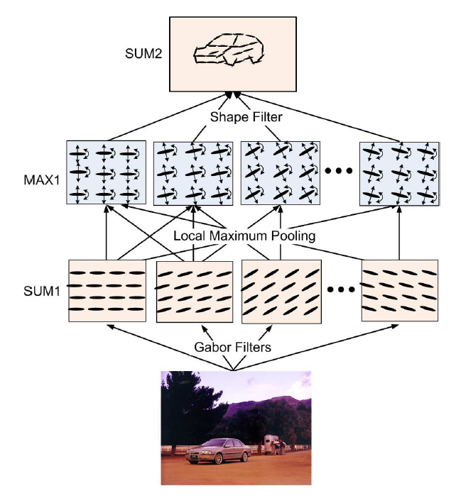
Active Basis – Learning and Inference
Shared sketch algorithm
Local normalization
measures the importance of Bi
Inference: matching the template at each pixel, and select the highest score.

Slide 5
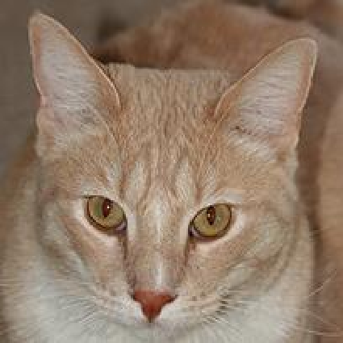
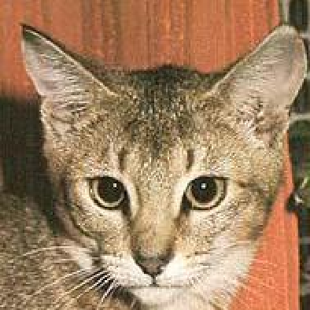
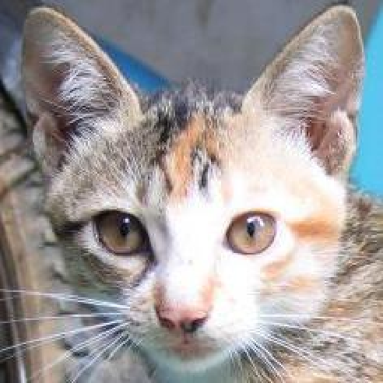
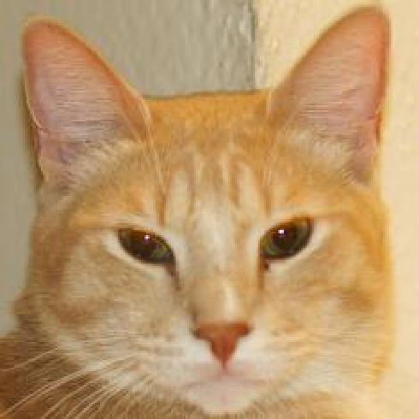
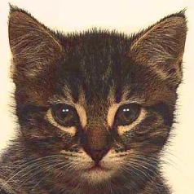
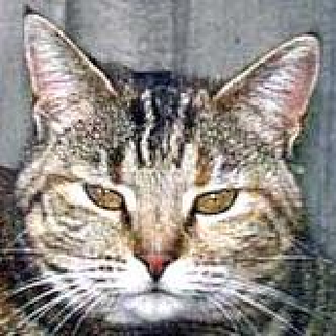
Active Basis – Example

Slide 6
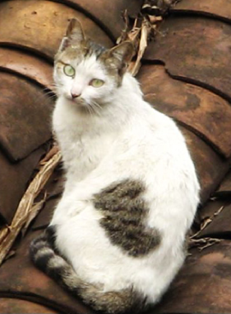
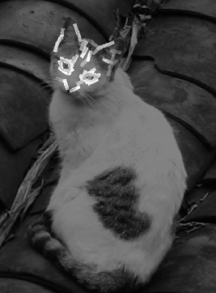
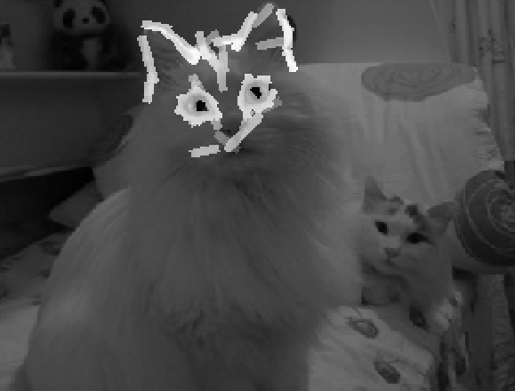
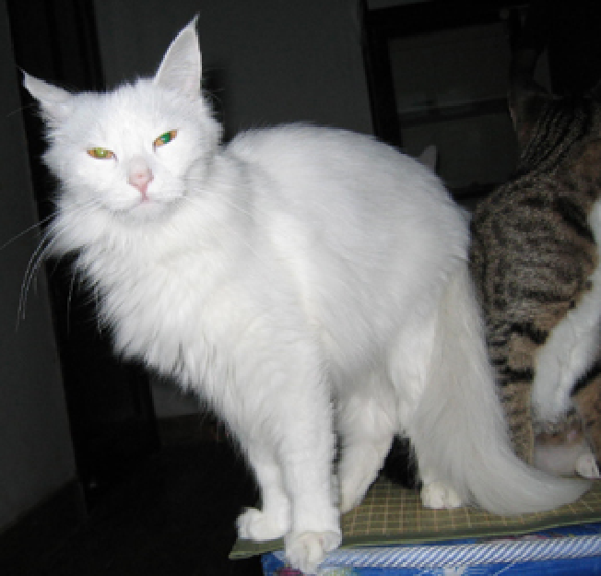
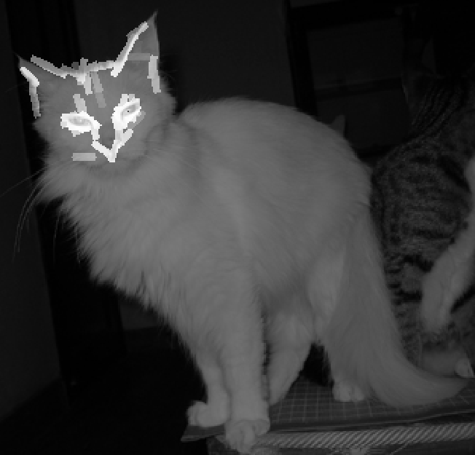
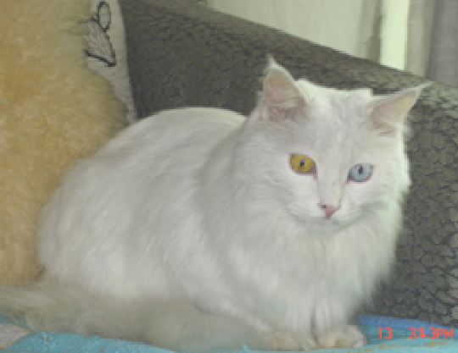
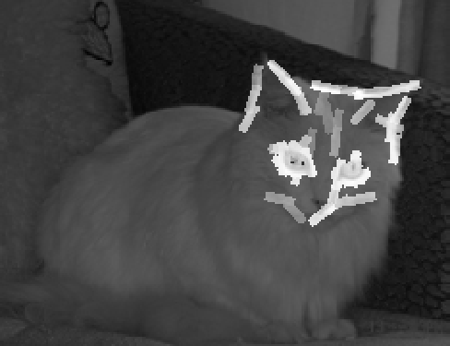
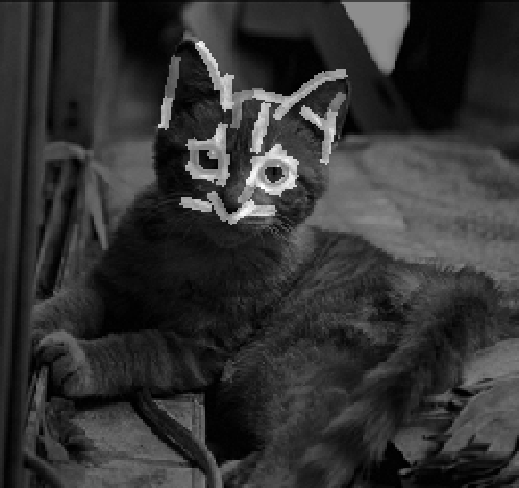
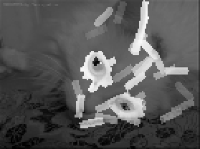
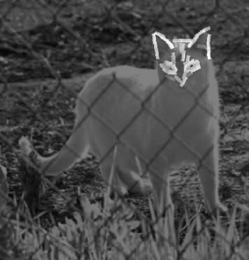
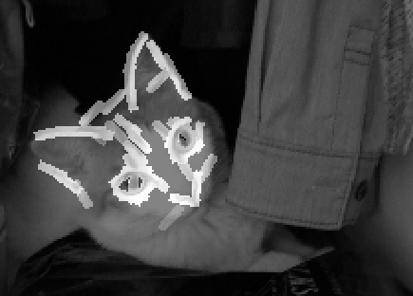

Slide 7
General Problem – Unsupervised Learning
Unknown categories – mixture model
Unknown locations and scales
Basis perturbations ………………
Active plates – a hierarchical active basis model
Hidden variables

Slide 8
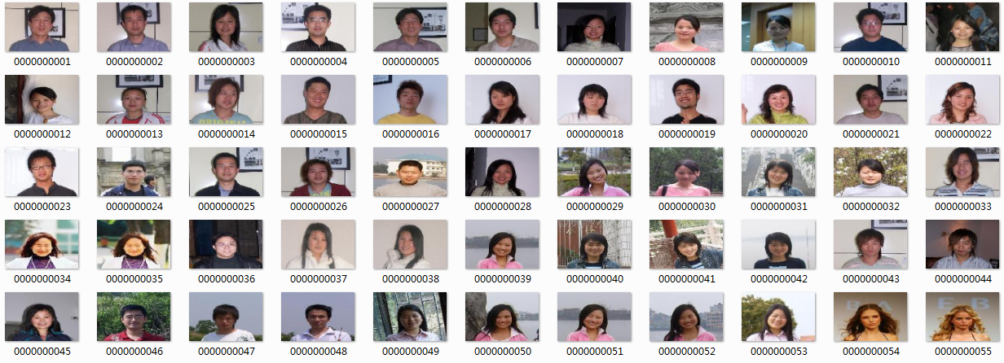
Starting from Supervised Learning
Data set: head_shoulder, 131 positives, 631 negatives.
………………

Slide 9
Active Basis as a Generative Model
Active basis – Generative model
Likelihood-based learning and inference
Discover hidden variables – important for unsupervised learning.
NOT focus on classification task (no info from negative examples.)
Discriminative model
Not sharp enough to infer hidden variables
Only focus on classification
Over-fitting.

Slide 10
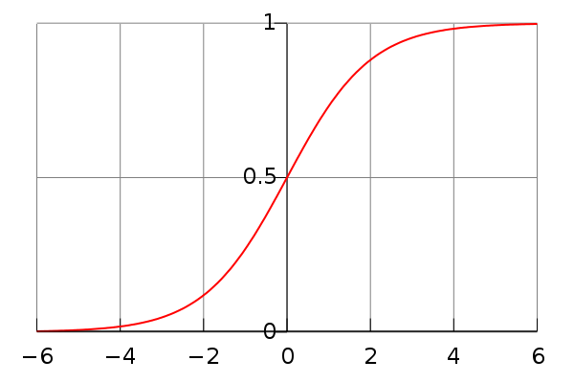
Discriminative Adjustment
Adjust λ’s of the template
Logistic regression – consequence of generative model
Loss function:
p

Slide 11
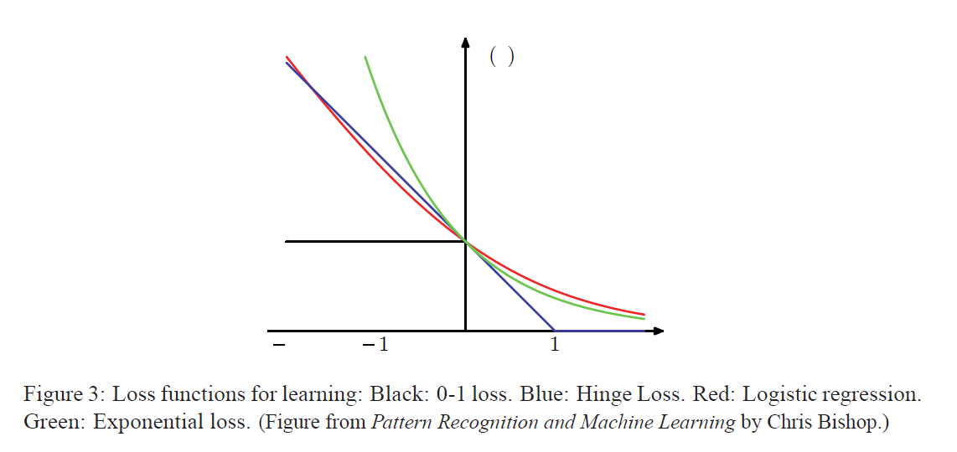
Logistic Regression Vs. Other Methods
Loss
Logistic regression
SVM
AdaBoost

Slide 12
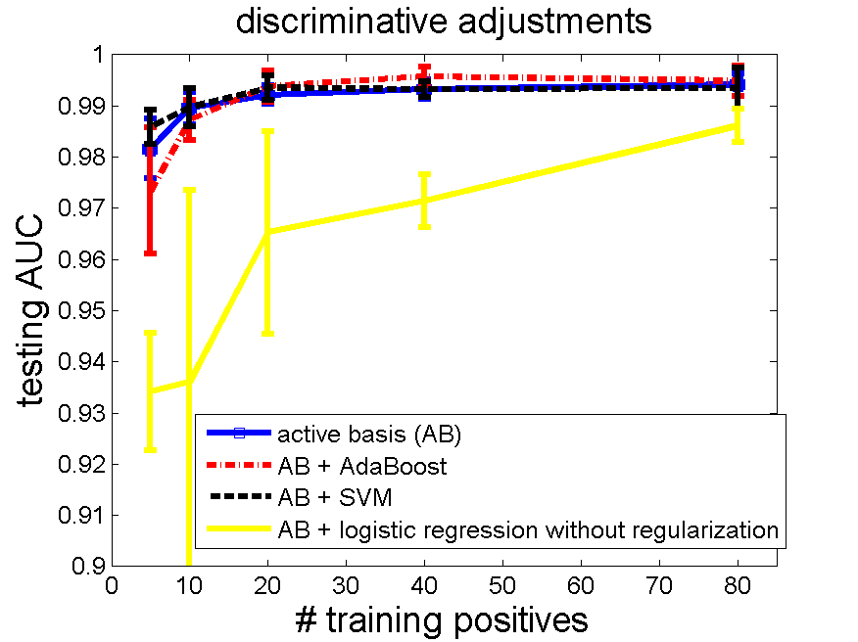
Problem: Over-fitting
head_shoulder; svm from svm-light, logistic regression from matlab.
template size 80, training negatives 160, testing negatives 471.
active basis
active basis + logistic regression
active basis + SVM
active basis + AdaBoost

Slide 13
Regularization for Logsitic Regression
Loss function for
L1-regularization
L2-regularization
Corresponding to a Gaussian prior
Regularization without the intercept term

Slide 14
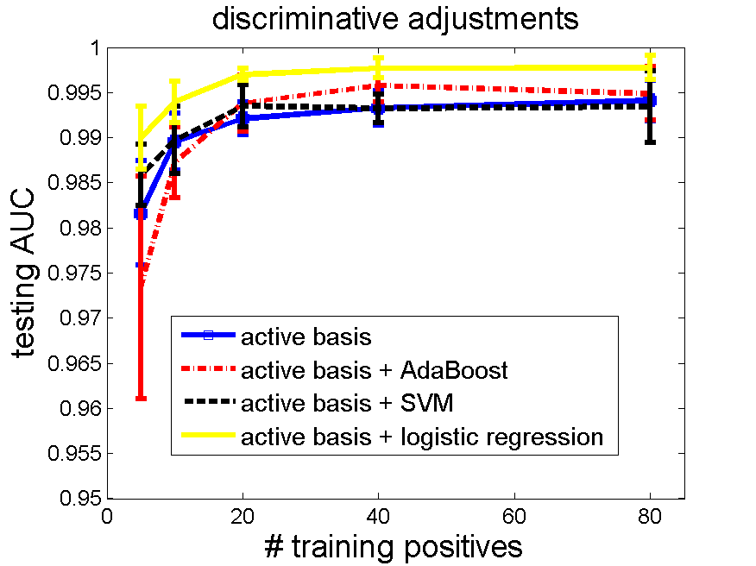
Experiment Results
head_shoulder; svm from svm-light, L2-logistic regression from liblinear.
template size 80, training negatives 160, testing negatives 471.
active basis
active basis + logistic regression
active basis + SVM
active basis + AdaBoost
Tuning parameter C=0.01.
Intel Core i5 CPU, RAM 4GB, 64bit windows
# pos | Learning time (s) | LR time (s)
5 | 0.338 | 0.010
10 | 0.688 | 0.015
20 | 1.444 | 0.015
40 | 2.619 | 0.014
80 | 5.572 | 0.013

Slide 15
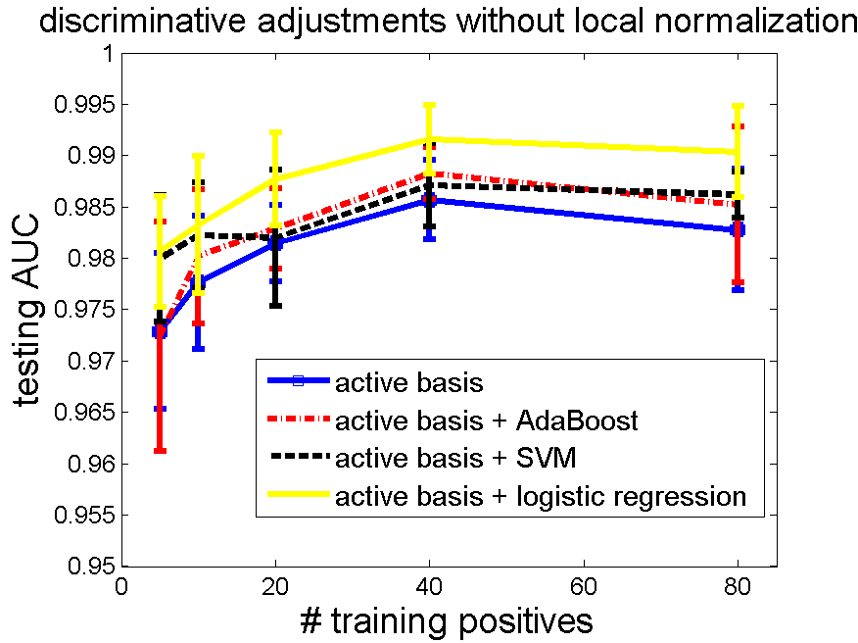
With or Without Local Normalization
All settings same as the head_shoulder experiment
With Without

Slide 16
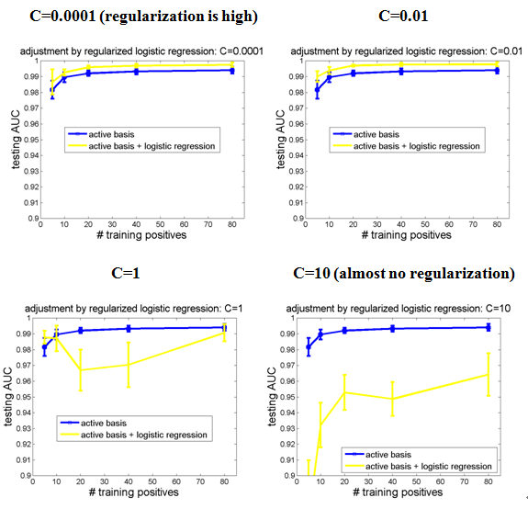
Tuning Parameter
All settings the same.
Change C, see effect of
L2-regularization

Slide 17
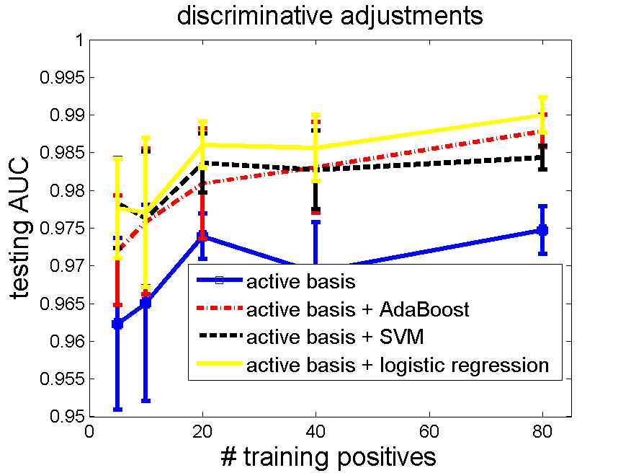
Experiment Results – More Data
horses; svm from svm-light, L2-logistic regression from liblinear.
template size 80, training negatives 160, testing negatives 471.
active basis
active basis + logistic regression
active basis + SVM
active basis + AdaBoost
Dimension reduction by active basis, so speed is fast.
Tuning parameter C=0.01.

Slide 18
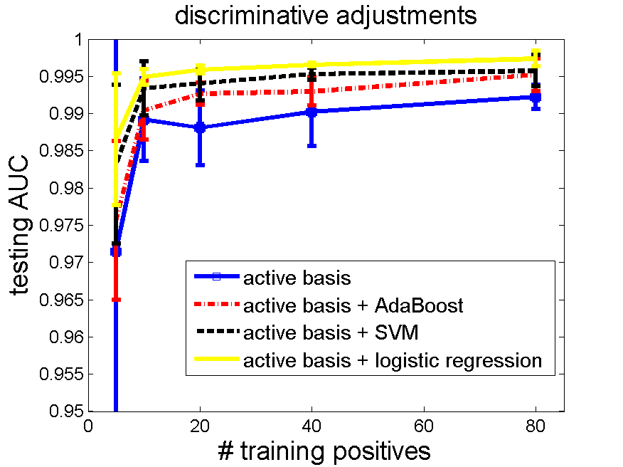
Experiment Results – More Data
guitar; svm from svm-light, L2-logistic regression from liblinear.
template size 80, training negatives 160, testing negatives 855.
active basis
active basis + logistic regression
active basis + SVM
active basis + AdaBoost
Dimension reduction by active basis, so speed is fast.
Tuning parameter C=0.01.

Slide 19
Future Work
Extend to unsupervised learning – adjust mixture model
Generative learning by active basis
Hidden variables
Discriminative adjustment on feature weights
Tighten up the parameters,
Improve classification performances
Adjust active plate model

Slide 20
Acknowledgements
Prof. Ying Nian Wu
Zhangzhang Si
Dr. Chih-Jen Lin
CSST program

Slide 21
Refrences
Wu, Y. N., Si, Z., Gong, H. and Zhu, S.-C. (2009). Learning Active Basis Model for Object Detection and Recognition. International Journal of Computer Vision.
R.-E. Fan, K.-W. Chang, C.-J. Hsieh, X.-R. Wang, and C.-J. Lin. (2008). LIBLINEAR: A Library for Large Linear Classification. Journal of Machine Learning Research.
Lin, C. J., Weng, R.C., Keerthi, S.S. (2008). Trust Region Newton Method for Large-Scale Logistic Regression. Journal of Machine Learning Research.
Vapnik, V. N. (1995). The Nature of Statistical Learning Theory. Springer.
Joachims, T. (1999). Making large-Scale SVM Learning Practical. Advances in Kernel Methods - Support Vector Learning, B. Schölkopf and C. Burges and A. Smola (ed.), MIT-Press.
Freund, Y. and Schapire, R. E. (1997). A Decision-Theoretic Generalization of On-Line Learning and an Application to Boosting. Journal of Computer and System Sciences.
Viola, P. and Jones, M. J. (2004). Robust real-time face detection. International Journal of Computer Vision.
Rosset, S., Zhu, J., Hastie, T. (2004). Boosting as a Regularized Path to a Maximum Margin Classifier. Journal of Machine Learning Research.
Zhu, J. and Hastie, T. (2005). Kernel Logistic Regression and the Import Vector Machine. Journal of Computational and Graphical Statistics.
Hastie, T., Tibshirani, R. and Friedman, J. (2001) Elements of Statistical Learning; Data Mining, Inference, and Prediction. New York: Springer.
Bishop, C. (2006). Pattern Recognition and Machine Learning. New York: Springer.
L. Fei-Fei, R. Fergus and P. Perona. (2004). Learning generative visual models from few training examples: an incremental Bayesian approach tested on 101 object categories. IEEE. CVPR, Workshop on Generative-Model Based Vision.
Friedman, J., Hastie, T. and Tibshirani, R. (2000). Additive logistic regression: A statistical view of boosting (with discussion). Ann. Statist.

Slide 22
Thank you. Q & A

