Slide 1
Unsupervised Learning of
Compositional Sparse Code
for Natural Image Representation
Ying Nian Wu
UCLA Department of Statistics
October 5, 2012, MURI Meeting
Based on joint work with
Yi Hong, Zhangzhang Si, Wenze Hu, Song-Chun Zhu

Slide 2
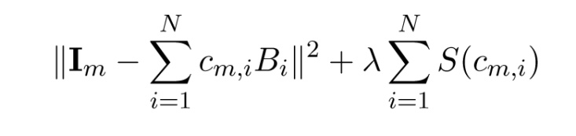
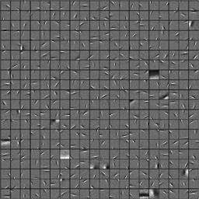
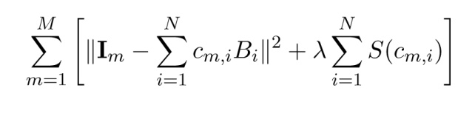
Sparse Representation
Sparsity: most of coefficients are zero
Matching pursuit: Mallat, Zhang 1993
Basis pursuit/Lasso/CS: Chen, Donoho, Saunders 1999; Tibshirani 1996
LARS: Efron, Hastie, Johnstone, Tibshirani, 2004
SCAD: Fan, Li 2001
Dictionary learning
Sparse component analysis: Olshausen, Field 1996
K-SVD: Aharon, Elad, Bruckstein 2006
Unsupervised learning: SCA, ICA, RBM, NMF ⬅ FA

Slide 3
Group Sparsity
Group Lasso: Yuan, Lin 2006
The basis functions form groups (multi-level factors/additive model)
Our goal: Learn recurring compositional patterns of groups
Compositionality (S. Geman; Zhu, Mumford)
Active basis models for deformable templates
Atomic decomposition ➔ molecular structures

Slide 4



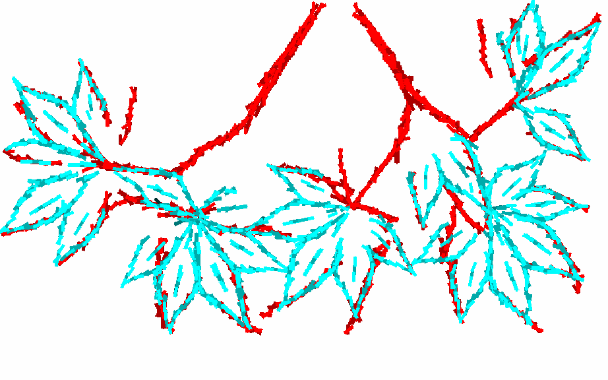
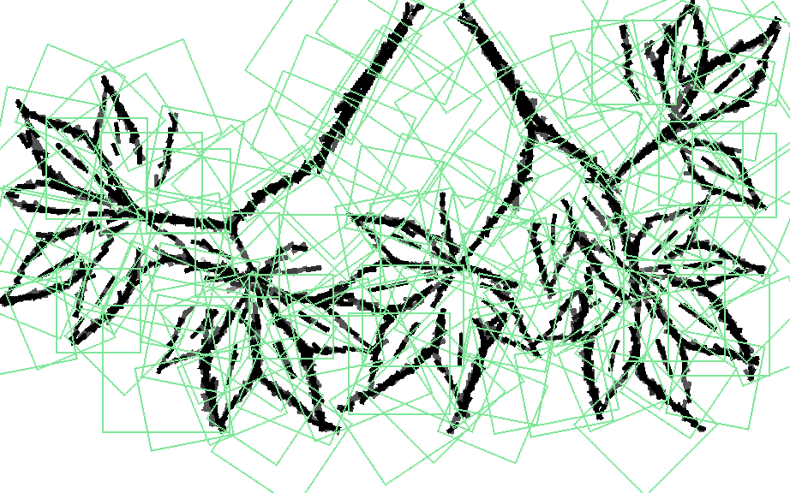
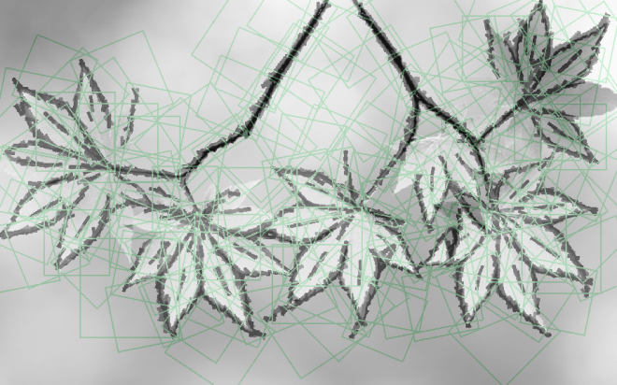
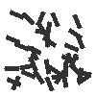
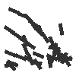






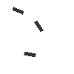

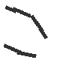




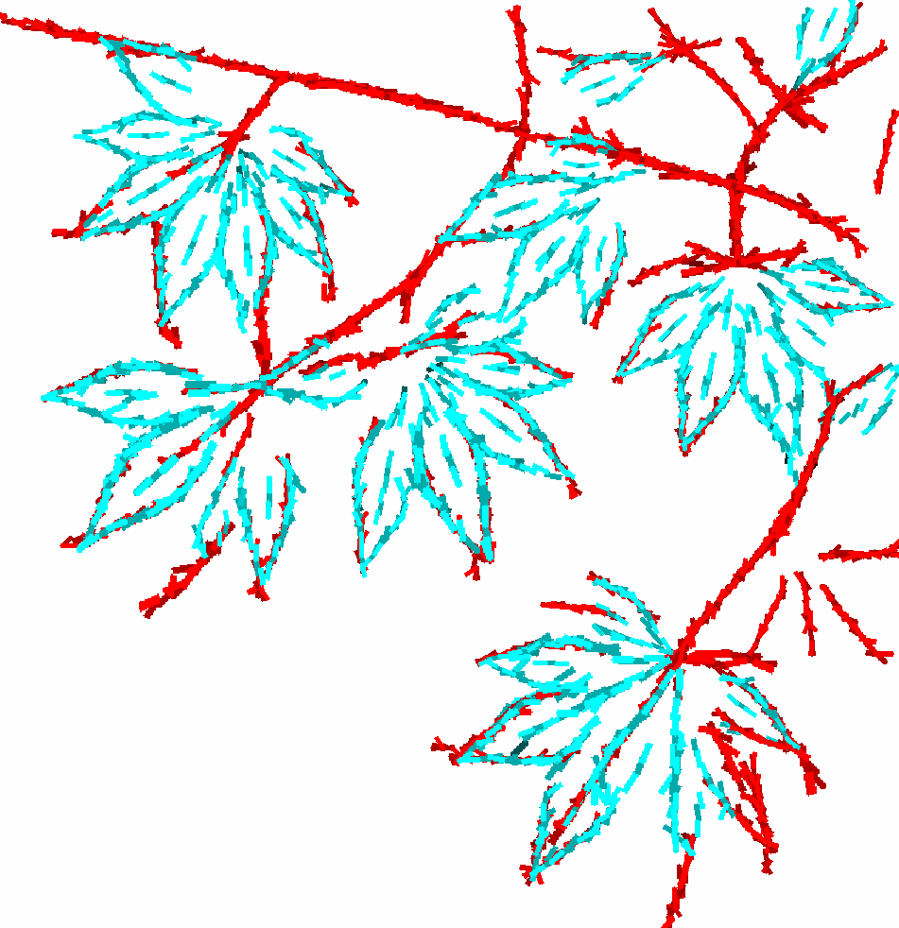

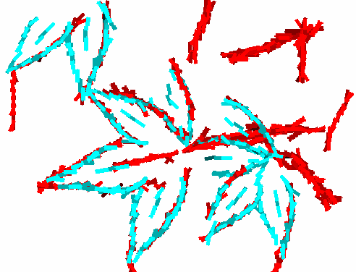
Learned dictionary of composition patterns from training image
The first 7 iterations
Learning in the 10th iteration
Generalize to testing images

Slide 5
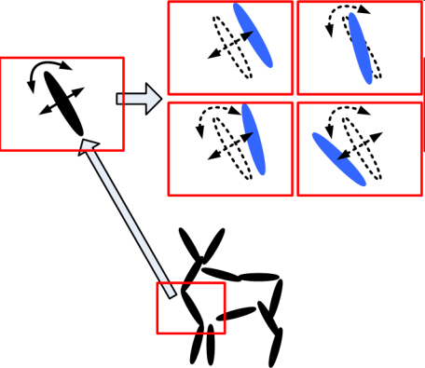
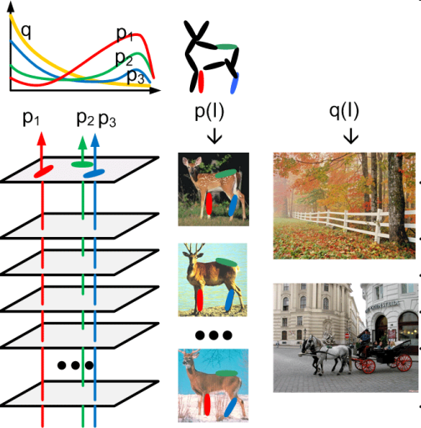
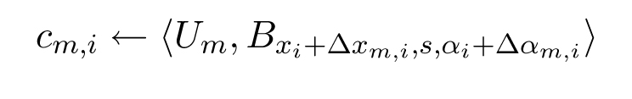
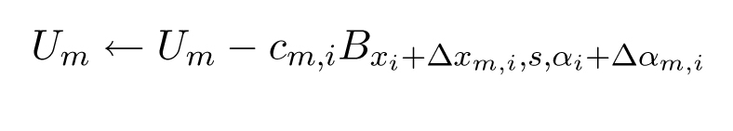
Active basis model
Shared matching pursuit
Support union regression
Multi-task learning
Avoid early decision

Slide 6
Active basis model: non-Gaussian background
Della Pietra, Della Pietra, Lafferty, 97; Zhu, Wu, Mumford, 97;
Jin, S. Geman, 06; Wu, Guo, Zhu, 08

Slide 7
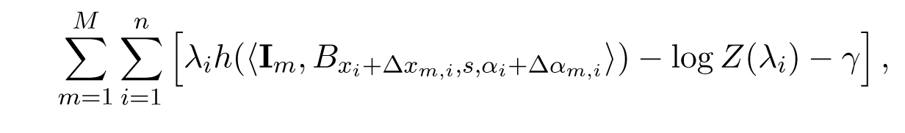
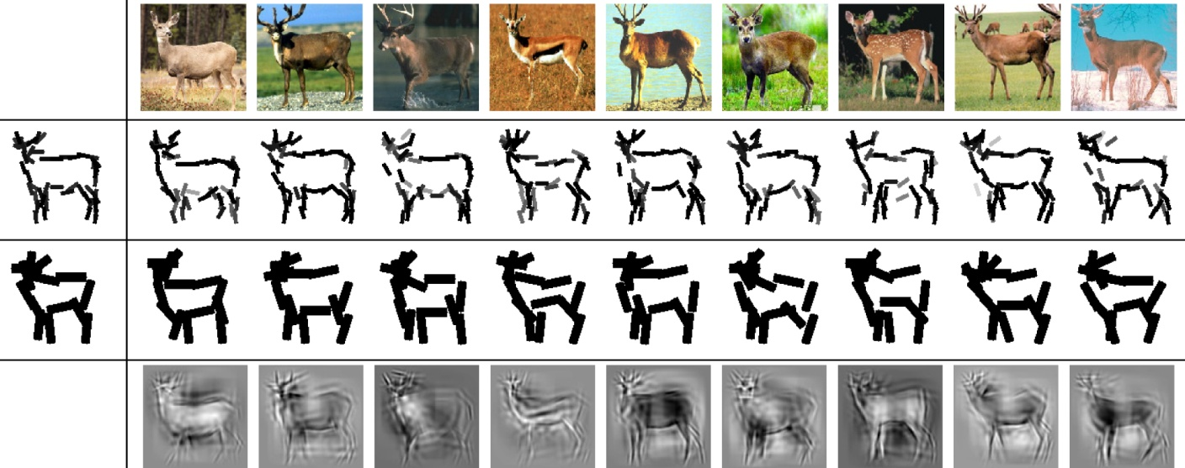
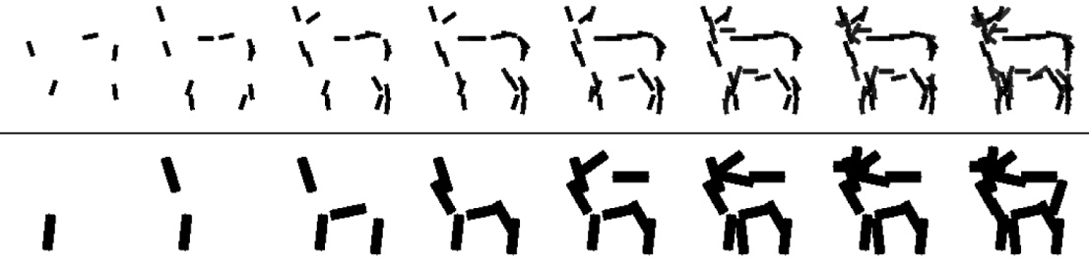
Log-likelihood

Slide 8
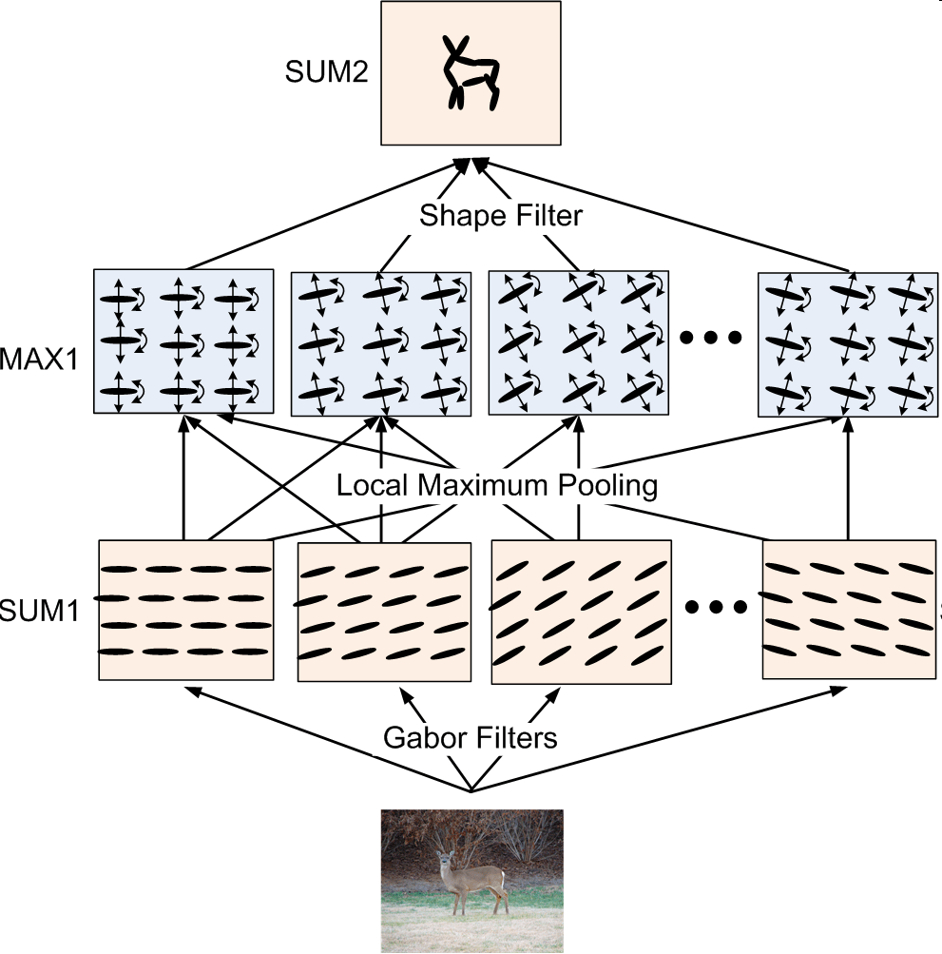
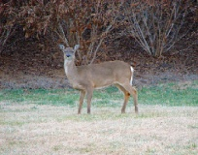
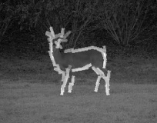
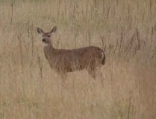
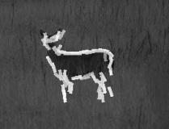
After learning template, find object in testing image

Slide 9
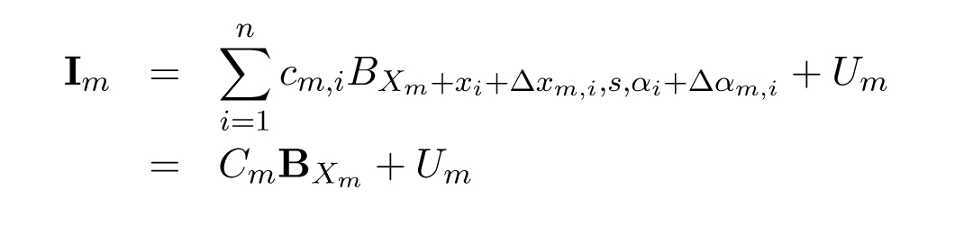
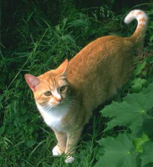
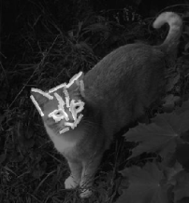
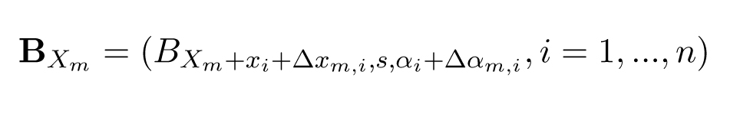

Sparse coding model
Rewrite active basis model in packed form
Represent image by a dictionary of active basis models

Slide 10
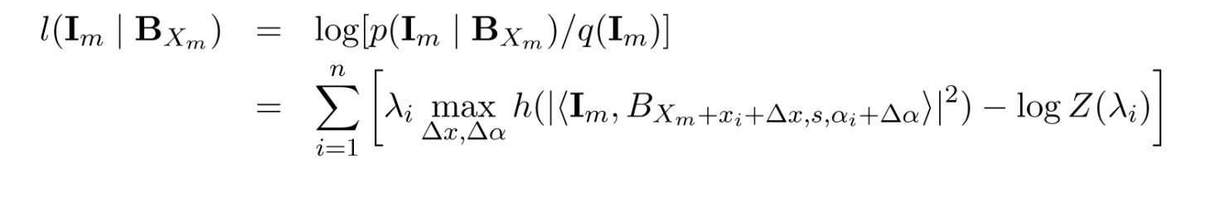
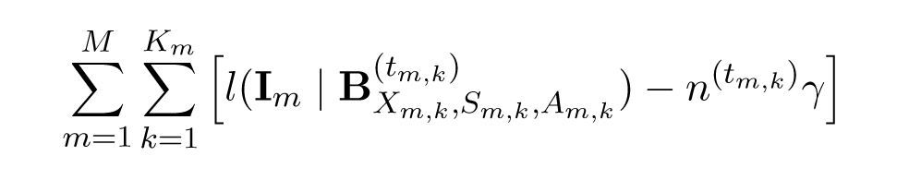
Olshausen-Field: coding units are wavelets
Our model: coding units are deformable compositions of wavelets
The coding units allow variations, making it generalizable
(1) variations in geometric deformations
(2) variations in coefficients of wavelets (lighting variations)
(3) AND-OR units (Pearl, 1984; Zhu, Mumford 2006)
(4) Log-likelihood

Slide 11
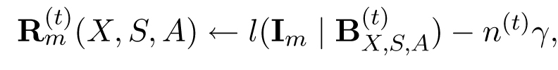
Our model: coding units are deformable compositions of wavelets
Learning algorithm: specify number and size of templates
Image encoding: template matching pursuit
Inhibition
Dictionary re-learning: shared matching pursuit
collect and align image patches currently encoded by each template
re-learn each template from the collected and aligned image patches
The first 7 iterations
Learning in the 10th iteration

Slide 12

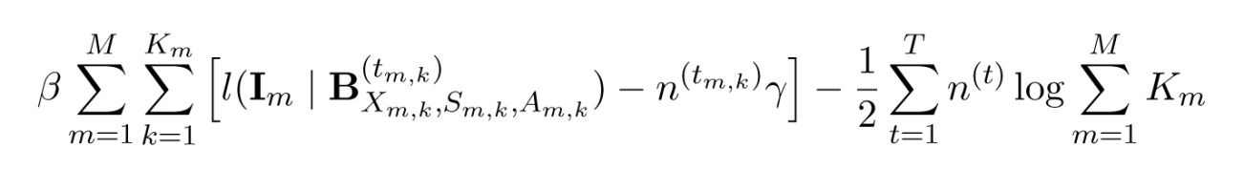
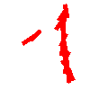
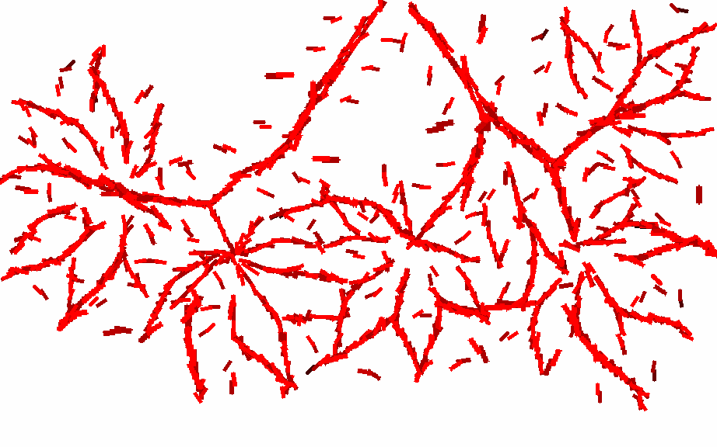

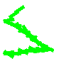


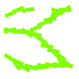

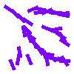
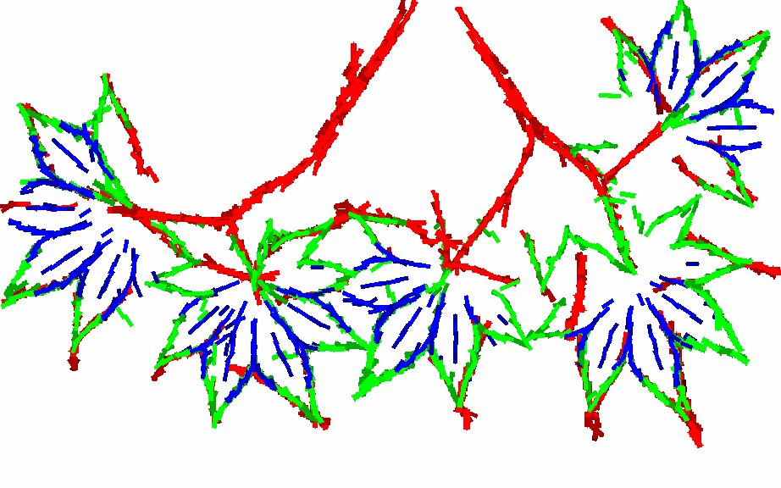
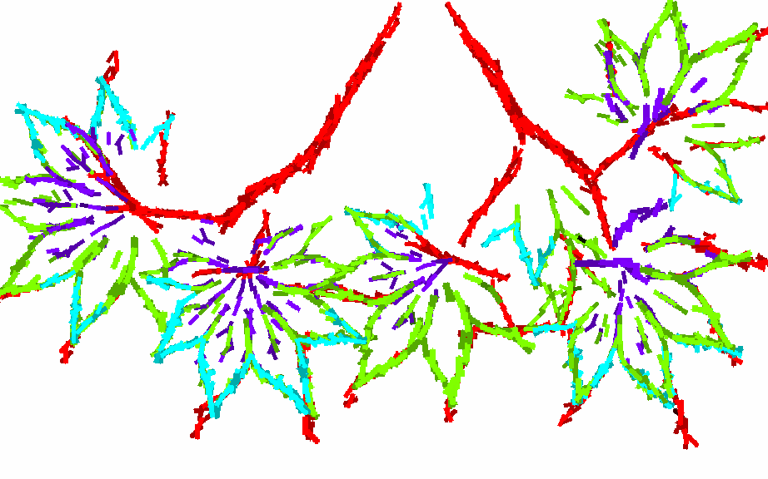
1385
1950
1831
1818

Slide 13
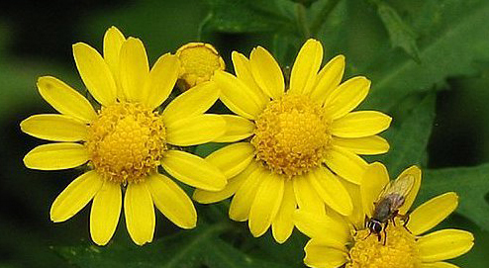
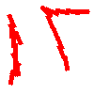
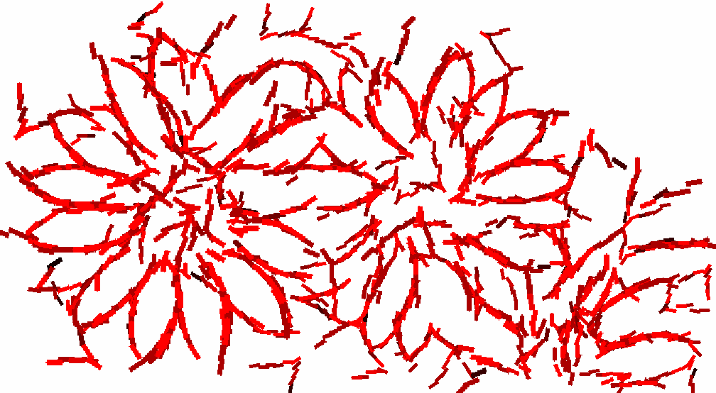

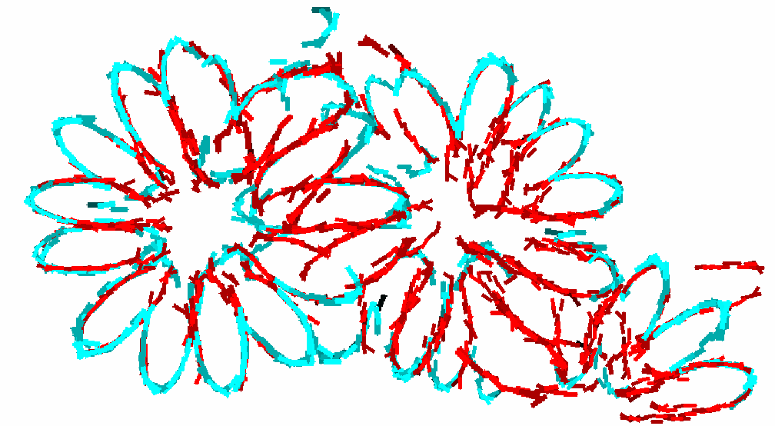



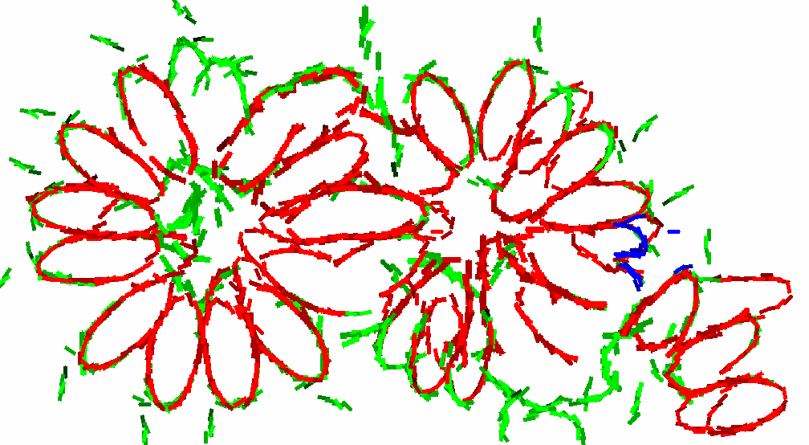
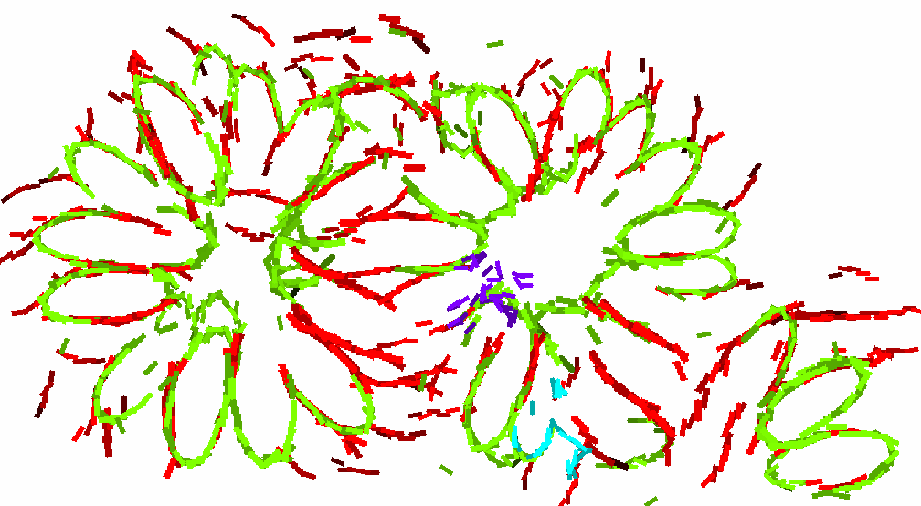

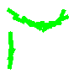
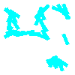

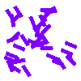
725
1247
1096
844

Slide 14
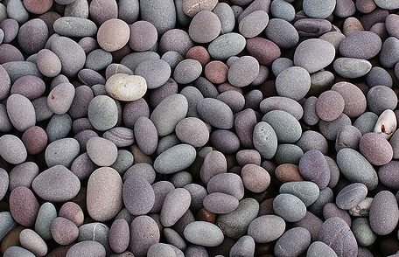

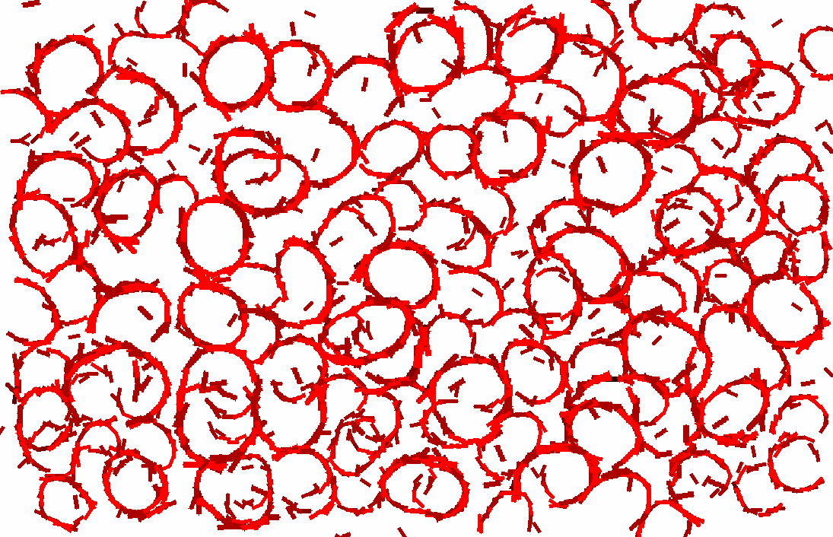












1887
2838
2737
2644

Slide 15











Slide 16

















Slide 17









Slide 18








Slide 19














Slide 20







Slide 21








Slide 22








Slide 23









Slide 24







Slide 25







Slide 26




Slide 27














Slide 28














Slide 29

















Slide 30
















Slide 31












Slide 32











Slide 33










Slide 34


15 training images: 61.63 \pm 2.2 %
30 training images: 68.49 \pm 0.9%

Slide 35










Information scaling
Wu, Zhu, Guo 2008
Change of statistical/information-theoretical properties of images
over the change of viewing distance/camera resolution
fine
coarse
Geometry→Texture
Image patterns of different statistical properties are connected by scale
A common framework for modeling different regimes of image patterns

Slide 36



