Slide 1
Unsupervised Learning of
Compositional Sparse Code
for Natural Image Representation
Ying Nian Wu
UCLA Department of Statistics
Institute of Statistics, Academia Sinica
December 17, 2012
Based on joint work with
Yi Hong, Zhangzhang Si, Wenze Hu, Song-Chun Zhu

Slide 2
A tale of p>n regression
with a twist of plot
What if we observe multiple response vectors,
but we do not know what to regress on?

Slide 3
Linear regression
Traditionally

Slide 4
High-dimensional regression
Sparsity: a small number of are non-zero

Slide 5
Variable selection in linear regression
Lasso
Tibshirani: lasso
Efron, Hastie, Johnston, Tibshirani: LARS

Slide 6
Variable selection in linear regression
Non-convex regularization
Fan, Li: SCAD
Zhang: MCP

Slide 7
Variable selection in linear regression
Matching pursuit: forward selection
Mallat, Zhang

Slide 8
Variable selection in linear regression
Bayesian variable selection
George, McCulloch

Slide 9
What if the candiate regressors are unknown?
Sparsity: a small number of are non-zero
Twist of plot: Can we learn the regressors?

Slide 10
Multiple response vectors
Sparsity:
(1) for each m, only a small subset of
are non-zero
(2) for different m, the non-zero subsets of
may be different

Slide 11
Sparse coding (Olshausen, Field, 1996)
Redundant dictionary → sparse representation
Learning the sparse code

Slide 12
Sparse coding (Olshausen, Field, 1996)
Learning algorithm

Slide 13
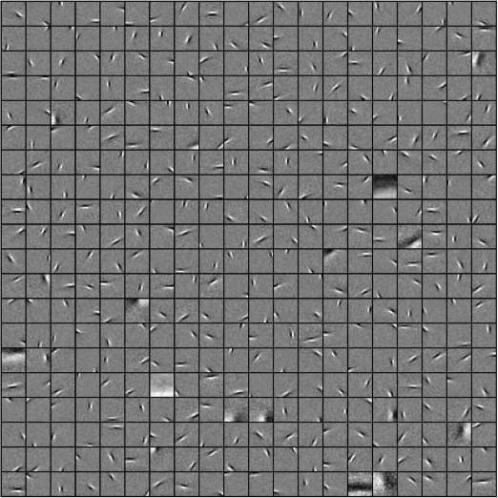
Sparse coding of natural image patches
Dictionary
Localized, elongated, oriented
Wavelets
Basis functions
Elementary signals
Atoms
Olshausen, Field

Slide 14
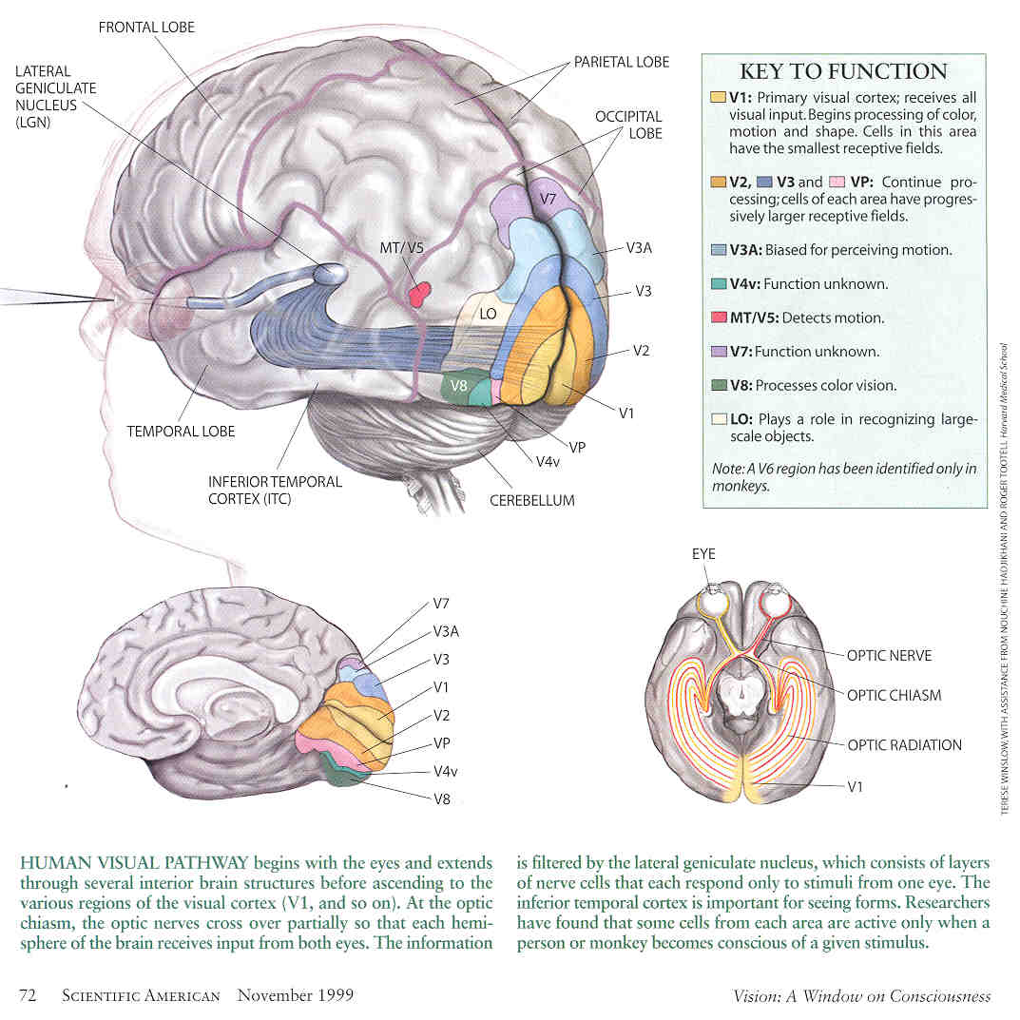
The plot thickens
V1: primary visual cortex
simple cells
Harmonic analysis
atomic decomposition
basis pursuit (Chen, Donoho)
A fantasy?
Source: Scientific American, 1999

Slide 15
Let the plot continue – our work
Visual cortex
what is beyond V1?
Harmonic analysis
what is beyond sparsity?
Statistical modeling
what is model of coefficients?
Source: Scientific American, 1999

Slide 16
Compositional sparse code
The regressors are selected in groups
The groups exhibit recurring compositional patterns
Compositional sparsity

Slide 17
Compositional sparse code
Group Lasso: candidate groups are given
only need to select groups
Our work: candidate groups are NOT given
Goal: learn a dictionary of candidate groups
(frequently occurring compositional patterns)
from multiple response vectors
(assume the regressors are given or learned)

Slide 18
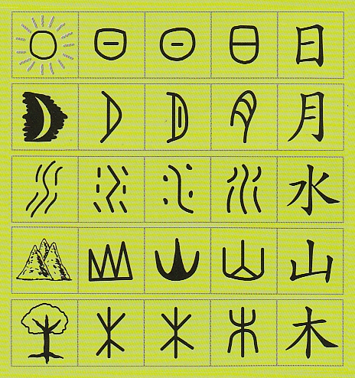
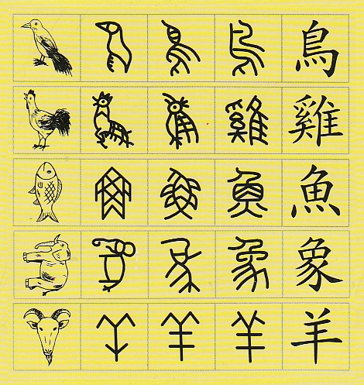
Compositional sparse code
strokes → characters

Slide 19
Compositional sparse code
letters → words (alphabet → dictionary)
Laplace: CONSTANTINOPLE (S. Geman)
Atomic decomposition in harmonic analysis
atoms → molecules
Compositionality: S. Geman, Potter, Chi
Zhu, Mumford: And-Or graph
Why compositional sparse code?
Sparser and more symbolic representation
Signal recovery
Classification and recognition

Slide 20
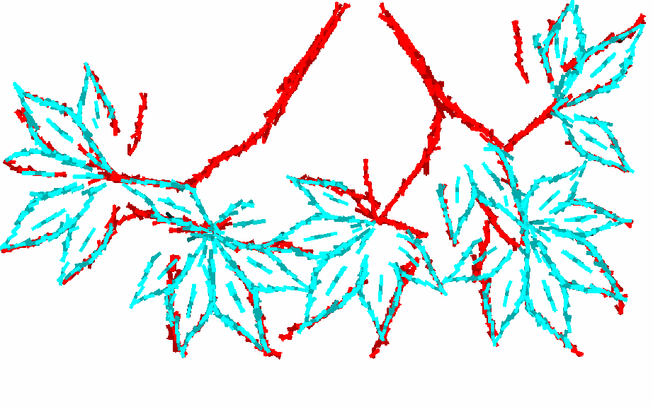
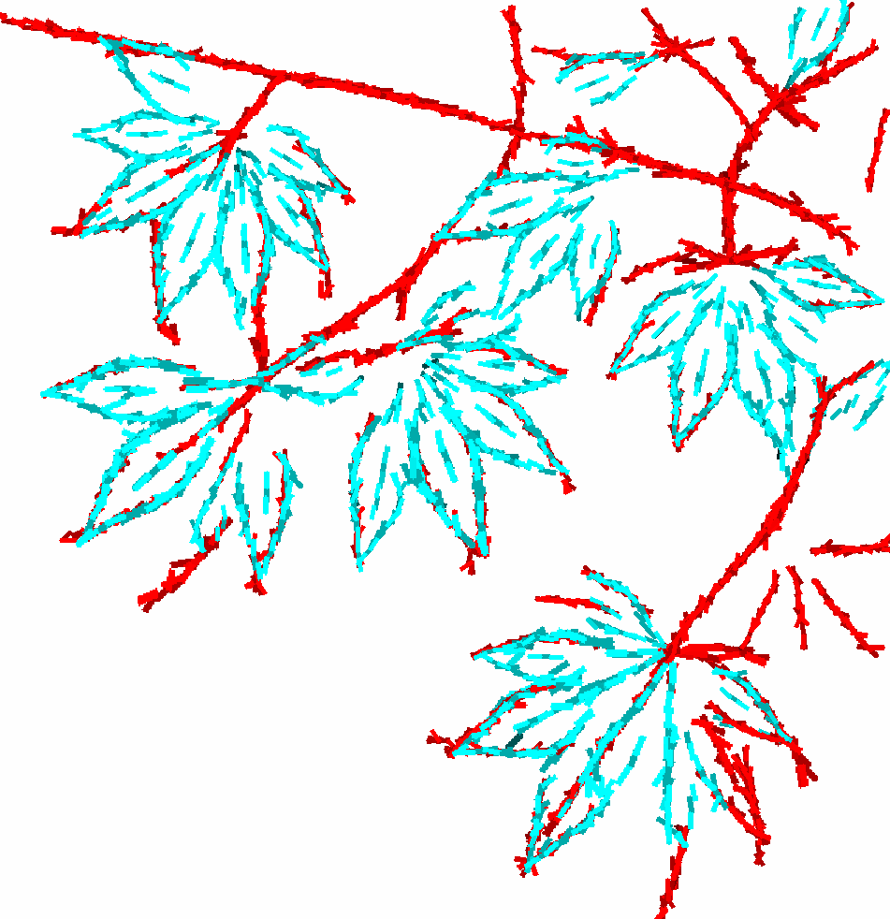
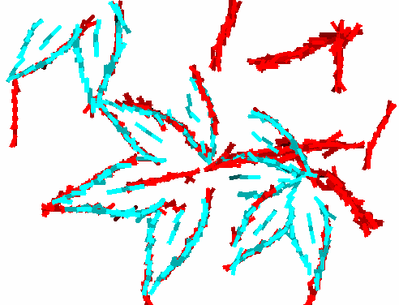
Compositional sparse code
Learned dictionary of composition patterns from training image
Generalize to testing images
One compositional pattern → many groups by spatial translation, rotation, scaling, deformation
highly overcomplete/redundant dictionary

Slide 21
Compositional sparse code
How to learn dictionary of candidate groups (patterns)?
An Ill-advised strategy
(1) Perform variable selection for each response vector
(2) Discover groups (compositional patterns)
Step (1) early decision or commitment , sparse but may not patterned
A better strategy
Learn patterns and infer sparse representations simultaneously
Highly patterned variable selection

Slide 22
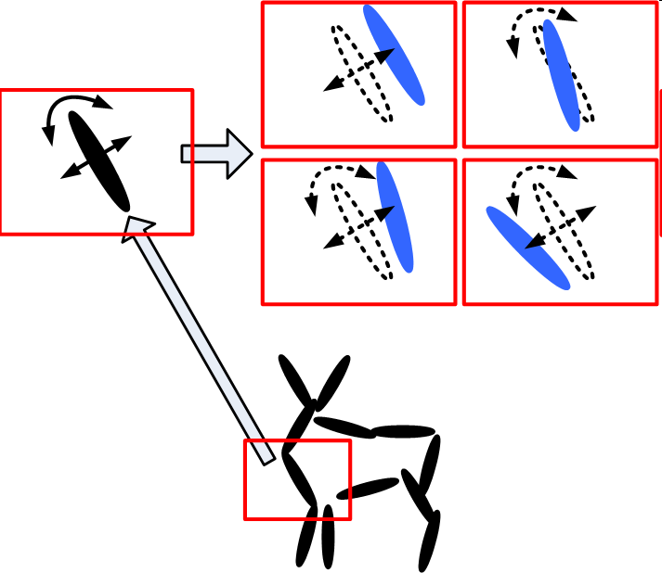
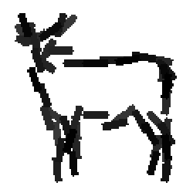
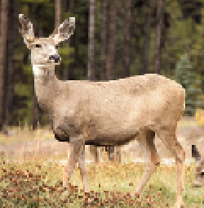
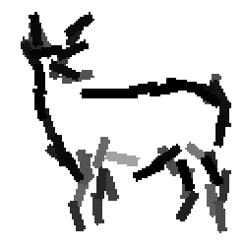
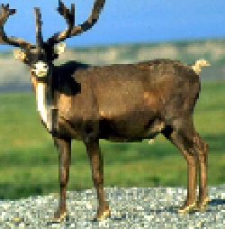
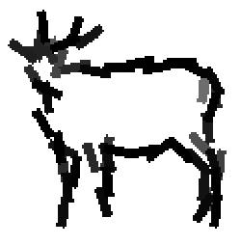
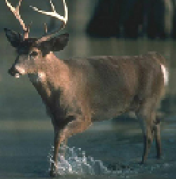
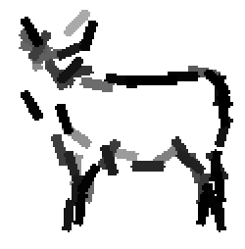
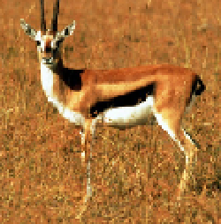
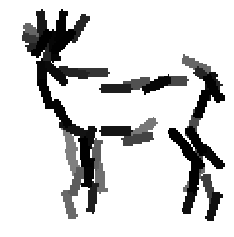
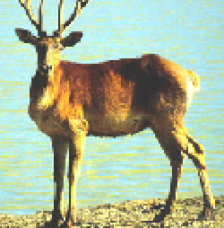
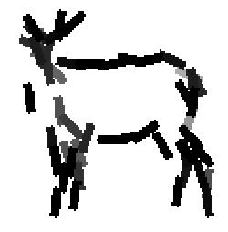
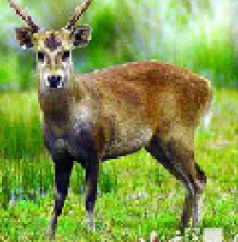
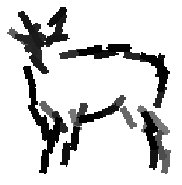
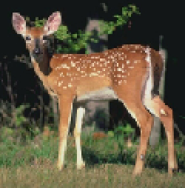
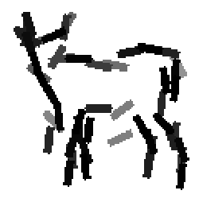
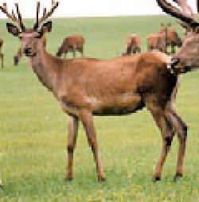
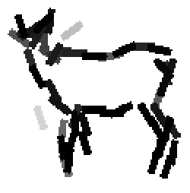
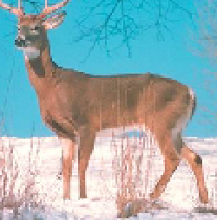
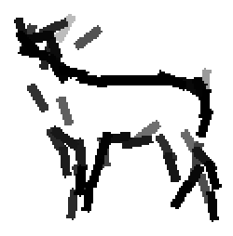
Learning a single group (word/character)
n-stroke template
n = 40 to 60, box= 100x100
Change of notation

Slide 23
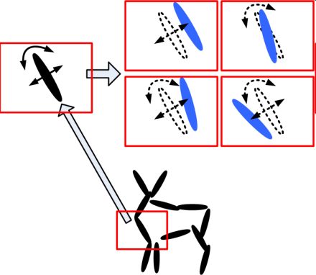
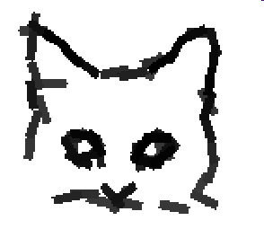
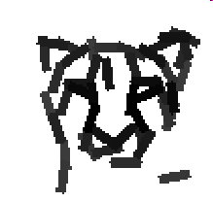
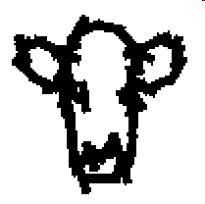
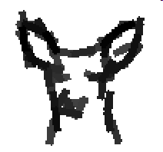
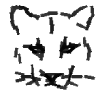
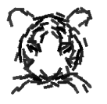
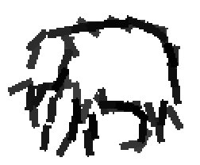
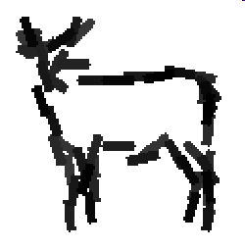
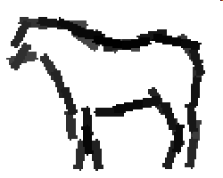
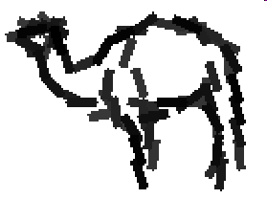
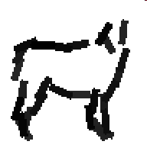
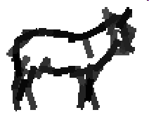
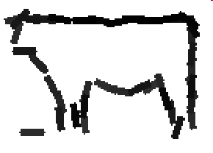
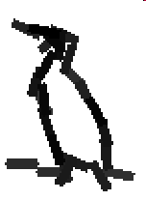
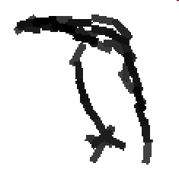
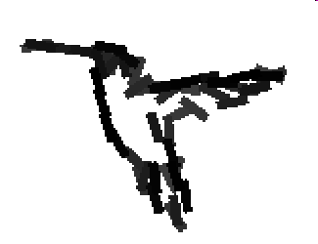
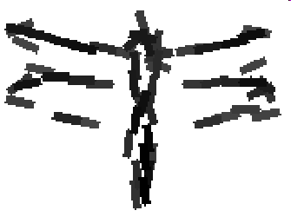
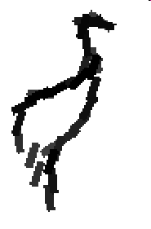
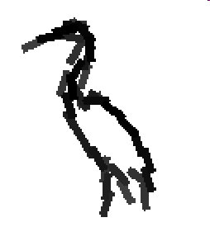
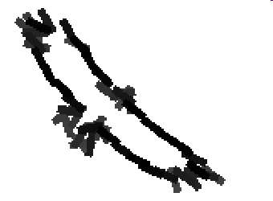
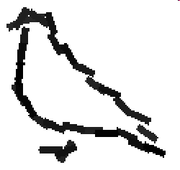
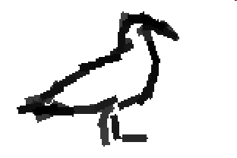
Active basis model
Wu, Si, Gong, Zhu
Si, Gong, Zhu, Wu
n-stroke template
n = 40 to 60, box= 100x100

Slide 24
Active basis model
n-stroke template
n = 40 to 60, box= 100x100

Slide 25
Image representation

Slide 26
Active basis model
Shared variable selection
Constrained sparsity
Collabrative/simultaneous

Slide 27
A compositional (grouping) pattern is a commonly shared sparse coding
Learning pattern in sparse coding is no much more than sparse coding itself

Slide 28
Generalizability: perturbations of basis functions + variations of their coefficients

Slide 29
Learning active basis models from non-aligned image

Slide 30
Learning active basis models from non-aligned image

Slide 32
Learning active basis models from non-aligned image

Slide 33
Sparse coding model
Rewrite active basis model in packed form
Represent image by a dictionary of active basis models

Slide 34
Compositional sparse coding model
Learning algorithm: specify number and size of templates
The first 7 iterations
Learning in the 10th iteration

Slide 35
1385
1950
1831
1818

Slide 36
725
1247
1096
844

Slide 37
1887
2838
2737
2644

Slide 58
15 training images: 61.63 +/_ 2.2 %
30 training images: 68.49 +/_ 0.9%

Slide 59
Multiple response vectors, but
what to regress on?
Learning dictionary of candidate regressors
Learning dictionary of candidate groups
highly patterned variable selection (convexification?)
Visual cortex: what is beyond V1?
Harmonic analysis: what is beyond sparsity?
Statistical modeling: what is model of coefficients?
Probing deeper than sparsity
Spasity: signal recovery (compression, denoising, compressed sensing)
Patterned sparsity: signal understanding (classification, recognition, …)
frequently occuring, commonly shared sparse coding

