Slide 1
Representational Model of Grid Cells
Lie group representation & magnified isometric embedding & flat torus
Ying Nian Wu
UCLA Department of Statistics
Joint with Ruiqi Gao, Jianwen Xie, Xue-Xin Wei, and Song-Chun Zhu
September 9, 2021 @bios.UNC
Some pictures are taken from internet. Copyright belong to original authors

Slide 2
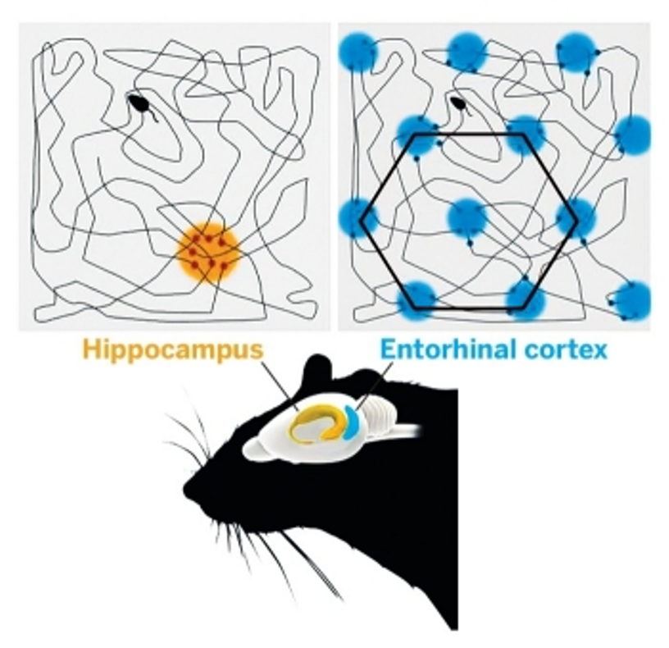
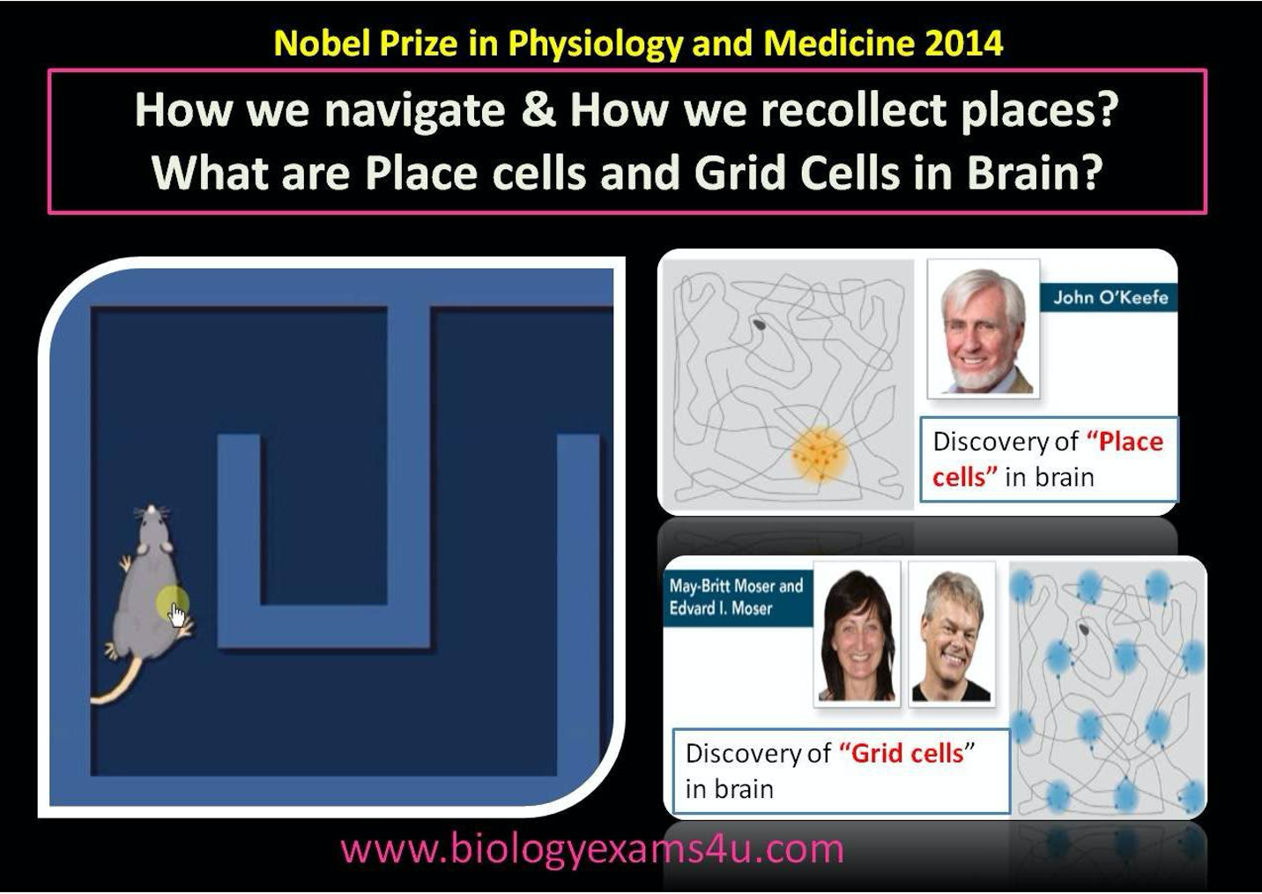
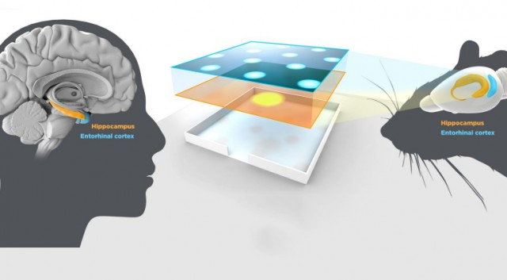
Grid cells & place cells
O’Kefee, 1979, Hafting, et al. 2005

Slide 3
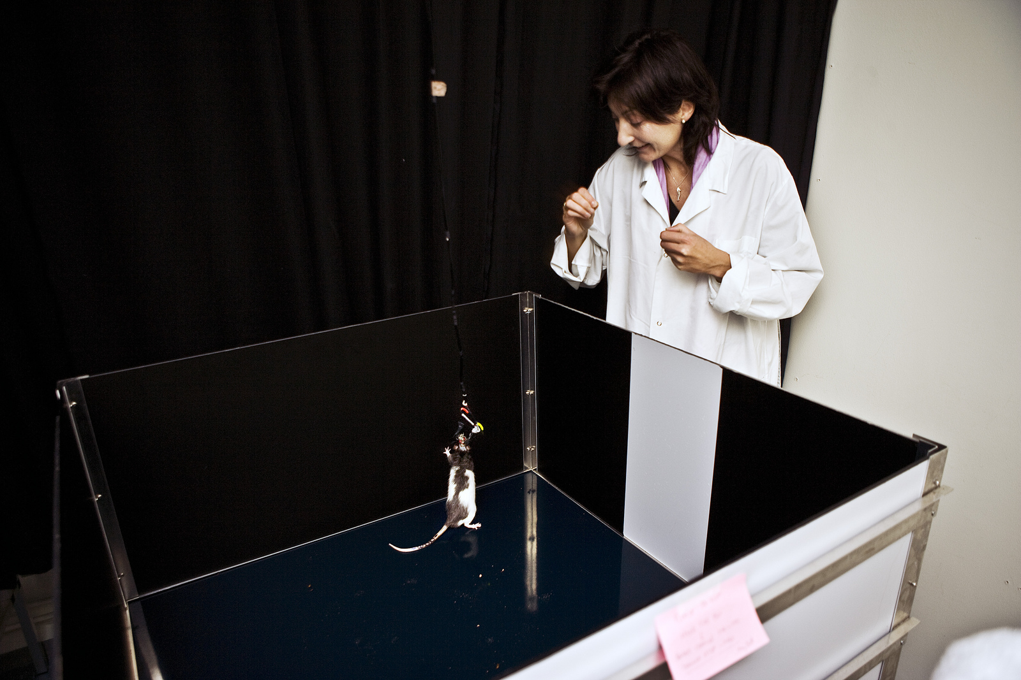
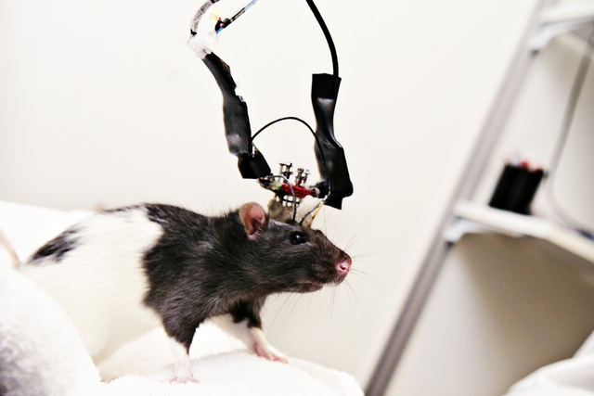
Single neuron recording

Slide 4
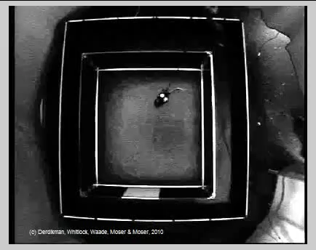
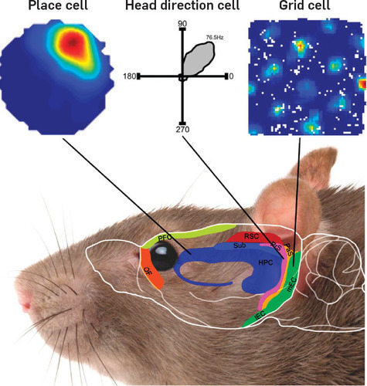
Response map of a cell

Slide 5
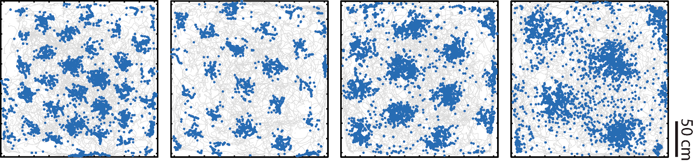
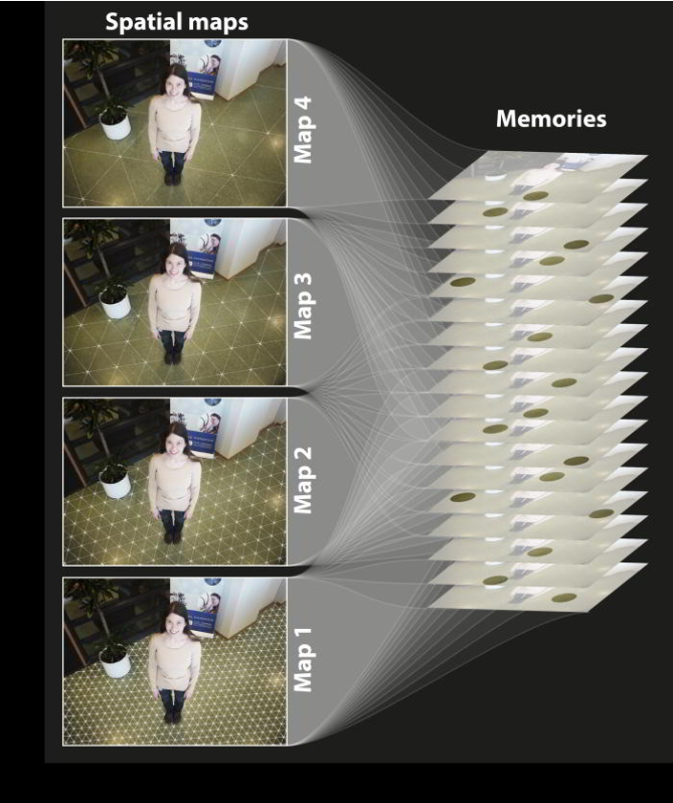
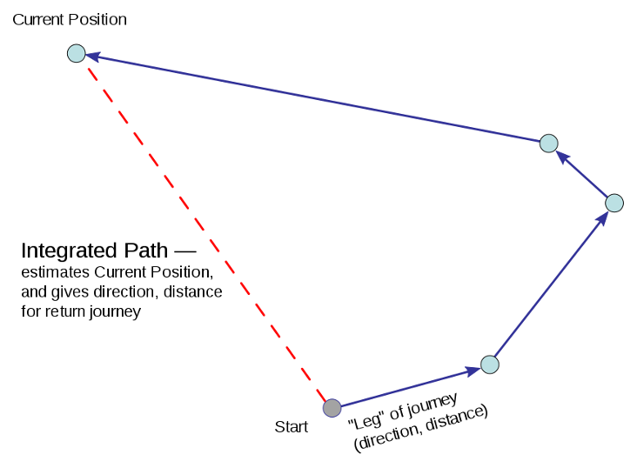
Grid cells
Different grid cells have different scales and phases
Navigation of mammals: path integration
An internal GPS system

Slide 6

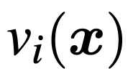
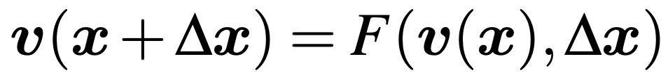
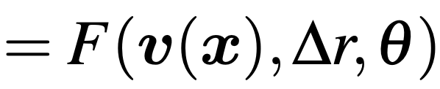
Vector representation and general transformation
Vector representation of self-position: “position embedding”
Each represents the firing rate of one neuron.
Path integration: a general transformation, RNN
Egocentric motion:
(head direction, polar)
“Learning Grid Cells as Vector Representation of Self-­Position Coupled with Matrix Representation of Self­-Motion”, Gao*, Xie*, Zhu, Wu. ICLR 2019.
“On Path Integration Model of Grid Cells: Locally Conformal Embedding and Matrix Lie Algebra”, Gao, Xie, Wei, Zhu, Wu. arXiv.

Slide 7



Conditions of general transformation
Condition 1. (Group representation): v and F form a representation of the 2D additive Euclidean group
Can move in one step by
Or first move by , and then by
A necessary self-consistent condition
continuous attractor neural network (CANN)

Slide 8




Conditions of general transformation
Infinitesimal self-motion:
(Infinitesimal displacement, direction) =
[directional derivative]
Condition 2. (Isotropic scaling) for any fixed ,
is independent of
No preferred direction

Slide 9
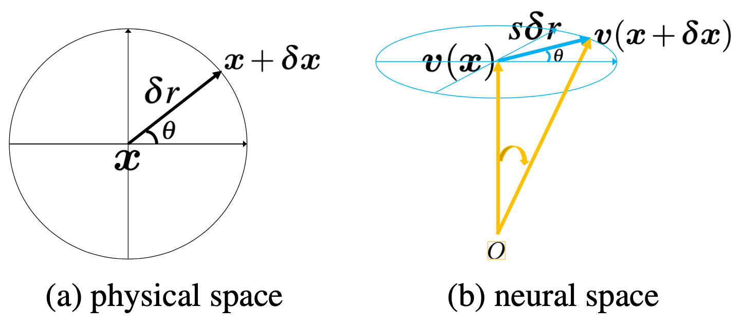
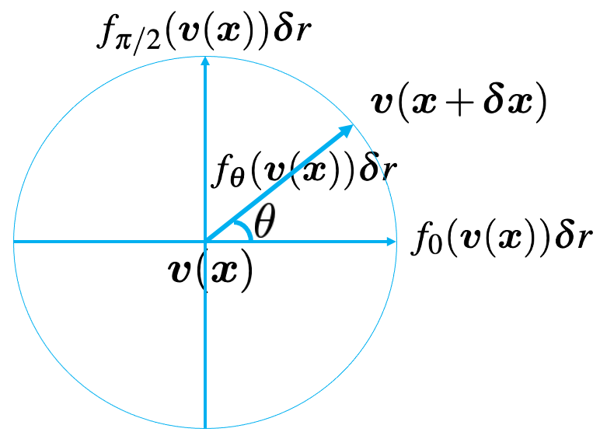
Magnified isometric embedding
Theorem 1. conditions 1+2 → local scaled isometry and conformal embedding
bending but not stretching

Slide 10



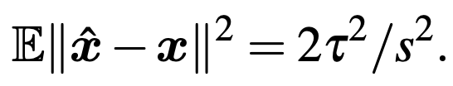
Why isotropic scaling and scaled isometry?
Neurons are intrinsically noisy. We don’t want any adversarial perturbations in v(x) causing excessively big errors in x.
Theorem 2: conditions 1+2 → errors in neurons translate proportionally to errors in the physical 2D space.
Noisy neurons:
Inferred position:
Inference error:

Slide 11




Linear special case
Assume the transformation model is linear
Group representation
For infinitesimal displacement
Directional derivative
Transformation model
→

Slide 12
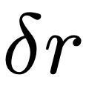



Algebraic structure: matrix Lie algebra and matrix Lie group
(infinitesimal displacement, direction) =
(finite displacement, direction) =

Slide 13
Algebraic structure: matrix Lie algebra and matrix Lie group
(infinitesimal displacement, direction) =
(finite displacement, direction) =
Generator Matrix
Matrix Lie group
Generator matrix

Slide 14
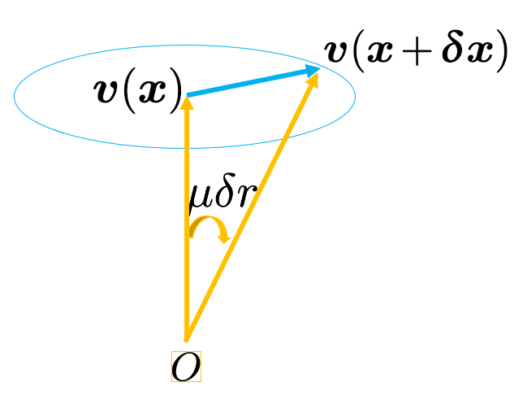


Geometric structure: a rotation group
“metric, angular speed”
→ periodic patterns and error correction.
Why hexagon patterns? Theorem 3: handcrafted hexagon patterns → conditions 1+2.

Slide 15


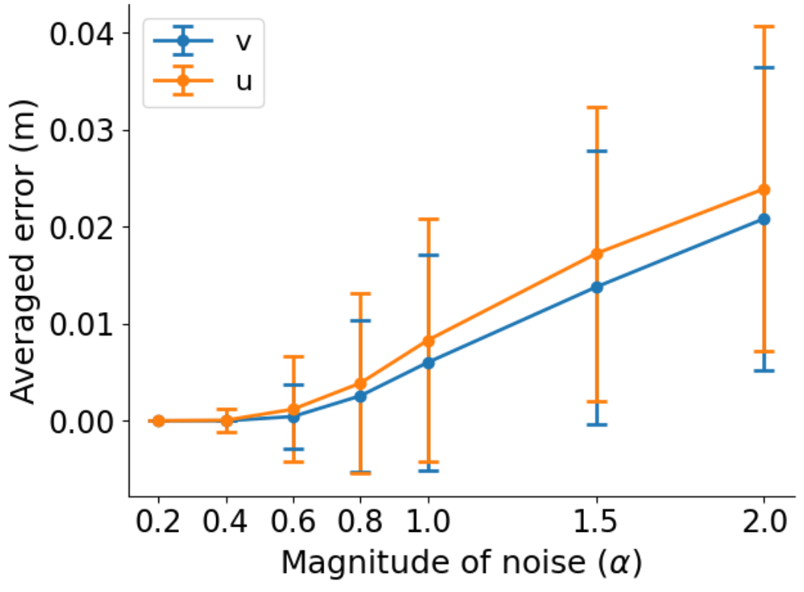

Geometric structure: a rotation group
Theorem 4. error correction depends on and
Noisy neurons:
Inferred position:

Slide 16



Multiple modules
We partition into K modules.
Module of neurons: similar scale, difference phases
Each module is a sub-vector rotated by a sub-matrix
Multi-arm clock in the neural space

Slide 17
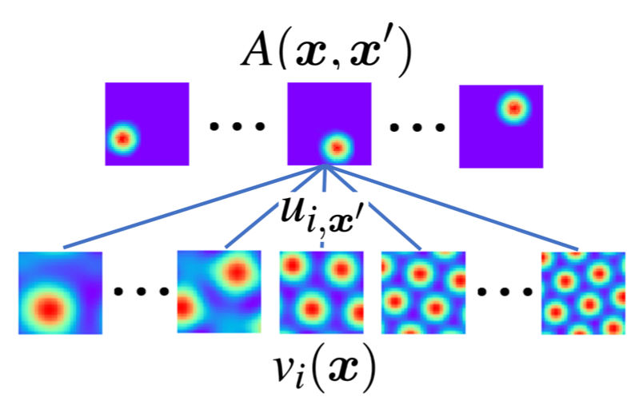
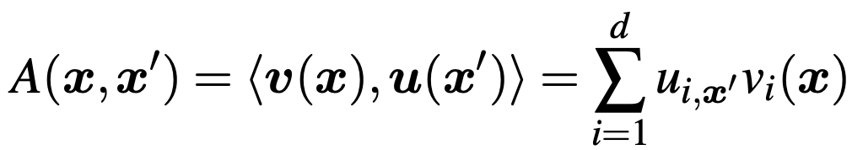
Interaction with place cells
Basis expansion:
A: adjacency kernel, response of place cell (x’) when agent is at x.
u(x’): read-out weights, a linear decoding layer

Slide 18


Interaction with place cells
Unitary group representation
Peter-Weyl: irreducible representation →
deep root and generalization of Fourier analysis
forms a set of orthogonal basis functions of
also forms a set of basis functions

Slide 19

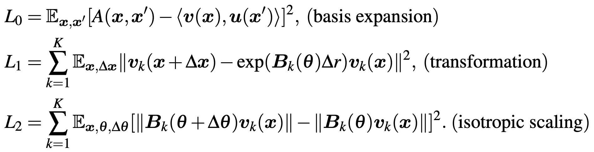
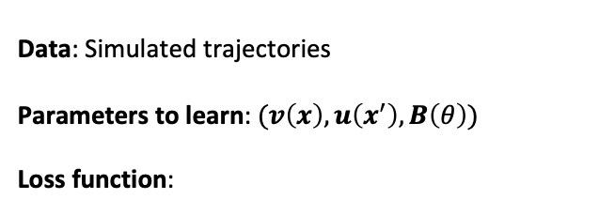
Learn the model
Data: Simulated trajectories
Parameters to learn: $(v\left(x\right), u\left(x^{′}\right), B\left(θ\right))$
Loss function:
Notes:
We learn the model by optimizing a loss function defined based on three model assumptions

Slide 20
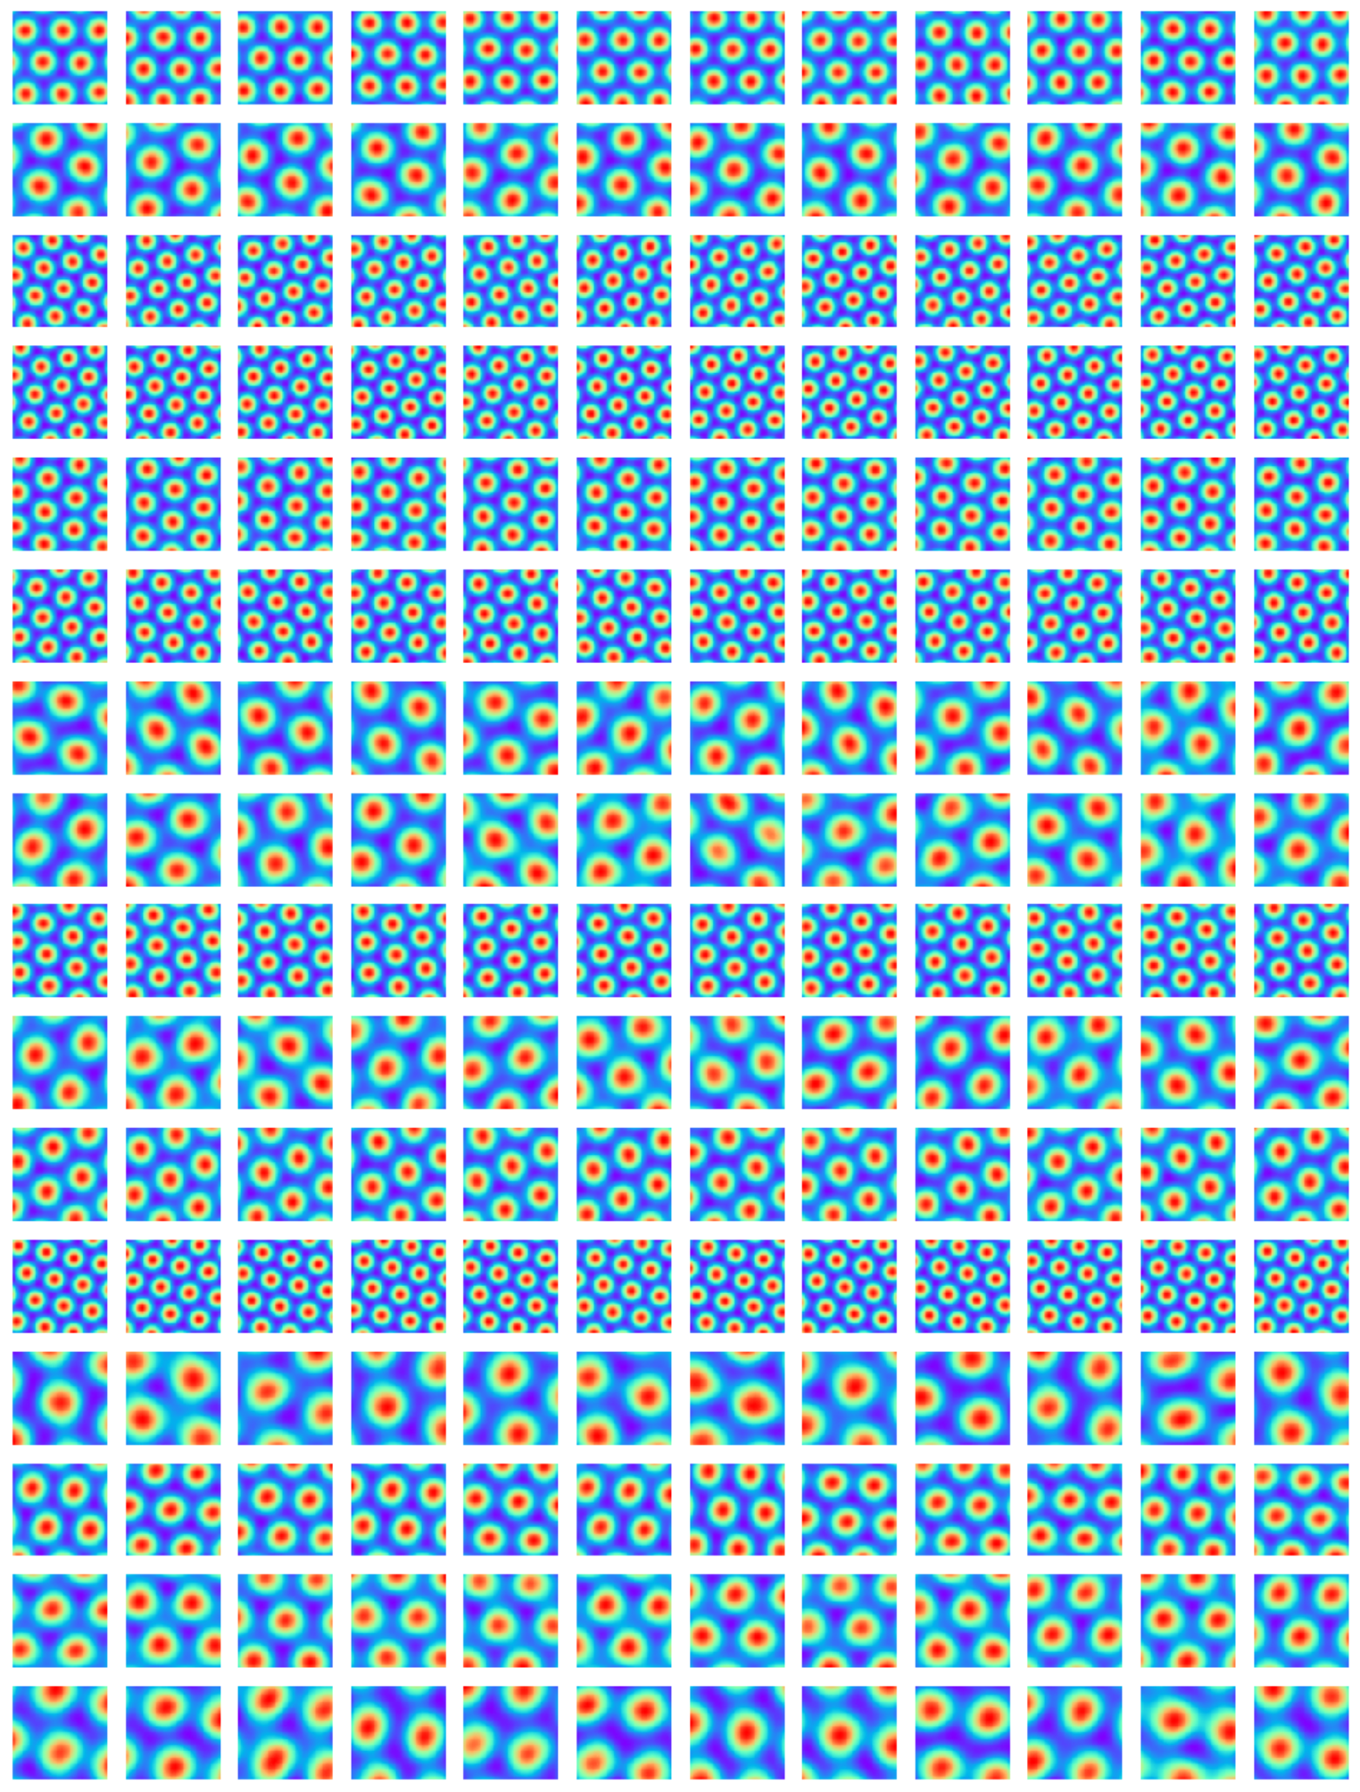
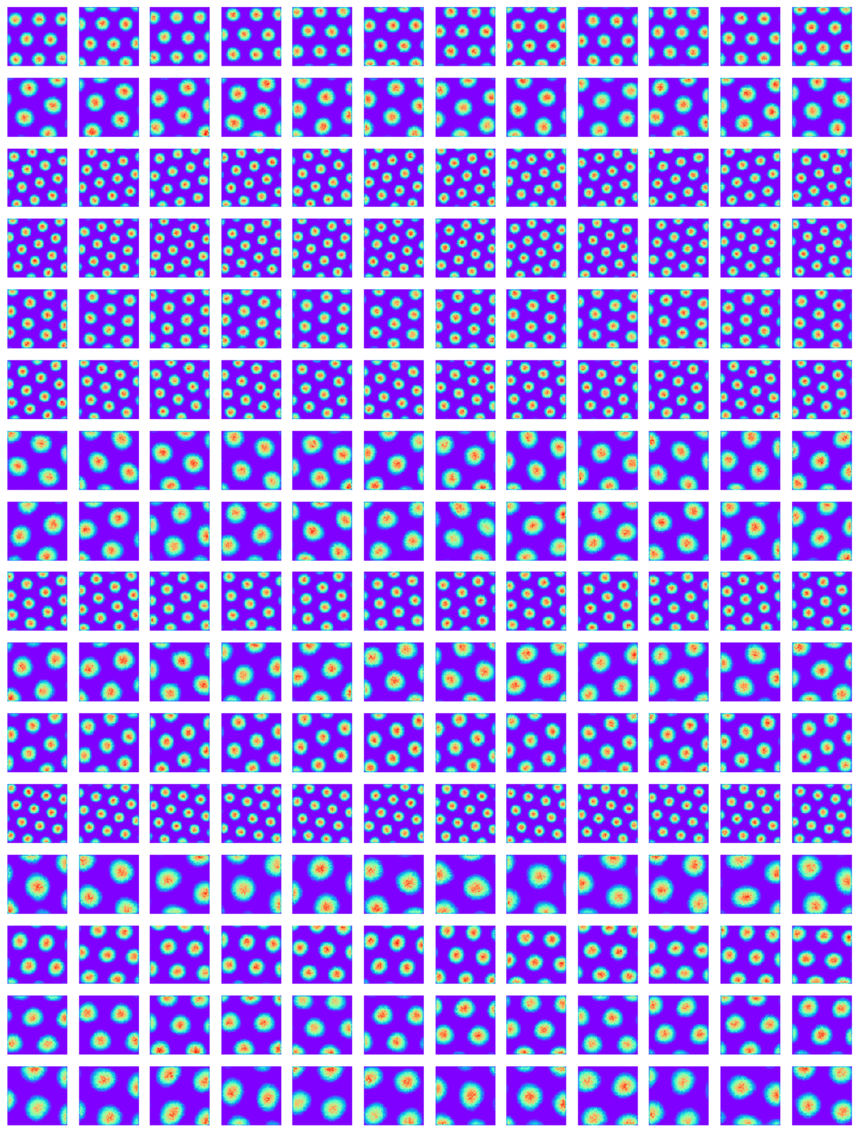

Learned results

Slide 21
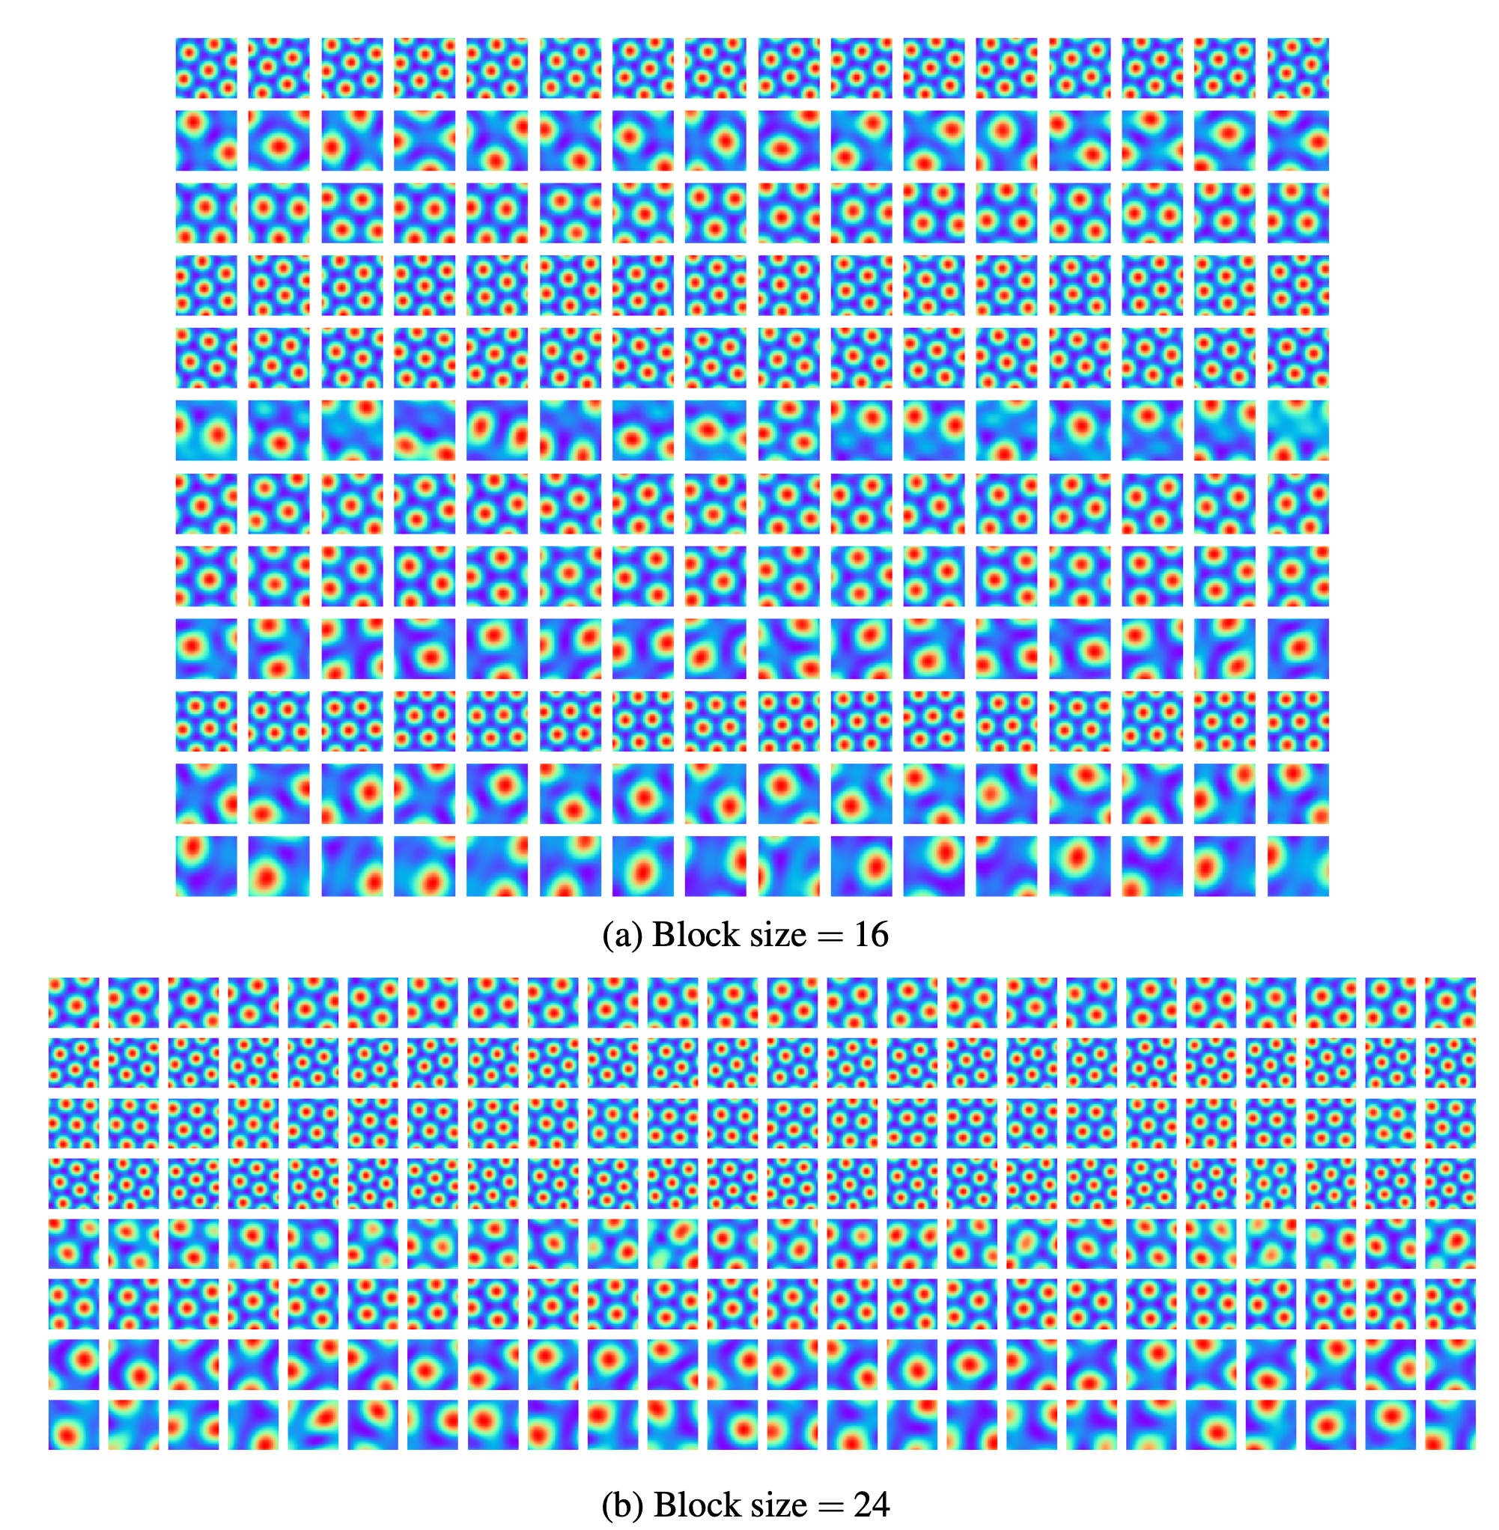
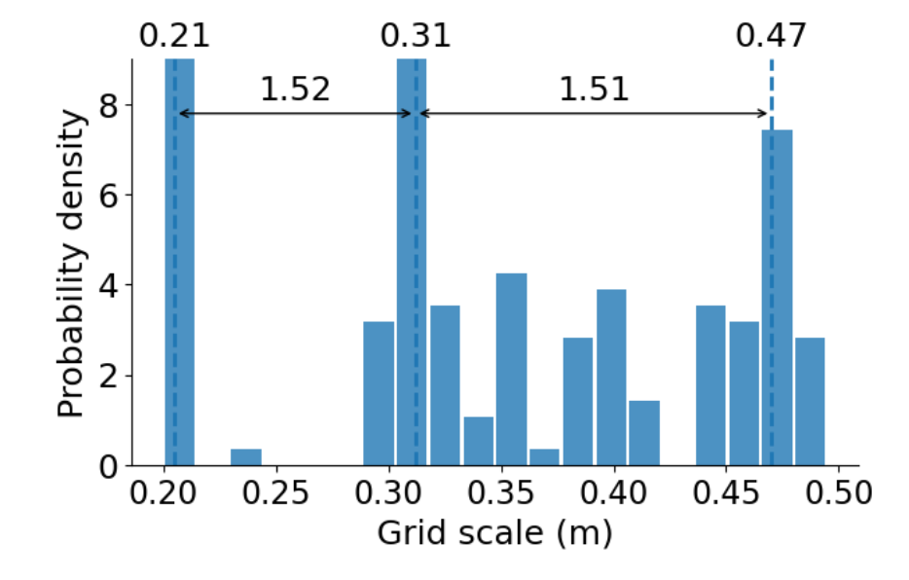
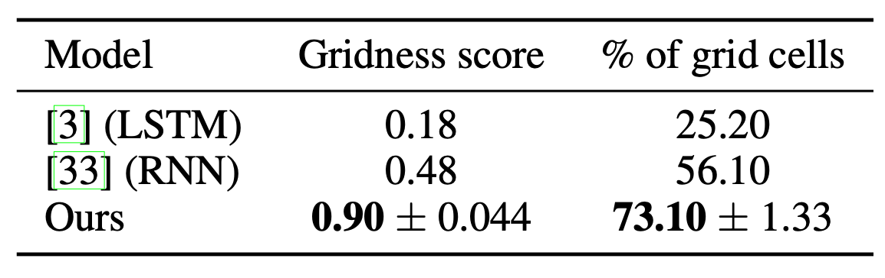
Learned results

Slide 22

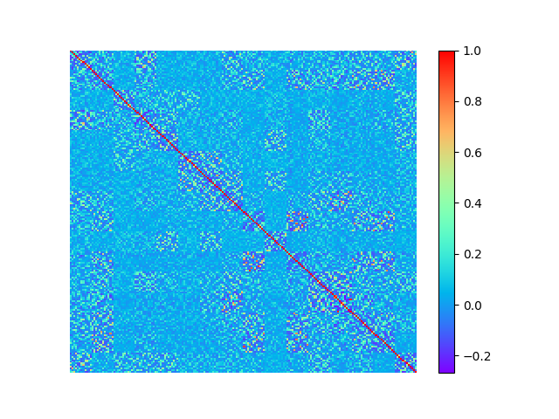
near orthogonal basis functions

Slide 23
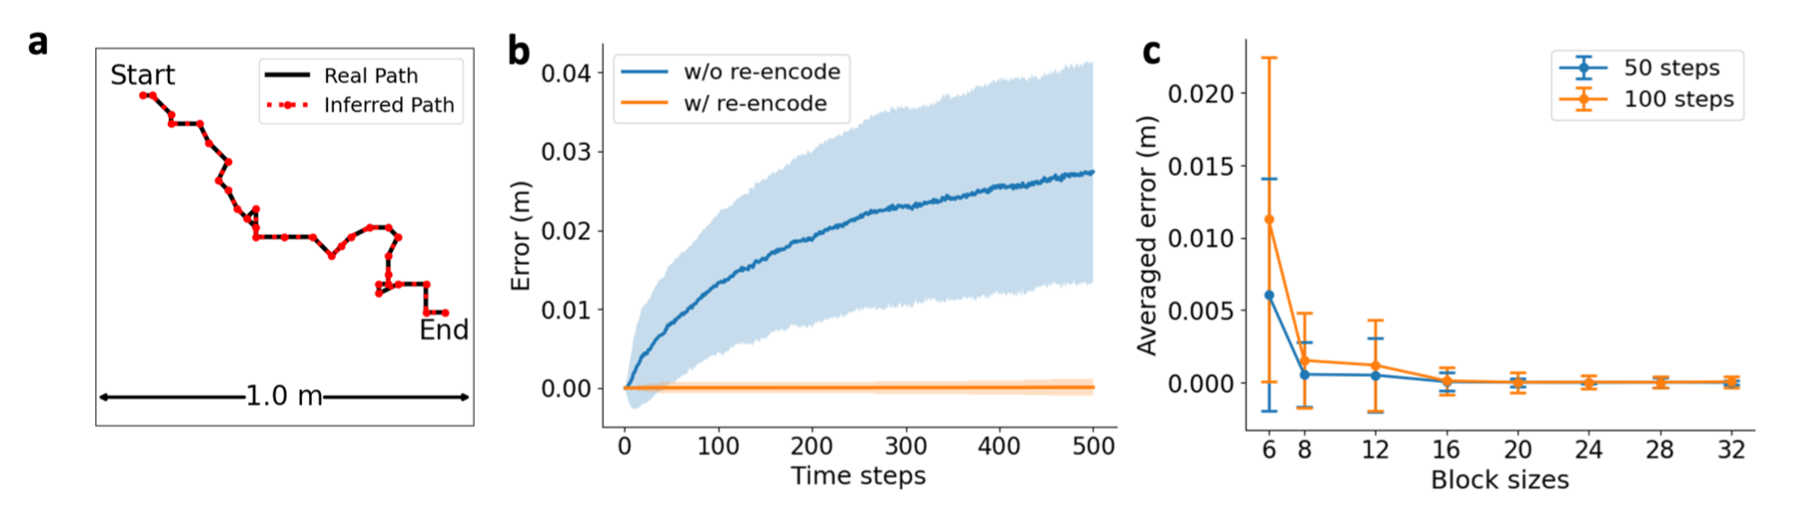
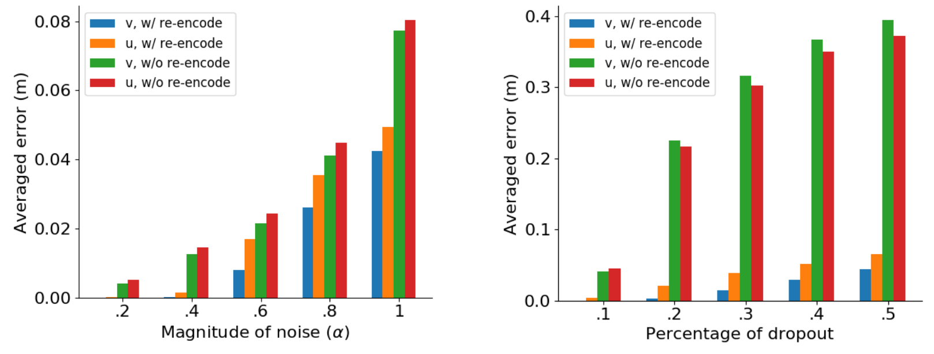
Learned results
Path integration
Error correction

Slide 24


Path planning
The adjacency kernel can be modeled as
: discount factor controlling the temporal and spatial scales
- For random walk in open field,
For planning, we need kernels of both big and small scales.
We discretize to a finite list of scales and learn a list of .

Slide 25




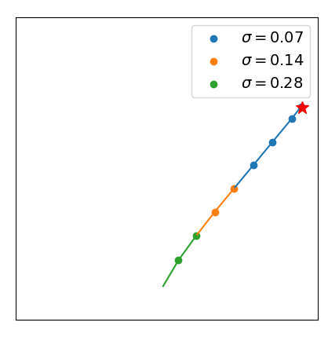
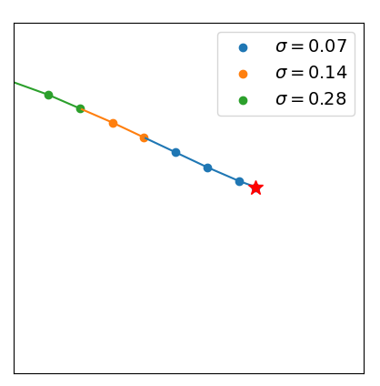
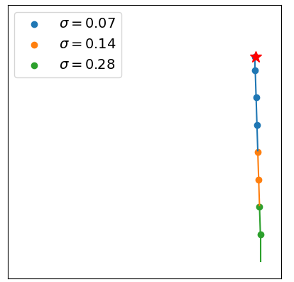
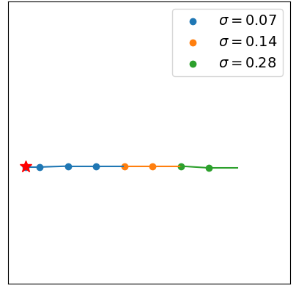
Path planning
Planning: let be the target, be the current position, plan the next step by
- The next position is
- : chosen from all allowed single-step displacement.
- : chosen to be sensitive to change.
Success rate
100%

Slide 26
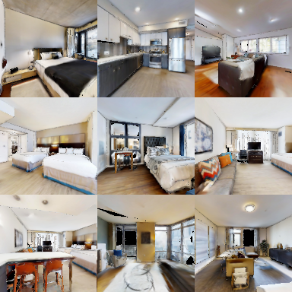
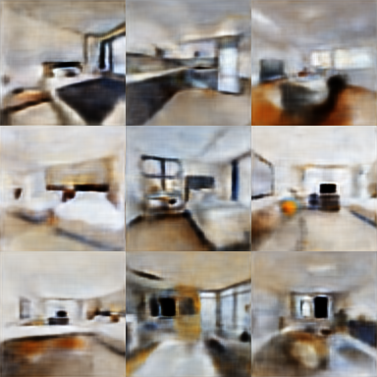
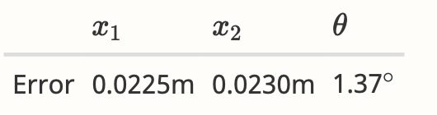





Egocentric vision
Novel view synthesis: PSNR 23.53
Inference of pose:
Encoding position and orientation (aka pose) of the camera as
Encode the 3D scene as a vector (shared across difference camera poses)
Novel view synthesis: .
Inference of pose: → →

Slide 27
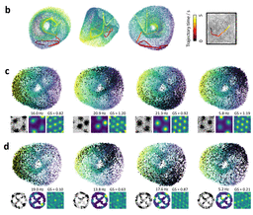
Topology: torus
R. J. Gardner, et al. Toroidal topology of population activity in grid cells, Nature 2021

Slide 28
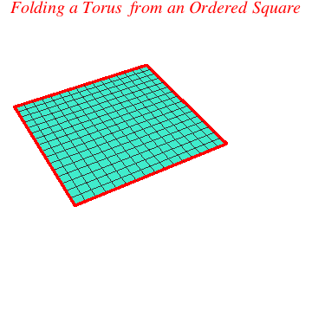
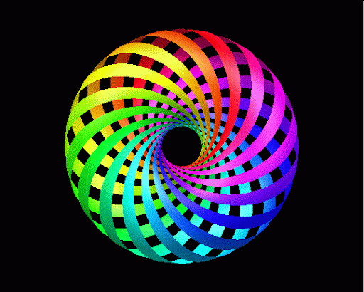
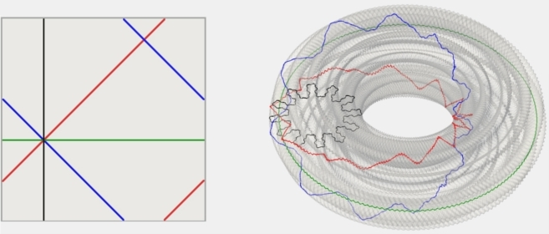
Flat torus

Slide 29
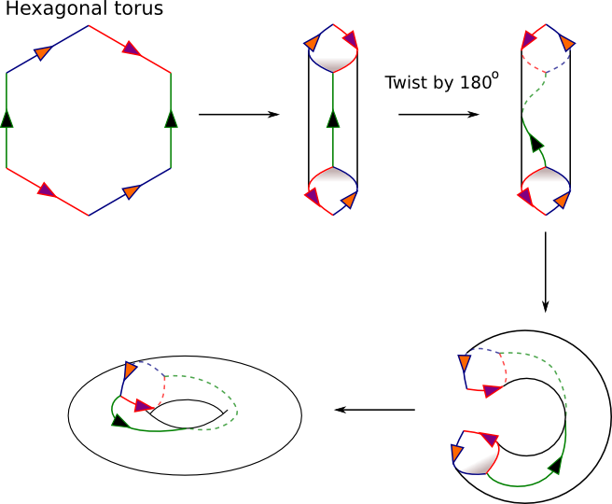
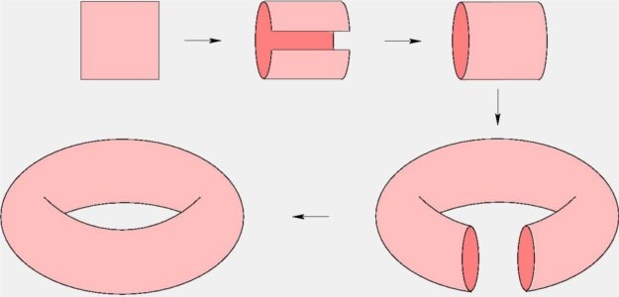
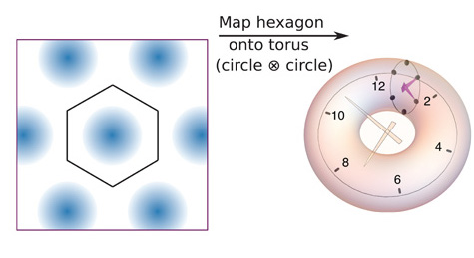
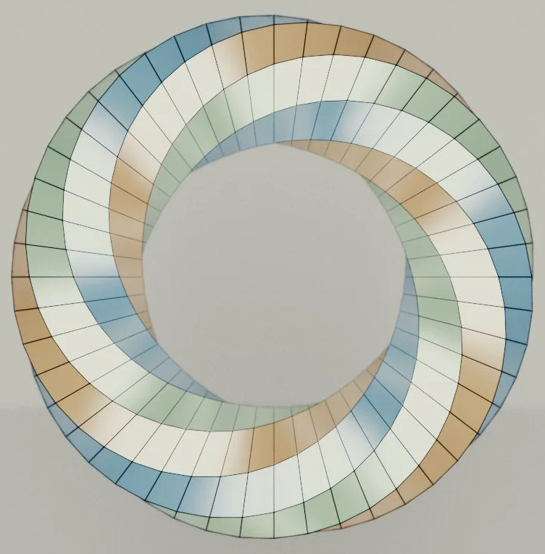





Torus

Slide 30
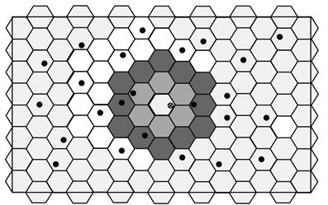
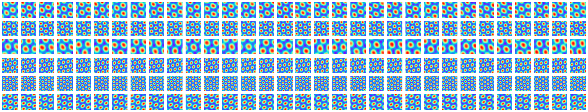
Rotation as cyclic permutation

Slide 31
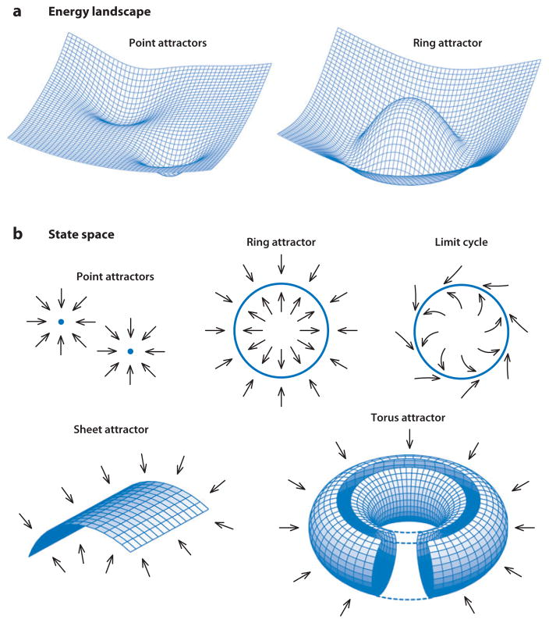
Continuous attractor neural network (CANN)

Slide 32
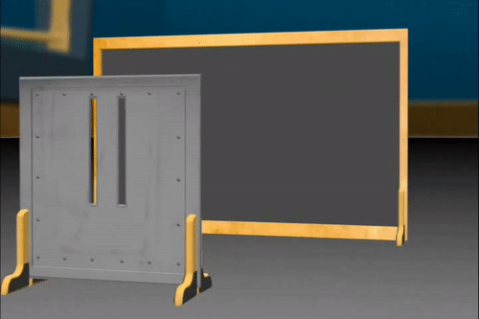

Deep learning
Function approximator (ReLU network = piecewise linear / multivariate spline)
Learned computation (ResNet / Transformer = finite step iterative algorithm)
Vector representation (thought vector, embedding, encoding, distributed representation)
Transformation (Lie algebra/group/representation, magnified isometric embedding, flat torus)
particle-wave duality

