Slide 1
Representational Model of Grid Cells
Lie group representation & conformal isometry & flat torus
Ying Nian Wu
UCLA Department of Statistics, ywu@stat.ucla.edu
Joint with Ruiqi Gao, Dehong Xu, Jianwen Xie, Wenhao Zhang, Xue-Xin Wei, and Song-Chun Zhu
Thanks to Si Wu for discussions on neuroscience and attractor network
“Learning Grid Cells as Vector Representation of Self-­Position Coupled with Matrix Representation of Self­-Motion”, Gao*, Xie*, Zhu, Wu. ICLR 2019.
“On Path Integration Model of Grid Cells: Locally Conformal Embedding and Matrix Lie Algebra”, Gao, Xie, Wei, Zhu, Wu. NeurIPS 2021.
“Conformal isometry of Lie group representation in recurrent network of grid cells”, Xu*,Gao*, Zhang, Wei, Wu. NeurReps Workshop, NeurIPS 2022.
Some pictures and videos are taken from internet. Copyright belong to original authors.

Slide 2
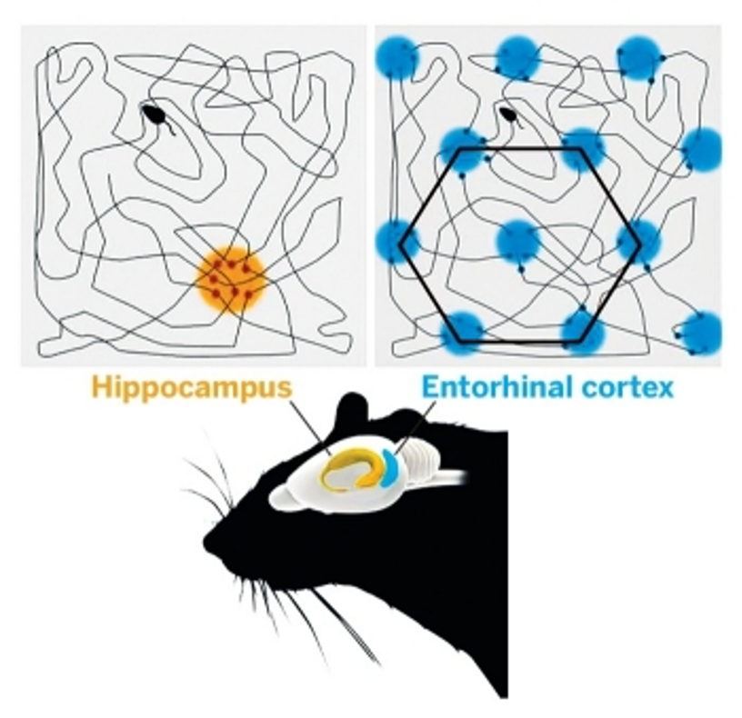
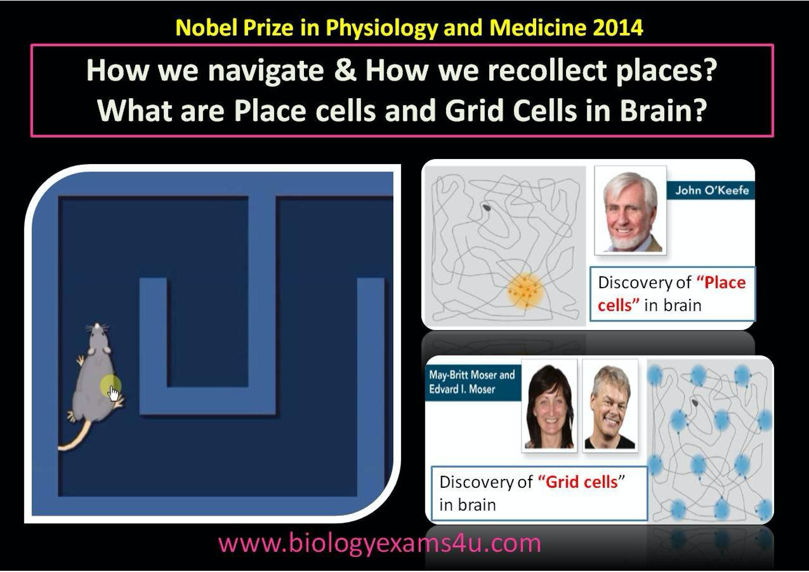
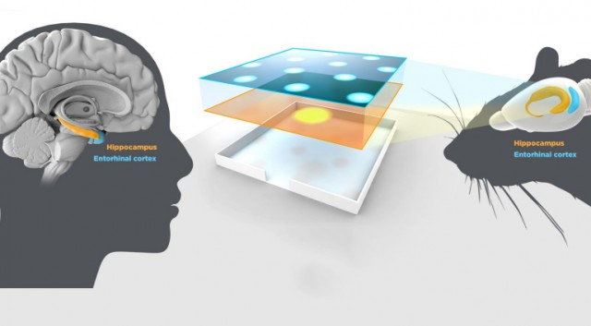
Grid cells & place cells
O’Kefee, 1979, Hafting, et al. 2005

Slide 3
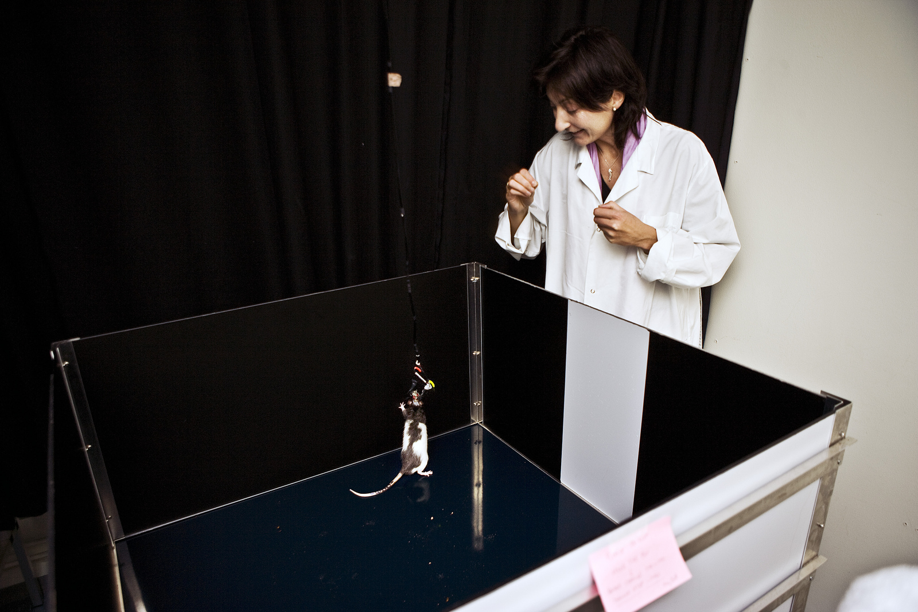
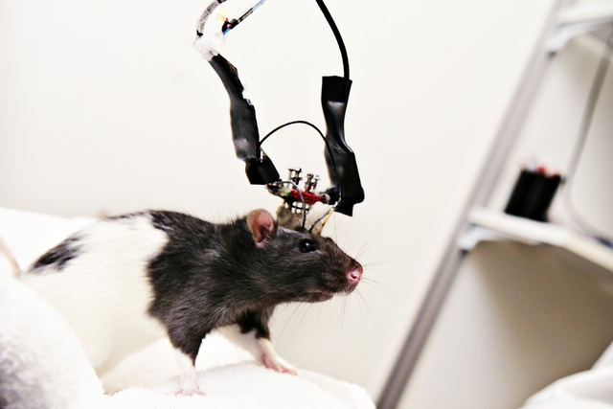
Single neuron recording

Slide 4
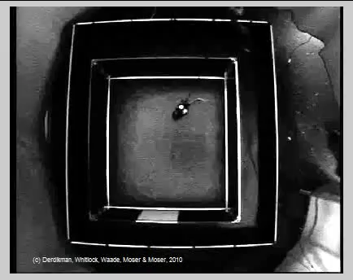
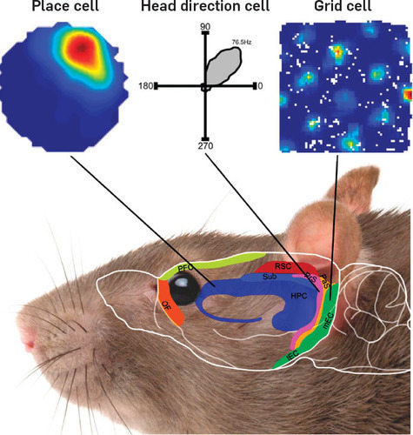
Response map of a cell

Slide 5
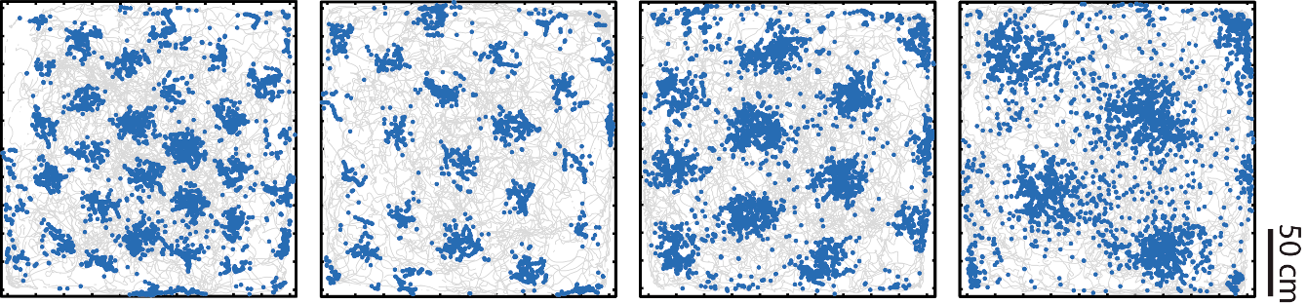
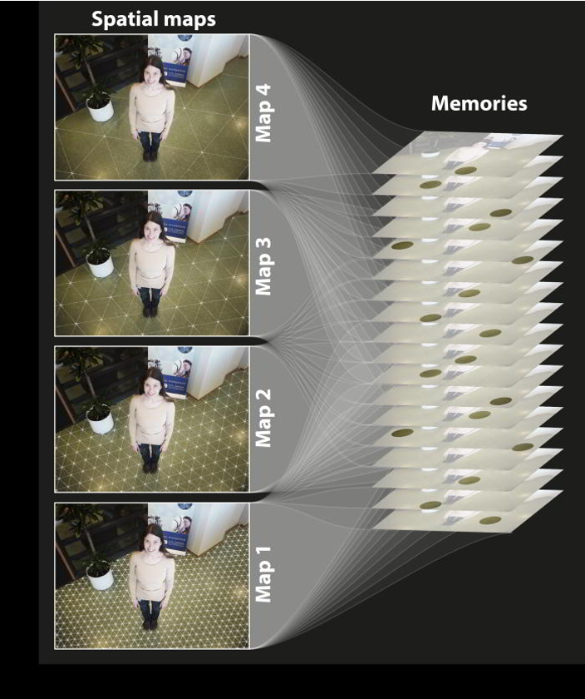
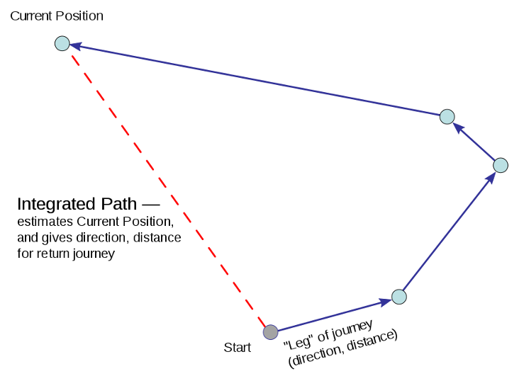
Grid cells
Different grid cells have different scales and phases
Navigation of mammals: path integration
An internal GPS system

Slide 6
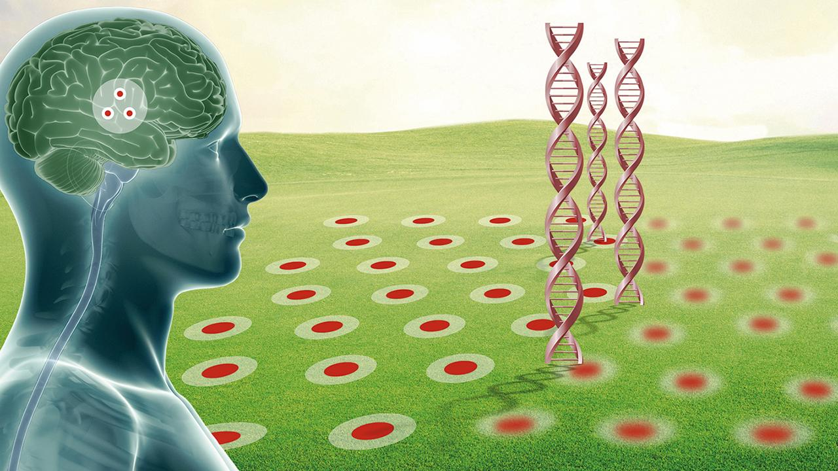
Alzheimer

Slide 7

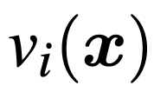
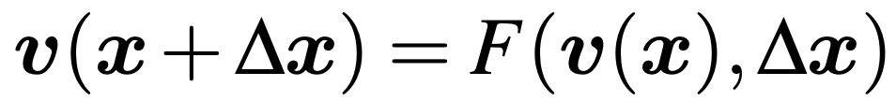
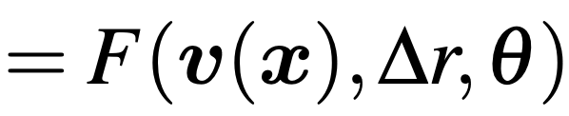
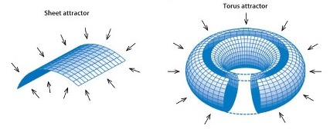
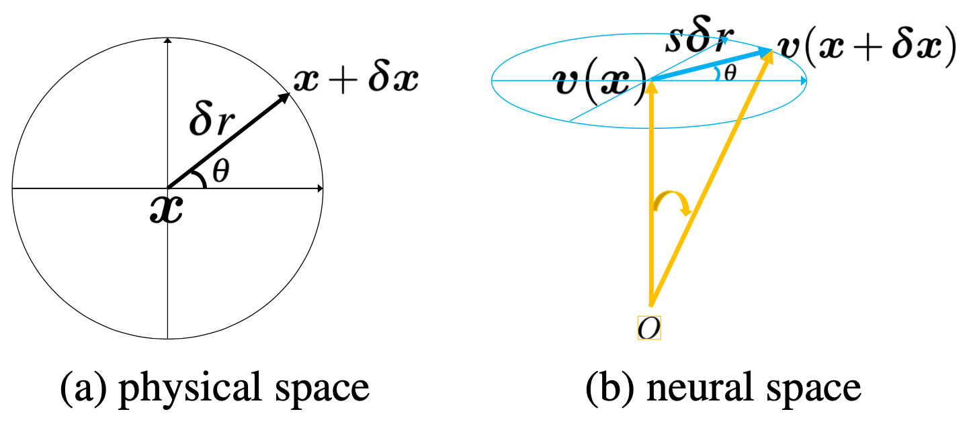
Vector representation and general transformation
Vector representation of self-position: “position embedding”
Each represents the firing rate of one neuron.
Path integration: a general transformation, RNN
Egocentric motion:
(heading direction, polar)

Slide 8



Conditions of general transformation
Condition 1. (Group representation): v and F form a representation of the 2D additive Euclidean group (abelian Lie group)
Can move in one step by , or first move by , and then by
A necessary self-consistent condition for path integration
, zero motion does not change v(x)
On manifold: fixed point, group representation.
Off manifold: attracting, projecting to manifold

Slide 9




Conditions of general transformation
Infinitesimal self-motion:
(Infinitesimal displacement, direction) =
[directional derivative]
Condition 2. (Conformal isometry) for any fixed ,
is independent of , isotropic scaling

Slide 10
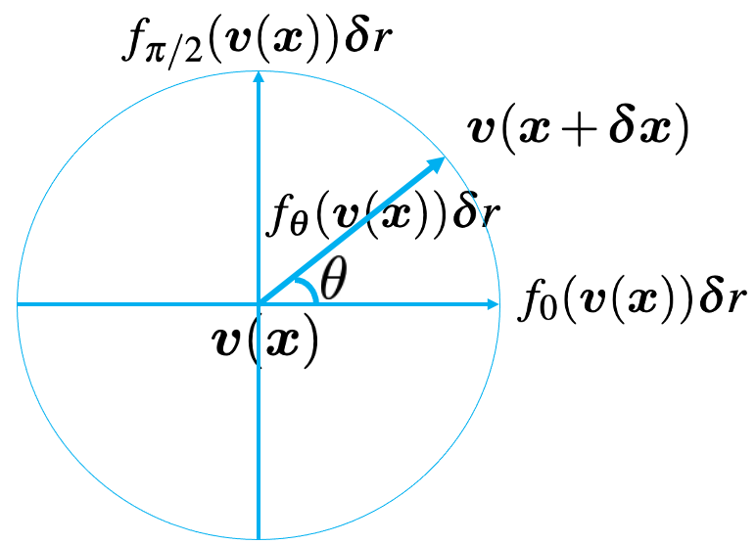
Conformal isometry and conformal embedding
Theorem 1. conditions 1+2 → conformal isometry and conformal embedding
maintain intrinsic Euclidean geometry (bending but not stretching)

Slide 11



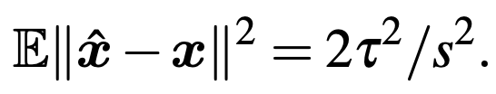
Why conformal isometry?
Neurons are intrinsically noisy. We don’t want any adversarial perturbations in v(x) causing excessively big errors in x.
Theorem 2: conditions 1+2 → errors in neurons translate proportionally to errors in the physical 2D space.
Noisy neurons:
Inferred position:
Inference error:

Slide 12




Linear recurrent network
Assume the transformation model is linear
Group representation
For infinitesimal displacement
Directional derivative
Transformation model
→

Slide 13
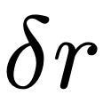



Algebraic structure: matrix Lie algebra and matrix Lie group
(infinitesimal displacement, direction) =
(finite displacement, direction) =

Slide 14
Algebraic structure: matrix Lie algebra and matrix Lie group
(infinitesimal displacement, direction) =
(finite displacement, direction) =
Generator Matrix
Matrix Lie group
Generator matrix

Slide 15

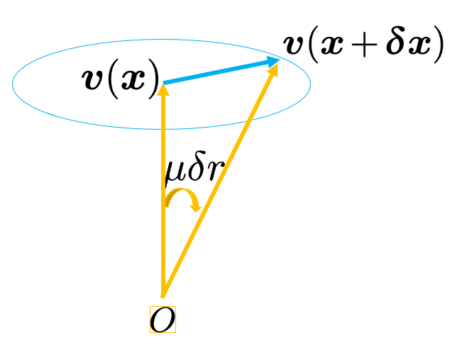


Geometric structure: a rotation group
“metric, angular speed”
→ periodic patterns and error correction.
Why hexagon patterns? Theorem 3: handcrafted hexagon patterns → conditions 1+2.

Slide 16


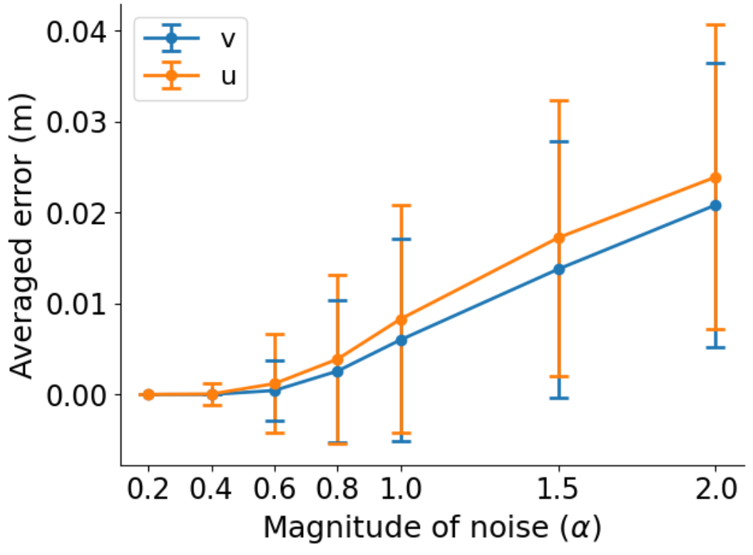

Geometric structure: a rotation group
Theorem 4. error correction depends on and
Noisy neurons:
Inferred position:

Slide 17
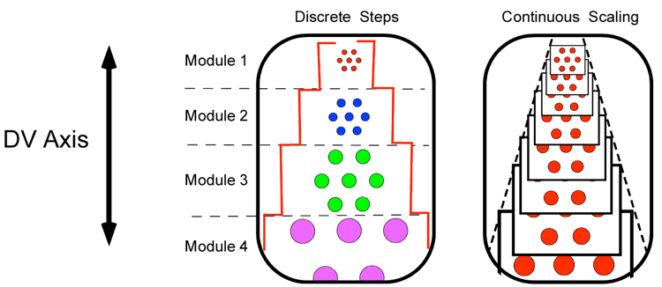

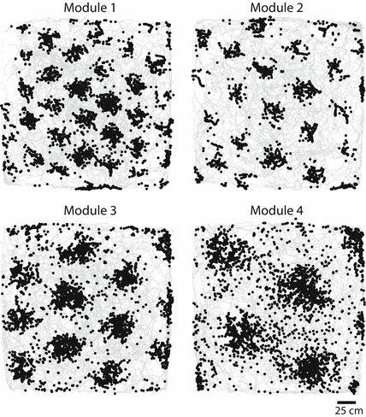
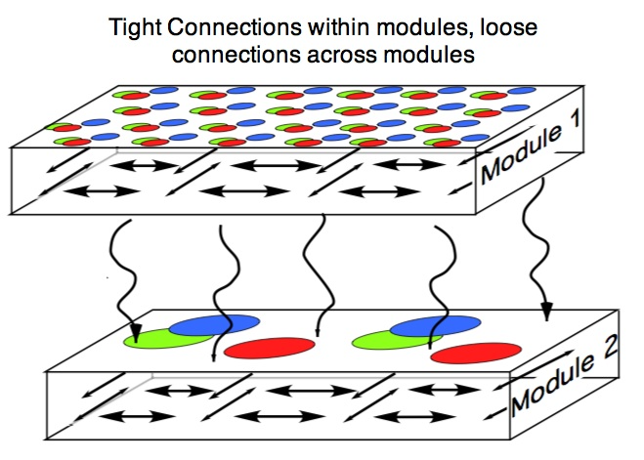


Multiple modules
We partition into K modules.
Module of neurons: similar scale, difference phases
Each module is a sub-vector rotated by a sub-matrix
Multi-arm clock in the neural space

Slide 18
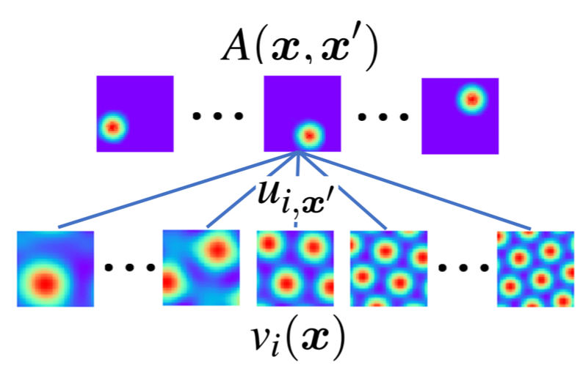
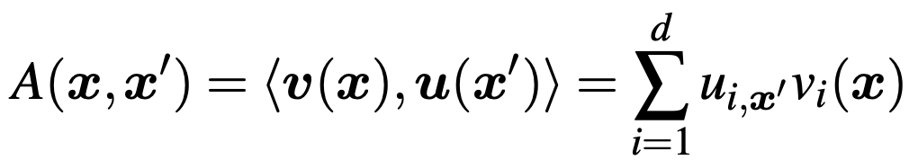
Interaction with place cells
Basis expansion:
A: adjacency kernel, response of place cell (x’) when agent is at x.
u(x’): read-out weights, a linear decoding layer

Slide 19
Interaction with place cells
transition
emission
Peter-Weyl theory: group representation ➔ basis functions
Fourier analysis
two roles of grid cells: path integration and basis expansion
forms a set of basis functions

Slide 20

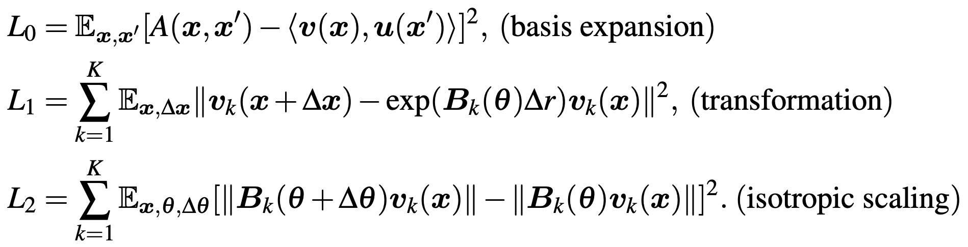
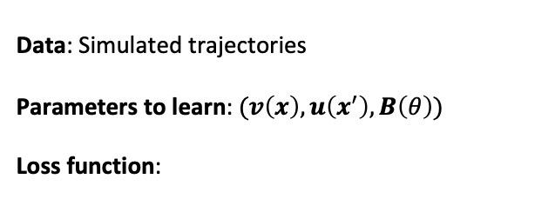
Learn the model
Data: Simulated trajectories
Parameters to learn: $(v\left(x\right), u\left(x^{′}\right), B\left(θ\right))$
Loss function:
for place cells
for path integration
for conformal isometry
Input
Notes:
We learn the model by optimizing a loss function defined based on three model assumptions

Slide 21
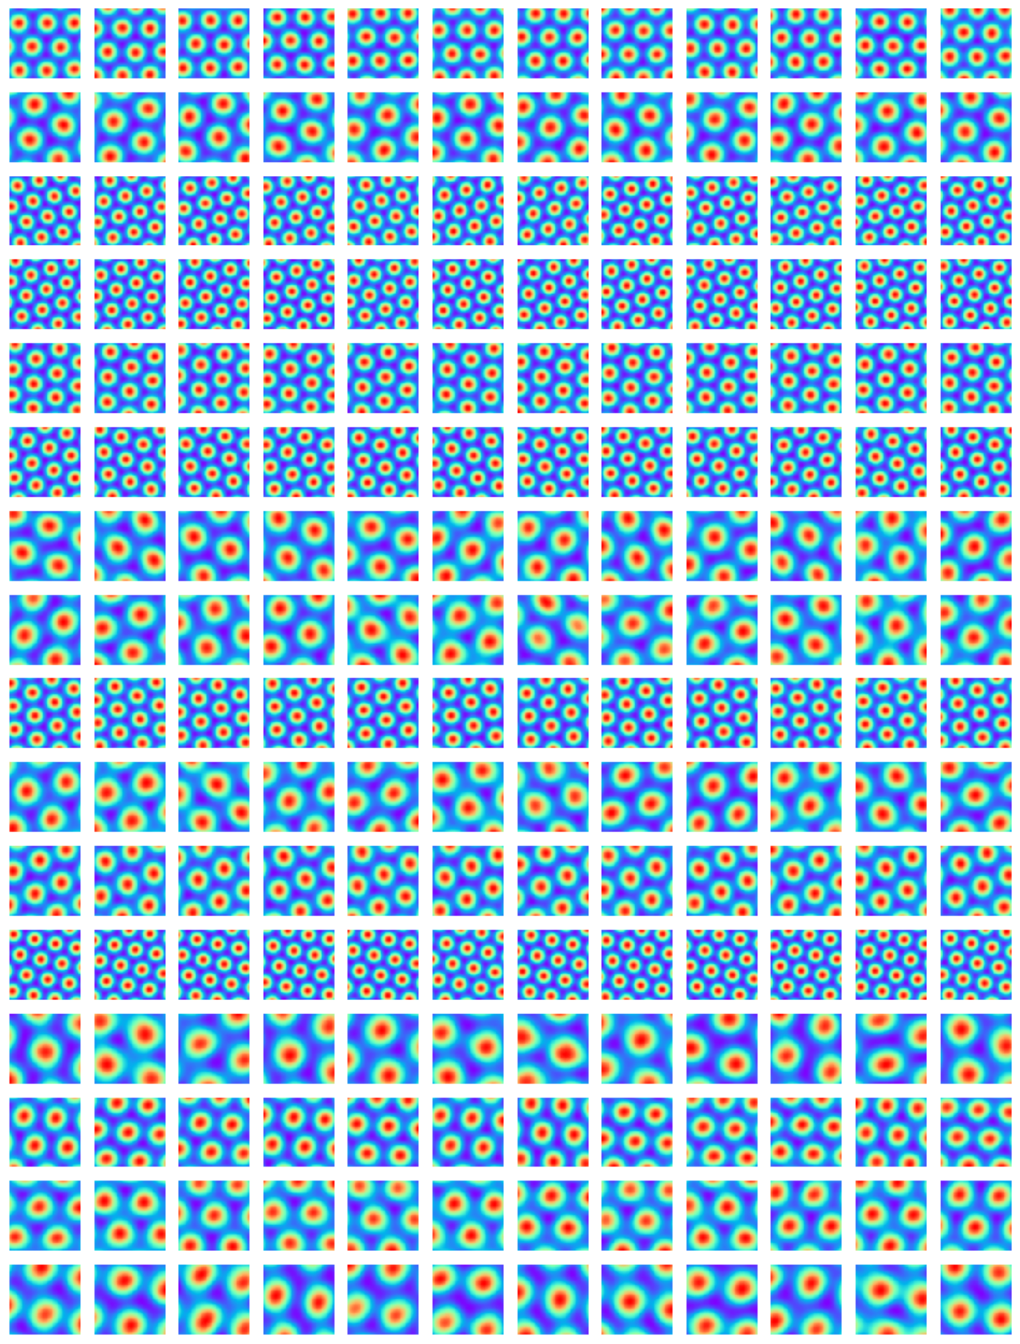
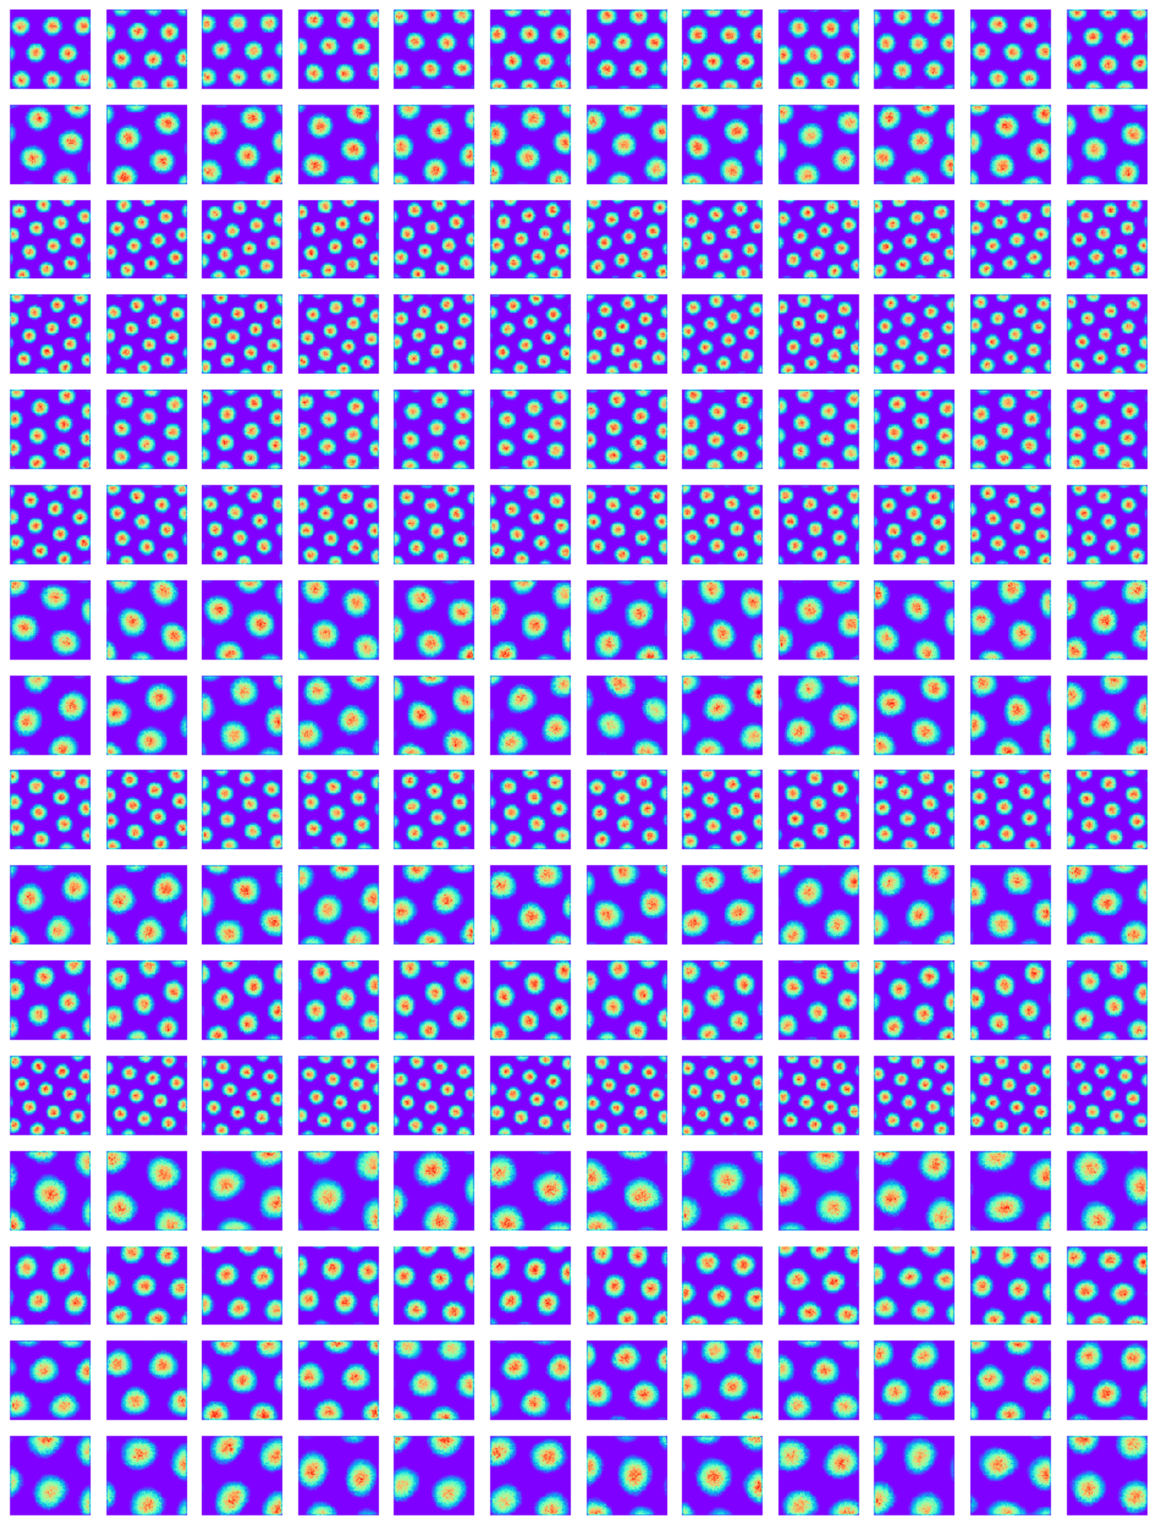


Hexagon grid patterns

Slide 22
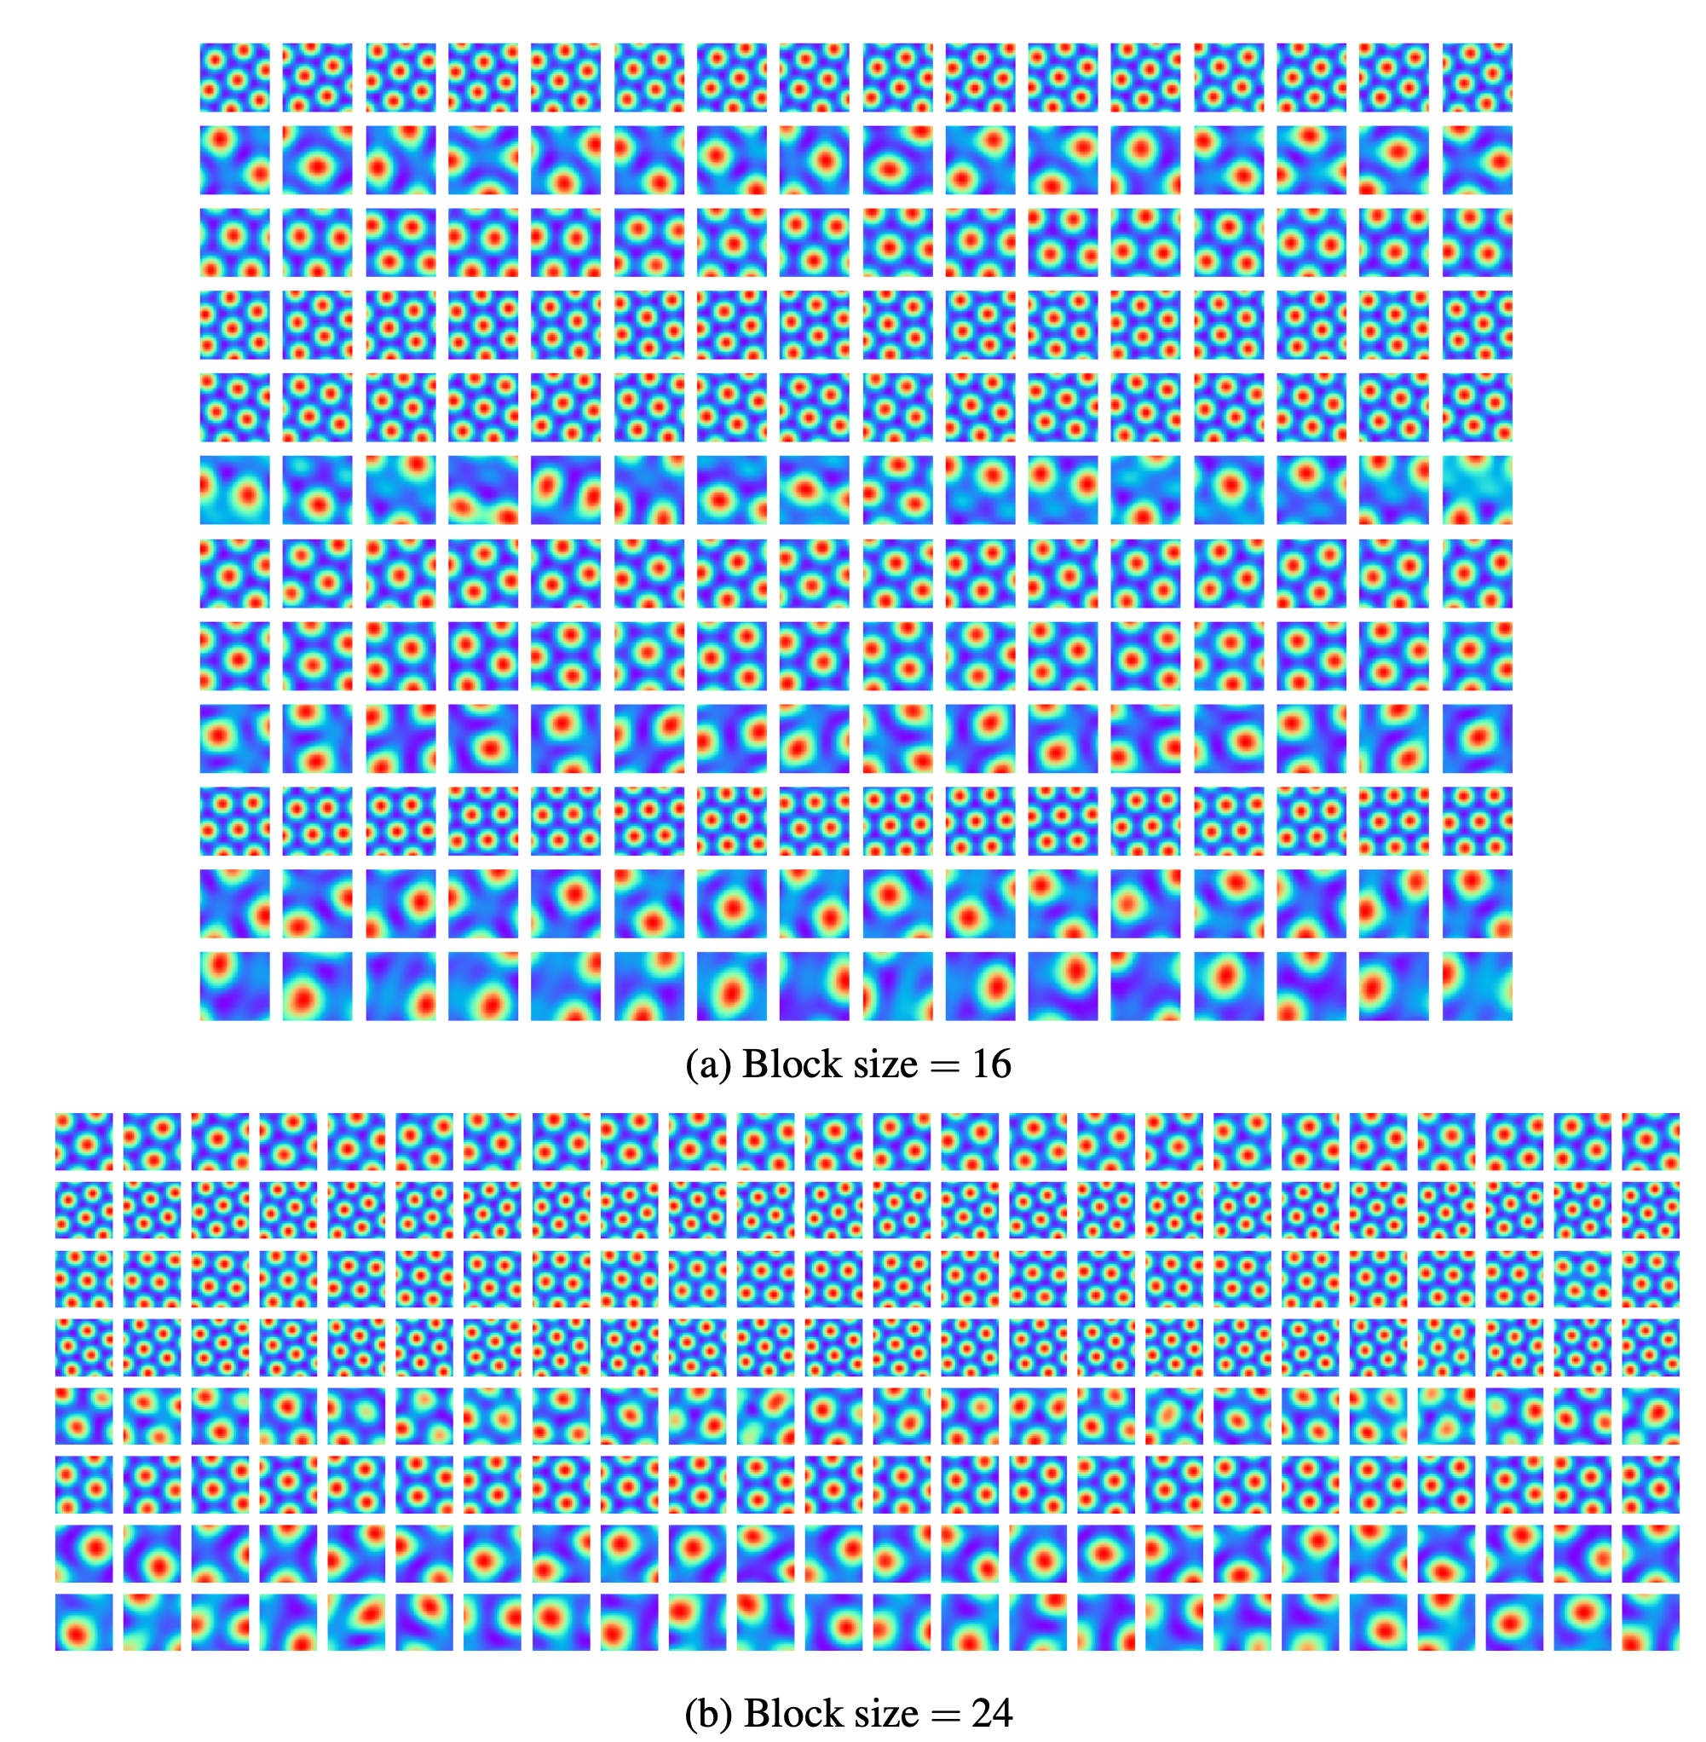
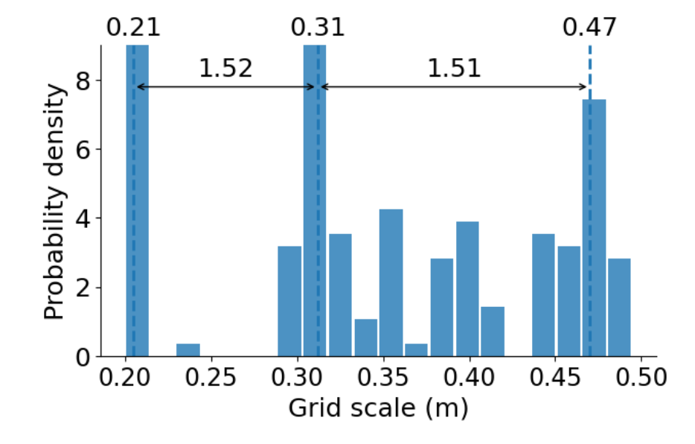
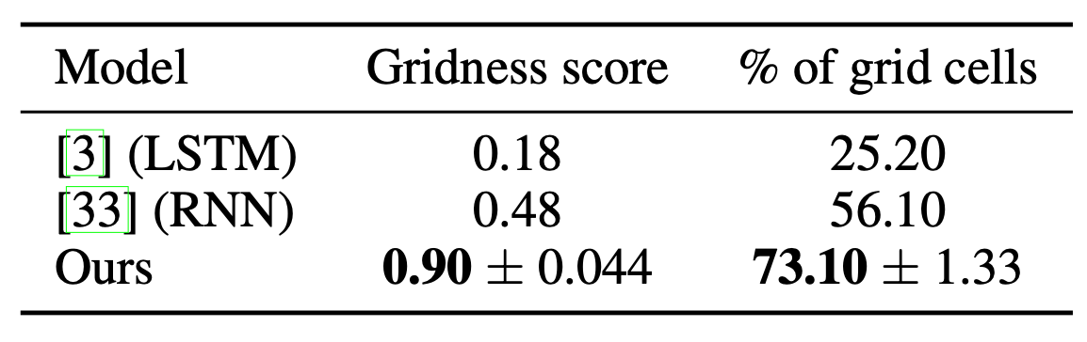
Scale distribution

Slide 23
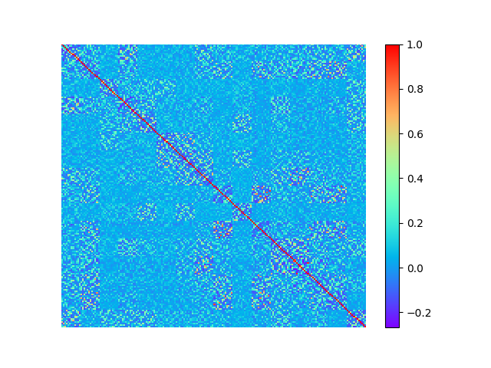
Near orthogonal basis functions
Peter-Weyl theory: group representation ➔ basis functions

Slide 24
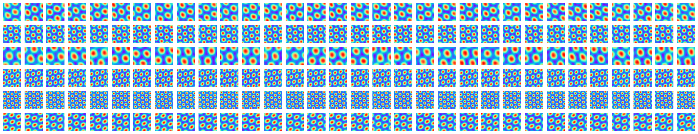
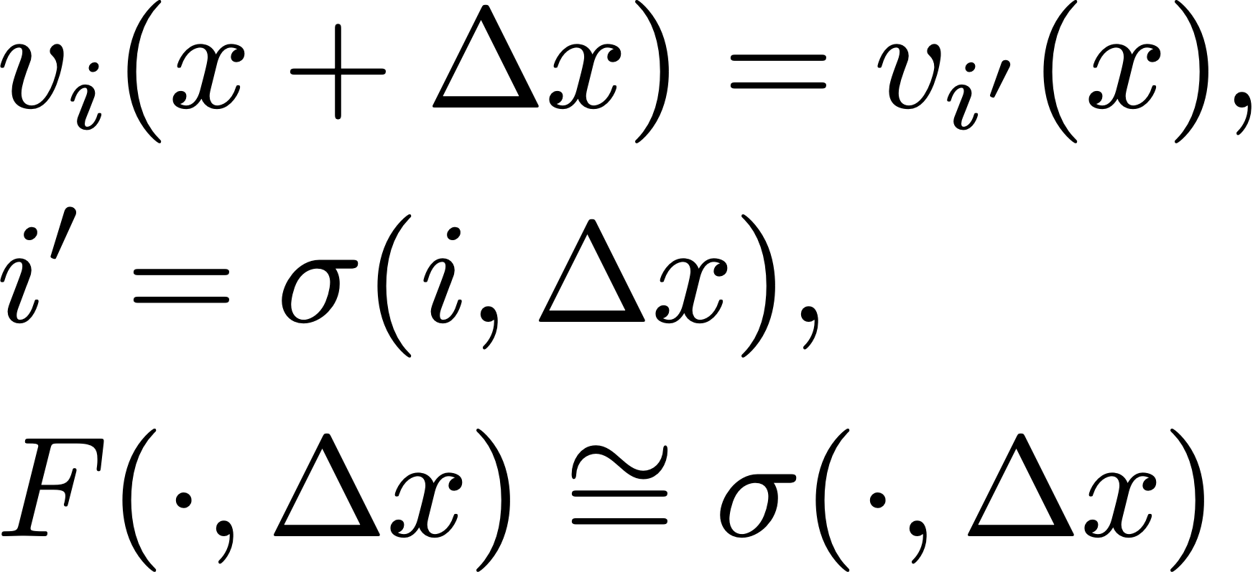
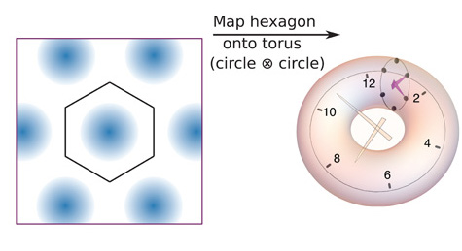
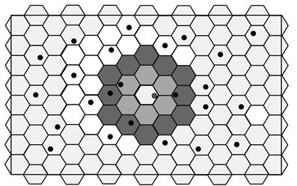
Learned response maps are shifted versions
rotation of vector = permuting its elements
cyclic subgroup of permutations
placing elements on a 2D neural sheet with periodic (torus) boundary condition
bump moves on neural torus sheet as agent moves (continuous attractor neural network)

Slide 25
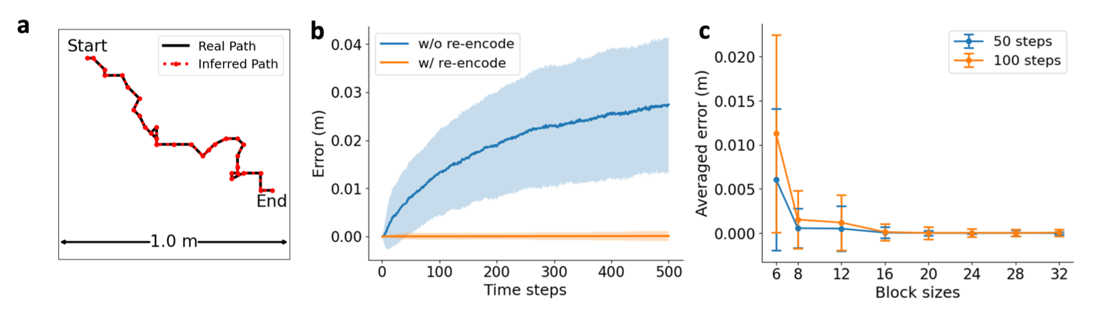
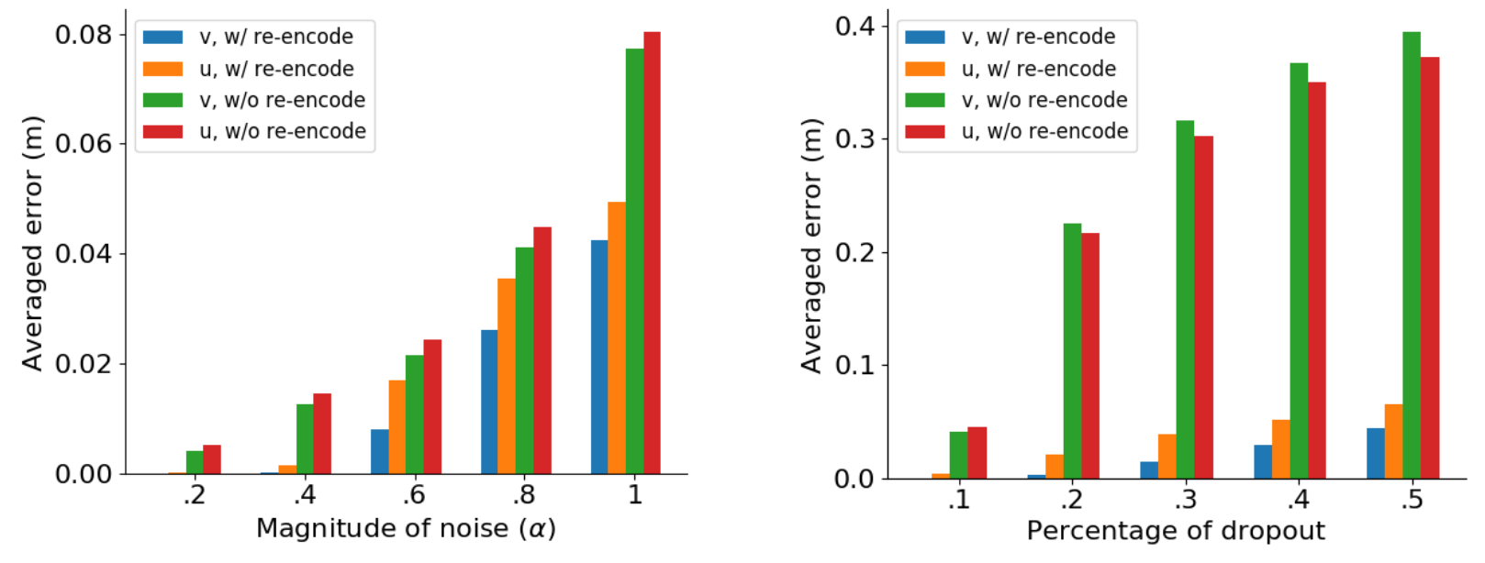
Path integration (with projection on manifold)
Path integration
Error correction

Slide 26
Ablation studies

Slide 27
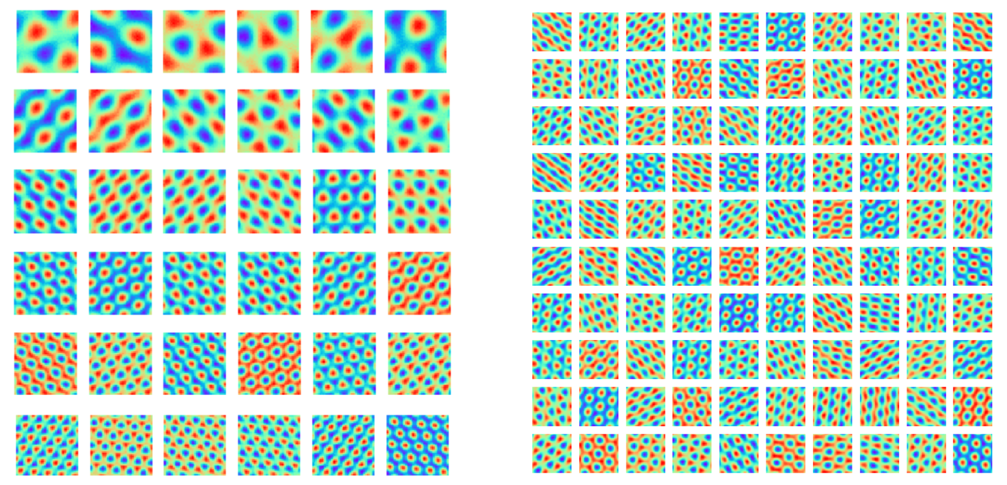

Single block: group representation + conformal isometry
Each row is a single block
A single block of 100 cells

Slide 28
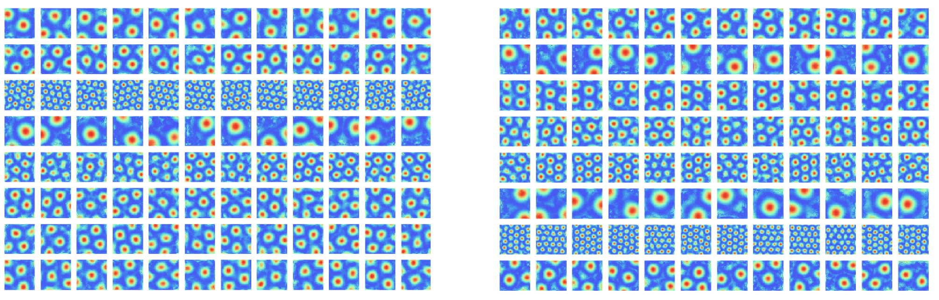
Non-linear recurrent network
versus linear recurrent network

Slide 29
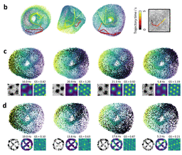
Topology: torus
R. J. Gardner, et al. Toroidal topology of population activity in grid cells, Nature 2021

Slide 30
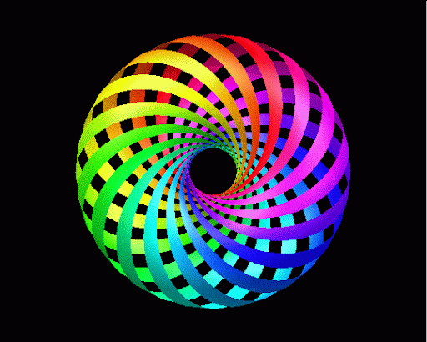
Flat torus
Algebra: abelian Lie group
Topology: compact and connected abelian lie group is torus
2D torus = two axes become circles (isomorphic)
Geometry: conformal isometry ➔ two geometric circles (isometric)
➔flat torus ➔ 2D periodic function

Slide 31
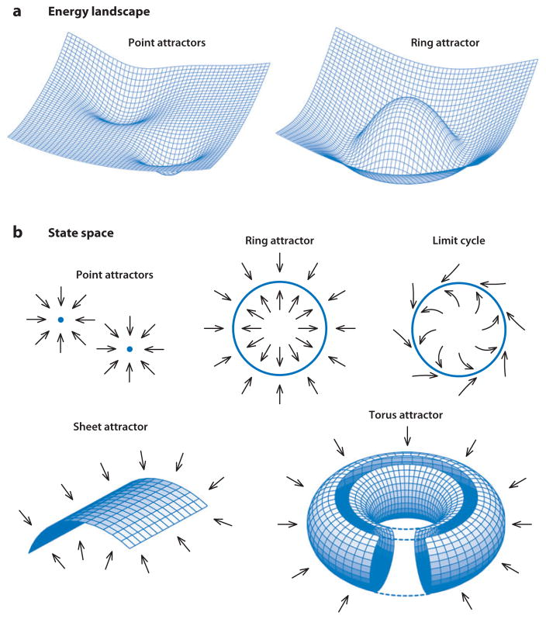
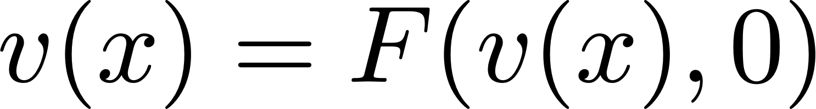
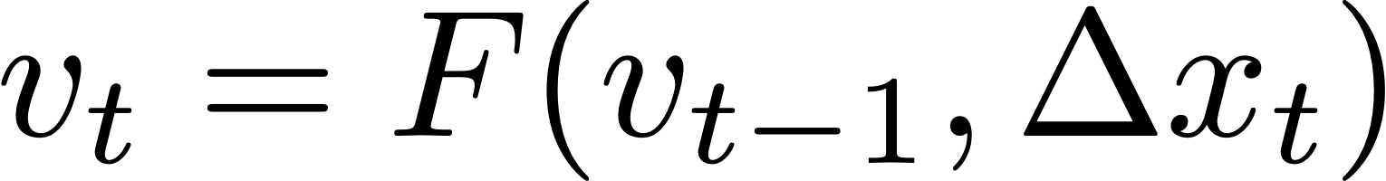
Continuous attractor neural network (CANN)
On manifold

Slide 32
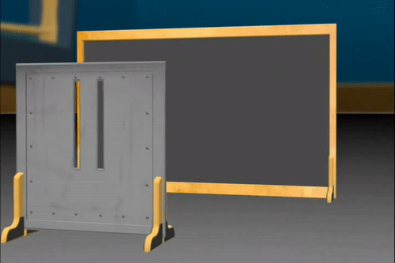
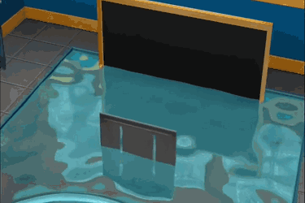
Deep learning
Vector representation (thought vector, embedding, encoding, X2vec)
Transformation (algebra: Lie group representation, geometry: conformal isometry, topology: flat torus)
Particle-wave duality
~ Schrodinger equation
~ Born rule

Slide 33


Path planning
The adjacency kernel can be modeled as
: discount factor controlling the temporal and spatial scales
- For random walk in open field,
For planning, we need kernels of both big and small scales.
We discretize to a finite list of scales and learn a list of .

Slide 34




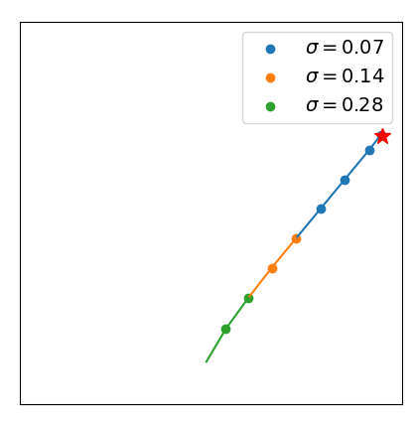



Path planning
Planning: let be the target, be the current position, plan the next step by
- The next position is
- : chosen from all allowed single-step displacement.
- : chosen to be sensitive to change.
Success rate
100%

Slide 35








Egocentric vision
Novel view synthesis: PSNR 23.53
Inference of pose:
Encoding position and orientation (aka pose) of the camera as
Encode the 3D scene as a vector (shared across difference camera poses)
Novel view synthesis: .
Inference of pose: → →

Slide 36



Representational models of V1 simple cells
Background
Model
Data:
image pairs related by local pixel displacements.
Model components:
(1) Vector representation of local image content.
(2) Matrix representation of local displacement.
“Learning Vector Representation of Local Content and Matrix Representation of Local Motion, with Implications for V1”. Gao, Xie, Huang, Ren, Zhu and Wu. AAAI 2022.

Slide 37








Torus

